Slide 1



Synalgebraic Simulation of Quantum Circuits
Principles Synalgebra Simulator Remarks
Anderson Beraldo DeAraujo
University of Campinas (IMECC, Brazil) University of Minho (CMAT, Portugal)
This material is based upon work supported by the Air Force Office of Scientific Research, under award number FA9550-24-1-0003, but the opinions expressed are responsibility of its author.
Synalgebra

Slide 2
Overview
Principles Synalgebra Simulator Remarks
Aim: To develop a classical simulator of large-scale quantum circuits for applications of quantum AI to cryptology.
Approach: Creation of a new mathematical framework called synalgebra
that represents quantum gates and measurements with rules and schemas.
Outcome: Knowledge about quantum Fourier networks based on Shor’s algorithm and SAT solvers designed to attack the RSA cryptosystem.
Synalgebra

Slide 3
Quantum Computing Postulates Interpreted
Principles Synalgebra Simulator Remarks
1) States are unit vectors in complex Hilbert spaces. They are abstract moving coins.
[ ] [ ]
a |0⟩ + b |1⟩ = a + b
1
0
0 1
2) Evolutions are invertible distance preserving linear operators over complex Hilbert spaces. They are general rotations.
[ ]
X =
0 1
X (a |0⟩ + b |1⟩) = aX |0⟩ + bX |1⟩ = a |1⟩ + b |0⟩
1 0
3) Measurements are projectors that probabilistically yield their eigenvectors. They are registrations in your sensors.
[ ]
1 1
|1⟩⟨1|( √₂ |0⟩ + √₂ |1⟩) ≡ |1⟩ with probability 0.5
|1⟩⟨1| =
0 0
0 1
4) States, evolutions and measurements are composable by tensors. They are pointwise parallel processes.
0
0 0 0 1
0 0 1 0
0 1 0 0
1 0 0 0
|0⟩ ⊗ |1⟩ =
1
X ⊗ X =
X ⊗ X (|0⟩ |1⟩) = X |0⟩ ⊗ X |1⟩
0
0
Synalgebra

Slide 4
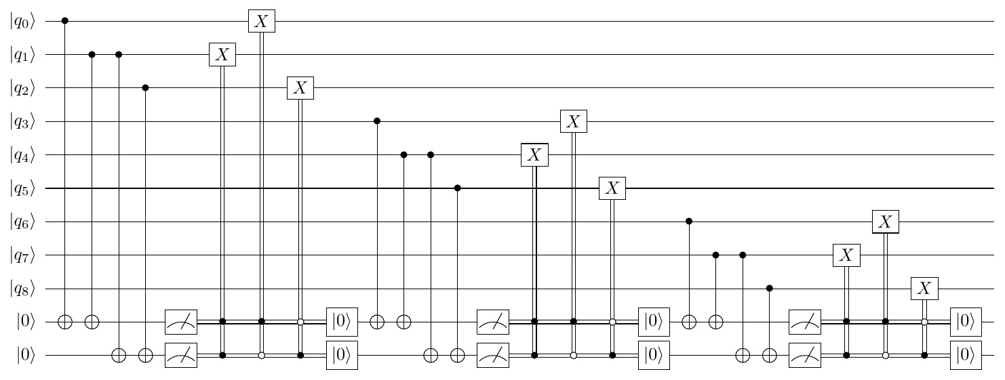
Quantum Software Challenges
Principles Synalgebra Simulator Remarks
We need tools to synthesize, verify and compile quantum circuits in large-scale and with noise.
Best simulators are based on tensor networks; they can’t reach to thousands of qubits and their results are hard to interpret.
New idea: How do we know whether this equations is true
1000 times
1000 times 1000 times
z }| {
z }| { z }| {
X ⊗ · · · ⊗ X |0⟩ · · · |0⟩ = |1⟩ · · · |1⟩?
We don’t do 2¹⁰⁰⁰ operations! We perform quantum reasoning.
based upon work supported
Synalgebra

Slide 5
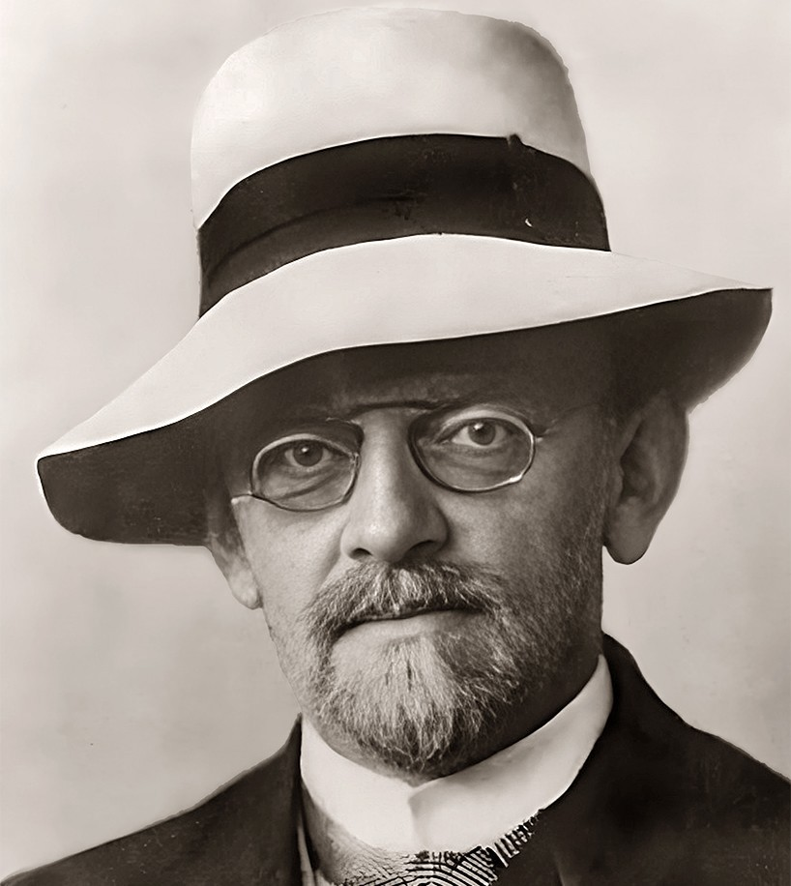
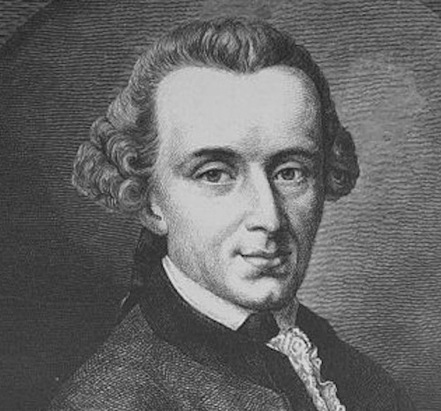
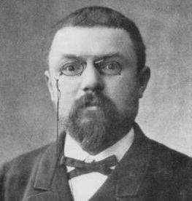
Principles Synalgebra Simulator Remarks
.
Idea: Equality (=) is identity (=) and similarity (≈)
Synalgebra
Consistency
← Similarity →
Satisfiability
2x ≈ x
Provability
←− Identity −→
Validity
2x = x + x
Syntax (rules)
Semantics (schemas)
←− −→
“Mathematics is a game played according to certain rules with meaningless marks on paper.” (Hilbert) “Mathematics is the art of giving the same name to different things.” (Poincar´e)
Synalgebra

Slide 6
Syntactical intuition
Principles Synalgebra Simulator Remarks
Global:
f : n → m ⊢ g : n → m g : n → m ⊢ f : n → m ≡
⊢ f ≡ g
R
⊢ f : n → m g : n → m ⊢ ≡
⊢ g : n → m f : n → m ⊢ ≡
L
L
f ≡ g ⊢ f ≡ g ⊢
Substitute = for ≡ if the leaves of the proof are axioms in the form
f : n → m ⊢ f : n → m
Substitute ≈ for ≡ in case the leaves of the proof are postulates like
.
f : n → m ⊢ or ⊢ f : n → m
|1⟩ : 1 → 2 ⊢ _{X} ⊢ |1⟩ : 1 → 2 _{X}
Local:
L0
R0
X ◦ |0⟩ : 1 → 2 ⊢
Anderson Beraldo DeAraujo
⊢ X ◦ |0⟩ : 1 → 2
Synalgebra

Slide 7
Semantic intuition
Principles Synalgebra Simulator Remarks
Global:
.
f = g or f ≈ g according it holds for all or for some, respectively:
u
_a
u
f
g
/\ /\ _{I} /\
v b v
There are schemas for linear operators:
· _{I}
(n, q) n · q
(f ,g )
f ⊗g
/\ ·
(m, p)
m · p
Local:
|0⟩
I I
1
1
2
1 |_0⟩
2
|1⟩
⇐⇒
|1⟩
X ⇐⇒
X
/\ /\ _{I}
2
2
^{|1}T⟩ his materia²l is based upon work supported
Synalgebra
7 / 16

Slide 8
Related works
Principles Synalgebra Simulator Remarks
MacLane (1971), Categories for the Working Mathematician. Lambek (1972): Deduction calculus for multicategories.
Szabo (1978): Algebra of Proofs.
Lambek & Scott (1986): Introduction to Higher Categorical Logic. Freyd & Scedrov (1990): Axioms with partial logic for categories. Shulman (2016): Sequent calculus for categories using type theory. Benzmuller & Scott (2020): Free-logic axiomatization of categories.
1
2
3
4
5
6
7
None provides a theory of equalities as identities and similarities:
Identities preserve the information about the action of gates without using matrices.
Similarities specify useful approximations of the measurements with statistical sampling.
Synalgebra

Slide 9
Example of measurement (one direction)
Principles Synalgebra Simulator Remarks
Similarity:
1
2
2/3
P 1
2 (|1⟩) = 2/3 ⇔ |1⟩⟨1| ◦ ( √ |0⟩ + √ |1⟩) ≈ |1⟩
√ |0⟩+ √ |1⟩
3
6
3 6
Proof:
A
2 2
|1⟩ ³ ⊢0 |1⟩ ³
√
F_{L}
2/ 6
2
2
3
√ |1⟩ ⊢
|1⟩
2/3
3
0
√
S_{L}
2/ 6 D
2
3
P_{L}
√_{D} |1⟩ ⊢
2 2
∗ |1⟩
√ · √
|1⟩⟨1| ⊢0
6 6
B_{L}
M_{L}
2
3
1
|0⟩ ; |1⟩⟨1| ⊢
2
|1⟩ ; |1⟩⟨1| ⊢ |1⟩
√
3
0
√
6
0
+_{L}
1 2
2
√₃ |0⟩ + √₆ |1⟩ ; |1⟩⟨1| ⊢0 |1⟩ ³
◦_{L}
1 2
2
3
|1⟩⟨1|◦( |0⟩
+ |1⟩) ⊢ |1⟩
√
3
√
6
0
Synalgebra

Slide 10
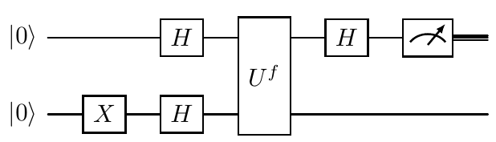
Deutsch’s algorithm
Principles Synalgebra Simulator Remarks
Given a function f : {0, 1} → {0, 1}, is f constant or not?
Circuit
(|a⟩⟨a| ⊗ 0) ◦ (H ⊗ 1) ◦ U_{f} ◦ (H ⊗ H) ◦ (1 ⊗ X ) ◦ |0⟩ ⊗ |0⟩ Formula
Synalgebra

Slide 11
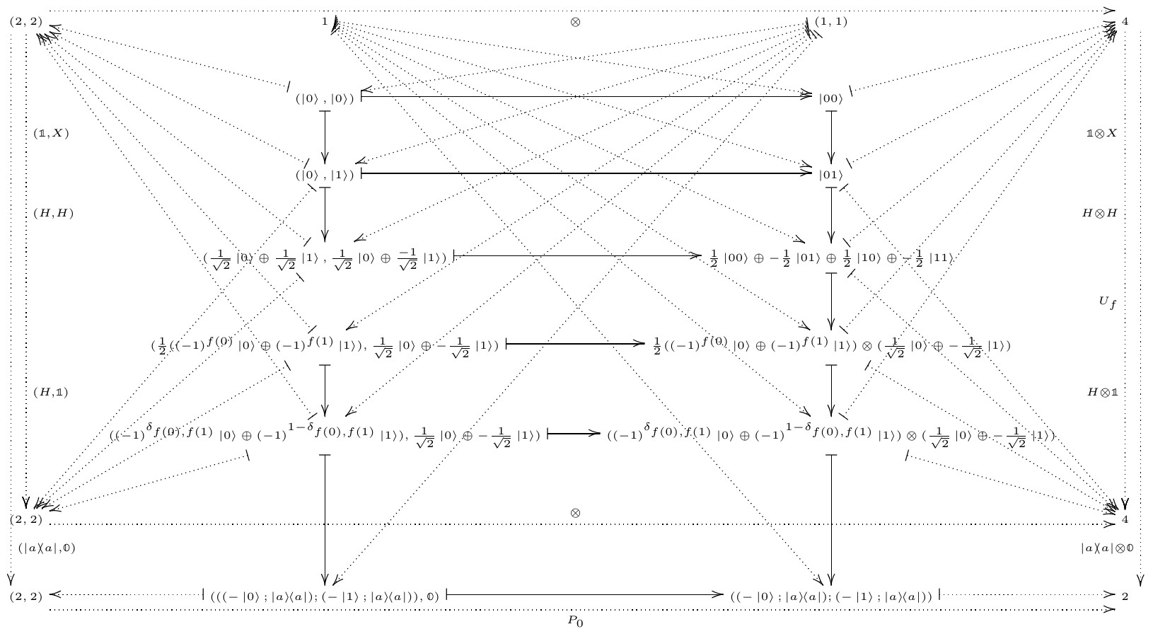
Principles Synalgebra Simulator Remarks
Deutsch’s schema
Synalgebra

Slide 12
What can go wrong?
Principles Synalgebra Simulator Remarks
Potential limitations:
1
The complexity of quantum algorithms may demand resources practically inviable.
Statistical significance about the output probability distributions may require too much samples.
2
Practical Strategies:
Quantum patterns: Rules based on Clifford group and SATs. Quantum edges: Experimental design modeled with machine learning.
1
2
Synalgebra

Slide 13
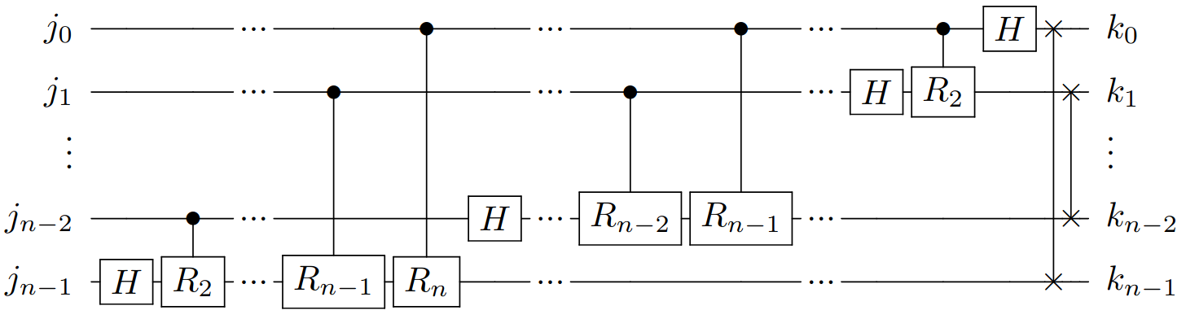
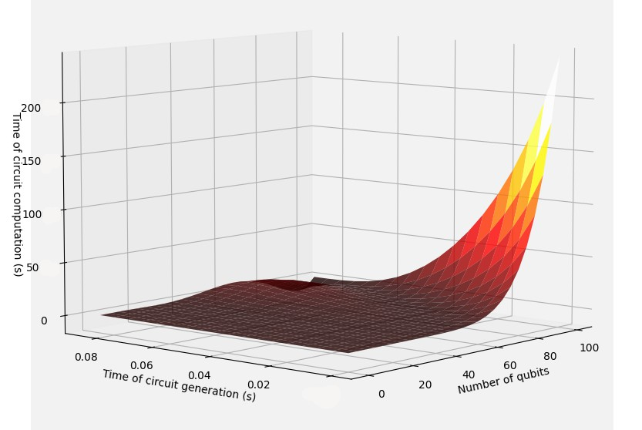
Quantum Fourier Transform in the library Synal (Rust)
Principles Synalgebra Simulator Remarks
This material based upon work supported
Synalgebra

Slide 14
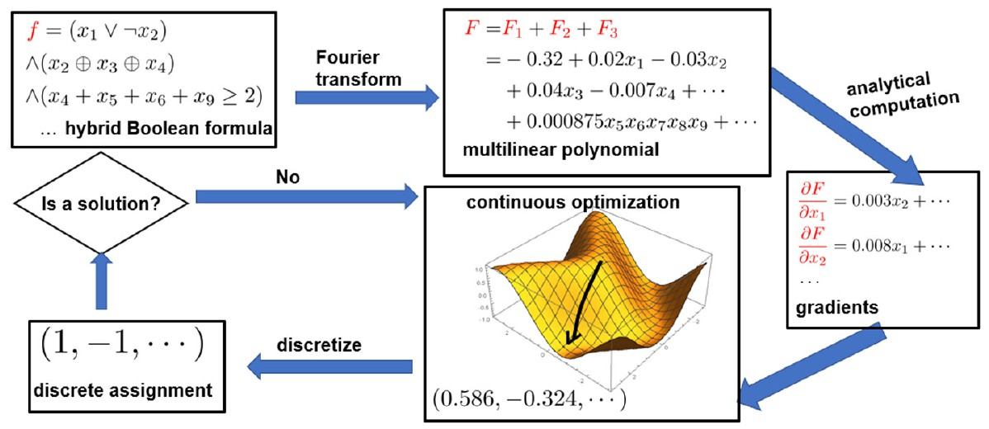
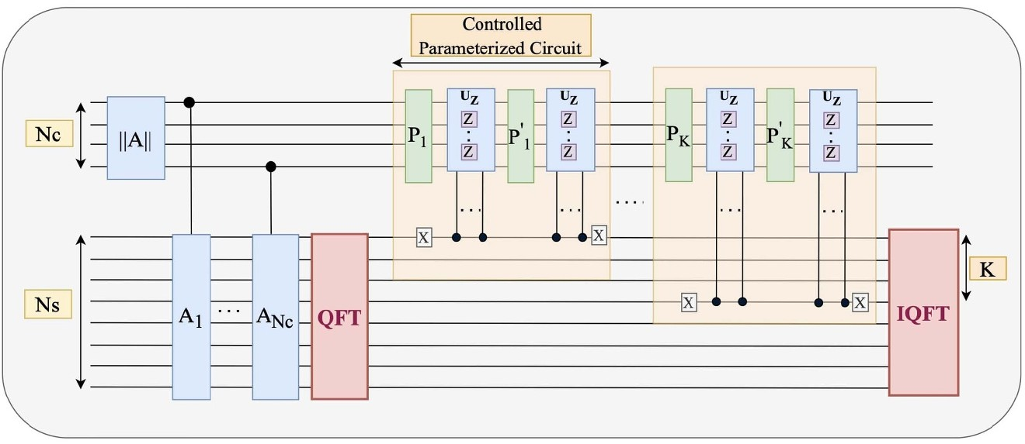
Quantum Fourier Networks + SAT Solver in Synal (VHDL)
Principles Synalgebra Simulator Remarks
Taking insights from Shor’s algorithm attack to the RSA cryptosystem.
Synalgebra

Slide 15
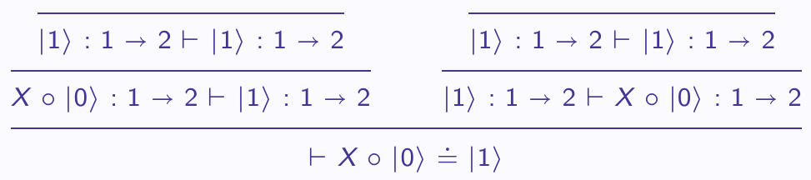
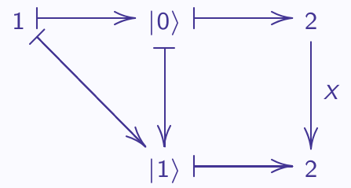
What if we succeed?
Principles Synalgebra Simulator Remarks
Powerfull tool for quantum softwares in large-scale and with noise. Math framework to explore identities and similarities in applications. Understanding the threats of quantum AI for cryptosystems.
1
2
3
⇌
Synalgebra

Slide 16
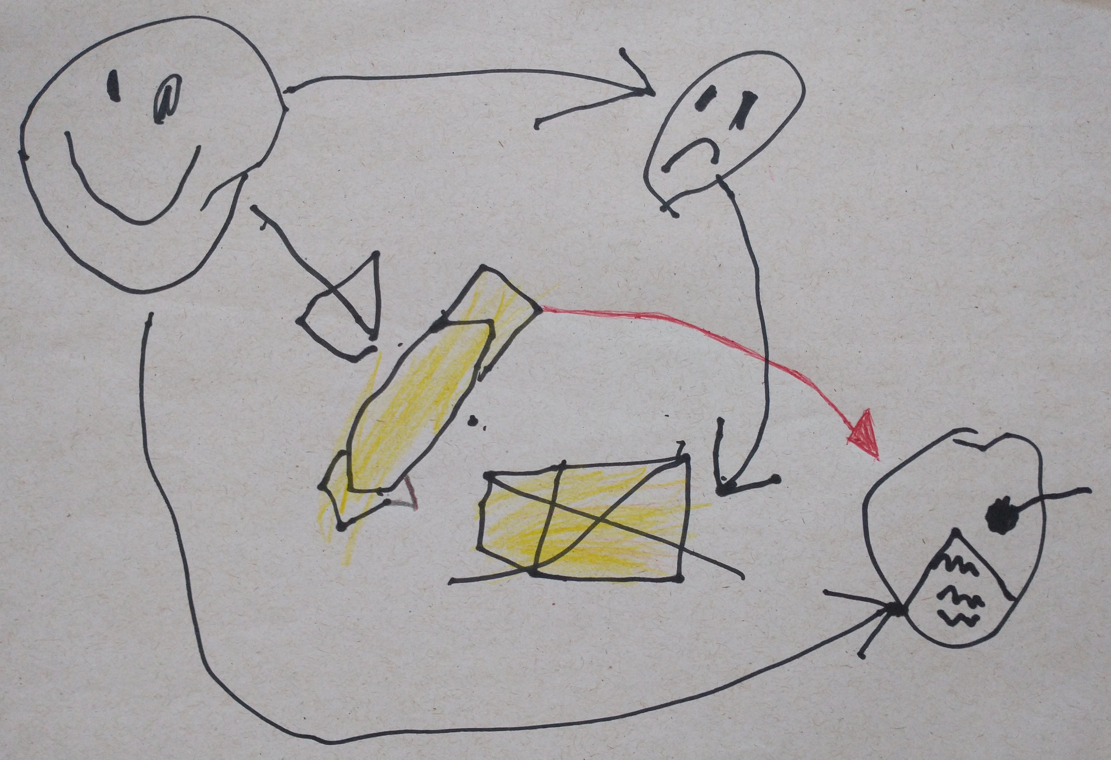
Thanks to
Principles Synalgebra Simulator Remarks
Kathy-Anne Soderberg, Laura Wessing, Shannon Ray (AFRL/RI)
James Lyke, Roger Greenwood (AFOSR/SOARD), Kyle Gustafson (ONRG) Luis Pinto, Jos´e Carlos Espirito Santo (UMinho)
Marcelo Terra Cunha, Rafael Rabelo (Unicamp) Viviane e Antoni Beraldo DeAraujo
Thank you!
Synalgebra

