Slide 1


Entanglement of trapped-ion qubits separated by 230 m
Maria Galli
Quantum for International Workshop
June 26, 2024
Rome, NY

Slide 2
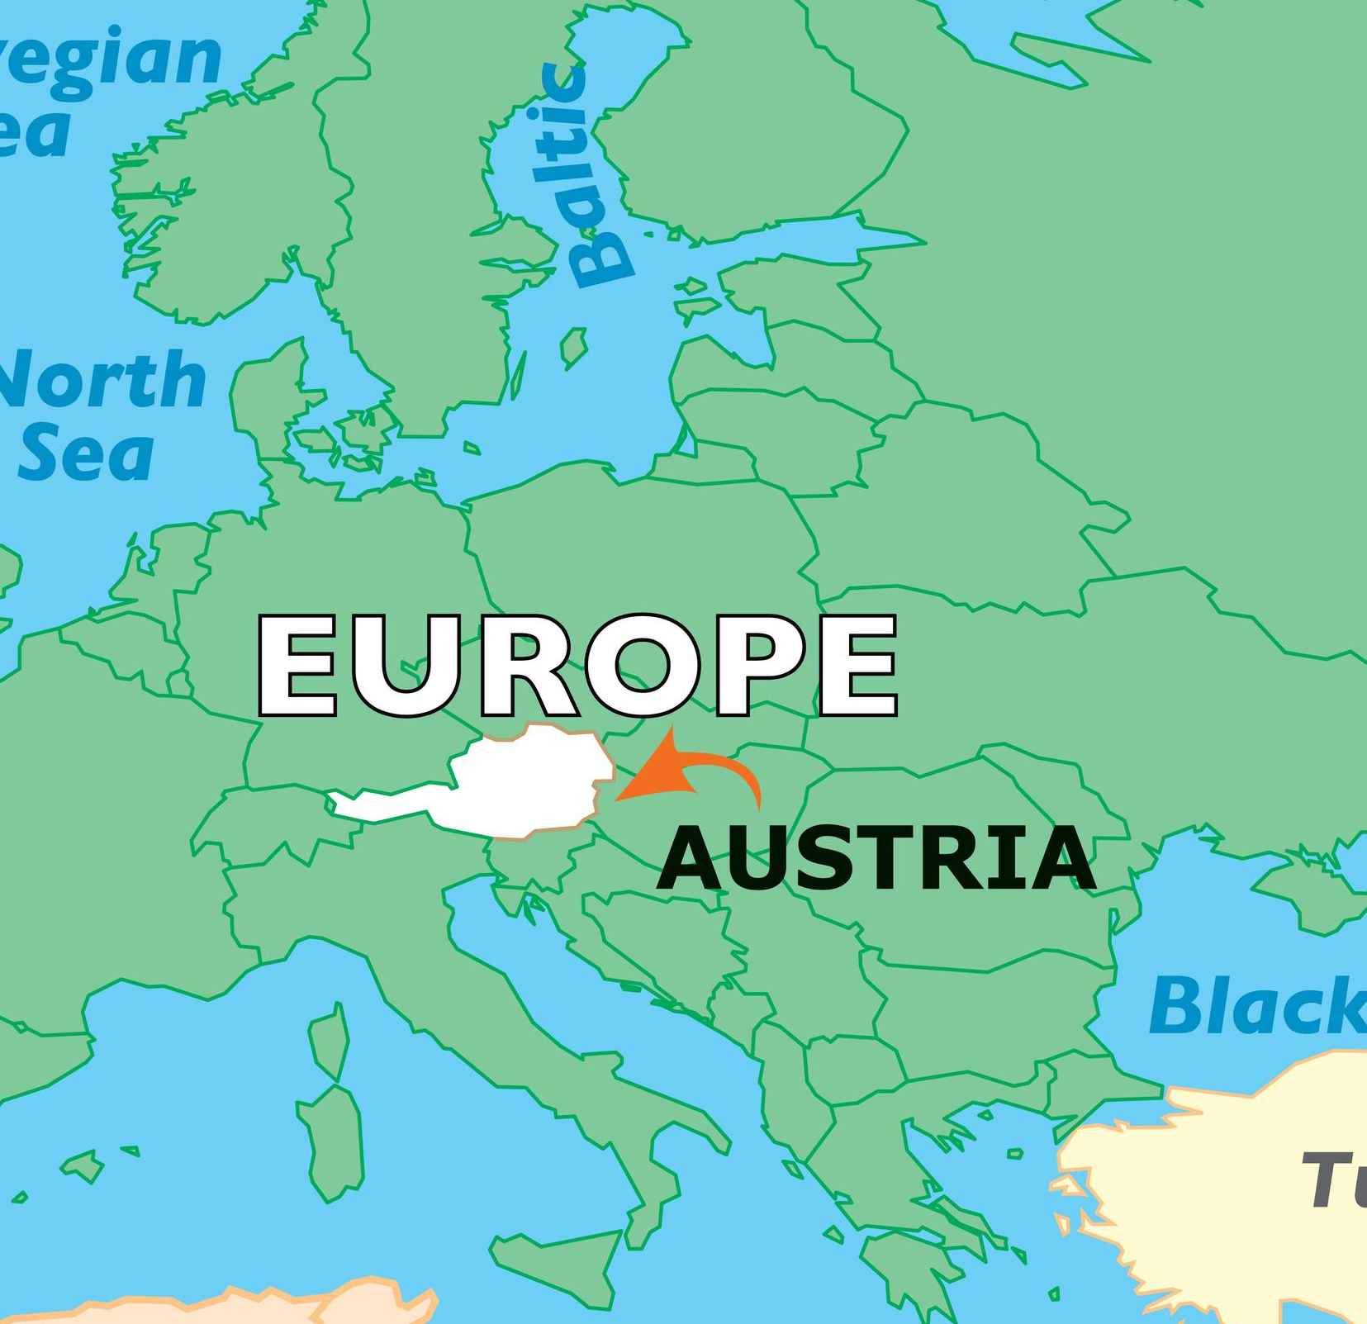
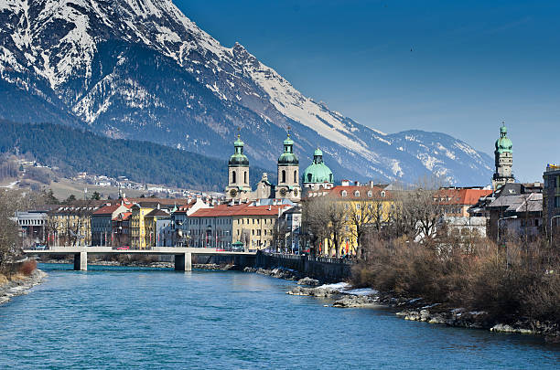
Our basecamp: Innsbruck, Austria
https://www.worldatlas.com/
https://www.istockphoto.com/

Slide 3

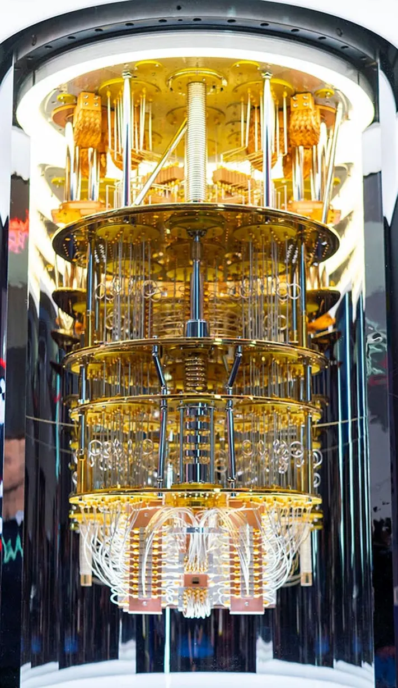
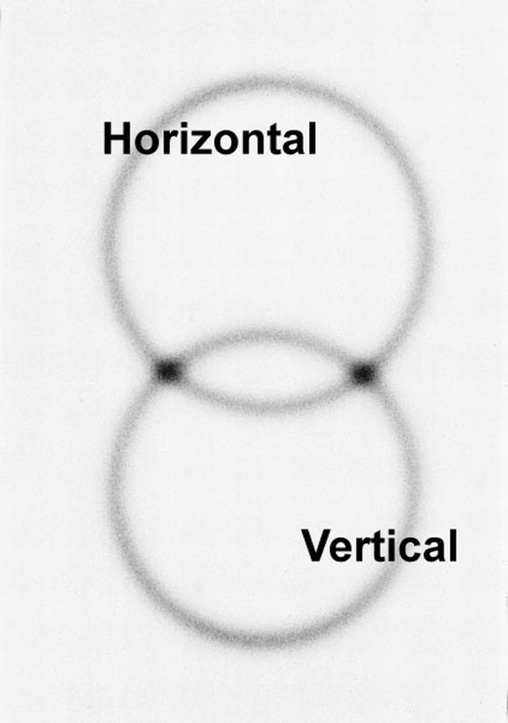
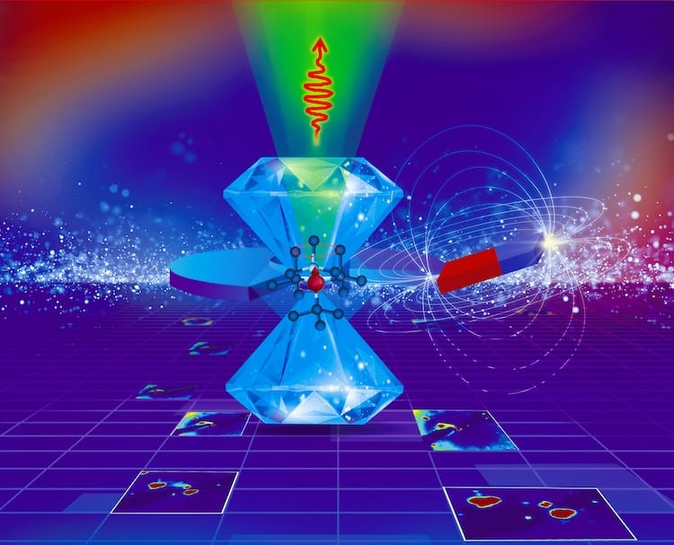
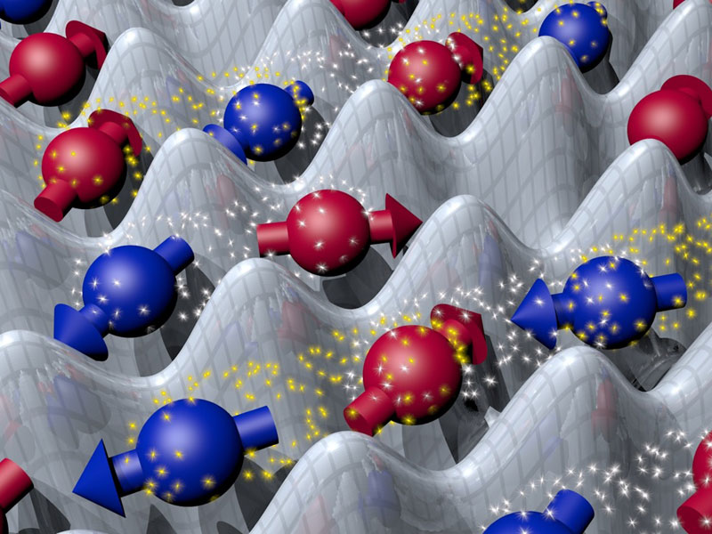
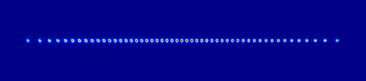
Implementing quantum technologies with diverse quantum platforms
Quantum computation
Superconducting qubits
Trapped ions
Quantum sensing
Nitrogen-vacancy (NV) centers
Quantum communication
Photons
D. Bouwmeester
et al., Nature 390,
575 (1997)
Quantum simulation
Neutral
atoms
IBM
physicsworld
ETH

Slide 4
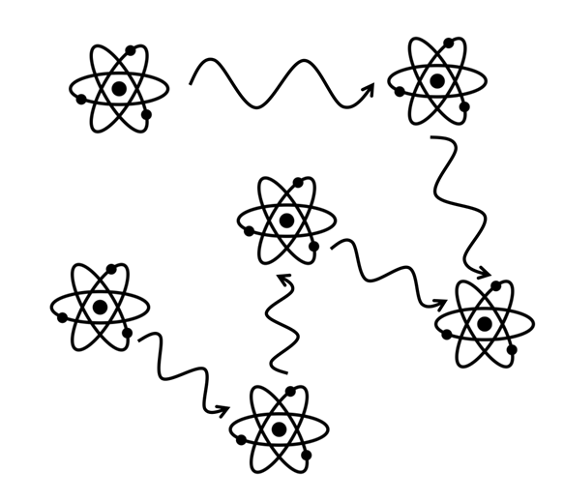
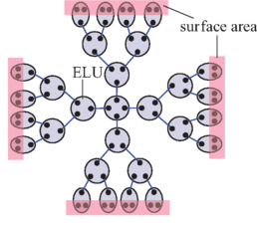
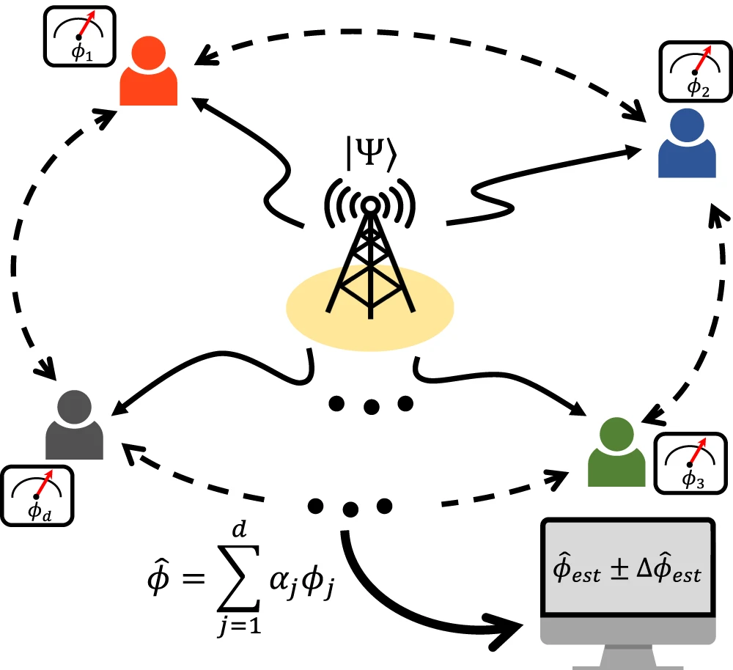
Quantum networks to enhance quantum technologies
Quantum
computation
Quantum
sensing
C. Monroe et al., Phys. Rev. A 89, 022317 (2014)
D.-H. Kim et al., Nature Comm. 15, 266 (2024)

Slide 5
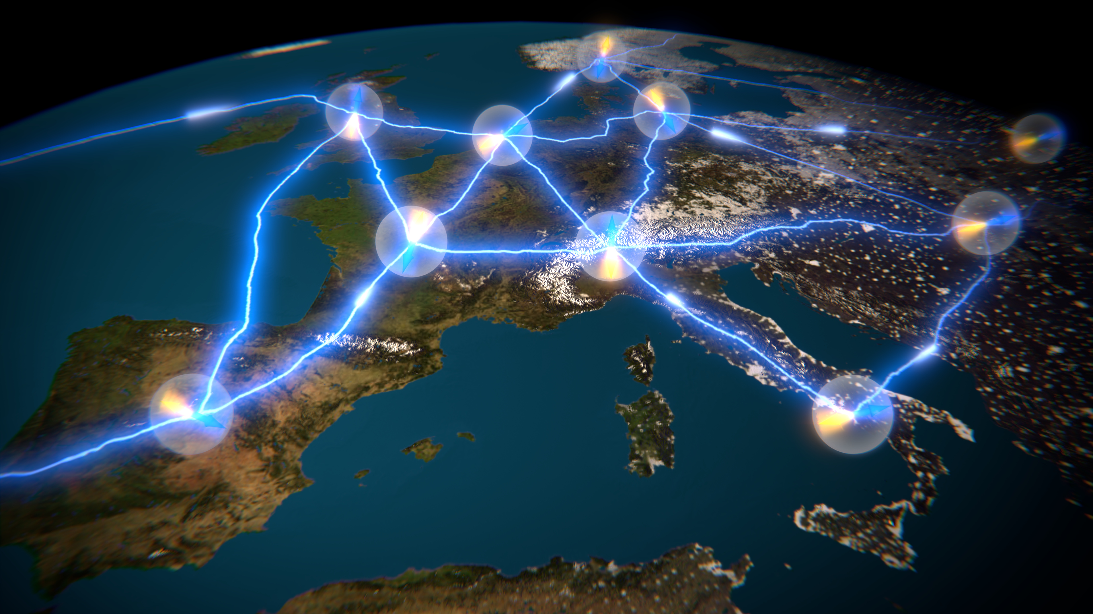


Our vision in Europe: a quantum internet
2018-2028

Slide 6
Our vision in Europe: a quantum internet
2018-2028
Quantum nodes:
Local quantum computation,
simulation & sensing

Slide 7
Our vision in Europe: a quantum internet
Quantum channels:
Distribution of (entangled) quantum states
2018-2028
Quantum nodes:
Local quantum computation,
simulation & sensing

Slide 8
Our vision in Europe: a quantum internet
How can we distribute entanglement
efficiently and with high fidelity?
Quantum channels:
Distribution of (entangled) quantum states
2018-2028
Quantum nodes:
Local quantum computation,
simulation & sensing

Slide 9
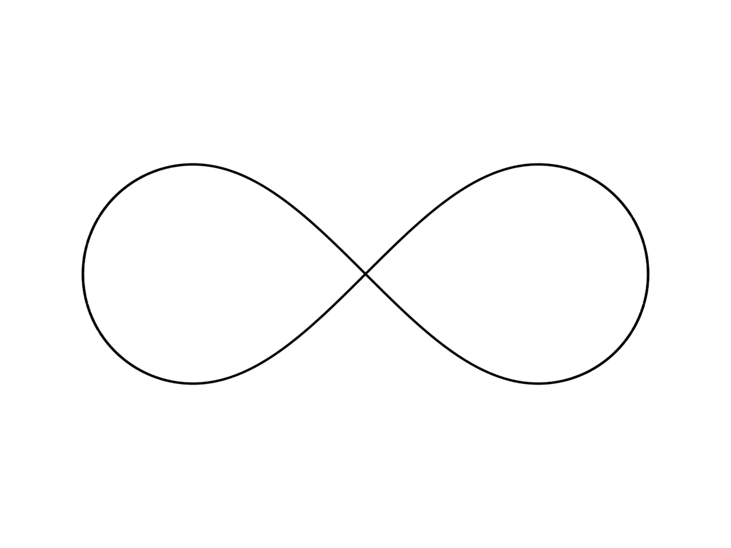
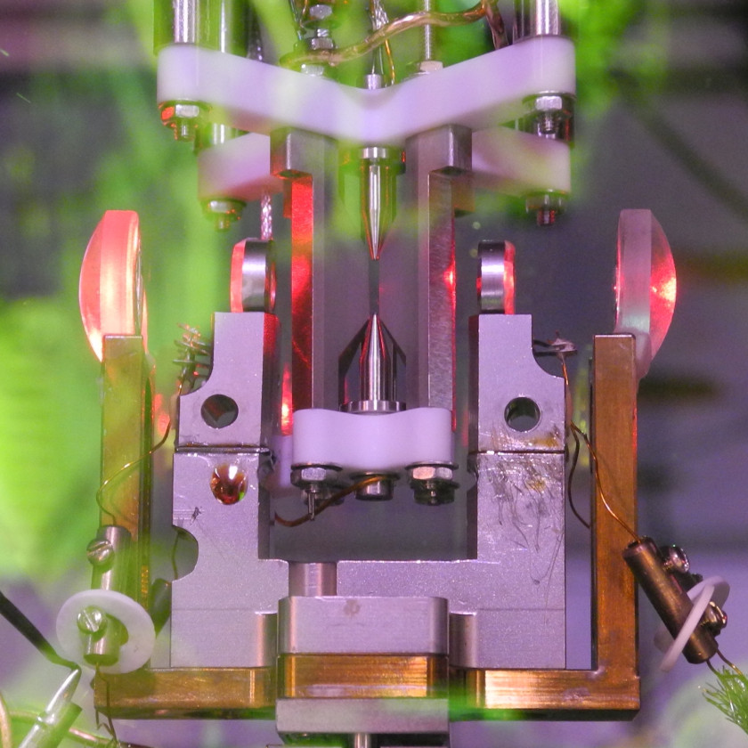
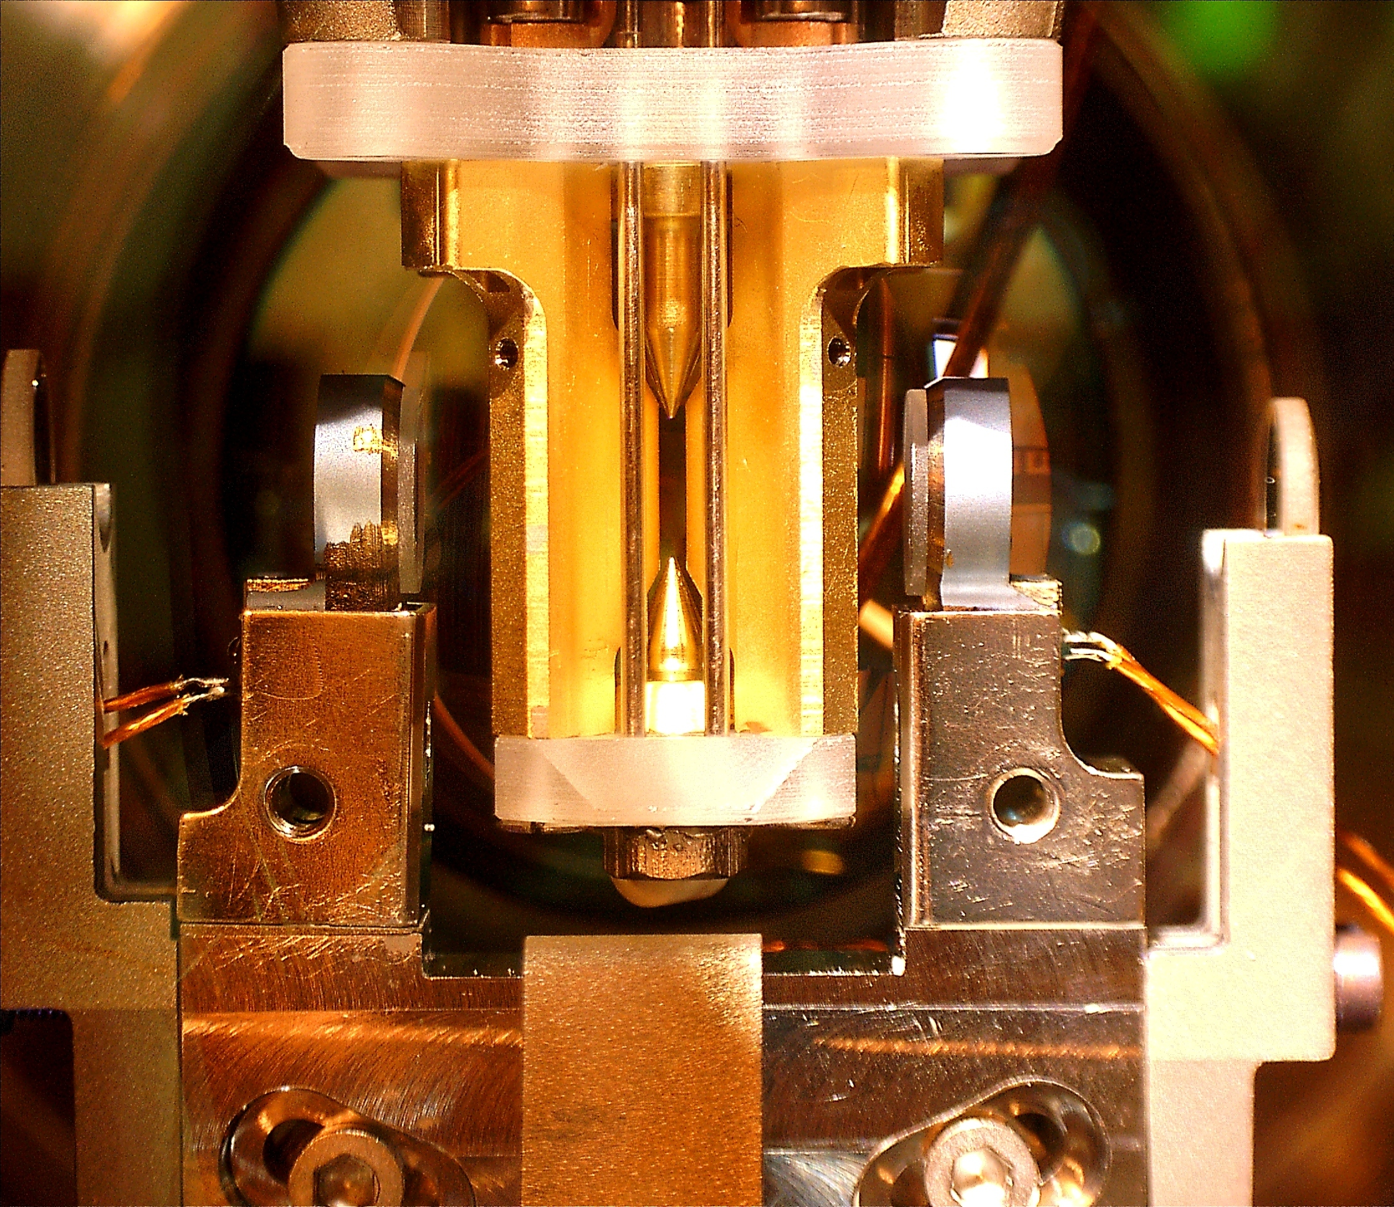
Entanglement of remote qubits
How to entangle remote qubits?
Our realization of remote-ion entanglement
Future experiments
based on remote-ion entanglement

Slide 10
1. How to entangle remote qubits?
The entanglement swapping protocol

Slide 11
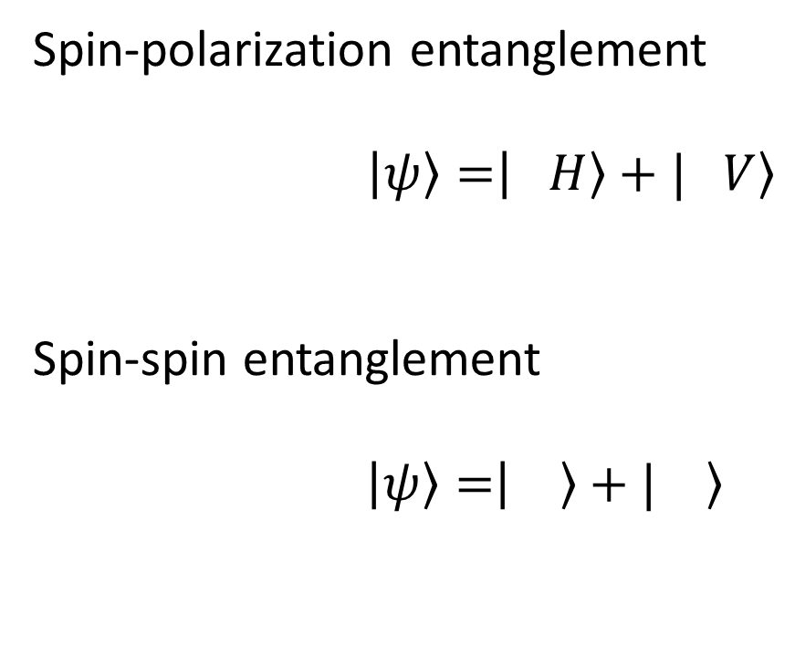
Encoding quantum information
Stationary qubit
Spin: or
Flying qubit (photon)
Polarization: H or V
Spin-polarization entanglement
$\left|\left.ψ\right\rangle =\right|\left. H\right\rangle +|\left. V\right\rangle$
Spin-spin entanglement
$\left|\left.ψ\right\rangle =\right|\left. \right\rangle +|\left. \right\rangle$

Slide 12
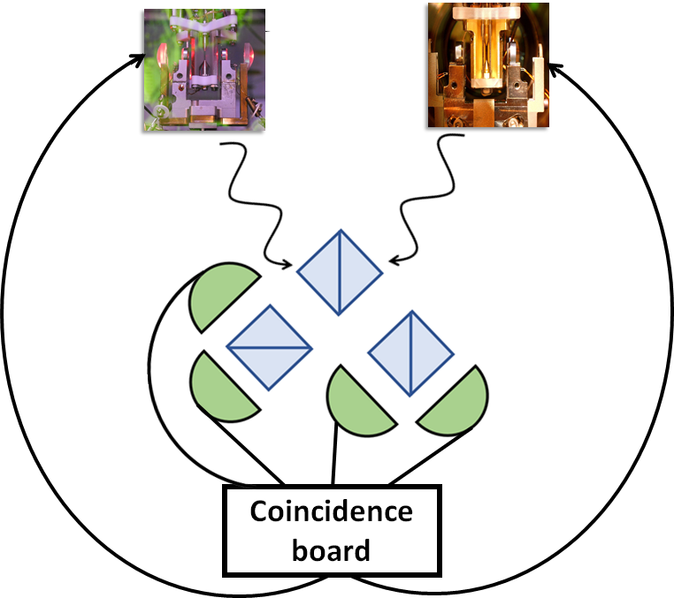



How to entangle remote qubits?
$$a$$
$$b$$
Generation of spin-polarization entanglement pairs
Interference of spin-entangled photons
Photon detection
$\left|{\left.ψ\right\rangle }_{ab}= \right.\left(\left|{\left. H\right\rangle }_{a}+ \right.\right.\left.{\left|\left. V\right\rangle \right.}_{a}\right)$ ⊗ $\left(\left| {\left.H\right\rangle }_{b}+ \right.\right.\left.{\left|\left.V \right\rangle \right.}_{b}\right)$

Slide 13
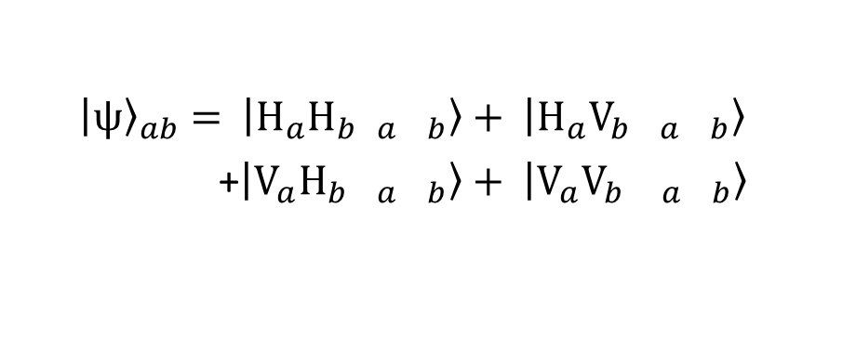
How to entangle remote qubits?
Generation of spin-polarization entanglement pairs
Interference of spin-entangled photons
Photon detection
$$\left|{\left.ψ\right\rangle }_{ab}= \right. \left|\left.H_{a}H_{b}{ }_{a}{ }_{b}\right\rangle + \right.\left|\left.H_{a}V_{b}{ }_{a}{ }_{b}\right\rangle \right.$$
+$\left|\left.V_{a}H_{b}{ }_{a}{ }_{b}\right\rangle + \right.\left|\left.V_{a}V_{b}{ }_{a}{ }_{b}\right\rangle \right.$
NPBS

Slide 14


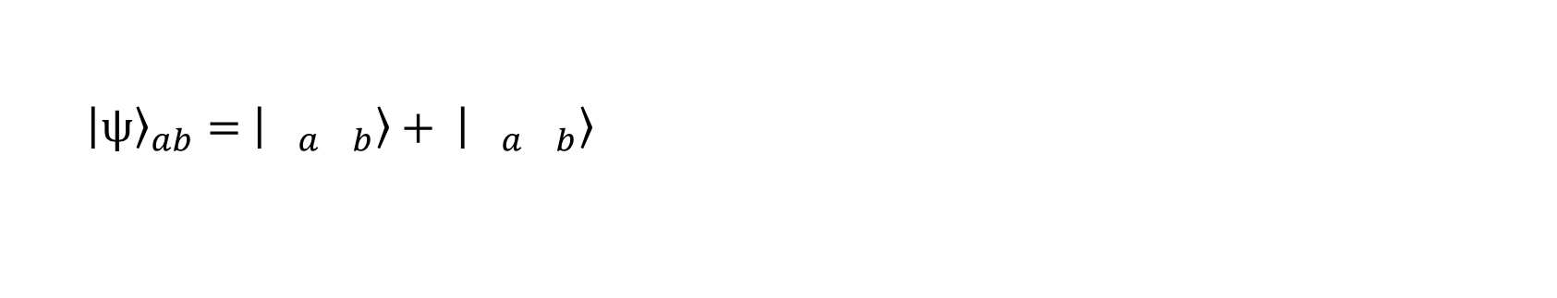
How to entangle remote qubits?
Generation of spin-polarization entanglement pairs
Interference of spin-entangled photons
Photon detection
$$\left|{\left.ψ\right\rangle }_{ab}= \right. \left|\left.H_{a}H_{b}{ }_{a}{ }_{b}\right\rangle + \right.\left|\left.H_{a}V_{b}{ }_{a}{ }_{b}\right\rangle \right.$$
+$\left|\left.V_{a}H_{b}{ }_{a}{ }_{b}\right\rangle + \right.\left|\left.V_{a}V_{b}{ }_{a}{ }_{b}\right\rangle \right.$
$$\left|{\left.ψ\right\rangle }_{ab}= \right.\left|\left.{ }_{a}{ }_{b}\right\rangle + \right.\left|\left.{ }_{a}{ }_{b}\right\rangle \right.$$
PBS

Slide 15
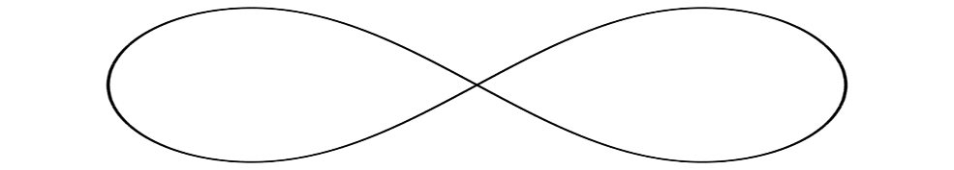
How to entangle remote qubits?
Generation of spin-polarization entanglement pairs
Interference of spin-entangled photons
Photon detection
Entangled qubits!
$$\left|{\left.ψ\right\rangle }_{ab}= \right. \left|\left.H_{a}H_{b}{ }_{a}{ }_{b}\right\rangle + \right.\left|\left.H_{a}V_{b}{ }_{a}{ }_{b}\right\rangle \right.$$
+$\left|\left.V_{a}H_{b}{ }_{a}{ }_{b}\right\rangle + \right.\left|\left.V_{a}V_{b}{ }_{a}{ }_{b}\right\rangle \right.$
$$\left|{\left.ψ\right\rangle }_{ab}= \right.\left|\left.{ }_{a}{ }_{b}\right\rangle + \right.\left|\left.{ }_{a}{ }_{b}\right\rangle \right.$$
PBS

Slide 16
State-of-the-art remote entanglement
Platforms for quantum information processing:
Ions
NV centers
Neutral atoms
Quantum dots
Superconducting qubits

Slide 17
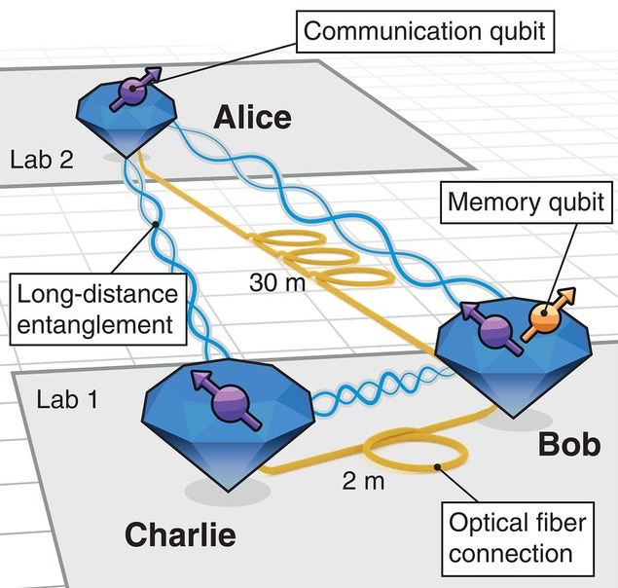
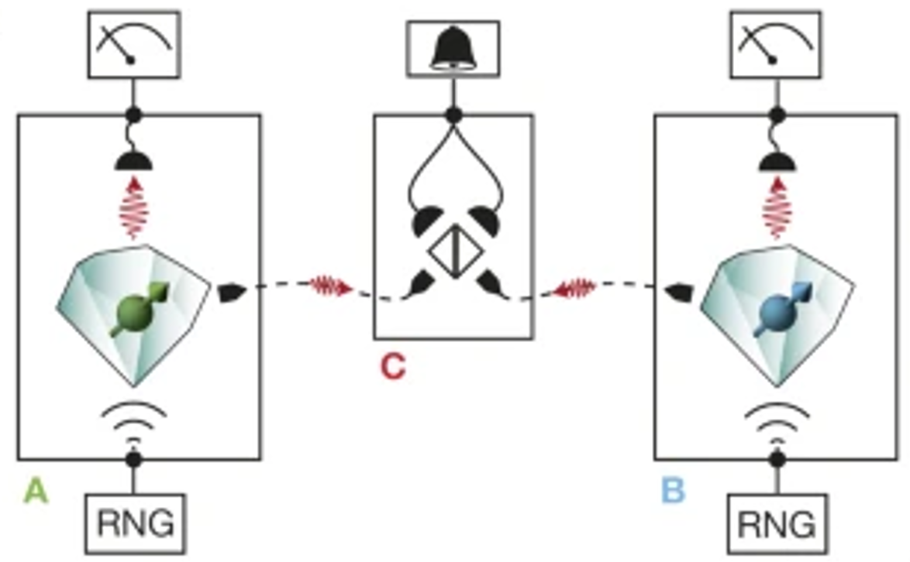
State-of-the-art remote entanglement
Platforms for quantum information processing:
Ions
NV centers
Neutral atoms
Quantum dots
Superconducting qubits
1.3 Km
M. Pompili et al., Science 372,
259–264 (2021)
B. Hensen et al., Nature 526,
682-686 (2015)

Slide 18
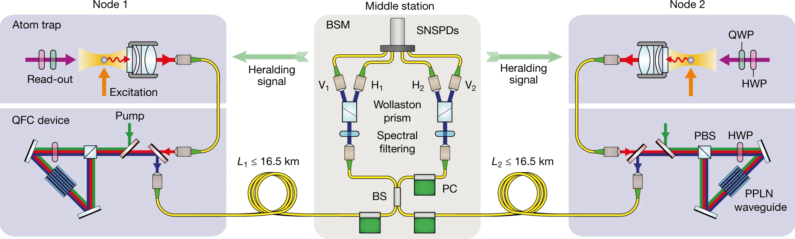

State-of-the-art remote entanglement
Platforms for quantum information processing:
Ions
NV centers
Neutral atoms
Quantum dots
Superconducting qubits
1.3 km
M. Pompili et al., Science 372,
259–264 (2021)
B. Hensen et al., Nature 526,
682-686 (2015)
400 m
T. Van Leent
et al.,
Nature 607,
69–73 (2022)
33 km

Slide 19
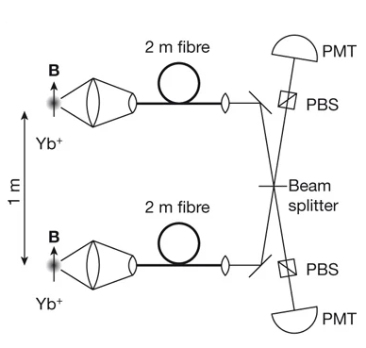
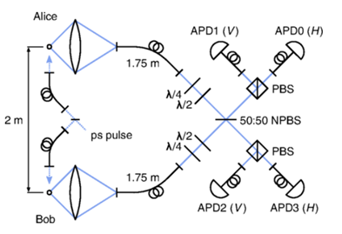
State-of-the-art remote-ion entanglement
Monroe’s group @University of Michigan
Lucas’s group @University of Oxford
D. L. Moehring et al., Nature 449,
68–71(2007)
L. J. Stephenson et al., PRL 124,
110501 (2020)

Slide 20
2. Our realization of remote entanglement
A realization based on trapped-ions coupled to cavities

Slide 21
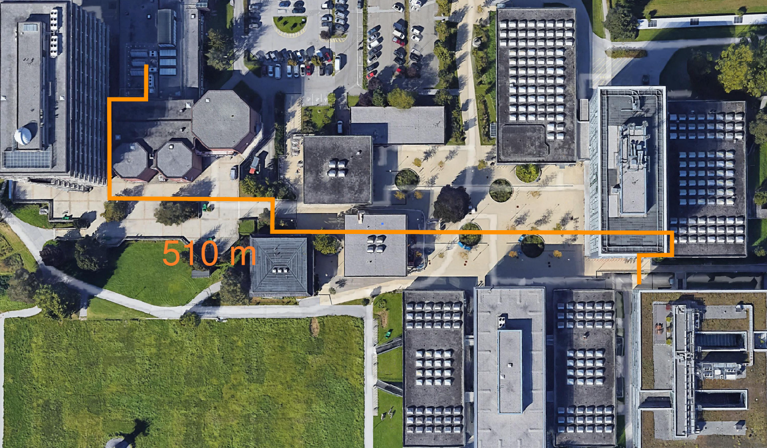


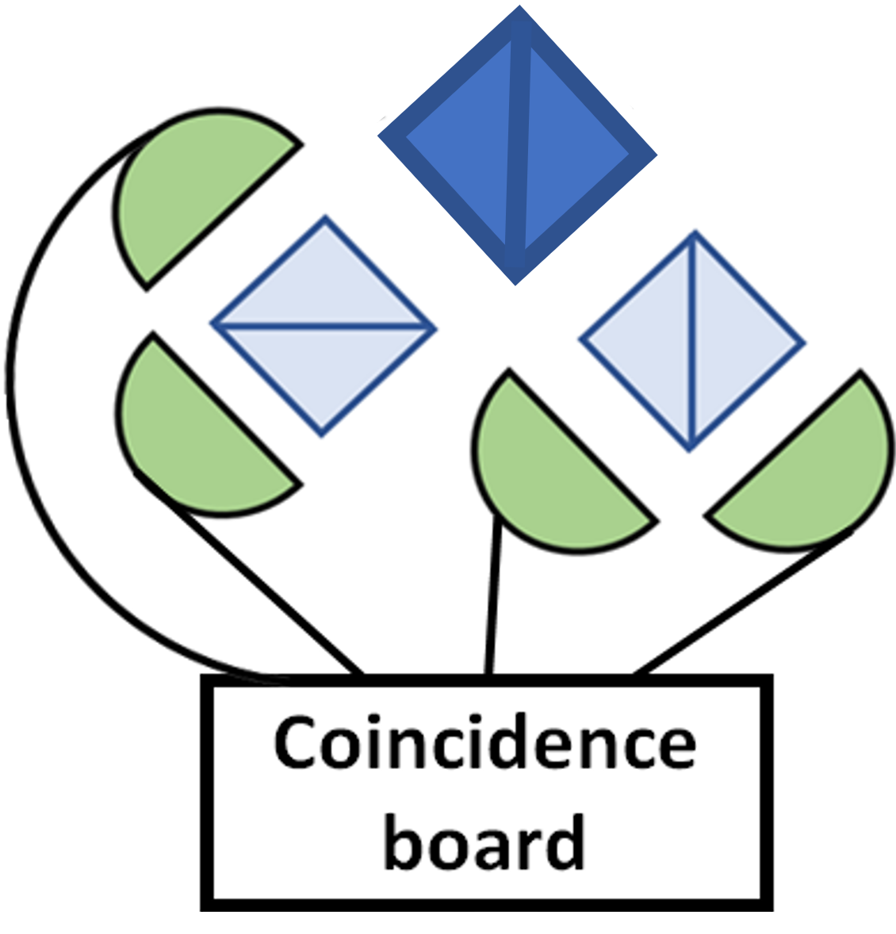
Our quantum network in Innsbruck
230 m
510 m

Slide 22
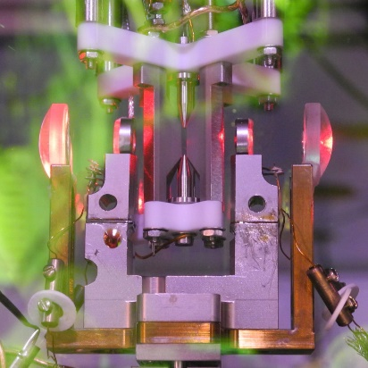

Our quantum network in Innsbruck
230 m
Tracy Northup’s group
Ben Lanyon’s group
510 m

Slide 23
Quantum network node: an ion-cavity system

Slide 24
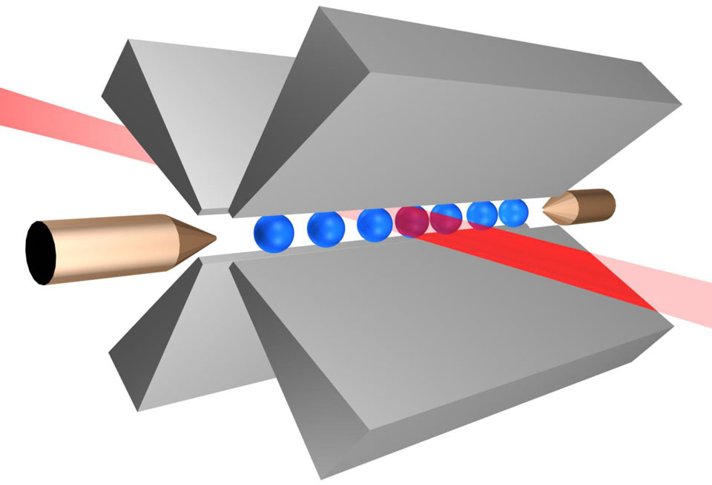
Quantum network node: an ion-cavity system
Ion trap
DC
ground
RF
RF
ground
DC
A.M. Eltony. et al., Quantum Inf Process 15, 5351–5383 (2016)

Slide 25

Quantum network node: an ion-cavity system
Ion trap
DC
ground
RF
Optical cavity
RF
ground
DC
A.M. Eltony. et al., Quantum Inf Process 15, 5351–5383 (2016)

Slide 26
Quantum network node: an ion-cavity system
Ion trap
DC
ground
RF
Optical cavity
RF
ground
Ion-cavity system:
a quantum interface
DC
A.M. Eltony. et al., Quantum Inf Process 15, 5351–5383 (2016)

Slide 27
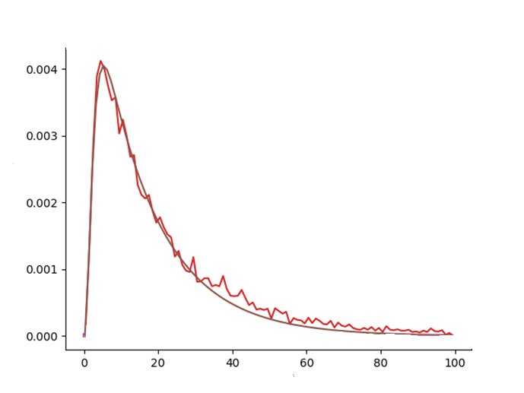





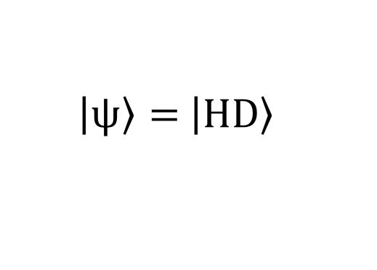

A Raman process generates single cavity photons
$${ ^{40}Ca}^{+}$$
$${4^{2}P}_{3/2}$$
cavity
854 nm
laser
393 nm
$$D^{ }$$
$${3^{2}D}_{5/2}$$
# photons (arb. units)
$$S^{ }$$
$$\left|\left.ψ\right\rangle = \right.\left|\left.HD\right\rangle \right.$$
$${4^{2}S}_{1/2}$$
Time (us)

Slide 28

A Raman process generates single cavity photons
$${ ^{40}Ca}^{+}$$
$${4^{2}P}_{3/2}$$
$$H$$
laser
393 nm
$$D^{ }$$
$${3^{2}D}_{5/2}$$
# photons (arb. units)
$$S^{ }$$
$$\left|\left.ψ\right\rangle = \right.\left|\left.HD\right\rangle \right.$$
-_
$${4^{2}S}_{1/2}$$
Time (us)

Slide 29
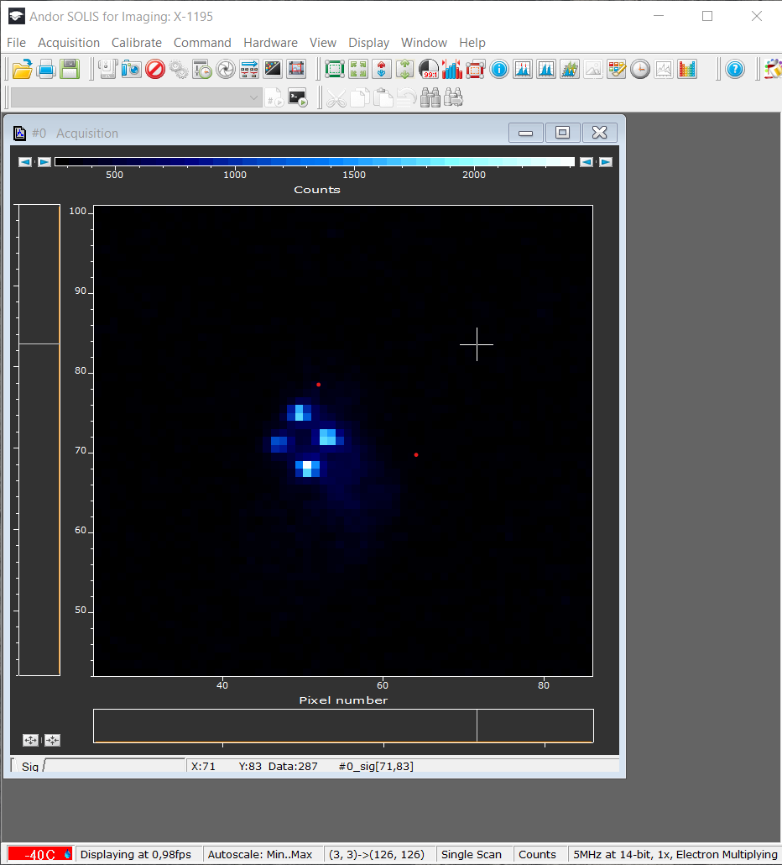

A Raman process generates single cavity photons
$${ ^{40}Ca}^{+}$$
$${4^{2}P}_{3/2}$$
$$H$$
$${4^{2}P}_{1/2}$$
cavity
854 nm
laser
393 nm
$$D^{ }$$
$${3^{2}D}_{5/2}$$
# photons (arb. units)
397 nm
$$S^{ }$$
$$\left|\left.ψ\right\rangle = \right.\left|\left.HD\right\rangle \right.$$
$${4^{2}S}_{1/2}$$
Time (us)

Slide 30
A Raman process generates single cavity photons
$${ ^{40}Ca}^{+}$$
$${4^{2}P}_{3/2}$$
$$H$$
$${4^{2}P}_{1/2}$$
cavity
854 nm
laser
393 nm
$$D^{ }$$
$${3^{2}D}_{5/2}$$
# photons (arb. units)
397 nm
729 nm
$$S^{ }$$
$$\left|\left.ψ\right\rangle = \right.\left|\left.HD\right\rangle \right.$$
$${4^{2}S}_{1/2}$$
Time (us)

Slide 31
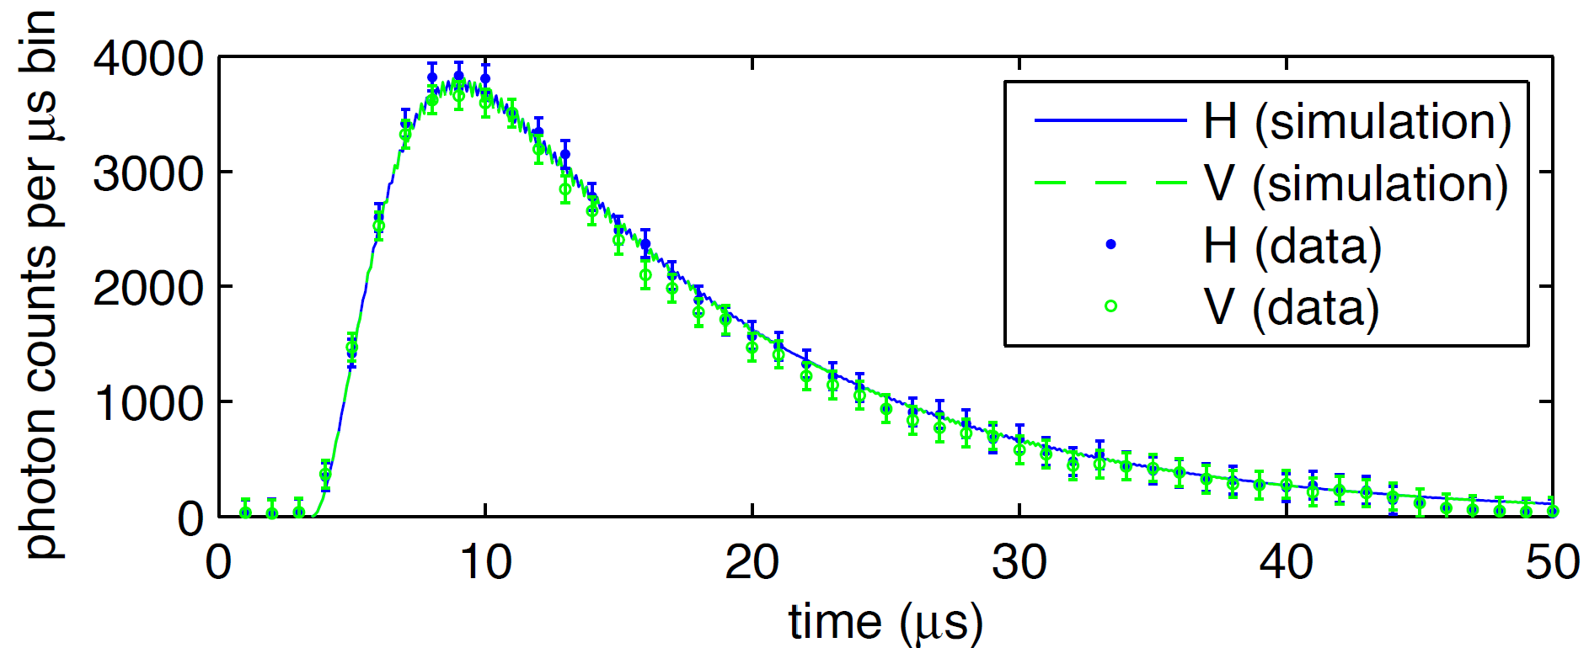
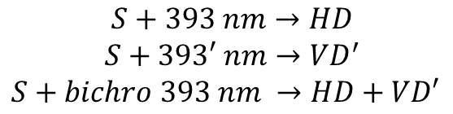




A bichromatic Raman process generates single cavity photons entangled with the ions
$${ ^{40}Ca}^{+}$$
$${4^{2}P}_{3/2}$$
$$H$$
laser
393 nm
$$V$$
$$D^{ }$$
$${3^{2}D}_{5/2}$$
$$D^{′}$$
$$S+393 nm→HD \\ S+393′ nm→{VD}^{′}$$
$S+bichro 393 nm →HD+VD′$
B. Brandstätter, Ph.D. thesis,
University of Innsbruck (2013)
$$S^{ }$$
$${4^{2}S}_{1/2}$$
$$\left|\left.ψ\right\rangle = \right.\left|\left.HD\right\rangle + \right.\left|\left.VD′\right\rangle \right.$$

Slide 32
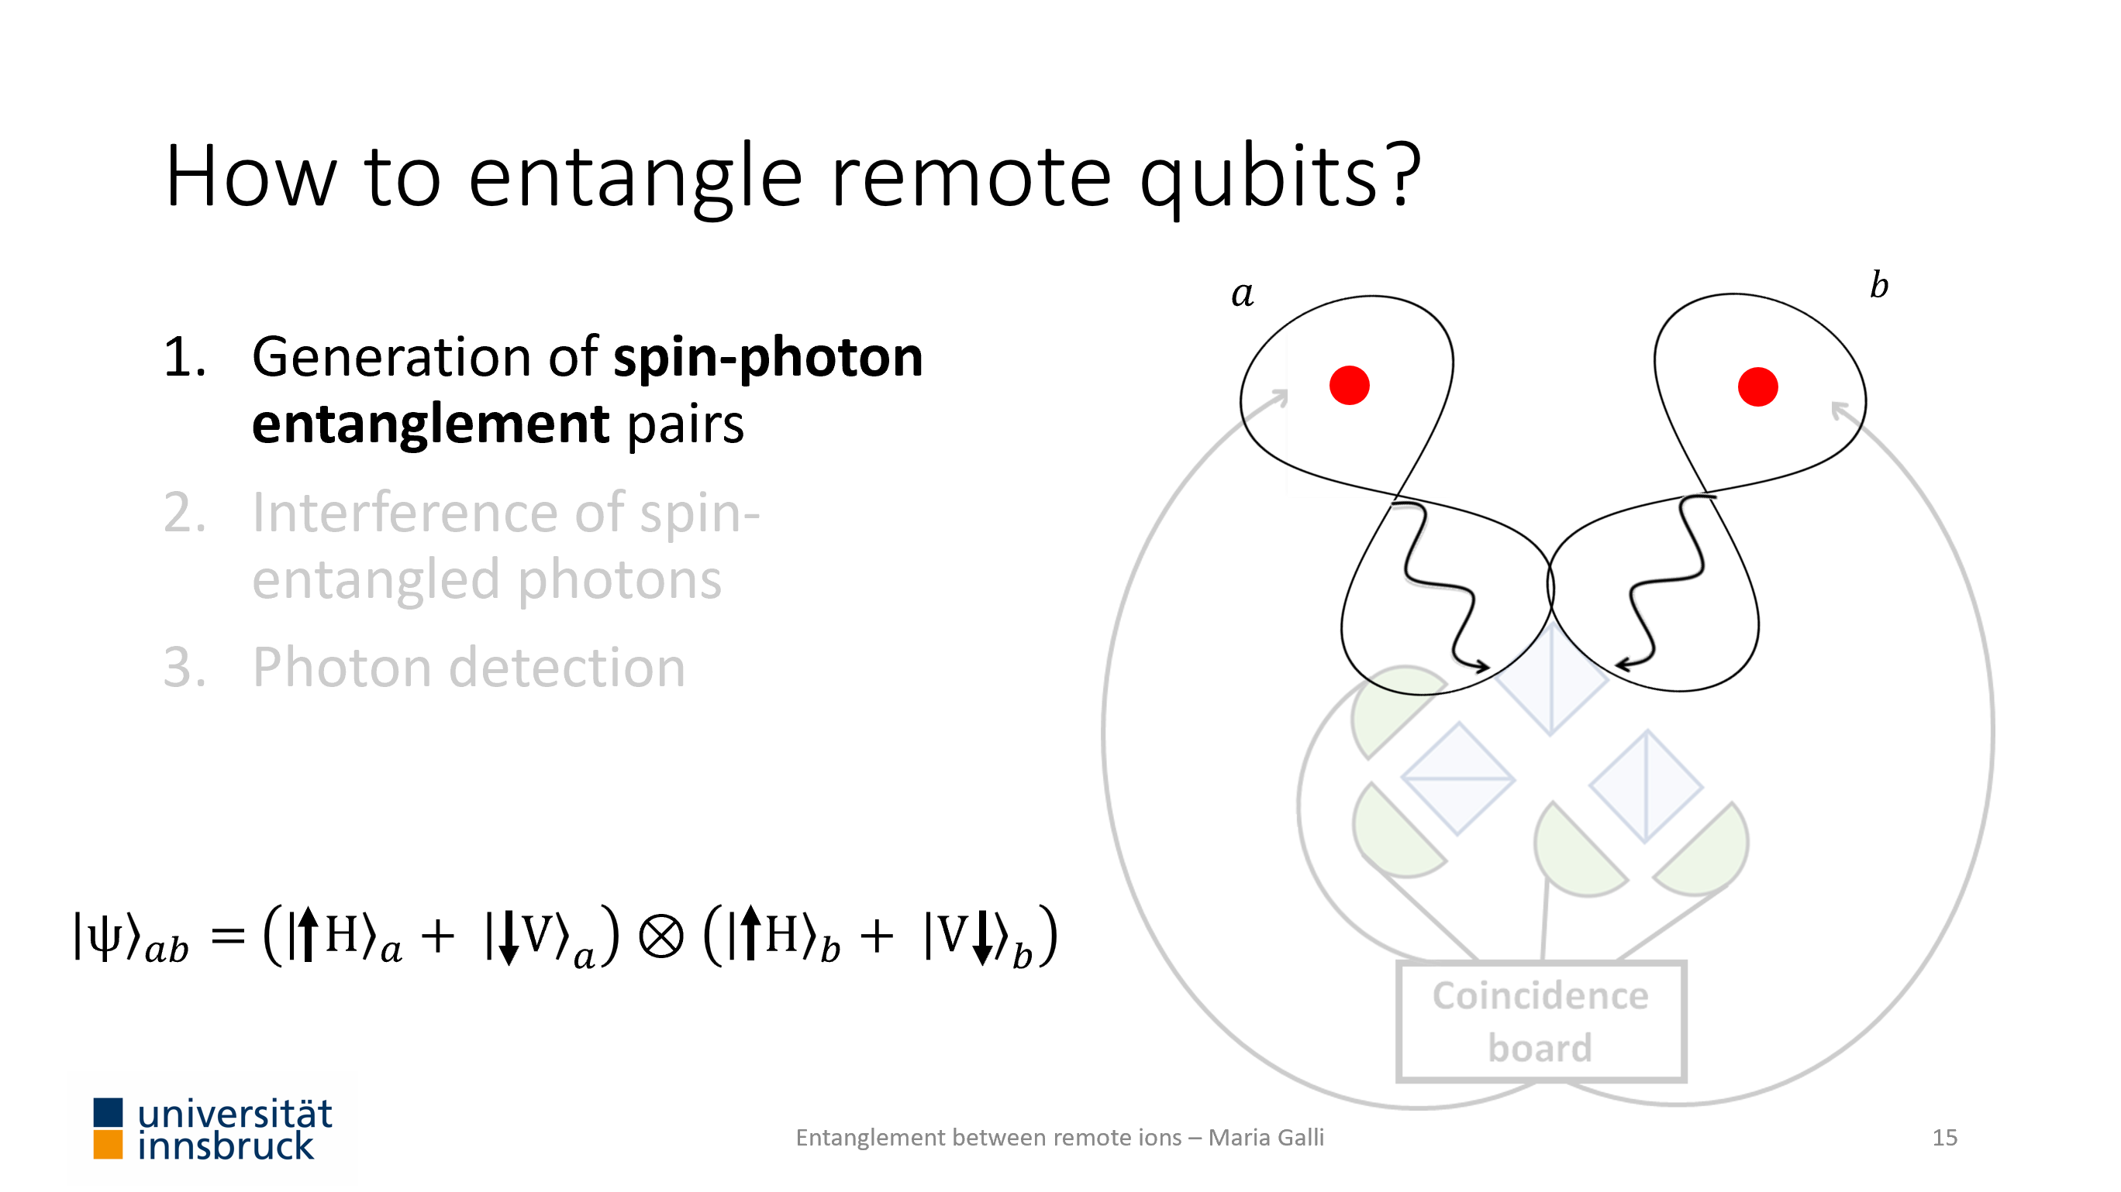
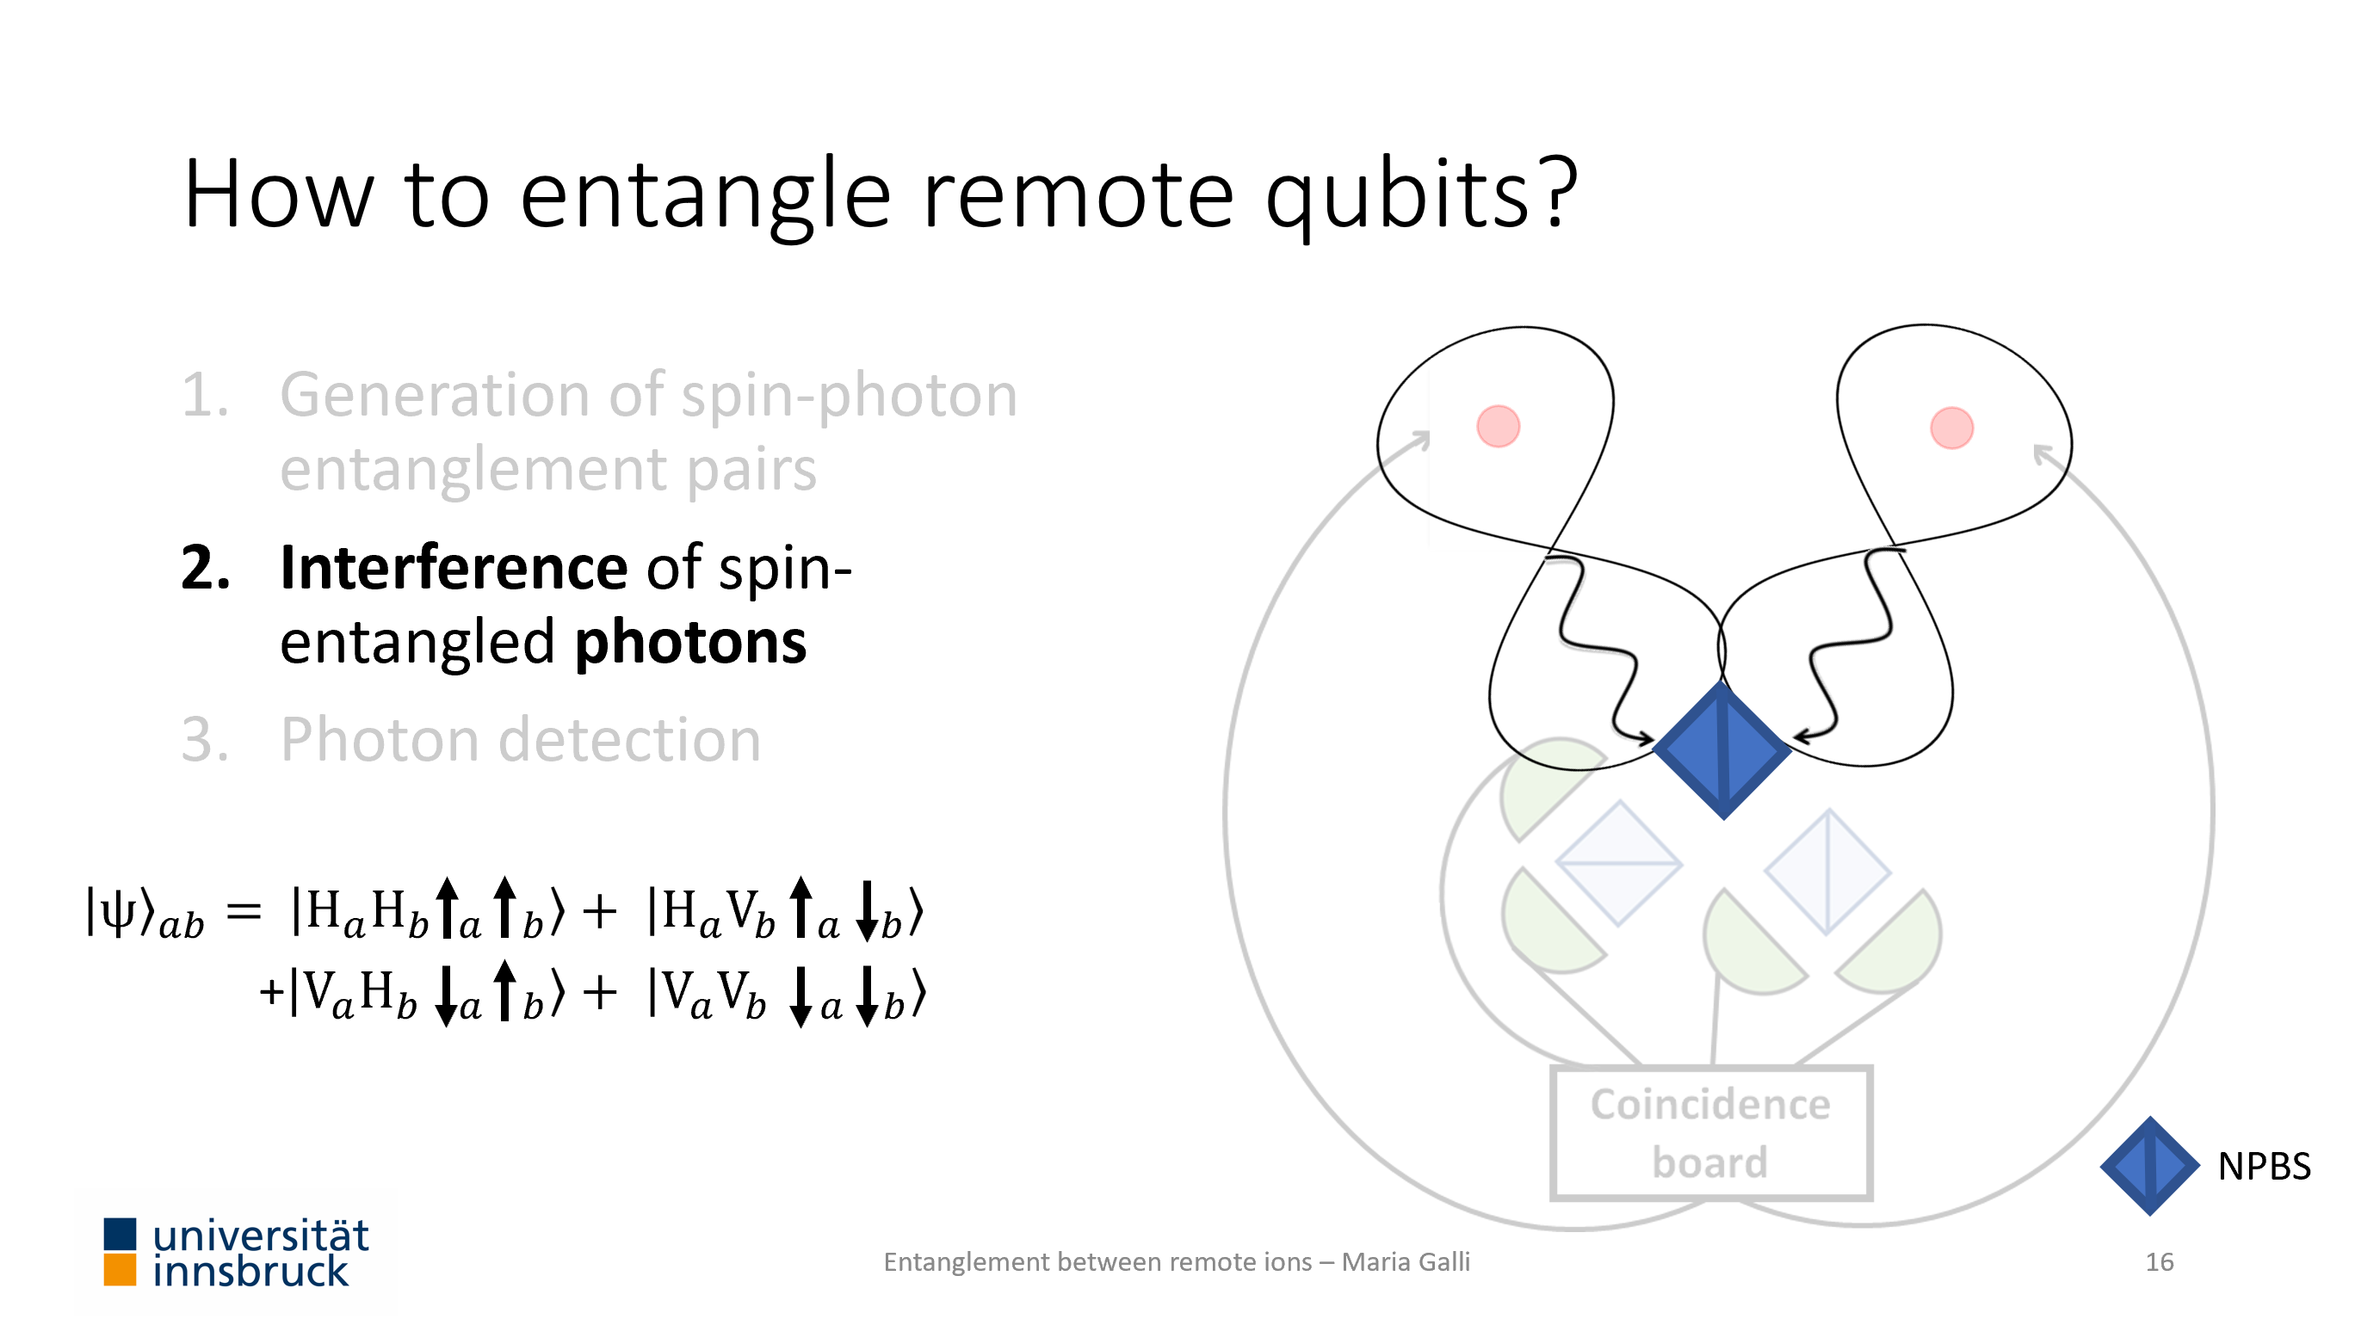
Assessing requirements for remote-qubit entanglement
Indistinguishability of photons
Generation of spin-polarization entanglement

Slide 33

Assessing requirements for remote-qubit entanglement
Indistinguishability of photons
Generation of spin-polarization entanglement

Slide 34
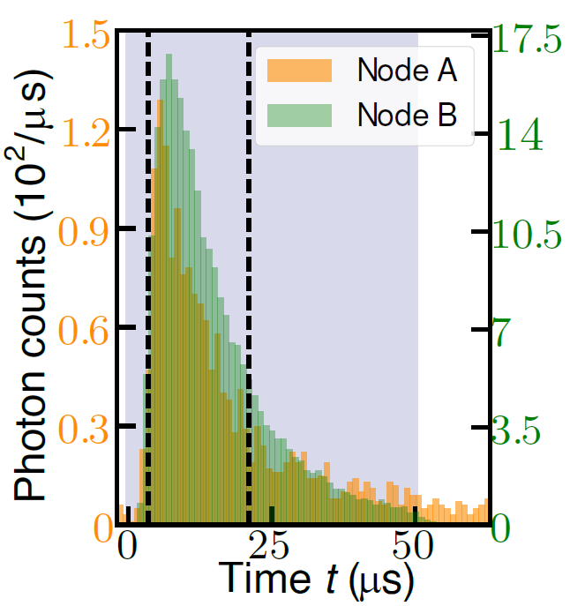


Making photons indistinguishable
Between the labs:
Time synchronization
GPS clock signal, pulse sequences synch.
Frequency matching
Match length of the optical cavities
Polarization stabilization
Characterize and correct for polarization rotation

Slide 35


Assessing photon indistinguishability
The Hong-Ou-Mandel effect
Indistinguishable photons leave the beam splitter at the same port.
No coincidences are observed.

Slide 36
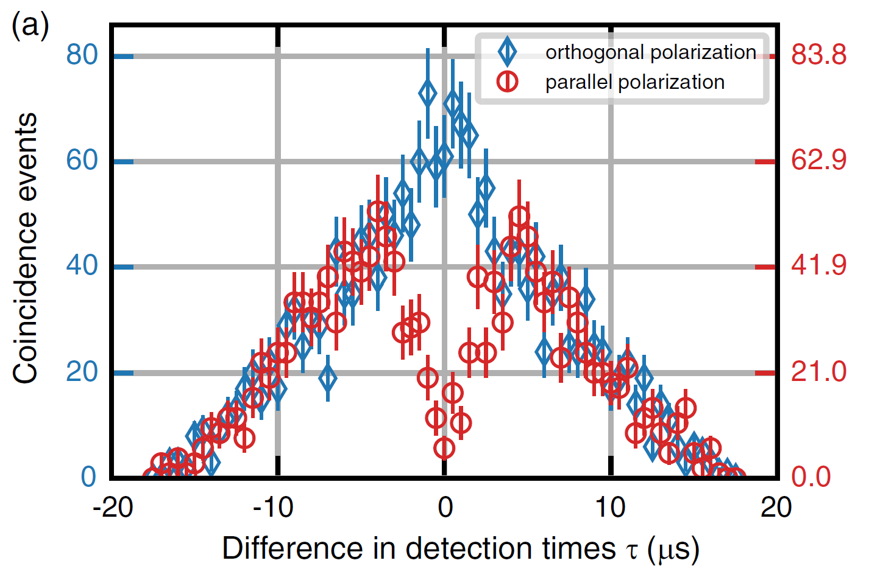
Assessing photon indistinguishability
The Hong-Ou-Mandel effect
Our measurement
Indistinguishable photons leave the beam splitter at the same port.
No coincidences are observed.

Slide 37
Assessing requirements for remote-qubit entanglement
Indistinguishability of photons
Generation of spin-polarization entanglement

Slide 38

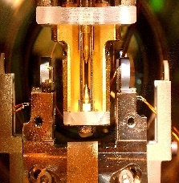



Our realization of remote-ion entanglement
Generation of ion-photon entanglement pairs
Interference of ion-entangled photons
Photon detection
Ion state read-out
$$a$$
$$b$$
$\left|{\left.ψ\right\rangle }_{ab}= \right.\left(\left|{\left.HD\right\rangle }_{a}+ \right.\right.\left.{\left|\left.VD′\right\rangle \right.}_{a}\right)$ ⊗ $\left(\left|{\left.HD\right\rangle }_{b}+ \right.\right.\left.{\left|\left.VD′\right\rangle \right.}_{b}\right)$
Coincidence
measurement
Coincidence
measurement

Slide 39
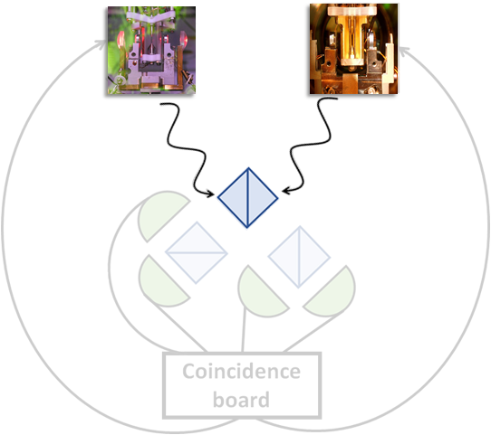
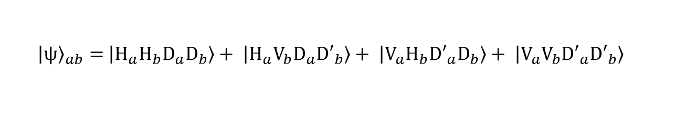
Our realization of remote-ion entanglement
Generation of ion-photon entanglement pairs
Interference of ion-entangled photons
Photon detection
Ion state read-out
$$\left|{\left.ψ\right\rangle }_{ab}= \right.\left|\left.H_{a}H_{b}D_{a}D_{b}\right\rangle + \right.\left|\left.H_{a}V_{b}D_{a}{D′}_{b}\right\rangle + \right.\left|\left.V_{a}H_{b}{D′}_{a}D_{b}\right\rangle + \right.\left|\left.V_{a}V_{b}{D′}_{a}{D′}_{b}\right\rangle \right.$$
Coincidence
measurement
NPBS

Slide 40
Our realization of remote-ion entanglement
Generation of ion-photon entanglement pairs
Interference of ion-entangled photons
Photon detection
Ion state read-out
$$\left|{\left.ψ\right\rangle }_{ab}= \right.\left|\left.H_{a}H_{b}D_{a}D_{b}\right\rangle + \right.\left|\left.H_{a}V_{b}D_{a}{D′}_{b}\right\rangle + \right.\left|\left.V_{a}H_{b}{D′}_{a}D_{b}\right\rangle + \right.\left|\left.V_{a}V_{b}{D′}_{a}{D′}_{b}\right\rangle \right.$$
Coincidence
measurement
PBS

Slide 41
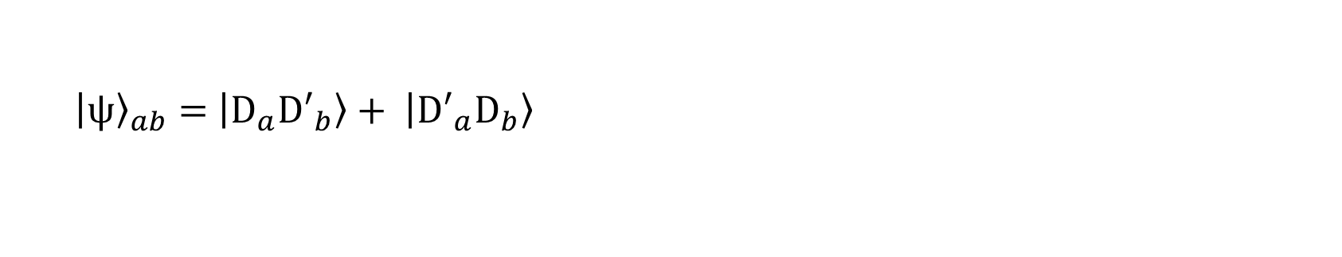
Our realization of remote-ion entanglement
Generation of ion-photon entanglement pairs
Interference of ion-entangled photons
Photon detection
Ion state read-out
$$\left|{\left.ψ\right\rangle }_{ab}= \right.\left|\left.H_{a}H_{b}D_{a}D_{b}\right\rangle + \right.\left|\left.H_{a}V_{b}D_{a}{D′}_{b}\right\rangle + \right.\left|\left.V_{a}H_{b}{D′}_{a}D_{b}\right\rangle + \right.\left|\left.V_{a}V_{b}{D′}_{a}{D′}_{b}\right\rangle \right.$$
Coincidence
measurement
$$\left|{\left.ψ\right\rangle }_{ab}= \right.\left|\left.D_{a}{D′}_{b}\right\rangle + \right.\left|\left.{D′}_{a}D_{b}\right\rangle \right.$$

Slide 42
Our realization of remote-ion entanglement
Generation of ion-photon entanglement pairs
Interference of ion-entangled photons
Photon detection
Ion state read-out
Entangled ions!
$$\left|{\left.ψ\right\rangle }_{ab}= \right.\left|\left.H_{a}H_{b}D_{a}D_{b}\right\rangle + \right.\left|\left.H_{a}V_{b}D_{a}{D′}_{b}\right\rangle + \right.\left|\left.V_{a}H_{b}{D′}_{a}D_{b}\right\rangle + \right.\left|\left.V_{a}V_{b}{D′}_{a}{D′}_{b}\right\rangle \right.$$
Coincidence
measurement
$$\left|{\left.ψ\right\rangle }_{ab}= \right.\left|\left.D_{a}{D′}_{b}\right\rangle + \right.\left|\left.{D′}_{a}D_{b}\right\rangle \right.$$

Slide 43
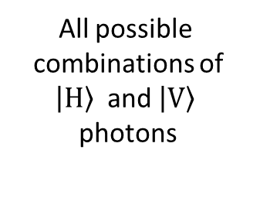
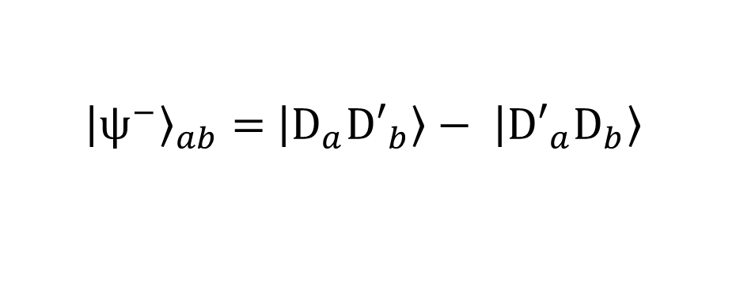
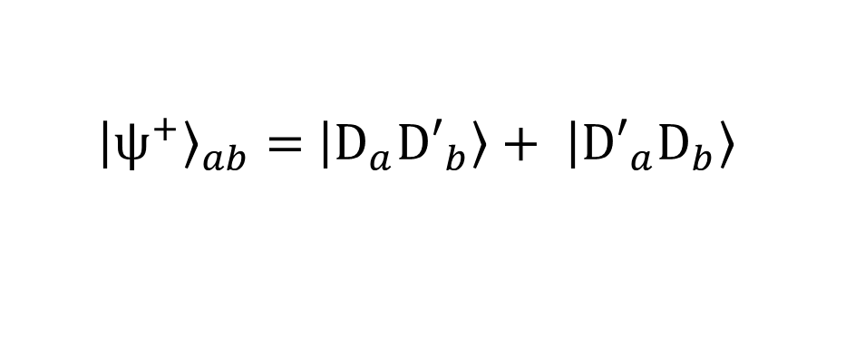
Photon detection possibilities
All possible
combinations of
$\left|\left.H\right\rangle \right.$ and $\left|\left.V\right\rangle \right.$
photons
Coincidence
measurement
Coincidence
measurement
$$\left|{\left.ψ^{+}\right\rangle }_{ab}= \right.\left|\left.D_{a}{D′}_{b}\right\rangle + \right.\left|\left.{D′}_{a}D_{b}\right\rangle \right.$$
$$\left|{\left.ψ^{−}\right\rangle }_{ab}= \right.\left|\left.D_{a}{D′}_{b}\right\rangle − \right.\left|\left.{D′}_{a}D_{b}\right\rangle \right.$$

Slide 44
Our realization of remote-ion entanglement
Generation of ion-photon entanglement pairs
Interference of ion-entangled photons
Photon detection
Ion state read-out
$$\left|{\left.ψ^{±}\right\rangle }_{ab}= \right.\left|\left.D_{a}{D′}_{b}\right\rangle ± \right.\left|\left.{D′}_{a}D_{b}\right\rangle \right.$$
Coincidence
measurement

Slide 45
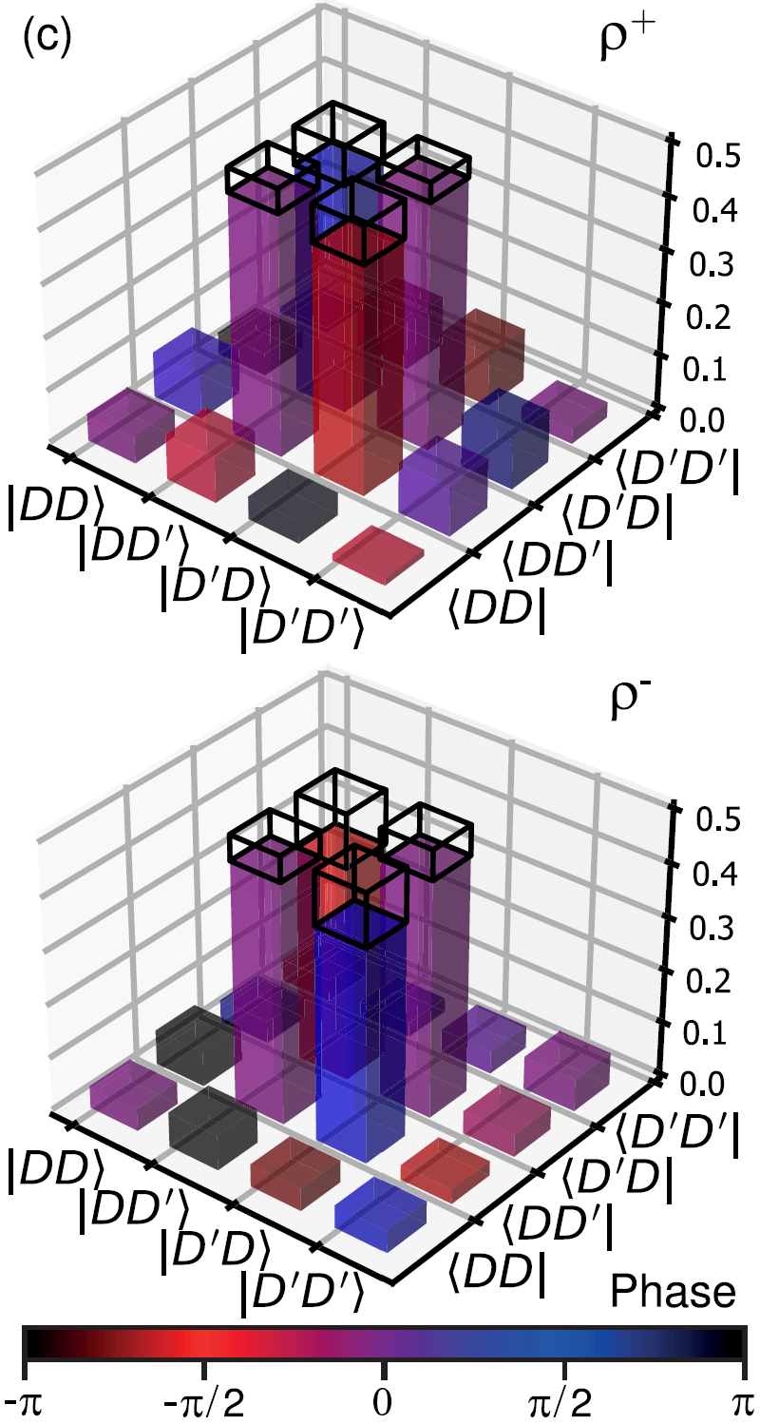
Entanglement of remote cavity-coupled ions
Full quantum state tomography complete state reconstruction:
Fidelity: 88.0 (+2.2, -4.7) %
Fidelity: 83.3 (+3.3, -6.4) %
Phase
Target states: $\left|{\left.ψ^{±}\right\rangle }_{ab}=\right. \frac{1}{\sqrt{2}}(\left|\left.D_{a}{D^{′}}_{b}\right\rangle ± \right.\left|\left.{D^{′}}_{a}D_{b}\right\rangle \right.)$
Krutyanskiy, Galli, et al.,
Phys. Rev. Lett. 130, 050803 (2023)

Slide 46
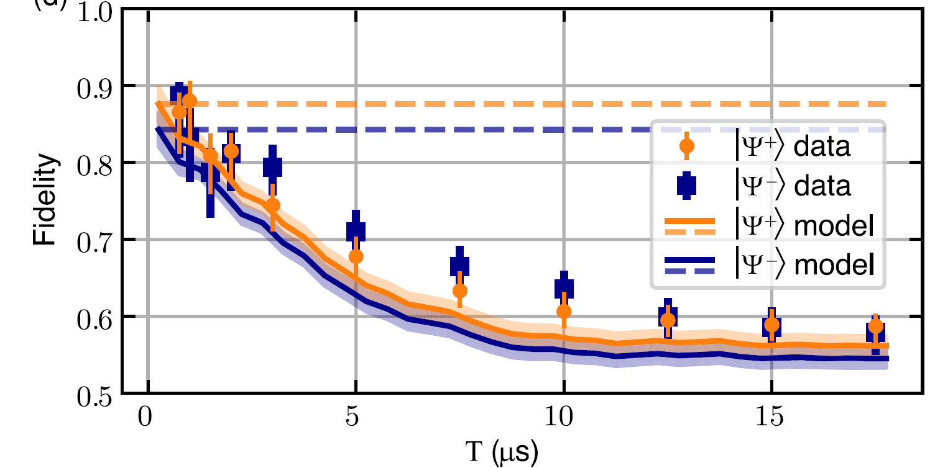
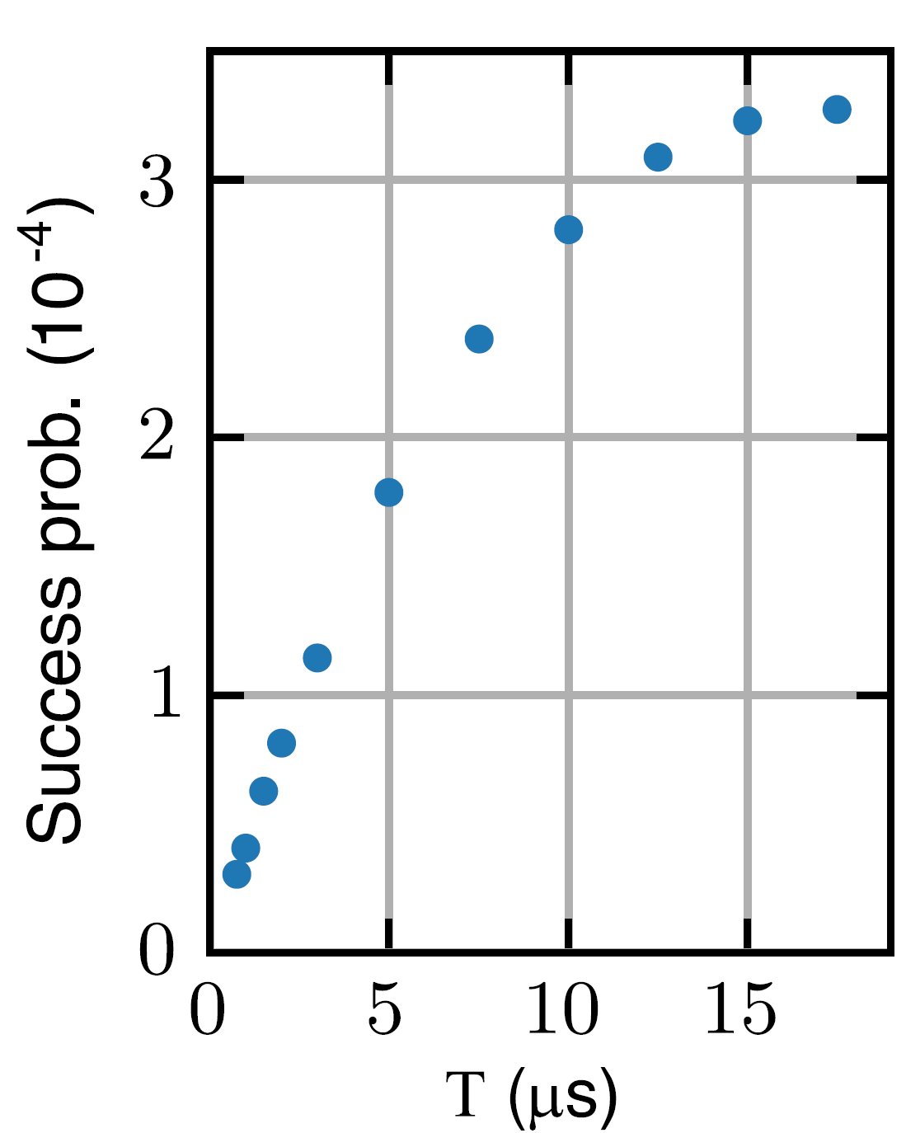
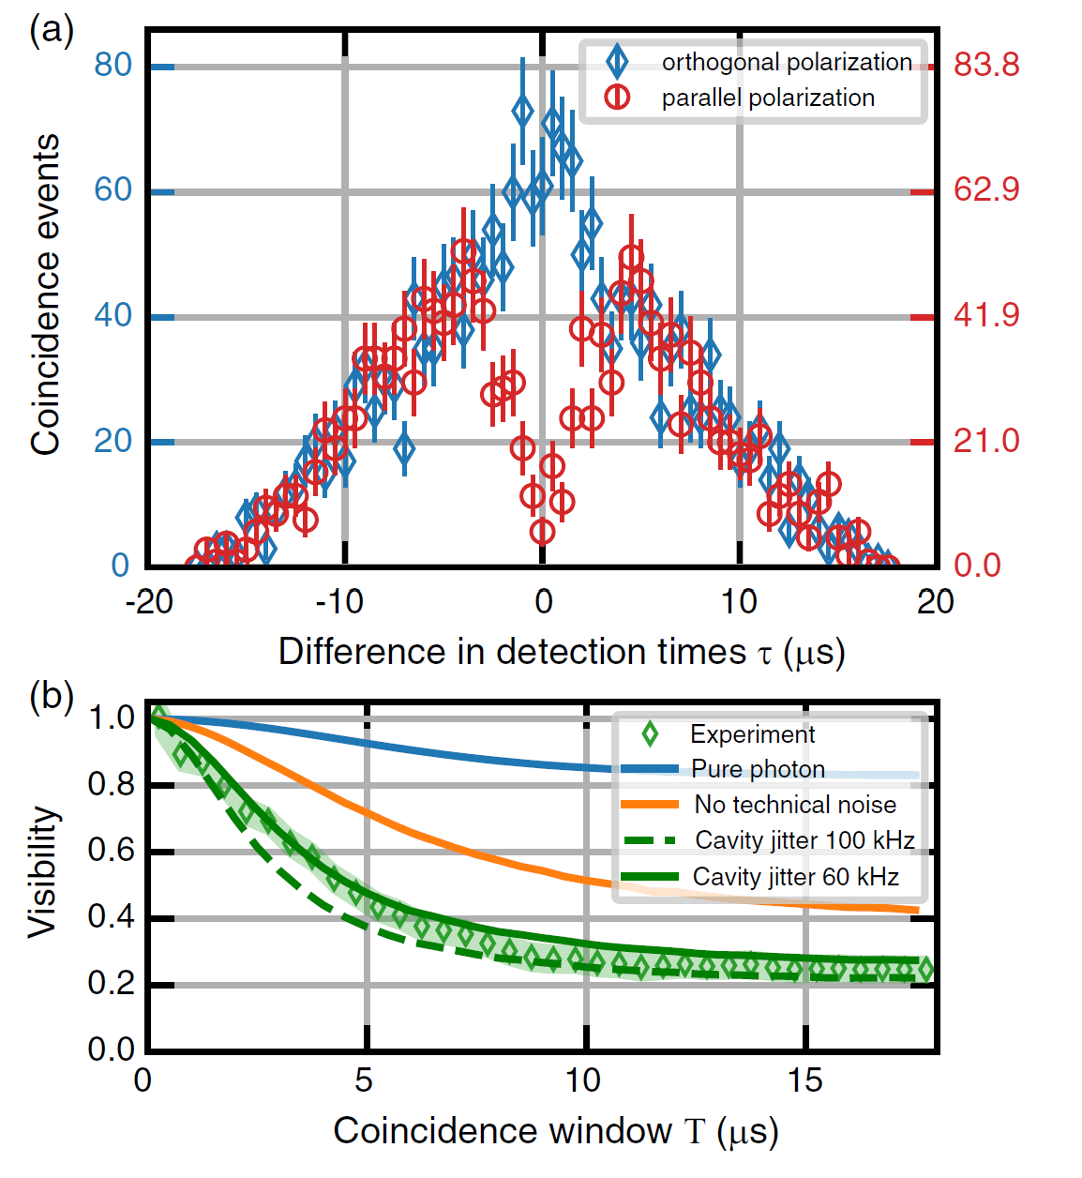
Trade-off between fidelity and rate
V. Krutyanskiy,
M. Galli et al.,
Phys. Rev. Lett. 130,
050803 (2023)
Coincidence window | 1μs | 17.5μs
Fidelity | 0.880+0.022-0.047 0.83.3+0.033-0.064 | 0.587+0.017-0.021 0.580+0.020-0.029
Rate | 0.058 Hz | 0.49 Hz
Maximum time delay
Between the two
detected photons

Slide 47
How to improve entanglement fidelity
Photon distinguishability results in fidelity drop
Krutyanskiy, Galli, et al.,
Phys. Rev. Lett. 130, 050803 (2023)

Slide 48
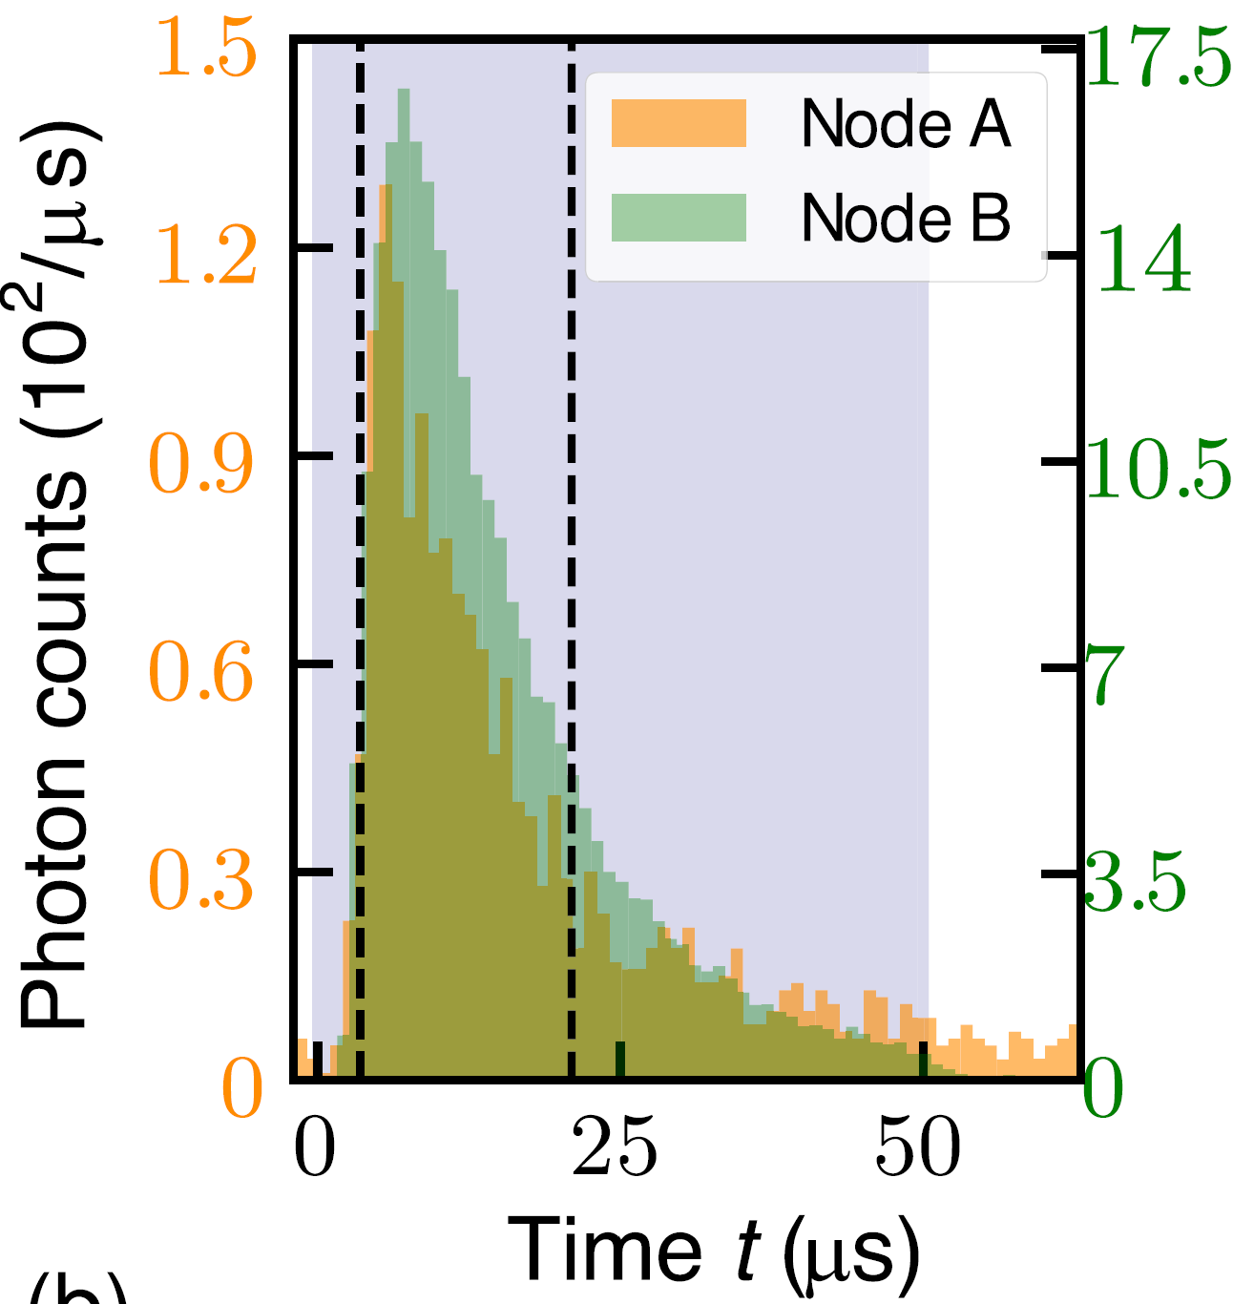
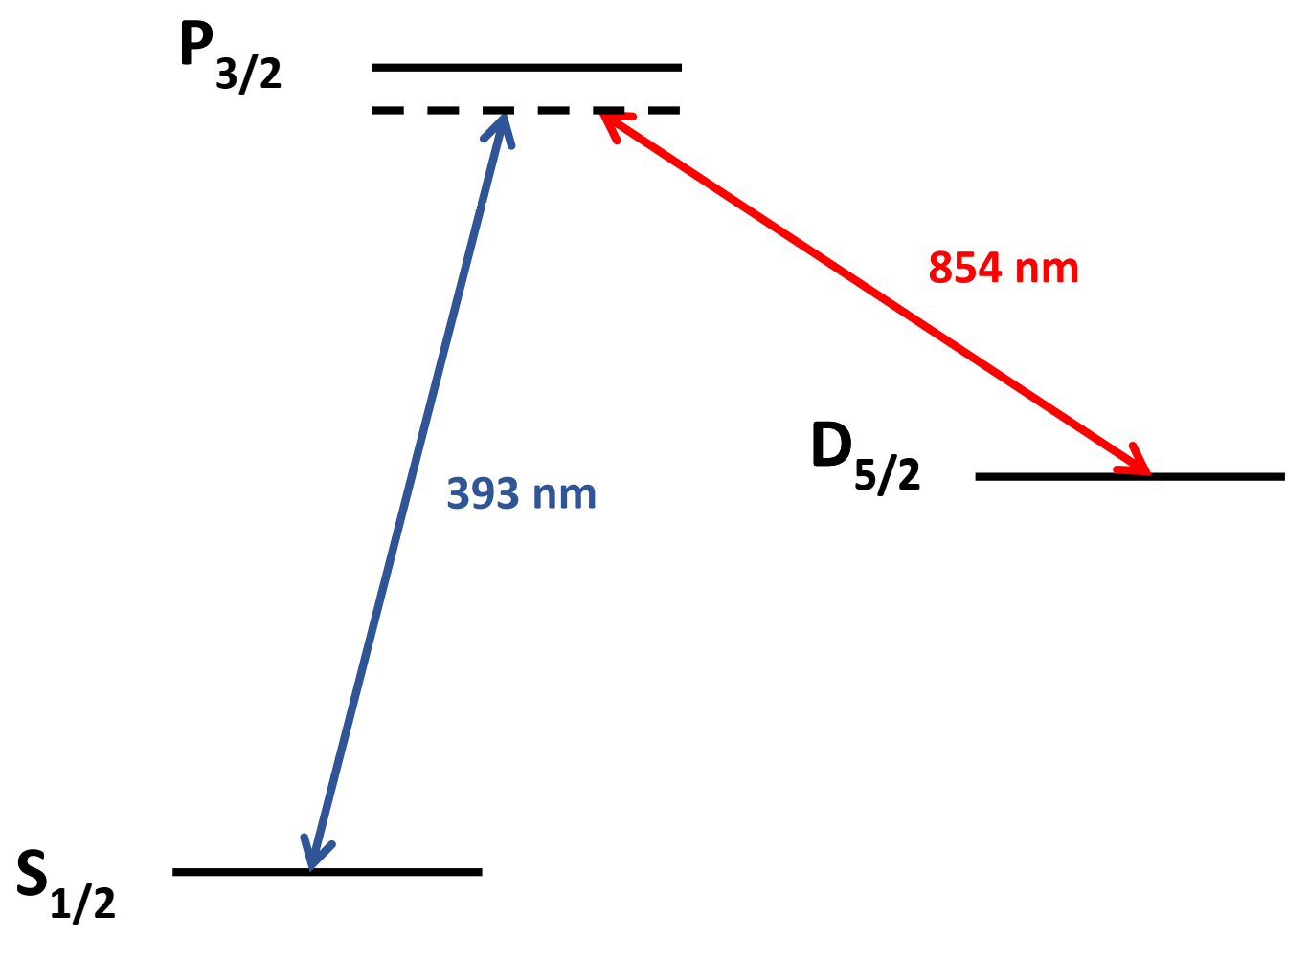

How to improve entanglement fidelity
  Limiting factors & possible improvements (1/3)
  Cause for photon distinguishability
  In time:
  mismatch of photons
  temporal wavepackets
  Shaping the drive laser pulse
  Possible solution
Krutyanskiy, Galli, et al.,
Phys. Rev. Lett. 130, 050803 (2023)

Slide 49
How to improve entanglement fidelity
  Limiting factors & possible improvements (2/3)
  Cause for photon distinguishability
  In time’: spontaneous scattered photons
  provide which-path information
  Increasing ion-cavity coupling
    → Superradiant states
    → Cavity with smaller mode volume
393 nm
Meraner et al.,
PRA 102, 052614 (2020)
  Possible solution
Krutyanskiy, Galli, et al.,
Phys. Rev. Lett. 130, 050803 (2023)

Slide 50
How to improve entanglement fidelity
  Limiting factors & possible improvements (3/3)
  Cause for photon distinguishability
  In frequency: not matching lengths of the
  cavities in two nodes
  Fix technical noise of cavity jitter and
  cavity-locking-laser noise.
  Possible solution
Krutyanskiy, Galli, et al.,
Phys. Rev. Lett. 130, 050803 (2023)

Slide 51
3. Future experiments
based on remote-ion entanglement

Slide 52

3.1 Entangling ions over 50 km
Quantum
frequency
conversion
Quantum
frequency
conversion
25 km
25 km

Slide 53

3.2 Demonstrating fundamental building blocks for quantum repeaters
Photonic client
1. ent.
1. ent.
2. ent.
3. ent. swapping

Slide 54





3.3 Extending the network: more and diverse nodes
Photonic client
Fiber cavity

Slide 55




The quantum network team in Innsbruck
Ben Lanyon
Tracy Northup

Slide 56

Ph.D. and Postdoc positions available!
Tracy Northup

