Slide 1

q4I Keynote address
Dr. Kevin t. Geiss, ses
Director, afrl/afosR
25 June 2024
Notes:
Good afternoon. A special thanks to the organizer and planning team for the invitation to speak to you all. I’m Dr. Kevin Geiss – I serve as the Director for the Air Force Office of Scientific Research, the basic research directorate under the Air Force Research Laboratory and the we are the single basic research arm for the Department of the Air Force.

Slide 2



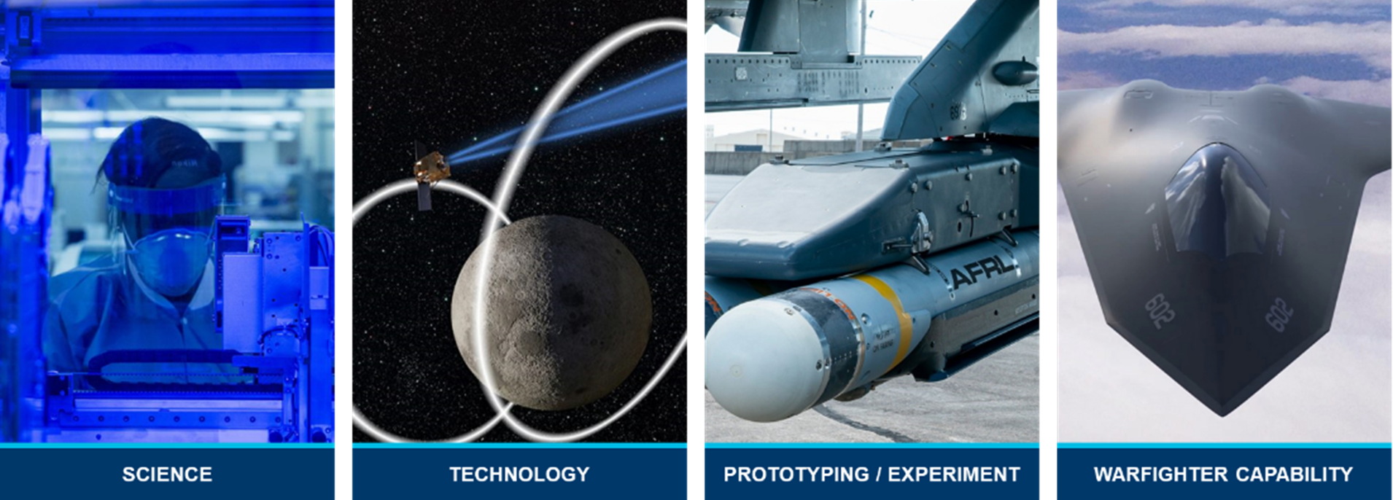



One AFRL, One Fight AFRL Reimagines Warfighter Capability for America’s Air, Space & Cyberspace Advantage
Notes:
The Air Force Research Laboratory, or AFRL, is the primary scientific research and technological center serving both the Air Force and Space Force. Harnessing the brain power of government, industry, academia and international partners, AFRL leads, discovers, develops and delivers warfighter capability for America’s air, space and cyberspace advantage integrating the collective scientific and technological efforts across domains and disciplines for the joint fight.

Slide 3
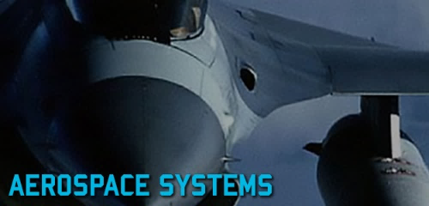
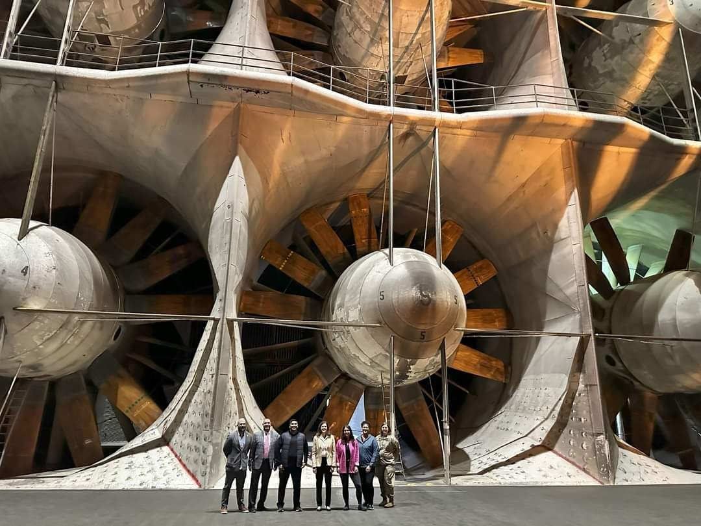


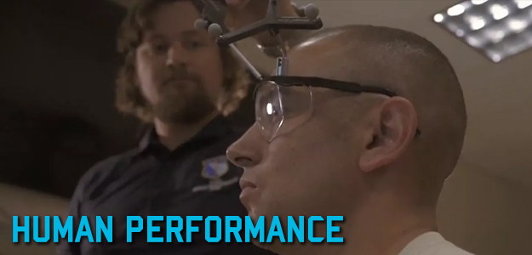

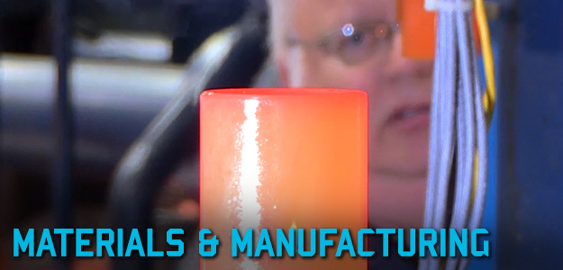
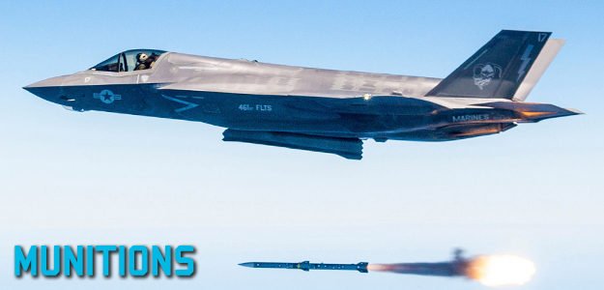
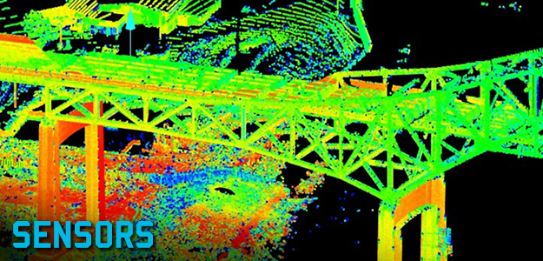
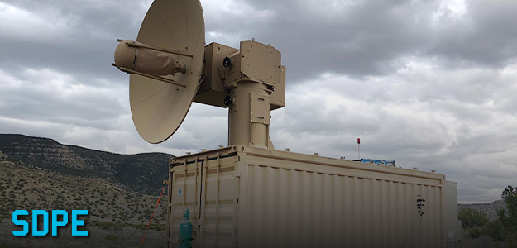

Air Force Research Laboratory (AFRL) Enterprise At-a-Glance
AEROSPACE SYSTEMS (RQ)
AFWERX (RG)
BASIC RESEARCH (AFOSR)
DIRECTED ENERGY (RD)
HUMAN PERFORMANCE (711th)
INFORMATION (RI)
MATERIALS & MANUFACTURING (RX)
MUNITIONS (RW)
SENSORS (RY)
INTEGRATED CAPABILITIES (RS)
SPACE VEHICLES (RV)
*Functional Directorates not pictured
Notes:
With a workforce of more than 12,500 personnel across multiple directorates and locations, AFRL manages a $7 billion portfolio of investments, supporting external customers and partners with industry while investing in basic research, applied research and advanced technology development. the latter of which focus on development and innovations separated from the functional directorates by technological capabilities.
AFRL Enterprise At-A-Glance​
The Air Force Research Laboratory is the primary scientific research and development center for the Department of the Air Force. Under our motto of “One AFRL – One Fight”, we are the go-to for science and technology organization serving the needs of the Air Force and Space Force.
AFRL’s vision is to defend America by unleashing the power of innovative air and space technology.​
To unleash this power, we pursue research across a wide range of scientific areas from basic science to technological transition. ​
AFRL is built for agility and uniquely positioned to take high levels of technical and relevant risk, providing interesting and challenging problems for researchers to solve in areas such as High-Speed Aerodynamics or Reentry Physics (Aerodynamics), Autonomy, Directed Energy, Biophysics, Quantum, Cyber, Space Situational Awareness and many more.
Anything you are working on, we are interested in.
As AFRL continues to support our Airmen and Guardians today with the best technological capabilities, we also plan for the future by strategically investing in science and technology efforts that fuel the discoveries that will meet future requirements of the Department of the Air Force.
As a world-class research and development center, we lead, discover, develop and deliver.
In supporting today’s research for tomorrow’s breakthroughs, the DoD has strong reputation for identifying and funding world-class researchers at the earliest stages of their careers.
This puts DoD in a uniquely advantageous position as a world leader in scientific discovery and in identifying new paths for investigation, because very often that first seedling research grant from the DoD serves as a springboard leading to additional opportunities within and outside of the DoD.
This early funding from the DoD often leads to very successful career trajectories for the next generation of scientists and engineers who dedicate their research to solving some of the most difficult scientific challenges that impact our everyday lives.

Slide 4
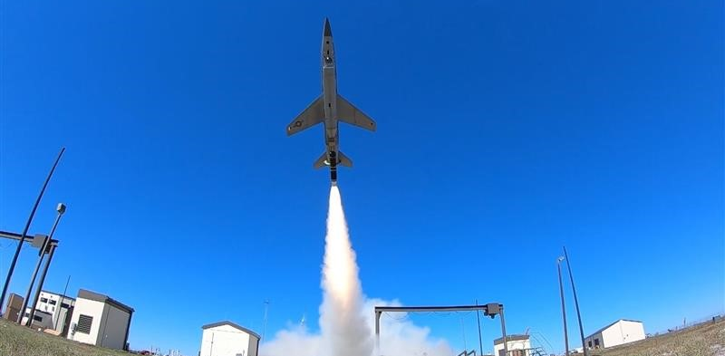
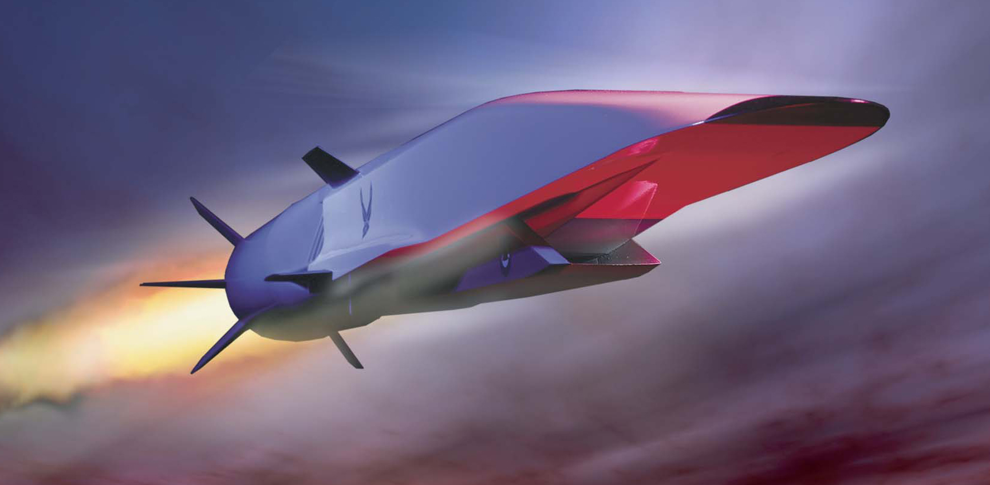

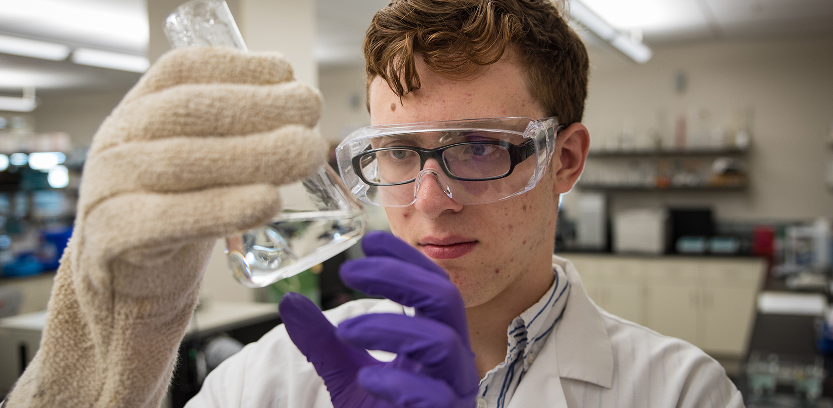
Balanced Near, Mid, Far-Term Investments
NEAR
MID
FAR
Ready to Go! 6.4+
Advanced Tech Development 6.3
Applied Research 6.2
Basic Research 6.1
OPERATIONAL DEVELOPMENT/ EXPERIMENTATION
Research, development, test and evaluation
Strategic development planning experimentation
Small business innovation research program
ADVANCED TECHNOLOGY DEVELOPMENT
Capabilities Concepts
The development and integration of hardware for field experiments and tests
APPLIED RESEARCH
Technologies
Appling knowledge or understanding to determine the means by which a recognized and specific need may be met
BASIC RESEARCH
Science Knowledge
Greater knowledge or understanding fundamental aspects
Observable facts
Without specific applications toward processes or products
Experimentation
From Application to Capability
Science to Application
New Science
~20%
~25%
~40%
~15%
Notes:
AFRL not only discovers, develops and delivers research divided by its scientific discipline, but also by its temporal investment and proximal value to the Department of the Air Force. These range from near, mid and far term discoveries, ranging from current operational test and experimentation to basic science knowledge breakthroughs. Regarded as the theoretical framework, 6.1 research serves as the foundation of all scientific and engineering breakthroughs, and its transition to applied research leads to the innovation of new, impactful, and useful discoveries. 6.2 and 6.3, often categorized with one another, represent applied research, and as opposed to 6.1, do intend on addressing a particular issue, or process because they are explanatory and analytical by nature. Finally, the translational 6.4 research operationalizes, mobilizes and strategizes applied research into programs and large-scale tests. All in all, AFRL oversees, manages and investigates all the technical directorates’ research, from the far “New Science” to mid- “Applications,” and finally to its “Immediate” development. It culminates, synthesizes and conducts the melodic tunes of scientific thought and curiosity into profoundly impactful, grandiose symphonies of scientific revolution and breakthroughs – a process that begins with the basic research managed by the Air Force Office of Scientific Research.

Slide 5
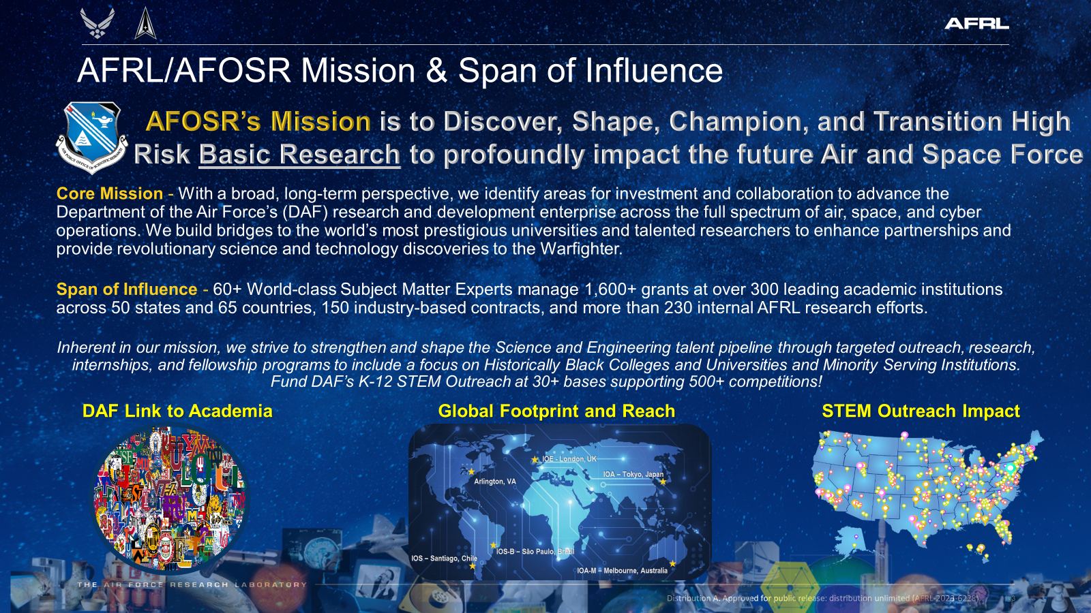
Distribution A. Approved for public release: distribution unlimited (AFRLAFRL-2024-3261) 17 June 2024.
Notes:
At AFOSR, we celebrate our 70+ year role in advancing the breadth and depths of basic research. Our mission is to discover, shape, champion and transition high risk basic research to profoundly impact the future Air and Space Force. Basic research is essential to the Department of the Air Force’s ability to carry out its mission serving as a source of new knowledge and understanding that supports Air and Space Force acquisitions and leads to superior technological capabilities for the military, as well as providing an integral part of the education and training of future scientists and engineers. Although AFOSR does not conduct its own research, our highly trained, experienced and technical scientists and engineers closely and constantly monitor, manage and respond to proposals of productive researchers in academia, global industries and government partners. Per year, we manage over 1600 grants and contracts of more than 380 academic institutions, over 70 contracts for commercial firms and more than 230 internal AFRL research efforts. Beyond our basic research investments, we also play a vital role in targeted STEM outreach, ensuring that ambitious, brilliant, young minds not only have the fair chance to partake in basic research, but are equipped with the capability to take over current research and develop into the next generation of innovative experts.
AFRL/AFOSR Mission & Span of Influence:
•Today’s global threats require multi-disciplinary solutions that function across multiple domains, and AFOSR is committed to keeping our joint warfighters ahead now and in the future.
•Basic research is essential to the Department of Defense’s ability to carry out its mission because it is a source of new knowledge and understanding that supports DoD acquisition and leads to superior technological capabilities for the military and is an integral part of the education and training of S&Es critical to meeting future needs of the nation’s defense workforce.
•AFOSR is the DAF’s leading entity that shapes, discovers, champions, and transitions high risk basic research to profoundly impact both the Air and Space Force.
•We execute the 6.1 investment for the DAF, as well as a portion of OSD’s 6.1 funds.
•Our world-class subject matter experts located in six (6) strategically placed offices across the globe maintain the pulse of worldwide basic research solutions to build future Defense technology, avoid technical surprise and build the future workforce.
•Basic research is the bedrock that enables applied research, as well as future technologies. Basic researchers investigate how the world works. Applied researchers then use the knowledge from basic researchers to make technologies. Some of these technologies can then be used by basic and applied researchers to discover new things, which are later used to develop new technologies. Applied research can also inspire basic research questions.
•Most basic research transitions require enduring investments that take place over many years, but ultimately, they mature and transition along various trajectories within AFRL and beyond.
•Our job is to discover the basic research that will protect the future Department of the Air Force and warfighter.
•We cover 37+ broad portfolio areas to ensure we are discovering basic research with potential for future capability. So we keep our portfolios as domain-agnostic as possible.
•Some portfolios indirectly contribute to other science areas and lead to discoveries in multiple areas which bring fresh, new ideas and information to unrelated areas of study.
•
•Our core mission is to identify and invest in emerging research areas of strategic importance and collaborate with academia, industry, and government partners to advance the DAF’s research and development enterprise across the full spectrum of air, space, and cyber operations to ensure future capabilities.
•We build bridges to the world’s most prestigious universities and talented researchers to support ground-breaking research, enhance partnerships, and provide revolutionary science and technology discoveries to the Warfighter.
•Historically, we manage approximately 1,600+ grants per year at over 300 leading academic institutions and have funded world-class researchers across all 50 states and 65 countries.

Slide 6



Who We Are
A small organization with a big mission …
to Discover, Shape, Champion and Transition High Risk Basic Research to profoundly impact the future Air and Space Force
Scientists & Engineers and Business Professionals
Active-duty Air & Space Force
All-service veterans
Renowned academics
Passionate civil servants
A global network of talent
We partner, grow and discover with a global network of the greatest scientific minds in the world, pulling them into our ecosystem, launching career trajectories, and strengthening their contributions to national defense.
We are the Basic Research Arm of the Department of the Air Force and AFRL
Notes:
AFOSR is a compact, diverse, inclusive and highly talented organization with a big mission.
Our mission, and ensuing impact, is driven by our dedicated workforce, made up of both scientists and engineers and business professionals, renowned for their expertise and accomplishments, and equipped with a practical mindset dedicated to the scouting and management of revolutionary basic research.
Likewise, our talented, passionate and instrumental scientists, engineers, and business professionals ensure the effective functioning and continuous expansion of AFOSR’s basic research programs.

Slide 7
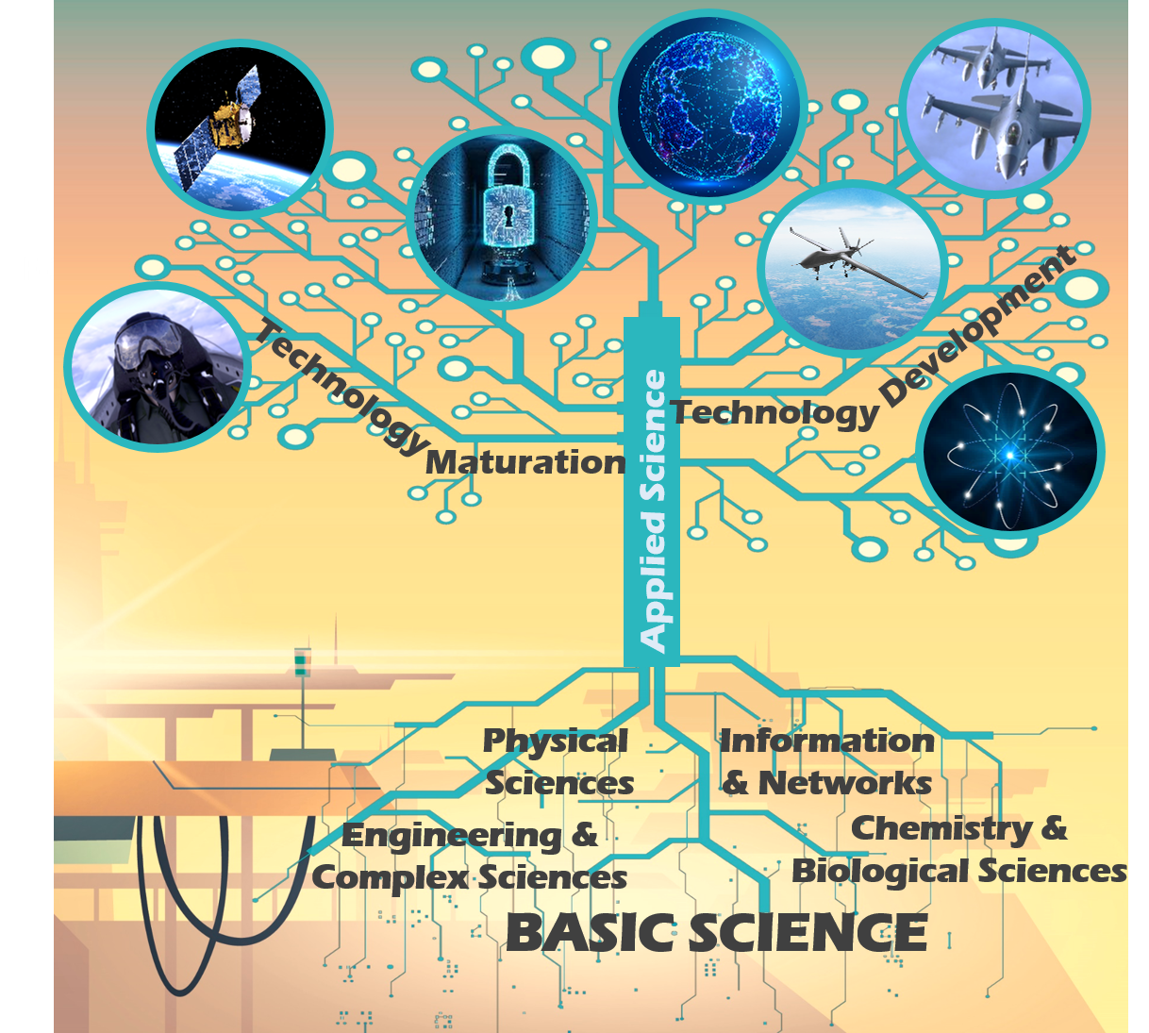
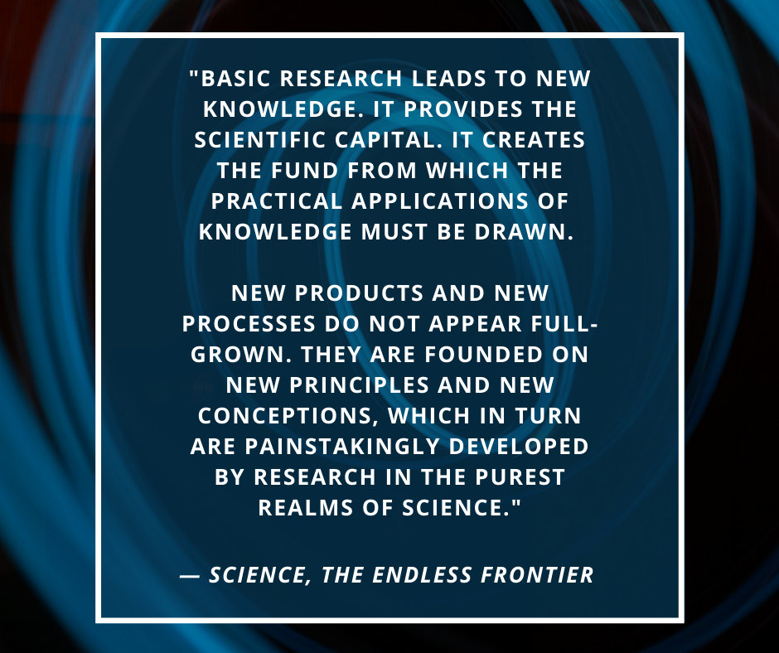
Why We Do What We Do
Our Job is to Discover the Basic Research that will Protect the Future Department of the Air Force!
Notes:
Basic research is the very foundation of all scientific and engineering progress. It leads to the innovation of new concepts and ideas, and by fostering, facilitating and nurturing seedlings of scientific curiosity and inquiry, we are able to harvest technical, pivotal and crucial scientific research. And, while some basic research may start off with one question in mind, sometimes it may veer off into new directions, producing dramatically different results and paving the way for new capabilities. Since 1951, AFOSR has provided transformational capabilities, setting and leading entirely new research directions and advancing science in important ways that have broad defense implications for our future Airmen and Guardians.

Slide 8
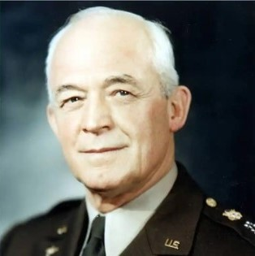
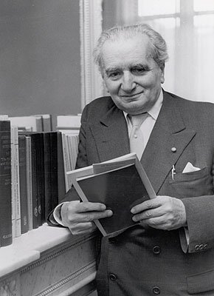
Historical Context for Basic Research
General Henry H. "Hap" Arnold (1886-1950)
Dr. Theodore von Kármán (1881-1963)
“The technical genius which could find answers was not cooped up in military or civilian bureaucracy but was to be found in universities and in the people at large.” ^{1.}
“The scientist describes what is; the engineer creates what never was.” ^{2.}
Henry H. Arnold, "The Wind and Beyond: Theodore von Karman, Pioneer in Aviation and Pathfinder in Science". Book by Theodore von Karman, p. 268, 1967.
Theodore von Kármán, Biographical Memoirs of Fellows of the Royal Society (1980), 26, 110.
Notes:
In his 1967 book, The Wind and Beyond, von Kármán remembered asking Arnold, “What do you wish me to do?”
“I want you to come to the Pentagon and gather a group of scientists who will work out a blueprint for air research for the next 20, 30, perhaps 50 years,” Arnold replied. Walter J. Boyne, the former director of the Smithsonian National Air and Space Museum, wrote in the January 2004 issue of Air Force Magazine,
“In all the history of aviation there has never been a more productive alliance than that of von Kármán and Gen. Henry H. “Hap” Arnold. The results of their efforts did much to bring the United States Air Force to its current state of unmatched capability and power. Von Kármán could interpret Arnold’s visions of the future, which were not always clearly stated. He gave Arnold new ideas and suggestions even as he established a strong liaison between military leaders, scientists, and academics. Arnold in turn gave von Kármán the resources, facilities, contracts, methodology, and approval on a vastly larger scale than would otherwise have been possible.”
In 1944 von Karman's career entered a new phase when General H. H. Arnold asked him to organize and chair a Scientific Advisory Group to study the use of science in warfare by the European nations and to interpret the significance of the new developments in rockets, guided missiles, and jet propulsion for the future of the U.S. Air Force.
The group was succeeded by the U.S. Air Force Scientific Advisory Board…in 1951, the same year as the creation of the Air Force Office of Scientific Research in Baltimore, MD…, of which von Karman was Chairman until 1954 and Chairman Emeritus until his death.
Basic Research is systematic study directed toward greater knowledge or understanding of the fundamental aspects of phenomena and of observable facts
Implications
Basic research investments impact far-term capabilities
Basic research can be published without restrictions
Free to invest internationally with very few restrictions
Quoting General Henry “Hap” Arnold, the Air Force has recognized the value of basic research, “The first essential of air power necessary for our national security is preeminence in research.”
By maintaining a robust basic research program today, the Air Force can continue to…
Probe today’s technology limits and ultimately lead to future technologies with DoD relevance
Attract the most creative minds to fields of critical DoD interest
Create a knowledgeable workforce in fields of critical DoD interest

Slide 9
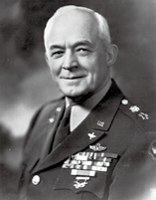
Why does the Department of the Air Force invest in Basic Research?
World Wars I and II made it obvious the perils of decades of neglect of aeronautical related R&D – U.S. pilots during World War I, for the most part, flew second-hand European aircraft during the war
“The first essential of air power is preeminence in research”
– Gen. Hap Arnold
General “Hap” Arnold, head of Air Forces
First Army Air Forces Scientific Advisory Group, 1944
“…clear beyond all doubt that scientific research is absolutely essential to National Security”
– Vannevar Bush, Director of Office for Scientific Research and Development, Science the Endless Frontier, 1945
Notes:
As I give this presentation, you may be wondering why the U.S. Air Force invests in basic research at all. I’ve asked myself the same question. The answer goes back to World Wars I and II. Those conflicts made it perilously clear the impact of decades of neglect of aeronautical related R&D. During World War I, U.S. pilots, for the most part, flew second-hand European planes – even though the first successful airplane was invented in the U.S by the Wright brothers. *Note the collaboration here between the U.S. and international partners. During World War II, the head of the Air Force, General Arnold (who also happened to have been taught to fly by the Wright brothers) recognized that “the first essential of air power is preeminence in research”. So in 1944, he convened the first group of top U.S. scientists and engineers to provide independent advice to the Air Force on Science and Technical matters. This Scientific Advisory Board continues to this day. --- Of course it wasn’t just the Air Force that understood the importance of science during the Wars. Dr. Vannevar Bush famously articulated the significance of science for National Security in Science the Endless Frontier, a report to President Roosevelt in July of 1945.

Slide 10
AFRL/AFOSR: Over 70 Years of Basic Research
In recognition of the significant role of basic research for the Air Force, the Air Force Office of Scientific Research (AFOSR) was created in October 1951
Original AFOSR location in downtown Baltimore, MD
The AFRL/AFOSR mission then still persists today – discover, shape, champion, and transition high risk basic research to profoundly impact the future Air Force and Space Force
Notes:
Shortly after the end of World War II, in October of 1951, AFOSR was created in recognition of the critical role of basic research for the Air Force. The original building was located in downtown Baltimore, Maryland, but it no longer stands. Today, AFOSR is situated in Arlington, Virginia. The original AFOSR building may not have lasted, but the AFOSR mission from 1951 still persists today, over70 years later – and that mission is to discover, shape, champion, and transition high risk basic research to profoundly impact the future Air Force and now the Space Force as well.

Slide 11



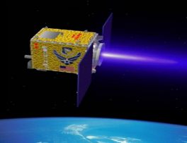
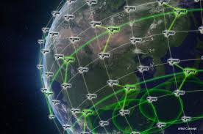
AFRL/AFOSR Basic Research Portfolio Areas
Engineering and Complex Systems
Information and Networks
Physical Sciences
Chemistry and Biological Sciences
Dynamic Materials and Interactions
Computational Cognition and Machine Intelligence
Materials with Extreme Properties
Biophysics
GHz-THz Electronics and Materials
Computational Mathematics
Atomic and Molecular Physics
Human Performance and Biosystems
Energy, Combustion, and Non-Equilibrium Thermodynamics
Dynamics and Control
Electromagnetics
Mechanics of Multifunctional Materials and Microsystems
Unsteady Aerodynamics and Turbulent Flows
Dynamic Data and Information Processing
Laser and Optical Physics
Molecular Dynamics and Theoretical Chemistry
High-Speed Aerodynamics
Information Assurance and Cybersecurity
Optoelectronics and Photonics
Natural Materials, Systems, and Extremophiles
Low Density Materials
Optimization and Discrete Mathematics
Plasma and Electro-Energetic Physics
Organic Materials Chemistry
Multiscale Structural Mechanics and Prognosis
Science of Information, Computation, Learning, and Fusion
Quantum Information Sciences
Space Biosciences
Space Propulsion and Power
Trust and Influence
Remote Sensing
International Office
Agile Science of Test and Evaluation (T&E)
Complex Networks
Space Physics
Asian Office of Aerospace R&D Tokyo
Cognitive and Computational Neurosciences
Ultrashort Pulse Laser-Matter Interactions
European Office of Aerospace R&D London
* Multiple AFOSR portfolios contribute to QIS
Condensed Matter Physics
Southern Office of Aerospace R&D Santiago
North America - Arlington
Notes:
AFOSR is always seeking to evolve and expand its vision and collaborations. Within AFOSR, the multidisciplinary aspect of Quantum Information Science is long recognized by the multiple portfolios that contribute to the field. These include not only the Quantum Information Science portfolio, but also Information Assurance and Cybersecurity, Materials with Extreme Properties, Atomic and Molecular Physics, and the others you see here highlighted in bold. In addition to the domestic portfolios, our International Offices across the globe partner with the broader international community to encourage the spirit of collaboration and curiosity, as well as solidify firm foreign engagements and connections.

Slide 12




















How We Accomplish Our Mission
Technology Transition
Basic Research Traditional Grants
Small Business Innovation Research (SBIR)/Small Business Technology Transfer (STTR) Program
Partnerships for Transition
All qualified, responsible organizational applicants from academia, the non-profit sector, and industry are eligible to submit research proposals.
Strengthening Academic Research Capabilities
Strengthening Air & Space Force Research Capabilities
Multidisciplinary University Research Initiative (MURI) Program
Defense University Research Instrumentation Program (DURIP)
Presidential Early Career Award for Scientists and Engineers (PECASE)
US Air Force Academy Program
Summer Faculty Fellowship Program (SFFP)/Science & Technology Fellowship Program (STFP)
Workforce Development
Expanding Air & Space Force Academic Reach
Young Investigator Program (YIP)
Historically Black Colleges & Universities/Minority Serving Institutions (HBCU/MSI) Program
AFRL Basic Research National Science Portals (NSPs)
Awards to Stimulate and Support Undergraduate Research Experiences (ASSURE)
National Defense Science and Engineering Graduate Fellowship Program (NDSEG)
Pre K-12 STEM
Diversified investment strategy for maximum discovery potential
Notes:
An AFRL/AFOSR basic research portfolio is a collection of diverse, high-quality basic research investments and communities orchestrated by AFRL/AFOSR program and international program officers (POs and IPOs) focused on Department of the Air Force interests.
Covering 36 different portfolio areas, AFRL/ AFOSR POs and IPOs are well positioned to build these portfolios because they are recognized experts and highly regarded in their respective fields, are critical for identifying and transitioning the most promising science for augmenting DAF capabilities and are advisers to policy makers at high levels shaping national policy! Their dedication and expertise helps shape the research agenda for the benefit of the Department of the Air Force.
We take “smart” risks in emerging areas of cutting-edge science.
AFRL/AFOSR funded research is mentioned regularly in research publications and subsequent news coverage.
Portfolios are reviewed and assessed continuously by the POs and IPOs, the Tech Advisors, and the Chief Scientist Office.
By spreading our investments across a wide range disciplines, diverse grantees, creative partnering arrangements, and varied institution types, we encourage interdisciplinary collaboration and strive for maximum discovery potential for the future Air and Space Force.

Slide 13









Achieving Local, National, and Global Partnerships
ACADEMIA
GOVERNMENT LABS
NON-TRADITIONAL ENTITIES
AFRL GLOBAL PARTNERSHIPS
SMALL BUSINESS
INDUSTRY
GOVERNMENT
INTERNATIONAL ALLIES
Notes:
Partnerships are vital to the advancement of basic research, and are evident in DoD contexts, academic links and other government offices. Through multidisciplinary, joint led, determined coalitions and partnerships can we enable next generation technology advancements. And, our success as an organization relies on an expansive network, which is well documented and periodically acknowledged in primary papers, and news coverage stories.

Slide 14
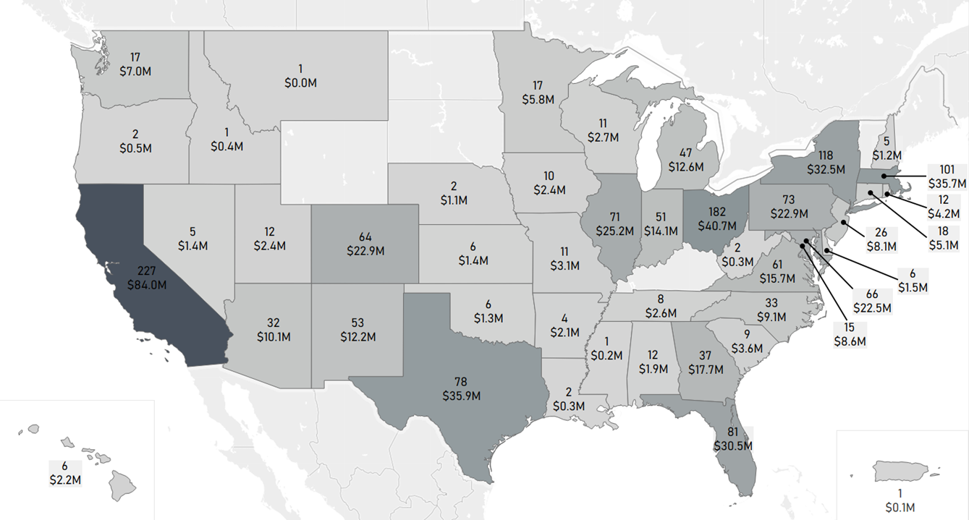
FY23 AFRL/AFOSR Domestic Investments in Basic Science
AFRL/AFOSR supported 1603 domestic investments in FY23 at 246 universities and small businesses across 45 states.
Note: This includes investments by both domestic and international program officers.
Notes:
Beyond the scientific acknowledgements that we have received, our success stories can also be seen in the profound impact of basic research studies and their ability to overcome technical areas. AFOSR’s investments and funding into domestic basic research programs have brought about significant implications, optimizations and enhancements for the Air and Space Force, such that during fiscal year 2023, our domestic mission supported over 1600 investments, across 246 universities and small businesses across 45 states. We serve as a collaborative international and domestic initiative, securing intangible scientific aspirations, curiosity and inquiry into meaningful, impactful and tangible scientific studies, all to maintain the Depart of the Air Force’s superiority and to lead the scientific community towards a transformative, revolutionary scientific future.

Slide 15
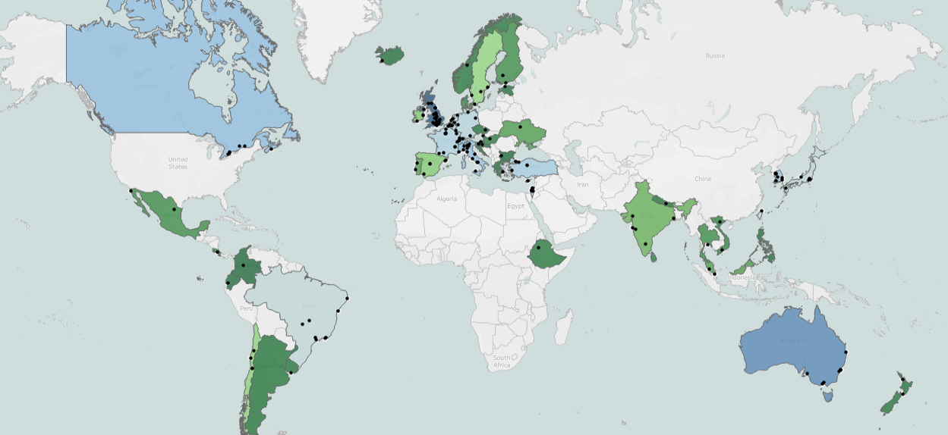


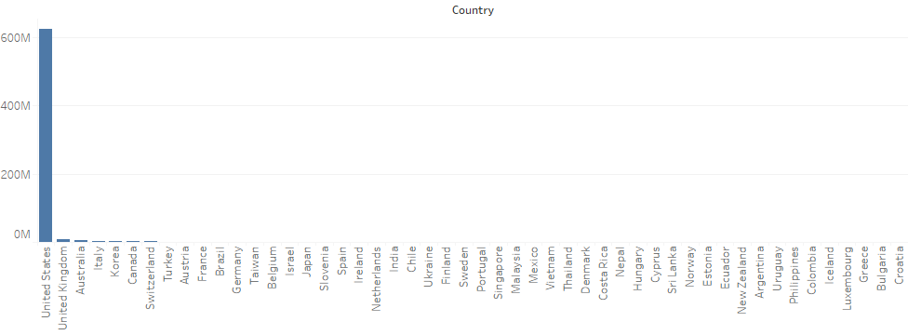

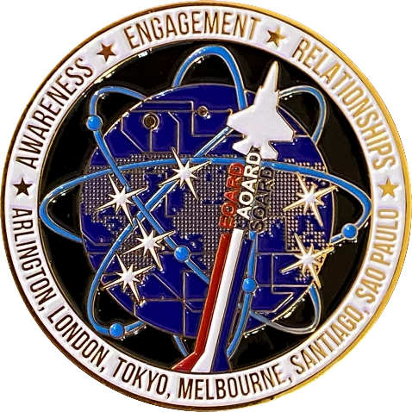
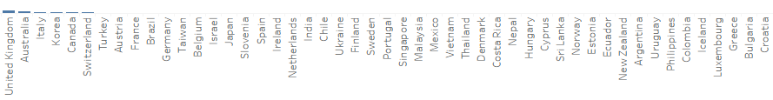

FY23 AFRL/AFOSR International Investments in Basic Science
AFRL/AFOSR supported over 460 investments in FY23 across 49 countries and 6 continents.
EOARD
London, UK
AFOSR
Arlington, VA
AOARD
Tokyo, Japan
FY23 Funding by Country
AFRL/AFOSR funds internationally, but Research Protection regulations focus on domestic actors
SOARD
São Paulo, Brazil
SOARD,
Santiago, Chile
AOARD
Melbourne, Australia
Notes:
Internationally, AFOSR has offices located in Sao Paulo, Santiago, London, Tokyo and Melbourne which are continuously monitoring the global fronts of basic research, supporting over 460 international investments across 49 countries and 6 continents in fiscal year 2023.

Slide 16
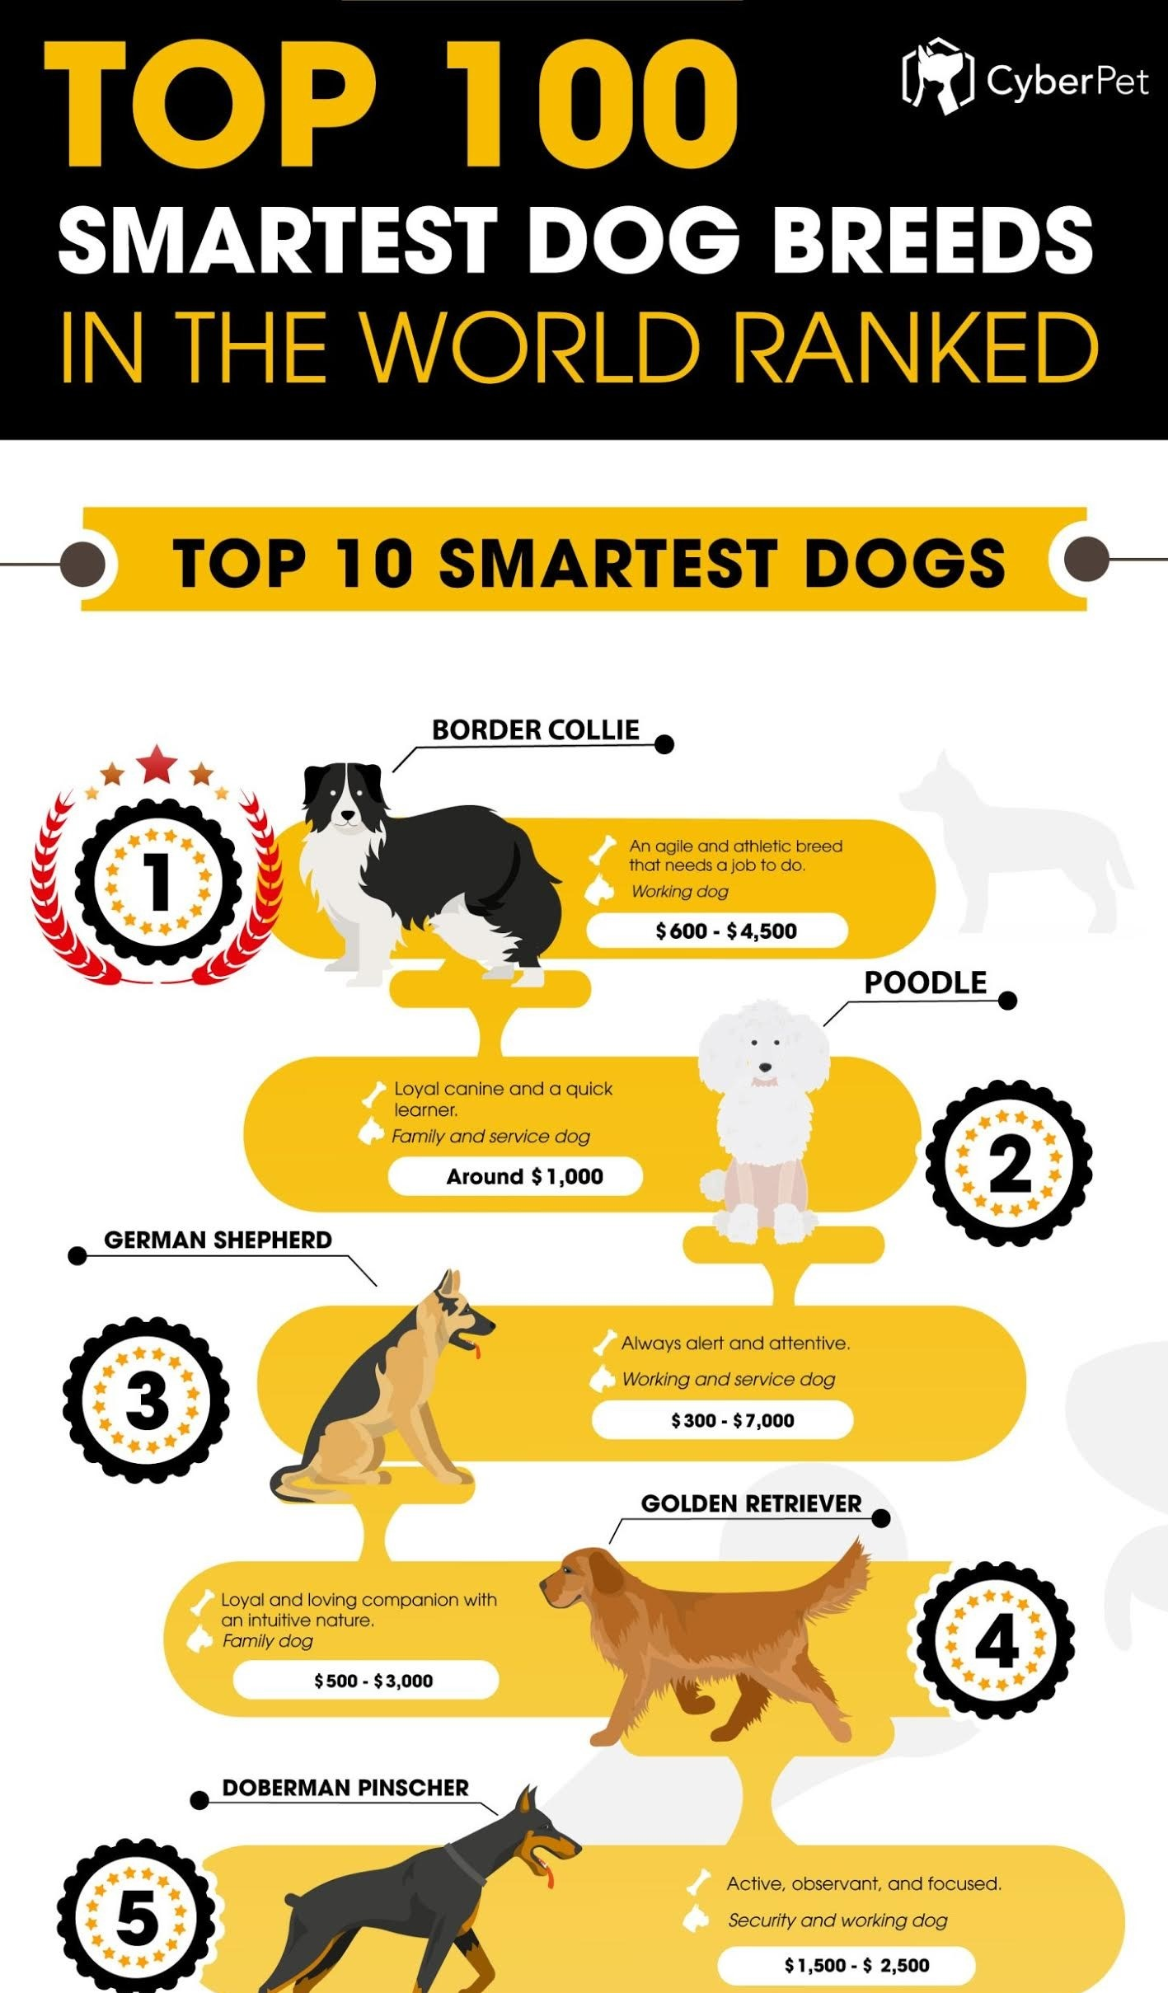

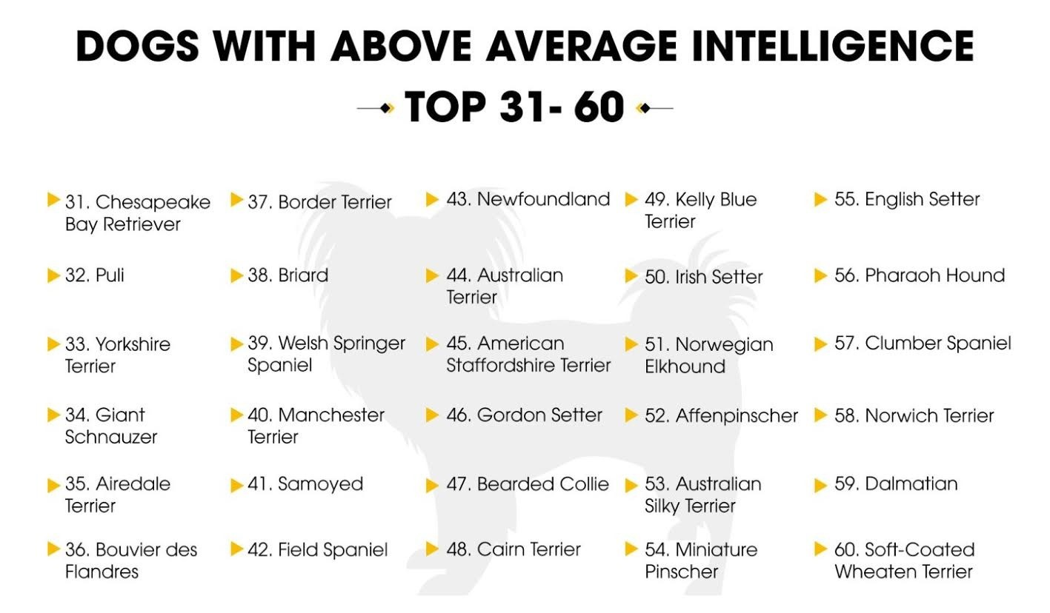
*
* Reference to this book does not imply Government endorsement of the book, its author, or content
https://www.cyberpet.com/wp-content/uploads/2020/04/Smartest-Dog-Breeds.jpg

Slide 17
Why does USAF/USSF/DoD care about Quantum Information Science?
Seen impact of atomic clocks in GPS for navigation
At the core, the promise and impacts of quantum science and technology are about the collection, generation, processing, and communication of information.
Three technology areas with critical value to DoD
Quantum Sensing (e.g., timing and positioning, magnetometry, gravimeters, etc.)
Quantum Computing (e.g., cryptography, signal processing, simulation, etc.)
Entanglement Distribution (e.g., teleportation, distributed computing, etc.)
Notes:
This leads us to the reason why we are here today -- Quantum Information Science. --- So why does the Department of Defense care about Quantum Information Science? One understandable motivation is that we have seen the usefulness quantum science, especially the role of atomic clocks in GPS for navigation.
A recent report by the Defense Science Board gives a nice description of several applications of quantum technologies that are of interest to the Department of Defense. “At the core, the promise and impacts of quantum science and technology are about the collection, generation, processing, and communication of information.” The report illustrates three technology areas with critical value, which are probably not surprising to you. These are Quantum Sensing for timing and positioning, magnetometry, and gravimeters; Quantum Computing for cryptography, signal processing, simulation, and others; and Entanglement Distribution for teleportation and distributed computing.

Slide 18
Nobel Prize Winning Research
Dr. Charles Townes, Columbia University
Microwave Amplification by Stimulated Emission of Radiation (MASER) (1953)
Basic Research leads to first MASER in 1954, supported by AFRL/AFOSR as part of Joint Services Electronics Program
Led to explosion of laser-related breakthroughs (many that were AFRL/AFOSR-supported), including atomic clocks integral to GPS satellite operations
1964 Nobel Prize in Physics, shared with Nicolay Basov and Aleksandr Prokhorov
Notes:
One of the easiest ways to demonstrate the influence of basic research is by looking at the history of Nobel Prize Winning Research. Since its establishment in 1951, AFOSR has sponsored 82 primary researchers who went on to become Nobel Laureates in Physics, Chemistry, Physiology/Medicine, and Economics. On average, these laureates received AFOSR funding 17 years prior to winning their Nobel awards.
One of the early Nobel Laureates supported by AFOSR that you’ve most likely heard of was Dr. Charles Townes. AFOSR sponsored in 1953, as part of the Joint Services Electronics Program, Dr. Townes and his colleagues for their basic research that soon led to the first MASER (or Microwave Amplification by Stimulated Emission of Radiation). As is well-known, the MASER precipitated the development of the LASER and an explosion of laser-related breakthroughs (many of which were also AFOSR-supported), including atomic clocks integral to the operation of every GPS satellite. Dr. Townes and his team’s work eventually led to a Nobel Prize in Physics about a decade later.

Slide 19
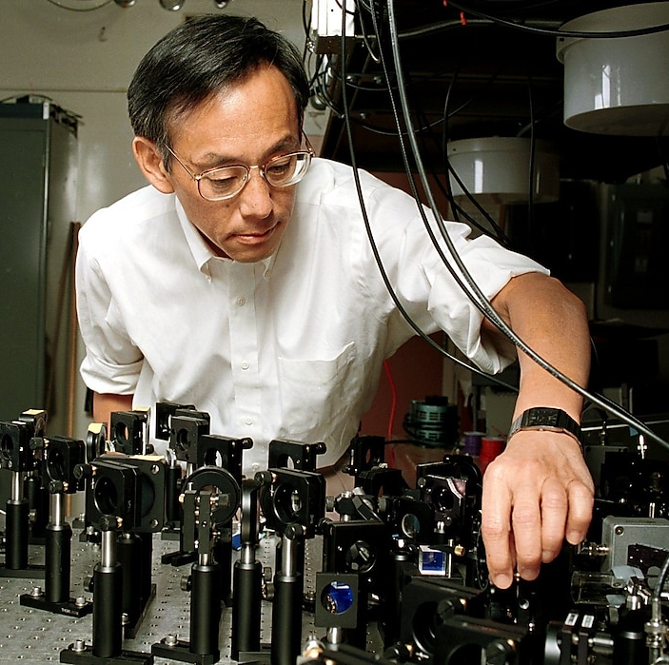
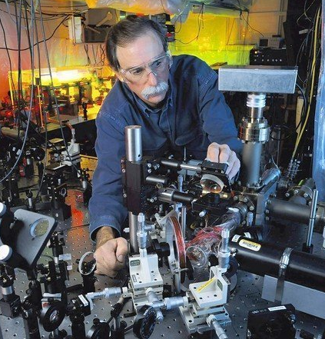
Nobel Prize Winning Research
Dr. Steven Chu, Stanford University
Laser Cooling (1988)
Research into cooling and trapping of atoms with laser light
Led to a 1000-fold increase in atomic clock accuracy
1997 Nobel Prize in Physics, shared with Claude Cohen-Tannoudji and William Philips
Dr. David Wineland, University of Colorado Boulder and NIST
Single Ion Manipulation (1982)
"for ground-breaking experimental methods that enable measuring and manipulation of individual quantum systems”
Demonstrated first quantum logic gate with two qubits
2012 Nobel Prize in Physics, shared with Serge Haroche
Notes:
With the advent of lasers came the development of exquisite control of quantum particles like atoms. In the late 70’s/early 80’s, AFOSR Program Officer Dr. Howie Schlossberg began following the work of Dr. Steven Chu at Bell Labs. Impressed by Dr. Chu’s talent, AFOSR began supporting Dr. Chu in 1988 – shortly after he joined Stanford University – for research into the laser cooling and trapping of atoms (building upon Dr. Townes’ maser work), which led to a 1000-fold increase in atomic clock accuracy. In 1997, Dr. Chu was awarded the Nobel Prize in Physics, shared with Drs. Cohen-Tannoudji and Philips.
Lasers are also used to manipulate the most fundamental block of quantum information – the quantum bit. Dr. Wineland, whom AFOSR began supporting in 1982, used lasers to demonstrate the first quantum logic gate with two quantum bits, and won the 2012 Nobel Prize in Physics for his “ground-breaking experimental methods that enable measuring and manipulation of individual quantum systems.”

Slide 20

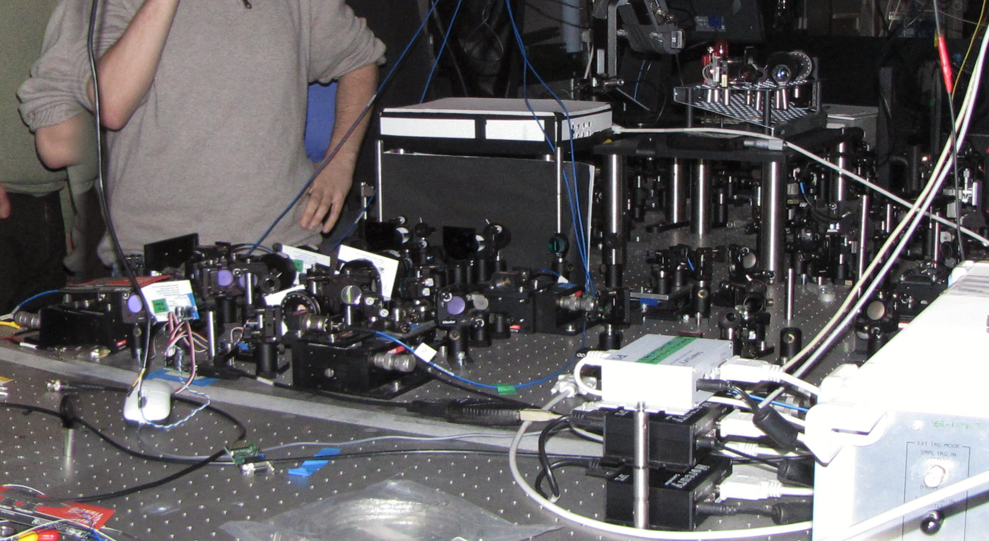
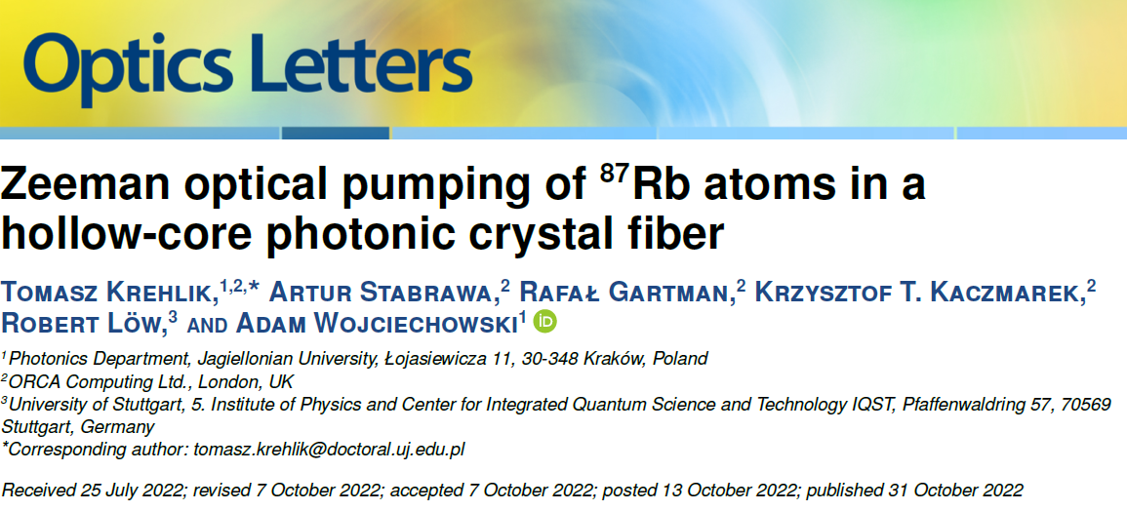
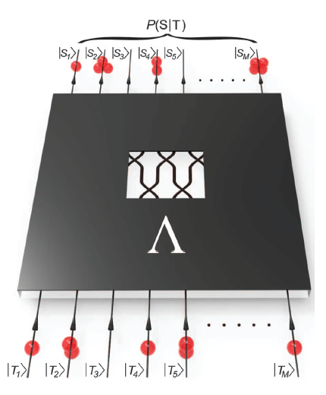

Quantum Photonics at Oxford & ORCA Computing as of 29 May 2024
Professor Ian Walmsley
Oxford University
AFOSR Grants 2009-12, 2012-15
ORCA Computing
Grant 2021-24
“Enhancing multiphoton rates with quantum memories,” Phys. Rev. Lett., 2013
ORCA Computing founded
28 Oct 2019, “ORCA” stems from the “Off-Resonance Cascaded Absorption”
memory
“ORCA Computing provides UK MoD with first quantum computer”, June 2022
2nd Oxford Grant
1 Sep 2012
152
7
ORCA Computing acquires Austin, Texas-based Integrated Photonics Division of GXC, Jan 2024
PAPERS
“Single-photon-level quantum memory at Room Temperature,” Phys. Rev. Lett, 2011
276
Fundamental Research
Fundamental Research
TRANSITION
Technology Advancement
1st Oxford Grant
1 Apr 2009
15
PAPERS
“Entangling Macroscopic Diamonds at Room Temperature,” (2011)
AFOSR Grant awarded Sept 2021 to ORCA Computing with goal to improve performance and robustness of quantum memories.
1st Contact
June 2008
940
CITATIONS
as of 2023
per Google Scholar
417
“Boson sampling on a photonic chip” (2013)
2008
2012
2016
2020
2024
“Changing the world one photon at a time”
Notes:
The science – Quantum enhanced applications are promising for improved communication, computation, timing and sensing. Photons as a physical realization hold promise for all these areas and these grants explore their development
First contact -Dr. Herb Carlson at AFOSR/EOARD attempts to establish UK MoD co-funding stream with Professor Walmsley’s group at Oxford with initial proposal dated 12 June 2008. While MoD partnering doesn’t come to fruition, AFOSR/EOARD funding from program manager LtCol Scott Dudley of Professor Walmsley begins on 1-Apr-2009. The grant’s overall goal is to demonstrate entanglement distribution and sensing of photons. This work is one possible physical realization to unlock the promise of quantum enhanced applications.
Output of first grant 2009-2012 - Among the 15 high quality papers resulting from this grant we highlight two here and an Air Force summer research student:
“Entangling macroscopic diamonds at room temperature” was published in 2011 in Science and reported on absorbed photons which created entangled phonons, i.e. lattice vibrations in two small but macroscopic millimeter-sized diamonds spatially separated on an optical table. The entanglement of these phonons involved on the order of 10^16 atoms in the diamonds (cited by 417 as of Apr 2023)
“Single-photon-level quantum memory at Room Temperature,” Phys. Rev. Lett, 2011 (cited by 276 as of Apr 2023)
Output of second grant 2012-2015 - Among the 7 high quality papers resulting from this grant we highlight the first experimental realization of boson sampling:
“Boson sampling on a photonic chip” was published in 2013 and was the first realization of Scott Aaronson and Alex Arkhipov’s proposal to extend the Hong-Ou-Mandel effect to a multi-photon system. A key researcher for this work was Major Justin Spring, a USAFA sponsored AFIT Dphil student with the same group and though not part of the grant, a very happy coincidence. Now LtCol Spring appears to be currently assigned to US Space Force. (cited by 940 as of Apr 2023)
“Enhancing multiphoton rates with quantum memories,” Phys. Rev. Lett., 2013 (cited by 152 as of Apr 2023).
Activity from 2015 to 2020 - To commercialize the same memories and develop quantum computing with them Orca Computing was co-founded on 28 October 2020 by Professor Walmsley, Dr. Joshua Nunn, Dr. Richard Murray, and Dr. Cristina Escoda. On 1 Sept 2018, Professor Walmsley moved to Imperial College taking on the position of Provost. Dr. Nunn is now a professor at the University of Bath.
Re-engaging in 2021 - with Dr. Nunn at University of Bath and with Orca Computing
Dr. Scott Dudley of AFOSR/EOARD awarded a grant with Orca Computing in September 2021 with ORCA Computing to create more robust, higher performance quantum memories, such as placing the gas in a hollow fiber. Despite ORCA Coputing being a start-up company, there is still fundamental research necessary to fully develop the quantum photonic memory as evidenced by the publication in Optics Letters, 2022, “Zeeman optical pumping of 87-Rb atoms in a hollow-core photonic crystal fiber.” The memory element for quantum photons remains a potential enabling component of photon sources which in turn are critical in most quantum enhanced applications. Coincidently, Orca Computing is located in the same building in London – Imperial College’s I-Hub Innovation Centre – where EOARD also has conference room space. Dr. Victoria Coleman, USAF Chief Scientist visited ORCA on 29 Sept 2021 and Ms. Barbara McQuiston, Deputy Under Secretary of Defense for Research and Engineering visited on 11 Oct 2021.
2024 – ORCA Computing acquires Texas-bask Integrated Photonics Division of GXC; deploys the PT-1 testbed to UK National Quantum Computing Centre; unveils Hybrid Algorithm Utilizing ORCA’s PT-1 Photonic Quantum Processor and NVIDIA CUDA Quantum

Slide 21
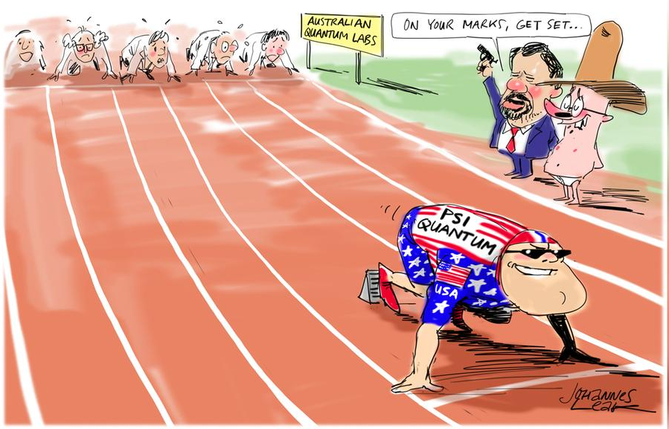
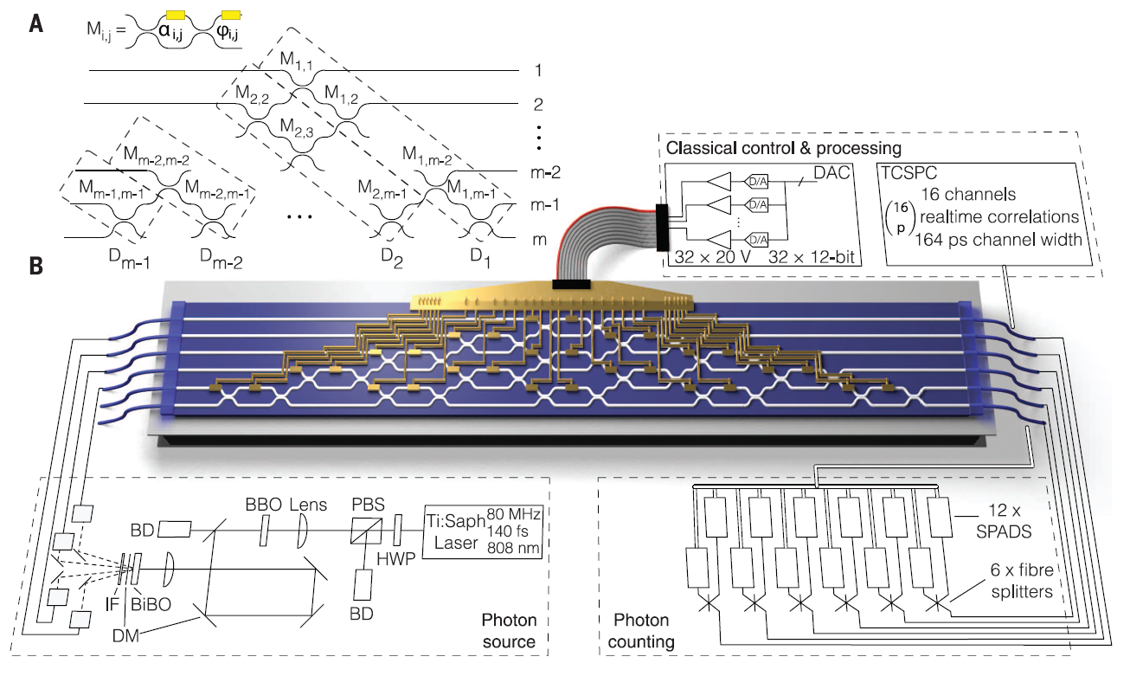
Quantum Photonics at University of Bristol as of 29 May 2024
Quantum Photonics Beyond Conventional Computing
- Professor Jeremy O’Brien
- Bristol University
- AFOSR grant, 2012-15
Quantum Computing Startup Raises $215 Million for Faster Device, Bloomberg, 6 April 2020
PsiQuantum Closes $450 Million Funding Round to Build the World’s First Commercially Viable Quantum Computer, Business Wire 27 July 2021
PSiQuantum, founded 28 Jun 2016 in Palo Alto, California by Bristol’s O’Brien & Mark Thompson and Imperial College’s Pete Shadbolt and Terry Rudolph
QUANTUM NEWS
Australia raises eyebrows by splashing A$1bn into US quantum-computing start-up PsiQuantum
Physics World 7 May 2024
Dec 2010
Interest in photonic quantum computing from Air Force and visits Bristol group
Fundamental Research
TRANSITION
Technology Advancement
AFRL/RI
NEW TECH
Grant 2012-15, “Quantum
photonics beyond
Conventional computing”
Paper of note 14 August 2015
Senator Schumer announces $25 million for GlobalFoundries and PsiQuantum to develop the next generation of quantum computers at Rome Air Force Research Lab & Malta, 7 April 2022
PsiQuantum will Partner with DARPA to Accelerate Path to Build the World’s First Utility-Scale Quantum Computer,
31 Jan 2023
7
PAPERS
EOARD
1128
Universal linear optics
“We programmed this system to implement heralded quantum logic and entangling gates, boson sampling with verification tests, and six-dimensional complex Hadamards,” said the University. “We implemented 100 Haar random unitaries with an average fidelity of 0.999 ± 0.001. Our system can implement any linear optical protocol.” Electronics Weekly, 10 Aug 2015
CITATIONS as of 2024
March 2011 Prof O’Brien visits AFRL/RI Rome, NY
Connections to US Air Force
O’Brien visits AFLR/RI, Rome AFB, March 2011
AFOSR director visits Bristol, Jun 2011
AFRL/RI researchers visit Bristol, Sep 2011
CY
2011
2012
2016
2020
2024
Notes:
The Science – Quantum computation is a difficult technological endeavor, but if achieved it holds promise to solve problems that a classical computer wouldn’t be able to in a reasonable time. This includes solving large systems of linear equations, which often are the workhorse of many problems including processing large data sets such as those generated by networks of sensors.
First contacts ~ intentional, chief scientist of Air Force Space Command, requested a visit to Professor Jeremy O’Brien’s at the University of Bristol, which is coordinated through EOARD and LtCol Scott Dudley on 14 December 2010. The research was a very high interest item for future computation ability to handle the deluge of data produced by sensors in space or terrestrially. This is followed by several more interaction with the group:
- in March 2011 EOARD sponsors a Windows on Science visit for Professor O’Brien to visit the AFRL/RI in Rome, NY
- in June 2011 Colonel Jack McCrae (EOARD Commander), Dr. Barrett Flake (EOARD Technical Director), Dr. Thomas Russell (AFOSR Director) and LtCol Scott Dudley visit Professor O’Brien’s group in Bristol
- in September 2011 AFRL/RI researchers Mike Fanto, Tim Genda, Corey Peters, and Paul Alsing visit Bristol coordinated by EOARD/Dudley.
EOARD Grant with Professor Jeremy O’Brien – 15 Mar 2012 – 15 Mar 2015 In March 2012 Professor O’Brien’s grant was awarded with a funding level of $100k/yr for 3 years. The grant produced 7 papers, with “Universal Linear Optics” appearing in Science, 14 August 2015. It’s abstract reads:
“Linear optics underpins fundamental tests of quantum mechanics and quantum technologies. We demonstrate a single reprogrammable optical circuit that is sufficient to implement all possible linear optical protocols up to the size of that circuit. Our six-mode universal system consists of a cascade of 15 Mach-Zehnder interferometers with 30 thermo-optic phase shifters integrated into a single photonic chip that is electrically and optically interfaced for arbitrary setting of all phase shifters, input of up to six photons, and their measurement with a 12-single-photon detector system. We programmed this system to implement heralded quantum logic and entangling gates, boson sampling with verification tests, and six-dimensional complex Hadamards. We implemented 100 Haar random unitaries with an average fidelity of 0.999 ± 0.001. Our system can be rapidly reprogrammed to implement these and any other linear optical protocol, pointing the way to applications across fundamental science and quantum technologies.”
Electronics Weekly reports on 10 August 2015, quoting Bristol University, “We programmed this system to implement heralded quantum logic and entangling gates, boson sampling with verification tests, and six-dimensional complex Hadamards,” said the University. “We implemented 100 Haar random unitaries with an average fidelity of 0.999 ± 0.001. Our system can implement any linear optical protocol.”
Activity from 2015 to 2020 Jeremy O’Brien joins with Mark Thompson, Terry Rudolph, and Pete Shadbolt to found PsiQuantum on 28 Jun 2016. This spin-off aims to commercialize quantum computation, with the Science paper a key steppingstone. The company is based in Palo Alto, California.
Military engagement with PsiQuantum
- Senator Schumer announces $25 million for GlobalFoundries and PsiQuantum to develop the next generation of quantum computers at Rome Air Force Research Lab & Malta, 7 April 2022, source: https://www.schumer.senate.gov/newsroom/press-releases/schumer-announces-25-million-for-globalfoundries-and-psiquantum-to-develop-the-next-generation-of-quantum-computers-at-rome-air-force-research-lab-and-malta-campus-fed-funding-will-strengthen-national-security-supercharge-us-technological-competitiveness_ensure-upstate-new-york-continues-to-lead-quantum-technology
PsiQuantum Will Partner with DARPA to Accelerate Path to Build the World’s First Utility-Scale Quantum Computer, 31 Jan 2023, source: https://psiquantum.com/news/psiquantum-will-partner-with-darpa-to-accelerate-path-to-build-the-worlds-first-utility-scale-quantum-computer
In 2023 the UK Government invested 9million GBP in a site at Daresbury (outside Liverpool). This isn’t shown on the slide
In 2024 the Australian government invests a substantial amount, A$1B, for a site at Brisbane which would be tasked to build the first optical fault tolerant quantum computer. Not all Australians celebrate the news as the political cartoon of Johannes Leak depicts an unfair “Head Start,” 6 May 2024.

Slide 22
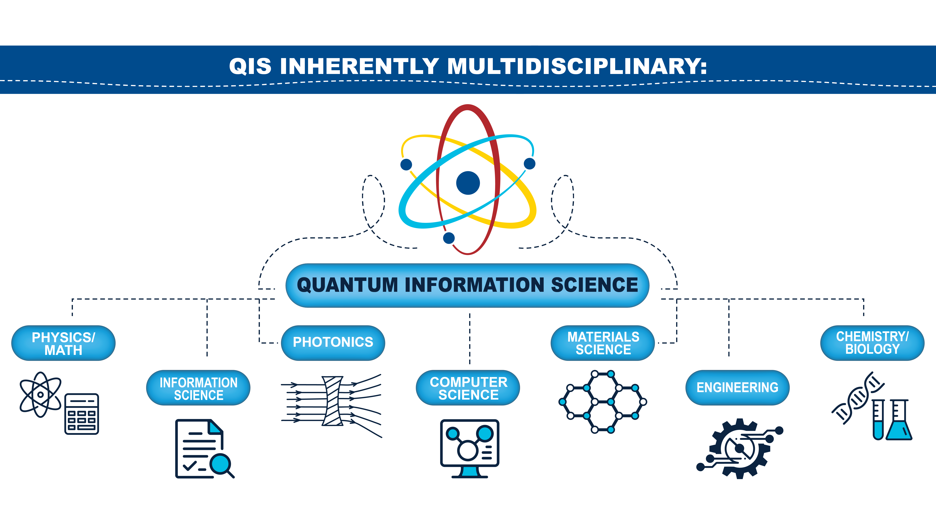
Notes:
One of the challenges, but also what makes Quantum Information Science so powerful is that it is inherently multidisciplinary. Quantum mechanics was originally the merging of exciting new physics concepts at the time with the elegant formalism of mathematics. Quantum mechanics or quantum physics merged with Information Science to gives us Quantum Information Science. But as the field progressed, it became clear that other disciplines play important roles, such as photonics, computer science, materials science, engineering, chemistry, and more. It’s therefore exciting to see how so many collaborative efforts bring together the expertise from many of these different communities.

Slide 23
QIS Multidisciplinary University Research Initiatives (MURIs)
1995 AFOSR Optical Switching
1996 ARO Photonic Band Engineering
1999 *ARO Manipulating Quantum Information
2001 *AFOSR Superconductor-based Quantum Computing
2003 ARO Photonic Quantum Information Systems
2004 *AFOSR Nanophotonics and Plasmon Optics for Networks, Sources and Sensors
2006 *AFOSR Silicon-based Lasers and Nanophotonics
2007 AFOSR Quantum Simulations of Condensed Matter Systems using Ultra-Cold Atomic Gases
2009 ARO Integrated Quantum Circuits
AFOSR Complex Nonperiodic Nanophotonics
2010 AFOSR Superconducting Semiconductors
2011 *AFOSR Quantum Memories and Light-Matter Interfaces
AFOSR Integrated Hybrid Nanophotonics
2012 AFOSR Quantum Metaphotonics and Metamaterials
2013 ONR Free Space Optical Quantum Key Distribution
ARO Non-Equilibrium Many-Body Dynamics
AFOSR New Quantum Phases of Matter
AFOSR Optimal Measurements for Scalable Quantum Technologies
Quantum Computing and Networking
2014 *AFOSR/ARO/LPS, Quantum Transduction
AFOSR Control of Light Propagation through Metasurfaces
2015 ARO New Regimes in Quantum Optics
AFOSR Semantics and Structures for Higher-level Quantum Programming Languages
Colored by area: Quantum Computing (black), Networking (orange), Timing (green) and Sensing (blue).
Year denotes start date of program with a typical 5 year duration per program. An asterisk denotes multiple awards for the topic.
2016 ARO/AFOSR Modular Quantum Systems
AFOSR Quantum Many-Body Physics with Photons
*AFOSR Attojoule Nanooptoelectronics
2017 AFOSR Foundations of Interactive Protocols for Quantum Computation and Communications
ARO Anyons in 2D materials and cold Atomic gases
2018 ARO Integrated Quantum Sensing and Control for High Fidelity Qubit Operations
2019 AFOSR Dissipation Engineering in Open Quantum Systems
AFOSR Quantum Holography
2020 ARO Mathematical Intelligence: Machines with More Fundamental Capabilities
AFOSR Weyl Fermion Optoelectronics
2021 ARO Quantum Network Science
AFOSR Quantum Random Access Memory
AFOSR Non-Hermitian Programmable Materials at Exceptional Points
AFOSR/ARO Interfacial Engineering of Superconductors
1990
1995
2000
2005
2010
2015
2020
2025
2021 ONR Molecular Qubits for Synthetic Electronics
2020 ARO Quantum State Engineering for Enhanced Metrology
*AFOSR Full Quantum State Control at Single Molecule Levels
2019 ARO Reactive and non-Reactive Scattering from Targeted Molecular Quantum States
2018 ARO Novel solid- state materials and color centers for quantum science and engineering
2015: ARO Exploiting Nitrogen Vacancy Diamonds for Manipulation of Biological Transduction
ONR Quantum Optomechanics
2014 ARO, Ultracold Molecular Ion Reactions
2012 ARO Quantized Chemical Reactions of Ultracold Molecules
Quantum Timing and Sensing
2011 ARO Qubit Enabled Imaging, Sensing & Metrology
ARO Quantum Stochastics and Control
2010 ARO Atomtronics
2009 *AFOSR Ultracold Molecules
2006 ONR Detection and Sensing Below the Shot Noise
2005 ARO Quantum Imaging
ONR Magnetic Detection Science and Technology
2002 *ONR Optical Clocks
1992 ARO Coherent Control of Wavefunctions
2000 *ARO Atom Optics
Notes:
Another example of the multidisciplinary aspect of Quantum Information Science can be seen here in the progression of Quantum Information Science over several decades through the OSD MURI program. The intent of the MURI program is to bring together ideas (not from multiple universities) but from multiple disciplines to solve problems that cannot be solved otherwise. This dense chart is not meant for you to strain your eyes and read, but see in a snap shot how the MURI efforts have grown and evolved over the years in the different categories of quantum computing (in black), quantum networking (in orange), timing (in green) and quantum sensing (in blue). In the next chart I will pull out some examples.

Slide 24

Sustained Long-Term Research and Development
Continuous support of creative ideas
Engage with academic community to shape focused efforts
Continuously evolve and spawn new areas
Partner for larger impact
Quantum Simulation
DARPA ONISQ
ARO MURI: Non-Equilibrium Many-Body Dynamics
*AFOSR MURI: New Quantum Phases of Matter
AFOSR MURI: Quantum Simulations
DARPA OLE
Optomechanics for Sensing and Transduction
LPS CQTS
*AFOSR/ARO/LPS MURIs: Quantum Transduction
DARPA QuASAR
DARPA ORCHID
ONR MURI: Quantum Optomechanics
2010
2020
Notes:
So what can be learned by examining the MURI programs in Quantum Information Science? Firstly, you can see from the span of several decades that it takes long-term, sustained research and development to advance the field. I will give two examples, the first one being quantum simulation. There were other important research efforts leading up to this, but in the early 2000’s, a seminal experiment was performed that demonstrated how an ensemble of cold atoms trapped in an optical lattice could be used to simulate strongly correlated materials. Soon after, AFOSR, ARO and DARPA got together, engaged with the research community, and began developing coordinated programs in quantum simulation. The result was the joint launch of the Fiscal Year 2007 AFOSR MURI on “Quantum Simulations of Condensed Matter Systems using Ultra-cold Atomic Gases” and the DARPA Optical Lattice Emulator (or OLE) program. Near the end of those programs, lessons learned helped to formulate the next stage of programs, namely two Fiscal Year 2013 MURIs: the Army Research Office (or ARO) MURI on “Non-Equilibrium Many-Body Dynamics” and the AFOSR MURI on “New Quantum Phases of Matter” to explore what other novel phenomena could be simulated with exquisitely controlled cold atom systems. Several successful advancements made during the MURI and DARPA OLE programs are now leveraged in other programs, including the current DARPA program on Optimization with NISQ devices.
The second example I will discuss is in the area of optomechanics for sensing and transduction. While there were several smaller efforts over the years, the first large program on optomechanics was launched by DARPA around 2010 on “Optical Radiation Cooling and Heating in Integrated Devices” or ORCHID. This was primarily focused on cavity-optomechanics for non-cryogenic sensing at the standard quantum limit. A year later, DARPA launched the “Quantum-Assisted Sensing and Readout” or QuASAR program to develop atom or atom-like sensors, including hybrid and entangled quantum sensors that operate near or below the standard quantum limit. As the quantum transduction efforts were coming to an end in the DARPA QuASAR program, AFOSR, ARO, and the Laboratory for Physical Sciences or LPS, worked together to develop a multi-team MURI program to expand the development of controllable optomechnical devices towards new quantum transduction mechanisms between disparate quantum systems. Soon after, ONR launched a MURI on Quantum Optomechanics to further exploit the intrinsically quantum behavior of nanomechanical systems, including for new or improved quantum logic operations and precision measurements relevant to sensing. As the MURI on Quantum Transduction was coming to a close, LPS and ARO engaged with the research community and other agencies to create the Cross Quantum Technology Systems program, which continues to push the frontiers of quantum state transfer from microwave to optical wavelengths.
I am delighted to see continued support in these areas of science. I hope my examples here demonstrated the importance of exchanging ideas and working together between different agencies, and between different researchers, for larger, more impactful efforts. I hope my illustrations also show how new creative ideas, often supported by smaller core programs like single investigator awards, can seed larger programs that continuously evolve, sometimes nonlinearly into new and unexpected areas. Additionally, close engagement with the academic community and industry plays a significant role for funding agencies in shaping focused and valuable programs.

Slide 25
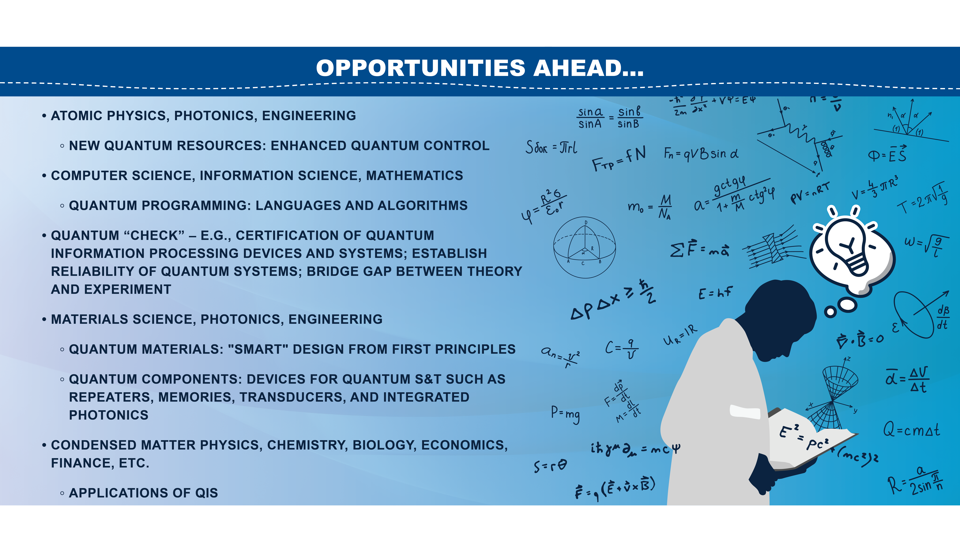
Notes:
Personally, I see many exciting opportunities ahead through collaborative efforts between different communities. This includes exploring new quantum resources and enhanced quantum control; developing quantum programming languages and novel quantum algorithms; bridging the gap between theory and experiment; the “smart” design of quantum materials; development of quantum components with unique requirements for Quantum Information Science and Technology; and the discovery of new useful applications for Quantum Information Science and Technology.

Slide 26
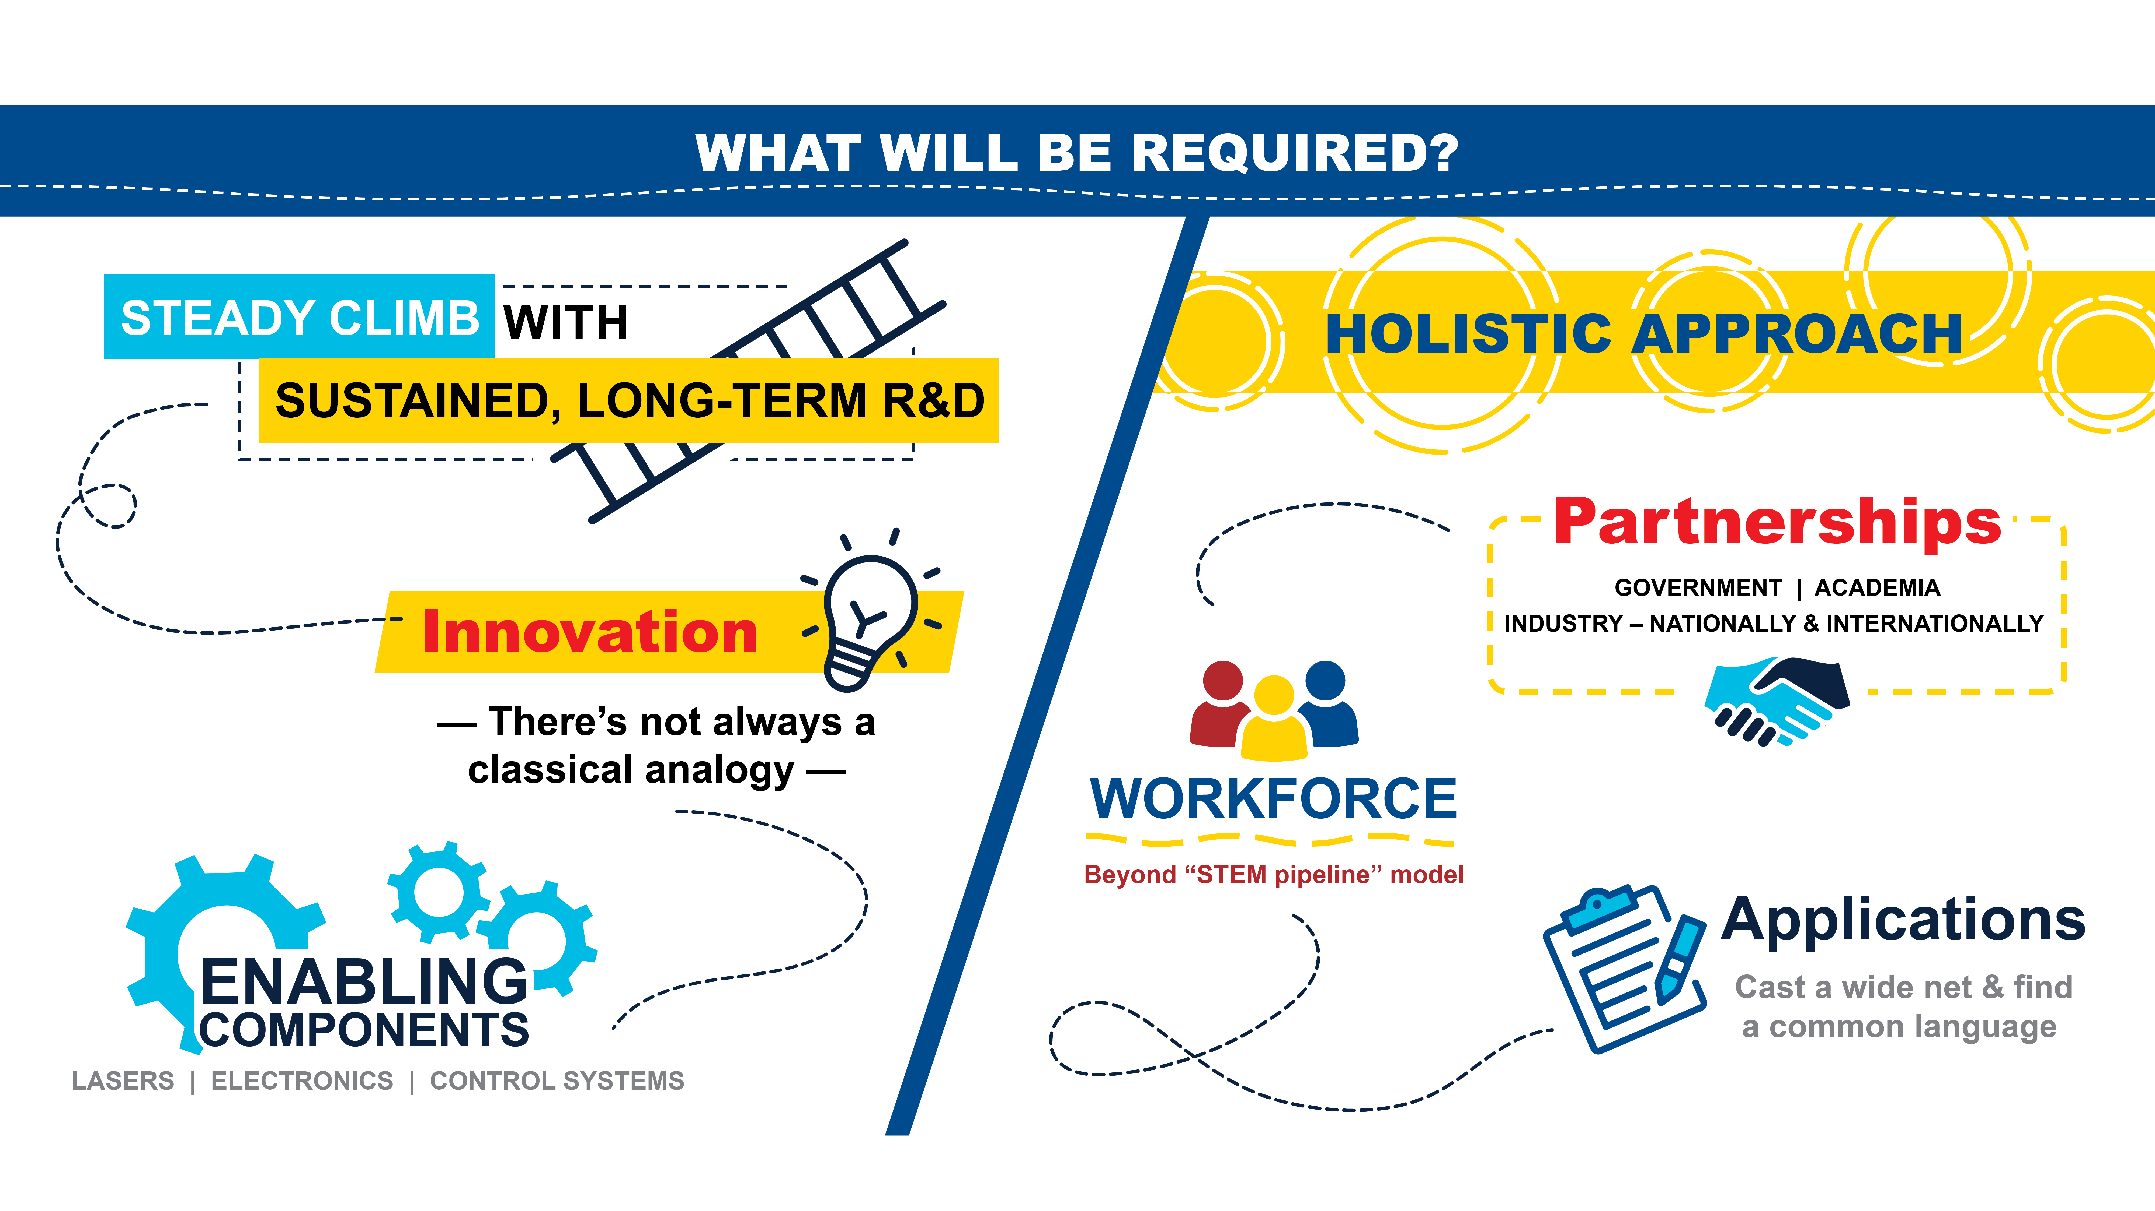
Notes:
So what will be required to get us from the basic research of ingenious ideas to practical applications? While we can hope, it is unlikely it will be a simple leap across this valley. It is more likely a long steady climb requiring sustained, long-term R&D. One cannot predict when innovation will occur. And for Quantum Information Science and Technology, there’s not always an intuitive classical analogy.
The path also requires a holistic approach. If you look closely, successful climbers are often not alone. Partnerships between government, academia, and industry are critical, both nationally and internationally.
Developing the workforce is also of utmost importance. Here, I would encourage the community to think beyond the standard “STEM pipeline” model.
In regards to applications, this will require casting a wide net as mentioned before, as well as developing a common language to translate some of the more complex and non-intuitive ideas of quantum physics.

Slide 27
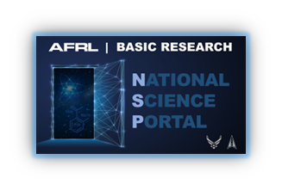
FY24 AFRL Basic Research National Science Portal (NSP)
The Department of the Air Force (DAF) faces unprecedented scientific and technological challenges that require better leveraging of the nation's defense ecosystem to develop innovative solutions. The National Science Portal provides the strategic opportunity to:
Accelerate science and engineering areas critical to the future DAF.
Build defense research capacity in Historically Black Colleges and Universities (HBCU) and Minority Serving Institutions (MSI).
This funding opportunity announcement (FOA) aims to diversify the research landscape and support scientific breakthroughs that enhance the technological supremacy of the Air Force and Space Force.
FOA posted on Grants.gov (FOAAFRLAFOSR20240008 or search “National Science Portal”)
Proposals due – 26 July, Notifications of award – 3 September
Technical Topic 1: Leveraging Quantum Computing to Explore Computational Challenges
AFOSR Program Officers
Dr. Gregg Abate, Unsteady Aerodynamics and Turbulent Flows
Dr. Fariba Fahroo, Computational Mathematics
Dr. Bennett Ibey, Natural Materials and Systems
Dr. Arje Nachman, Electromagnetics
Dr. Andrew Stickrath, Ultrashort Pulse Laser-Matter Interactions
Dr. Jennifer Talley, Space Biosciences
support: Dr. Grace Metcalfe, Quantum Information Science
Notes:
A specific opportunity to illustrate this is the National Science Portal.

Slide 28
NSP Topic: Leveraging Quantum Computing to Explore Computational Challenges
Objective: This topic seeks to explore the viability of novel quantum algorithms relevant for the DoD and DAF and build QIS research capabilities in technical disciplines outside the usual framework of QIS. Technical sub-areas of interest include
plasma and turbulent flow problems, wall-bounded turbulent flows, fluid-structure interaction, and/or turbulent combustion;
biomolecular-based material design (e.g., protein, DNA, and RNA);
innovative computational approaches to improving upon or bypassing Density Functional Theory (DFT) (e.g., determination of accurate exchange-correlation functionals from electron density for input into DFT calculations, non-adiabatic quantum mechanics, etc.);
biochemical processes design (e.g., catalyst efficiency or selectivity);
and novel neural network representations (e.g., non-binary output units).
Proposers do not have to address multiple topic sub-areas within a submission.
Drs. Gregg Abate & Fariba Fahroo
Dr. Bennett Ibey
Drs. Arje Nachman & Andrew Stickrath
Dr. Jennifer Talley

Slide 29
NSP Topic: Leveraging Quantum Computing to Explore Computational Challenges
Research Concentration Areas: Suggested research areas include, but are not limited to:
Appropriate translation of classical computational challenges into algorithms that can be processed by quantum computers with a computational speedup. Both purely quantum and hybrid quantum-classical algorithms are of interest.
Assessment of the trade-off between the computational cost and the speed and accuracy of the quantum or hybrid algorithm relative to state-of-the art classical computational approaches
No-go theorems or proofs of computational gains of quantum computers for the proposed computational challenge.
Projects should be supported by but not led by QIS experts.
While proposed efforts can include employing quantum cloud computers, proposed budgets should not include access to quantum cloud computing costs. Purely theoretical proposals are acceptable.

Slide 30
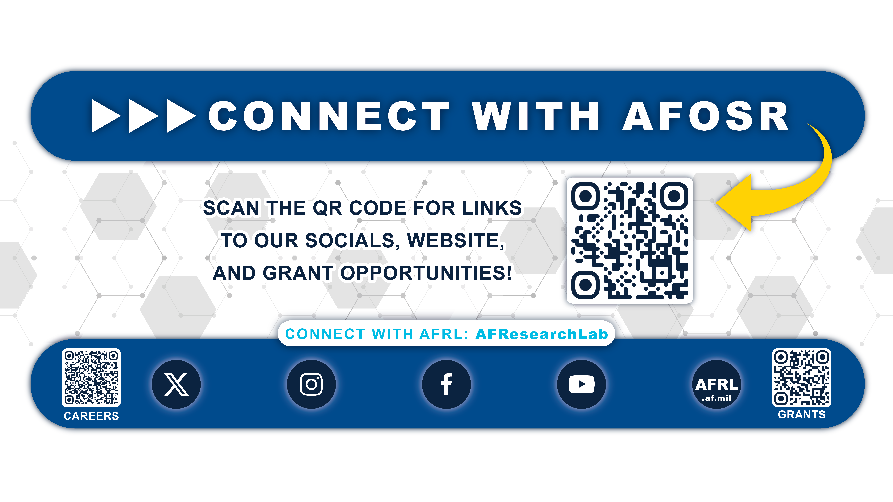
Notes:
So what will be required to get us from the basic research of ingenious ideas to practical applications? While we can hope, it is unlikely it will be a simple leap across this valley. It is more likely a long steady climb requiring sustained, long-term R&D. One cannot predict when innovation will occur. And for Quantum Information Science and Technology, there’s not always an intuitive classical analogy.
The path also requires a holistic approach. If you look closely, successful climbers are often not alone. Partnerships between government, academia, and industry are critical, both nationally and internationally.
Developing the workforce is also of utmost importance. Here, I would encourage the community to think beyond the standard “STEM pipeline” model.
In regards to applications, this will require casting a wide net as mentioned before, as well as developing a common language to translate some of the more complex and non-intuitive ideas of quantum physics.

Slide 31

Questions?

Slide 32
Back-Up Slides

Slide 33




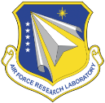
















































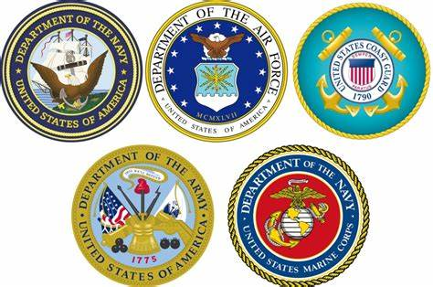


















































































































































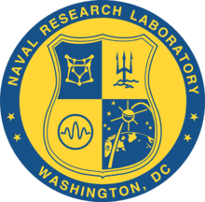
















































































Strategic Partnerships are Vital to Basic Research Success
It is the teaming of diverse areas of science that enables the next generation of technology advancements.
Department of Defense
Academia
Other Gov’t Offices
Notes:
We want your talent and need you to be part of our science and technology ecosystem.

Slide 34
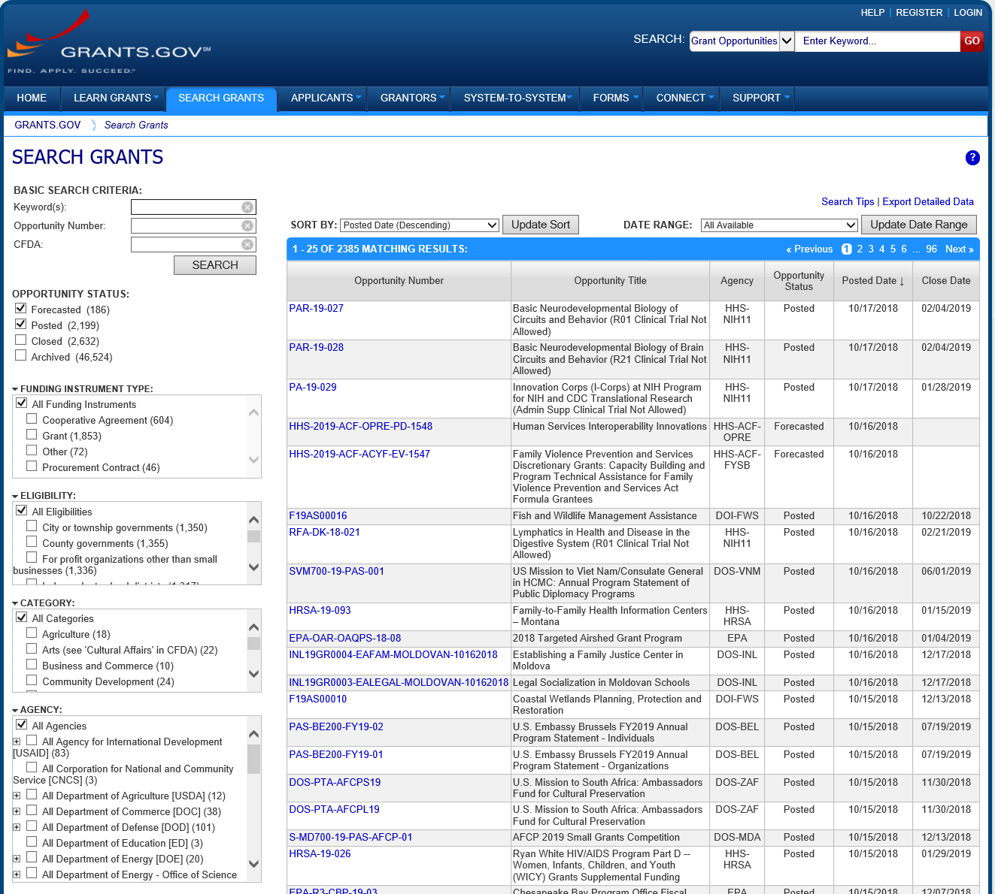
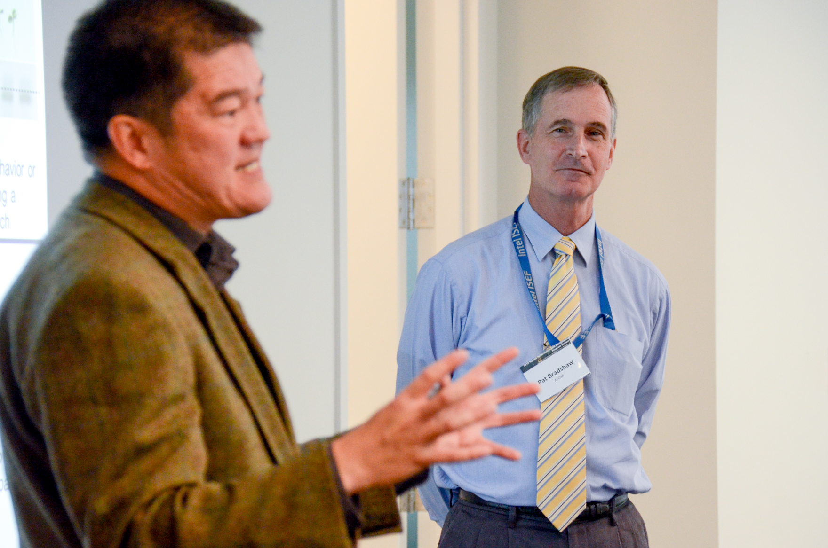
How to Work with Us Review Broad Agency Announcements
Researchers should visit www.grants.gov – the official source for finding and applying to Federal grants
Find opportunities that match interests. Search by:
Keyword
Eligibility
Category
Agency etc.
Study and keep current with BAAs
Attend program reviews to understand the directions and needs of program
Notes:
Figure out what you want to study and develop a research plan
Review BAAs from all organizations
Find your niche…scope idea
Draft an idea statement
Connect with a Program Officer from BAA to discuss
Discuss when and where to submit a full proposal.
Submit a full proposal on Grants.gov
Get funded or re-scope and try again next year

Slide 35

How to Work with Us Scope and Draft Idea Statement
Statement doesn’t have to be all-inclusive, but should address the unique value proposition of the research
Statement needs to be specific enough that it catches the interest of the Program Officer
Notes:
Figure out what you want to study and develop a research plan
Review BAAs from all organizations
Find your niche…scope idea
Draft an idea statement
Connect with a Program Officer from BAA to discuss
Discuss when and where to submit a full proposal.
Submit a full proposal on Grants.gov
Get funded or re-scope and try again next year

Slide 36
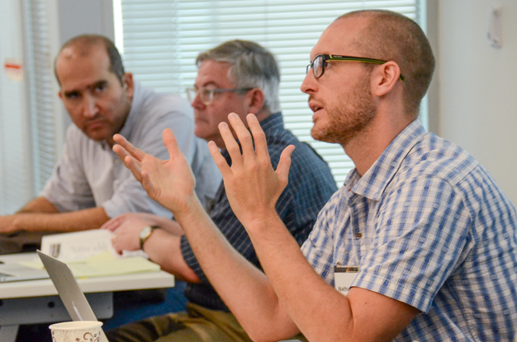
How to Work with Us Connect with a Program Officer
At this point, some Program Officers will want a specifically formatted white paper
Others will want to have a conversation
In person
Over the phone
Via email
If the idea seems promising, a Program Officer will initiate an ongoing dialogue setting expectations and explaining the process for full proposal submission.
Notes:
Figure out what you want to study and develop a research plan
Review BAAs from all organizations
Find your niche…scope idea
Draft an idea statement
Connect with a Program Officer from BAA to discuss
Discuss when and where to submit a full proposal.
Submit a full proposal on Grants.gov
Get funded or re-scope and try again next year

Slide 37
How to Work with Us Determine the Correct Funding Mechanism
There are many different mechanisms for universities to obtain basic research grant funding:
Traditional grants
University Research Initiatives (i.e. Multidisciplinary University Research Initiative (MURI), Defense University Research Instrumentation Program (DURIP)
Special Programs (i.e. HBCU/MSI, Young Investigator Program (YIP), Presidential Early Career Awards for Scientists and Engineers (PECASE))
Traditional grants can be awarded year-round from the general Broad Agency Announcement
Other opportunities have specific deadlines
Notes:
Figure out what you want to study and develop a research plan
Review BAAs from all organizations
Find your niche…scope idea
Draft an idea statement
Connect with a Program Officer from BAA to discuss
Work with PO to determine correct funding mechanism
Submit a full proposal on Grants.gov
Get funded or re-scope and try again next year

Slide 38
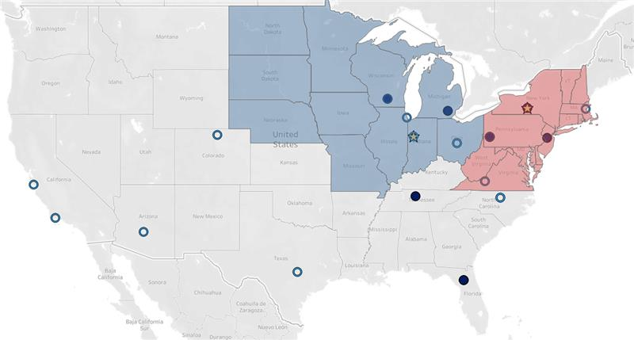
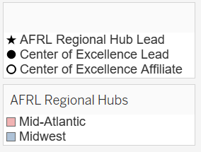
AFRL Partnership Opportunities
Centers of Excellence (CoEs)
AFRL Regional Hubs
Educational Partnership Agreements (EPAs)
Cooperative Research and Development Agreements (CRADAs)
Academic Partnership Engagement Experiment (APEX)
Competitive Proposal Development!
APEX focuses specifically on growing the Department of the Air Force’s technological defense capabilities in partnership with academia. This is the first of its kind in the country that is working across the country to connect small businesses and academia.
Notes:
AFRL Partnership Opportunities
AFRL Regional Hubs: A pilot initiative that assembles a new science and technology ecosystem with universities, large and small businesses, other government agencies and venture capitalists in which partners help the lab research high-risk case studies to leverage AFRL capabilities and expedite innovation.
The goal of establishing regional research hubs is to leverage research, translation, and workforce development successes across the country while integrating stakeholders to encourage S&T exchanges and drive innovation.
The first part of the pilot covers the Mid-Atlantic (demonstrated by the red portion of the map) and Midwest (demonstrated by the blue portion) regions with expansion to other regions possible in the future.
In March 2022, AFRL awarded Cooperative Agreements to Cornell University (Ithaca, New York) and Purdue University (West Lafayette, Indiana) to serve as Regional Hub partners for the Midwest and Mid-Atlantic regions.
We envision expanding on this model.
Demonstrated on the map as solid dots, you can see our current Centers of Excellence (CoEs): These are joint efforts amongst AFRL technical directorates and a university or team of universities to perform high priority collaborative research. They aim to drive research critical to DAF and DoD, strengthen in-house capabilities, and expose students to DAF challenges and recruiting opportunities.
Purposes of a University CoE:
Perform excellent research in high priority Air Force interest areas.
Strengthen AFRL in-house technical capabilities by providing frequent substantive professional interchanges between AFRL and university personnel.
Educate students within the US in vital technology areas and offer opportunities for AFRL new employee recruitment.
Educational Partnership Agreements (EPAs): Formal agreements between a defense laboratory and an educational institution for the purpose of encouraging and enhancing study in scientific disciplines at all levels of education.
Cooperative Research and Development Agreements (CRADAs): The purpose of a CRADA is to make available Government facilities, intellectual property, and expertise for collaborative interactions that lead to useful technology transfers that support our national defense.
Academic Partnership Engagement Experiment (PEX) PIA: A first of its kind program that aims to enhance partnerships between the DAF and academia. Provides free resources to academic researchers and innovators interested in participating in or applying for funding from the Air Force SBIR/STTR programs.

Slide 39
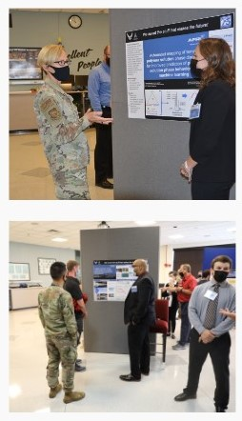
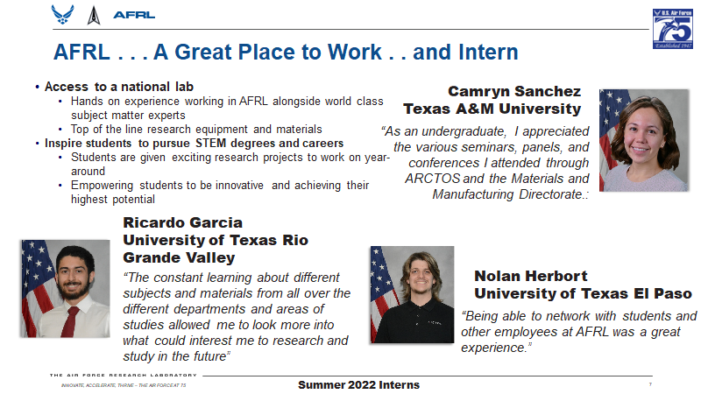
AFRL Internship/Fellowship Opportunities
AFRL Summer Faculty Fellowship Program (SFFP)
AFRL Science and Technology Fellowship Program (SFTP)
AFRL Scholars Program
SMART Scholarship-For-Service
National Defense Science and Engineering Graduate Fellowship Program (NDSEG)
AFRL/NSF Designing Materials to Revolutionize and Engineer our Future (DMREF)
AFRL Minority Leaders-Research Collaboration Program (ML-RCP)
“Being able to network with students and other employees at AFRL was a great experience.”
- Nolan Herbort University of Texas El Paso (ML-RCP 2022 Summer Intern)
Major General Heather Pringle (former AFRL Commander) and AFRL leadership attended the ML-RCP Summer Interns’ Poster Session in August 2022.
Notes:
AFRL Internship/Fellowship Opportunities
We have a multitude of opportunities for your students to come and engage directly with our S&Es.
AFRL Summer Faculty Fellowship Program (SFFP): Offers full-time science, math, and engineering faculty at US colleges and universities the opportunity to participate in research through 8-12 week residencies at DoD laboratories.
AFRL Science and Technology Fellowship Program (STFP): The premiere AFRL research associateship program. This nationally competitive fellowship offers awards to postdoctoral and senior scientists to perform collaborative research at DAF research facilities across the country.
AFRL Scholars Program: Offers stipend-paid internship opportunities for undergraduate and graduate-level university students pursuing STEM degrees. The selected interns gain valuable hands-on experiences working with full-time AFRL scientists and engineers on cutting-edge research and technology and can contribute to unique, research-based projects. Graduate interns can collaborate with AFRL on current research and incorporate the research into their graduate work.
Science, Mathematics, and Research for Transformation (SMART) scholarship-for-service: Part of a connected effort to improve the flow of new, highly skilled technical labor into Department of Defense facilities and agencies to enhance the technical skills of the workforce already in place.
National Defense Science and Engineering Graduate Fellowship Program (NDSEG): DoD-sponsored 3-year fellowship designed to increase the number of US citizens receiving doctorate in research discipline areas of DoD relevance at US institutions.
AFRL/NSF Designing Materials to Revolutionize and Engineer our Future (DMREF): A co-funded program between AFRL and NSF, DMREF is the primary program by which NSF participates in the Materials Genome Initiative (MGI) for Global Competitiveness. MGI recognizes the importance of materials science and engineering to the well-being and advancement of society and aims to "deploy advanced materials at least twice as fast as possible today, at a fraction of the cost.
AFRL Minority Leaders-Research Collaboration Program (ML-RCP): This program enables collaborative research partnerships between AFRL and academia that engage a diverse pool of talent in addressing foundational research challenges in support of the nation's air, space, and cyberspace technology needs with the objective to enable, enhance, and expand the research capabilities of HBCUs and MSIs through collaborative research efforts with AFRL.

