Slide 1
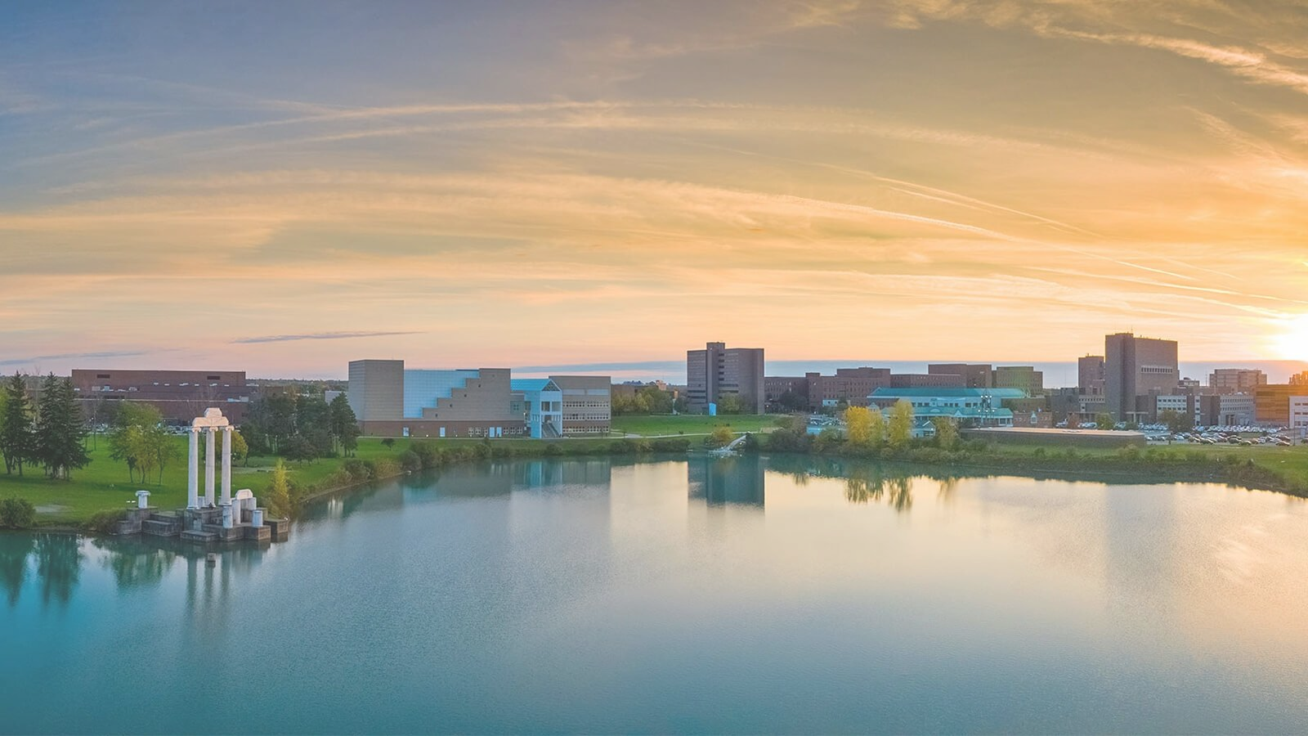

Enabling Efficient Qubit-Photon Interfaces
for
Scalable Quantum Information Processing Platforms
Herbert F. Fotso
Department of Physics University at Buffalo, SUNY

Slide 2

Outline
▶ Qubits/QIP, why do we care?
Technologically promising materials and their challenge
▶ Limits of classical computation
▶ Challenges at the interface of quantum optics and QIP
▶ Spectral diffusion, restoring photon indistinguishability
▶ Experimentally achievable external fields protocols VFRP and Collaboration with AFRL Quantum Group

Slide 3
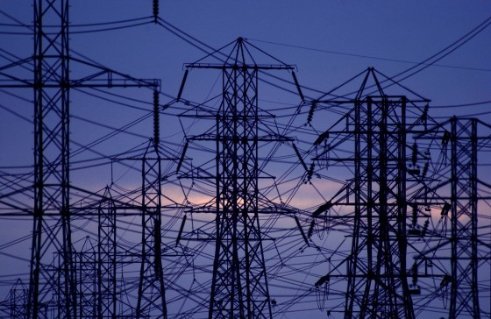
Electric current and dissipation
Metallic conductor ⇒ heat, dissipation US Power Grid, Loss ∼ 14 New York City’s

Slide 4
Superconductivity
Superconductivity, What is it?
ρ
Non-superconductive metal
Superconductor
Temperature
T_{c}
No dissipation/loss below a certain (critical) temperature (T_{c} )
Ideally, we want T_{c} to be room temperature.

Slide 5
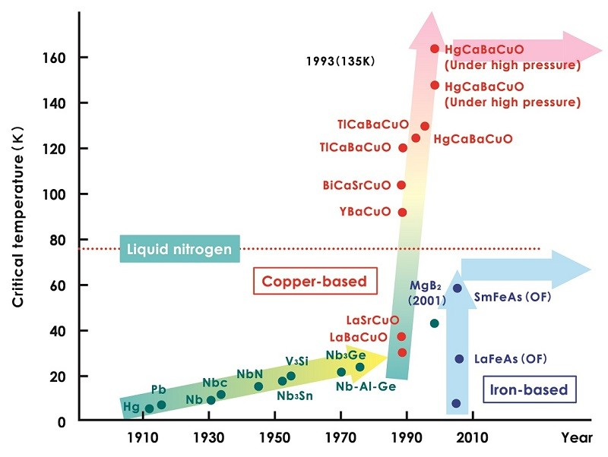
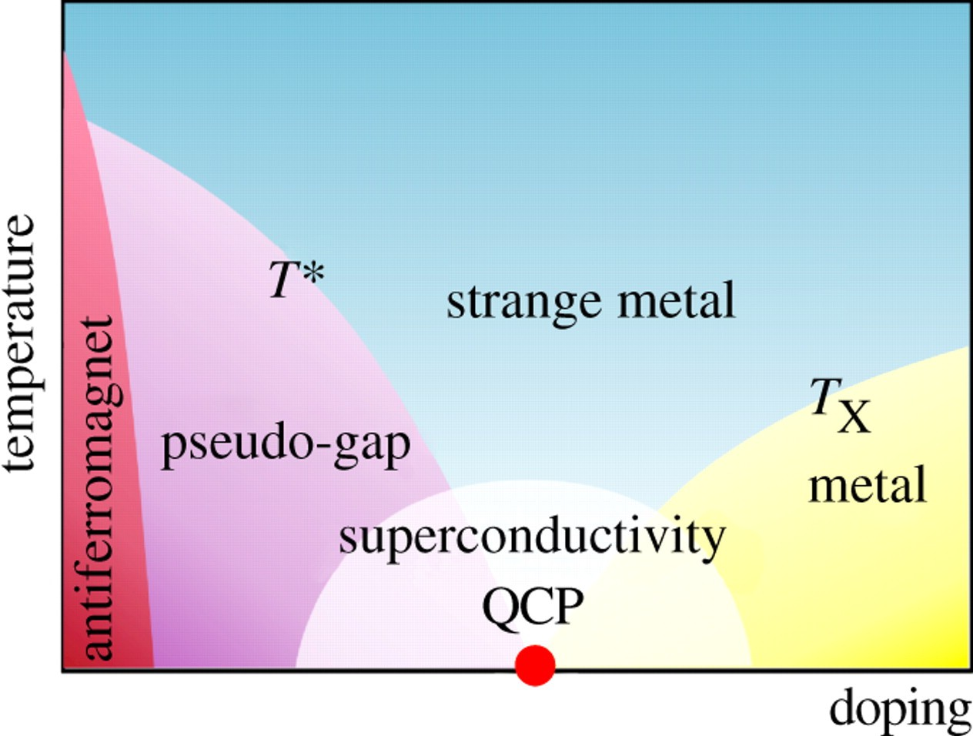
Superconductivity ...
High temperature superconductivity.
The T_{c} timeline:
Cuprates, phase diagram
Many competing phases High complexity

Slide 6
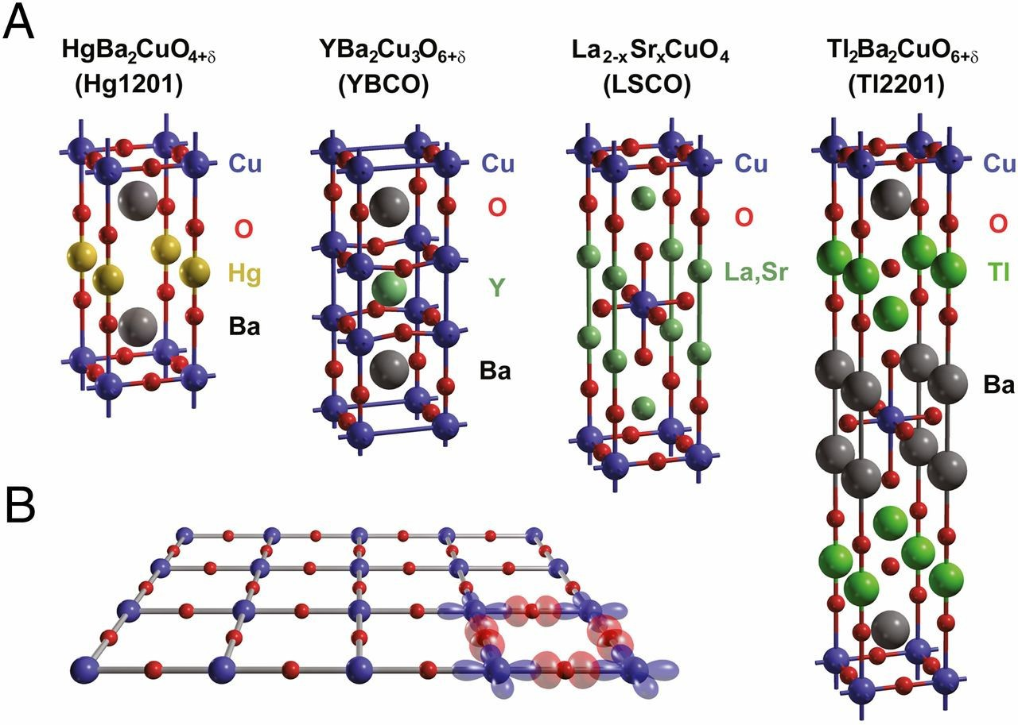
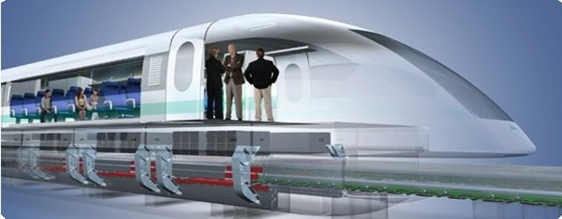
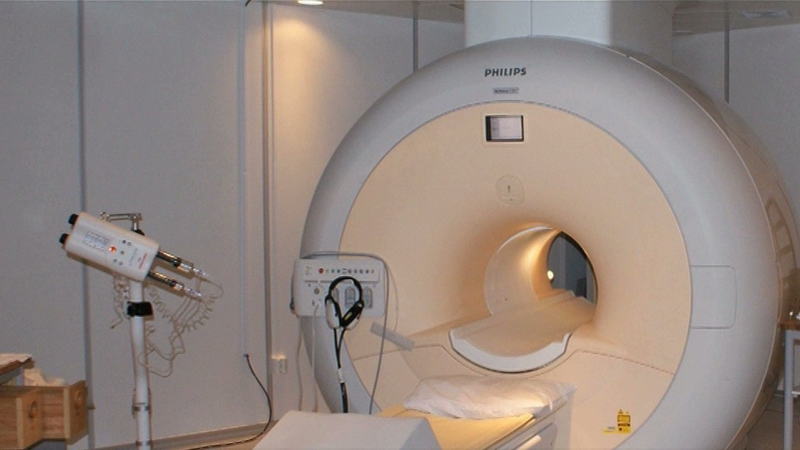
Developing Novel Materials: High T_{c} Superconductivity
Technological challenges
Promising Materials Challenging Theory
J(t)
U (t)
Metallic conductor ⇒ heat, dissipation US Power Grid, Loss ∼ 14 New York City’s
Levitating trains, top speed ∼ 300mph
Neven Barišić et al. PNAS 2013;110:12235-12240
Cuprates
High T_{c} superconductors Crystal structure
Hubbard model Deceptively simple
Better electromagnets, liquid Nitrogen
∼ 77K
Liquid Helium ∼ 4K

Slide 7
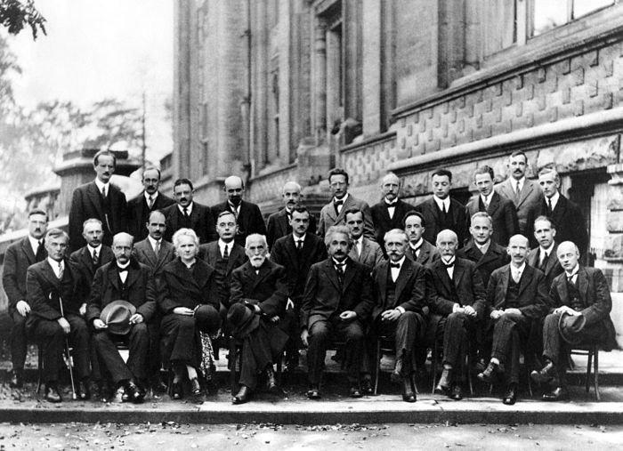
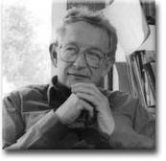
Computational Methods. Why?
“Theory of everything”
▶ Quantum Mechanics: Solvay conference 1927
▶ Only a handful of problems are solvable EXACTLY
▶ Progress relies on well understood approximations
▶ May also solve small systems numerically
Many interacting particles
▶ ”More is Different”
P.W. Anderson, Science 177, 4047 (1972).
▶ Many emergent phenomena

Slide 8
Computational Methods
▶ New insights
▶ Guide experiments
▶ Suggest new materials
▶ Explore possible mechanisms
.
▶ Ongoing efforts
▶ Challenge: Quantum problem on Classical computers
.

Slide 9

The limits of classical computation
Computer power alone will not be enough
1 Petaflop → ∼ 2 MW of power
(1 MW powers ∼ 1000 homes)
State of the art classical computer
∼ 50 electrons
→ Better algorithms are essential
Double the capacity ⇒ 1 more electron
Fundamental limits!

Slide 10

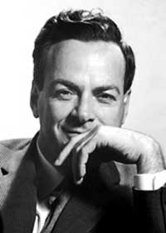
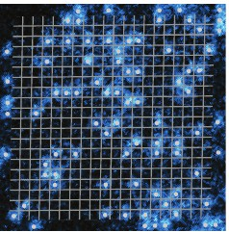
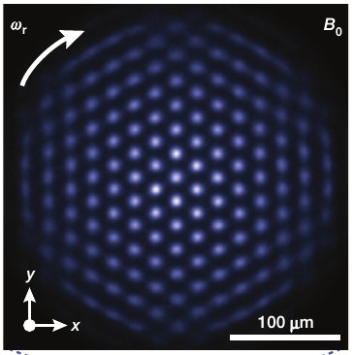
A Path Forward: Quantum Computation
Quantum computation for quantum systems.
Richard Feynman, 1982.
Match the exponential growth of the problem.
Quantum Simulators Quantum Computing
M.F. Parsons et al. PRL 114, 213002 (2015)
J.W.Britton et al. Nature 484, 489 (2012)

Slide 11
The Future: Quantum Computation?
Linear VS
Classical bit, on/off
▶ 1 bit: 1 or 0
▶ 2 bits: 00,10, 01, 11
system is completely defined by
2 independent numbers
Exponential Scaling
Quantum bits, qubit, spin-1/2
▶ 1 spin | ↑⟩ or, | ↓⟩
▶ 2 spins: a| ↑↑⟩
b| ↑↓⟩ + | ↓↑⟩ c| ↑↓⟩ − | ↓↑⟩ d| ↓↓⟩
4 numbers needed (2²)
▶ 3 spins:
8 numbers needed (2³)
.
.
▶ N bits:
· · · N numbers
.
.
▶ N spins: 2^{N} numbers 300 qubits ⇒ 2³⁰⁰ numbers/states
Number of particles in the Universe!!!
As long as they are fully entangled.

Slide 12


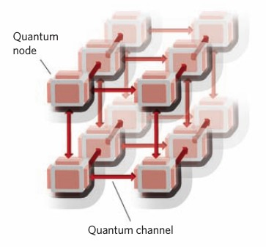
Beyond novel materials: ...
▶ Quantum Communication/Networking
J. Kimble, Nature 453, 1023 (2008).
▶ Encryption
▶ Quantum Chemistry
▶ Quantum Sensing
Detect/measure increasingly weak signals with high resolution
▶ What else? The future will tell...

Slide 13

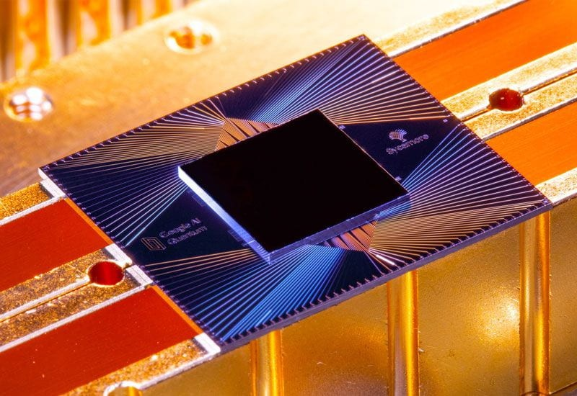
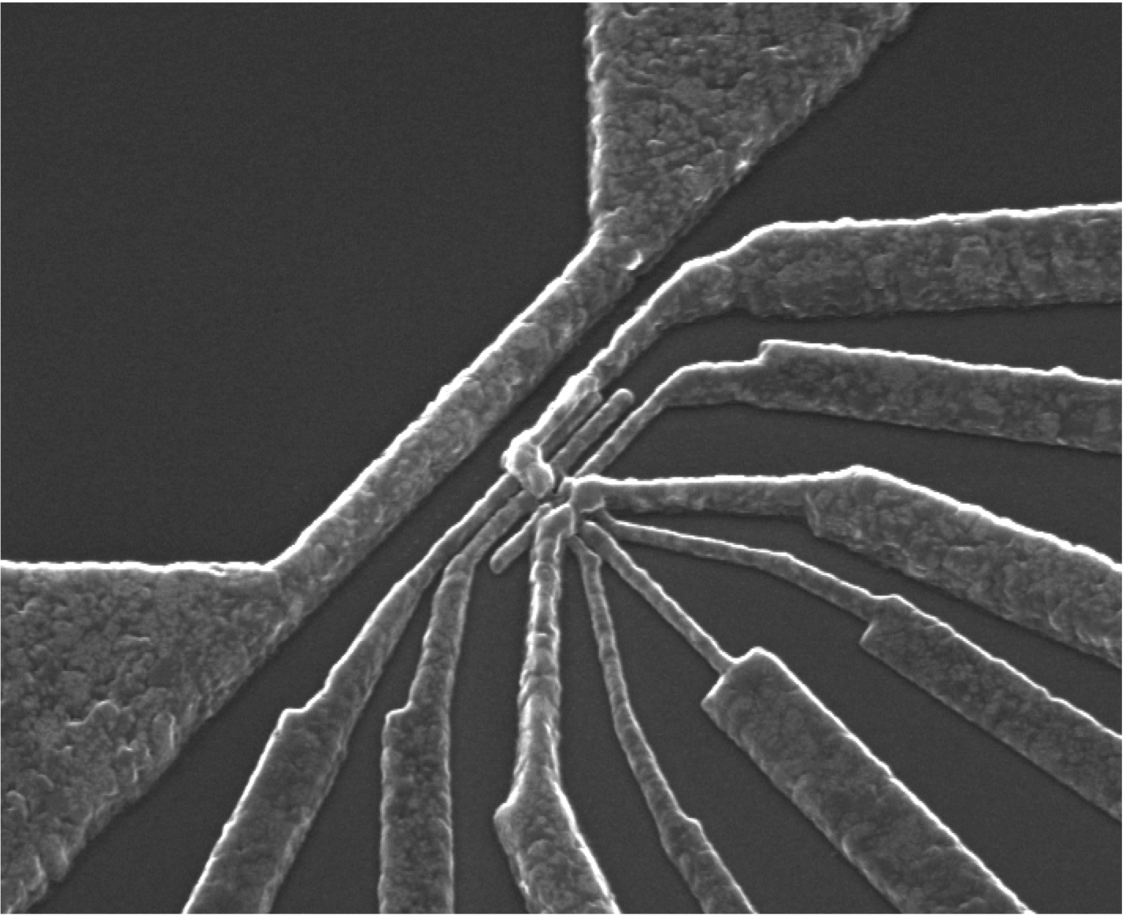
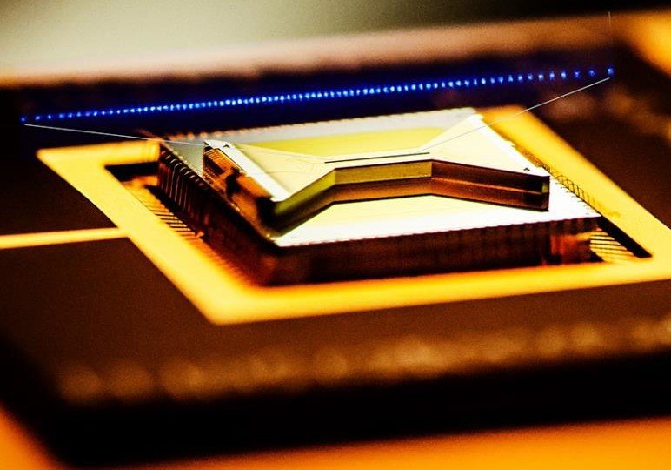
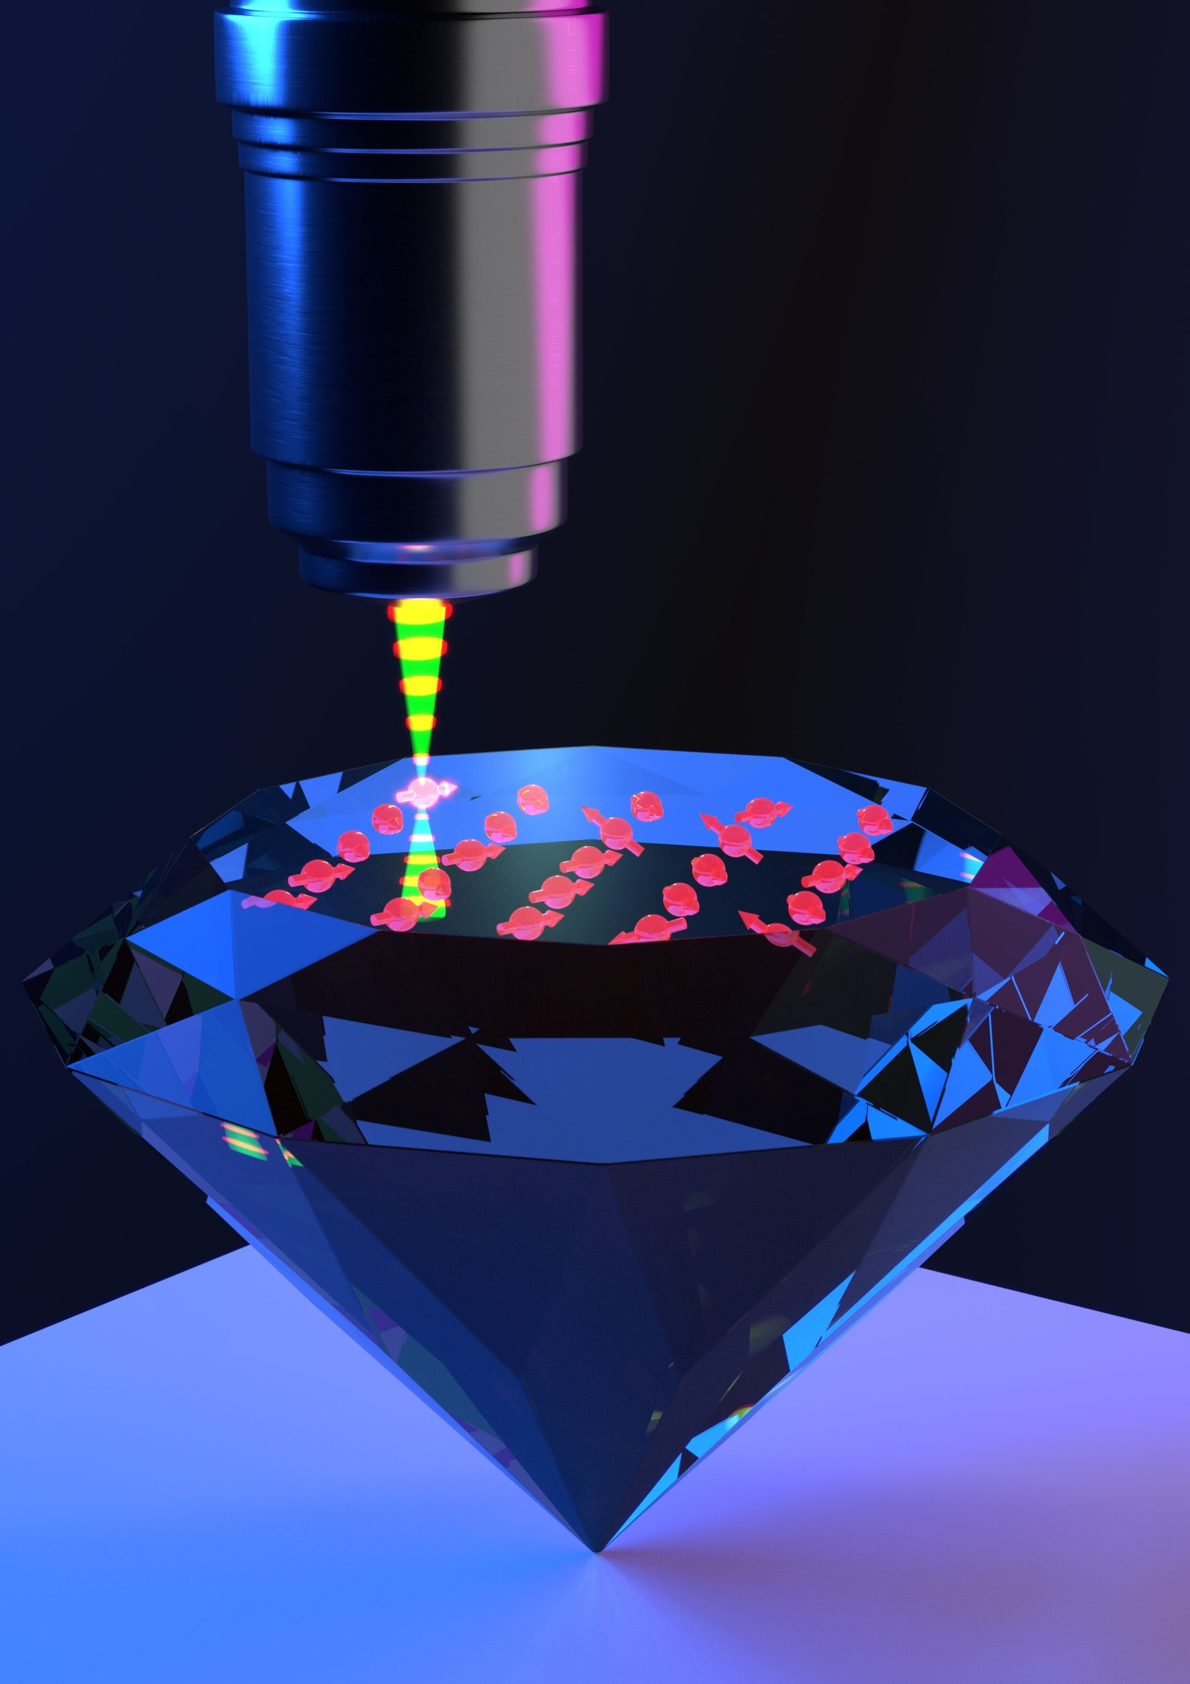
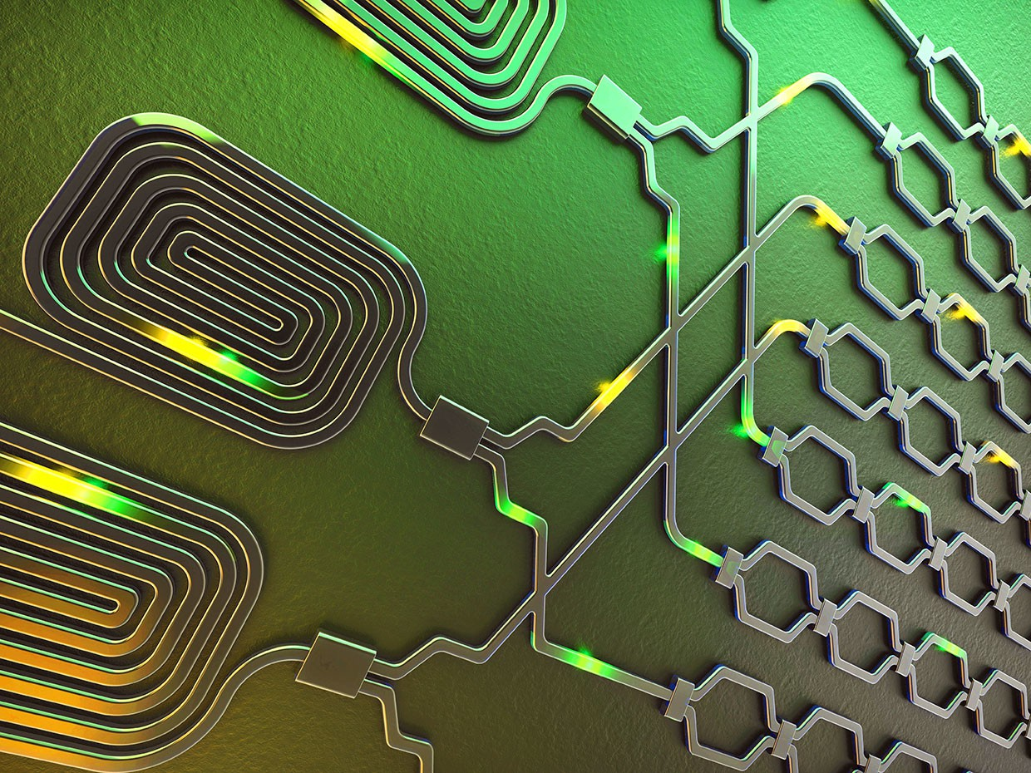
QIP The Building Blocks: Quantum Bits
Loss - DiVincenzo criteria:
State initialization of the qubits
Long-lived coherences
Universal set quantum gates
Efficient qubit measurement
Scalable to large numbers of qubits
h¯ ω = E₂ − E₁
TLS
Different promising implementations:
Superconducting qubits QDots Trapped ions
Electron/nuclear spins
Photons ...
Google
A. Dzurak
IonQ
Oxford Univ.
X Qiang

Slide 14
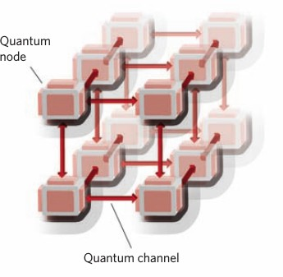
Hybrid Platforms, The Future?
J. Kimble, Nature 453, 1023 (2008).
▶ Use different systems for their optimal properties:
Superconductors for computation
Electron/nuclear spins for networking
Atomic clouds for memories ...
▶ Establish efficient interfaces between platforms
▶ Optimal light-matter interfaces are essential!

Slide 15


Photon-mediated processes for QIP challenges
∆1
D1
A
50:50
Emitters
Detectors
B.S.
∆2
B
D2
Two-Photon Interference, Entanglement Generation
|e) |e₂)
|e₁)
|e₁)
|e₂)
|g₂)
Transducer
Qubit 2
|g₂)
|g₁)
|g₁) |g)
Qubit 1
Different Frequencies,
Quantum Transduction
No-Clone Theorem,
Quantum Memories

Slide 16
Photon-mediated processes for QIP challenges ...
Hong-Ou-Mandel Two-Photon Interference and Distinguishable Photons
∆1
E₁
1
3
D₁
50:50
Emitters
Detectors
B.S.
∆2
2
4
D
E₂
2
8
E₂ E1
4
E₂
E₁
Can the spectra be adjusted as needed? Can we overcome spectral diffusion?
Can we restore TPI with external controls?

Slide 17
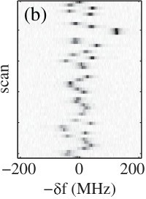
The challenge of spectral diffusion
Excited State
(ES)
Detuning Δ
(a)
Target frequency ω₀
Ground State
(GS)
(c)
Δ
Γ
ω₀
K. M. Fu et al. PRL 103, 256404 (2009)
Can we use pulse sequences to suppress spectral diffusion?

Slide 18
Two-Photon Interference
HOM with pulse-driven quantum emitters:
Intensity correlation function: G ⁽²⁾(t, θ) = ⟨a†(t)a†(t + θ)a4(t + θ)a3(t)⟩
34 3 4
J
(2)
T (2)
INtegrated cross-correlation function: g (θ) = lim
T →∞
G (t, θ)dt
34 0 34
_{0.5} Δ₁ = 3.0 (Γ), Δ₂ = -4.0 (Γ); No control
Δ₁ = 3.0 (Γ), Δ₂ = - 4.0 (Γ), τ = 0.2 (1/Γ)
1.25
0.4
1
_{g}2
₃₄(θ)
0.3
Δ = 3.0 (Γ)
Δ = -4.0 (Γ)
_{g}2
₃₄(θ)
0.75
0.06
τ = 0.2
0.8
Δ = 3.0 (Γ)
Δ = - 4.0 (Γ)
0.2
ρ(ω)
0.04
0.5
0.02
ρ(ω)
0.6
0
0.4
-30 -20 -10 0 10 20 30
0.1
ω (Γ)
0.25
0.2
0
-30 -20 -10 0 10 20 30
0
0
ω (Γ)
-2 -1.5 -1 -0.5 0 0.5 1 1.5 2
θ (1/Γ)
-2
-1.5 -1 -0.5 0 0.5 1 1.5 2
θ (1/Γ)
No control Periodic pulse sequence Minimal dependence on the detuning/environment: up to |∆2 − ∆1| ∼ 10Γ
HFF, Phys. Rev B 100, 094309 (2019).

Slide 19
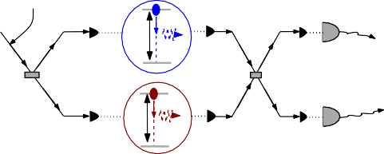
Collaboration with AFRL
▶ Innovare Advancement Center
Multiple qubit modalities:
Trapped Ion, Photon, Superconducting qubits
Theory - Experiment connection
Exploration of new frontiers
▶ Realistic protocols for spectral modulation and TPI Scheme for TPI with spectrally different ions:
Ion 1
Control laser
D₁
∆1
50:50
50:50 B.S.
Detectors
B.S.
∆2
D₂
Ion 2

Slide 20

Collaboration with AFRL ...
Imperfect Pulses: finite width, incomplete rotations
Control field ON
tπ
Ω
· · ·
τ
Time
Control field OFF
Δ = 4.0, Δ = -4.0, τ = 0.3
1 2
Δ = 4.0, Δ = -4.0, τ = 0.3, Ω = 30.0
1 2
1.5
1.5
2
g ₃₄(θ)
1
2
g ₃₄(θ)
1
0.5
Ω = 15.0
Ω = 30.0
Ω = 50.0
0.5
60% π
80% π
95% π
0
0
-2
-1.5 -1 -0.5 0 0.5 1 1.5 2
-2 -1.5 -1 -0.5 0
0.5
1
1.5
2
θ θ
Pulse sequence effective even when highly non-ideal: Finite width, Imperfect rotations

Slide 21
Explicitly Noisy Quantum Emitters
Spectral Diffusion: Explicit Noise
∆2
∆3
|e)
∆1
∆4
^{ω}0
|g)
^{t}1
^{t}2
^{t}3
^{t}4
Time
∆1
∆2
∆3
∆4
ω₀
ω₀
ω₀
ω₀
ρ(ω)
ω

Slide 22
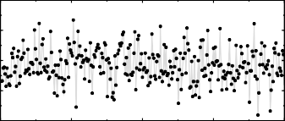

Emitter in Noisy Environment, Finite Width Pulses
Gaussian detuning Δ(t): Δ = 4.0, σ = 4.0
0 Δ
15
1
τ = 0.1, 24 pulses
τ = 0.2, 12 pulses
τ = 0.3, 8 pulses No control
10
Δ(t)
5
0.8
0
ρ(ω)
0.6
-5
0
0.1
0.2
Time
0.3
0.4
0.4
Finite width pulses
Control field ON
0.2
tπ
Ω
⁰ -40
-30 -20 -10 _{ω}0 10 20 30 40
· · ·
τ
Time
Control field OFF
Well defined refocused spectrum:
▶ Narrow central peak at pulse carrier frequency With ∼ 50% of spectral weight and width ∼ Γ
▶ satellite peaks at ±π/τ
HFF, Phys. Rev. A 107, 023719 (2023)

Slide 23
Two-Photon Interference: Two Distant Noisy Emitters
∆1^{(t)}
D1
E1
50:50
Emitters
Detectors
B.S.
∆2^{(t)}
D2
E2
No Control
Pulse Control, τ = 0.3
0.5
Δ₀₁ = 4.0; Δ₀₂ = -3.0
Δ₀₁ = 4.0; Δ₀₂ = -4.0
Δ₀₁ = 5.0; Δ₀₂ = -4.0
1.5
0.4
Δ₀₁ = 4.0; Δ₀₂ = -3.0
(2)
g ₃₄(θ)
(2)
g ₃₄(θ)
1
Δ₀₁ = 4.0; Δ₀₂ = -4.0
0.3
Δ₀₁ = 5.0; Δ₀₂ = -4.0
0.2
0.5
0.1
0
0 2 ⁰-2
-2 -1 1
-1 0 1 2
θ θ
Two random Gaussian detunings: σ_{∆1} = σ_{∆2} = 6.0
Enhancement of Two-Photon Interference from noisy emitters
HFF, Phys. Rev. A 107, 023719 (2023)

Slide 24
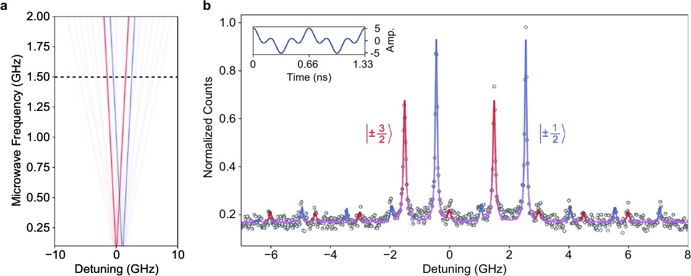
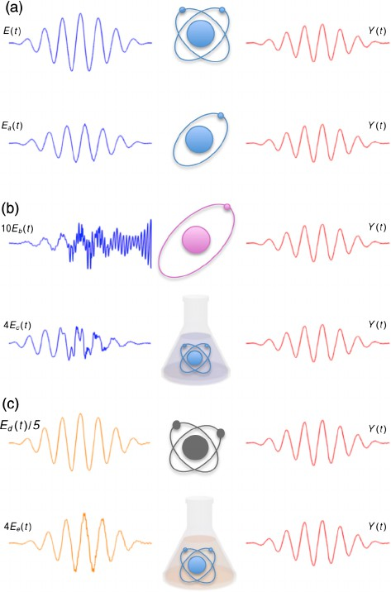
Other similar efforts
Experiment-Theory on SiC
Quantum Mimicry
Can we make multiple different systems behave in the same way?
Lukin et al., npj Quantum Information 6, 80 (2020).
Use of RF sideband for QDots or NVs two-qubit gates ...
A. G. Campos et al. PRL 118, 083201 (2017).

Slide 25
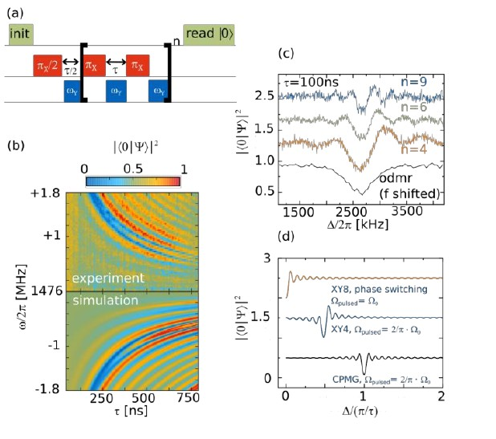
Sensing with absorption spectrum of pulse-driven emitters
Sensing of weak E&M signals: 1/T₂ instead of 1/T ∗
2
T. Joas et al, Nat. Comm., 8, 964 (2017)

Slide 26
Conclusion and Outlook
▶ The Promise of quantum computation
▶ Quantum Optics and QIP intersection
▶ Spectral inhomogeneity challenges for scalable QIP platforms
▶ External control fields to supplement materials engineering
▶ Can overcome spectral diffusion with pulse protocols Emission/absorption spectrum independent of the environment Restored photon indistinguishability between different qubits
▶ Protocols can improve efficiency of critical QIP operations
▶ Outlook: two-qubit gates, ...

Slide 27



Acknowledgement
Collaborators:
▶ D. Awschalom (U Chicago)
▶ V. Dobrovitski (TU Delft)
▶ Kathy-Anne Soderberg (AFRL)
▶ David Hucul (AFRL)
Thank You!

Slide 28
Model and Solution
Model: TLS coupled to bosonic bath + driving field.
Rotating Frame, Rotating-Wave Approximation:
∆
X X
Ω (t)
†
†
x
H = σ + ω a a − i g a σ − a σ +
(σ + σ )
2
z k _{k} k
k _{k} − k +
2
+ −
k k
Ω_{x} (t) is the external control field e.g periodic π pulses
Units Γ and Γ⁻¹ for energy and time. With Γ = 2
Initially, Emitter in the excited state + all bosonic modes unoccupied
Emission profile: N (t) = ⟨a† (t)a (t)⟩.
ω ω ω
N_{ω} (t = 0) = 0. N_{ω} (t > 0) = ?
Solve with different complementary methods

Slide 29







Solving the Problem
Analytical solution
Integrate the E.O.M iteratively between consecutive pulses
▶ Large number of pulses
▶ Markovian approximation
▶ Evaluate integrals numerically. Master equation
▶ Large number of bosonic modes
▶ Markovian approximation
▶ integrate out the bath
▶ iteratively integrate the master equation for ρ of the TLS.
Simulation with t − DMRG
Finite number of pulses Number of modes
∼ 151, 201, ...
1-D chain of bosons,
boson #1 is coupled to the emitter (spin 1/2)
A. E. Feiguin and C. A. Bu¨sser, Phys. Rev. B 84, 115403 (2011).
S. R. White and A. E. Feiguin, Phys. Rev. Lett. 93, 076401 (2004).

Slide 30
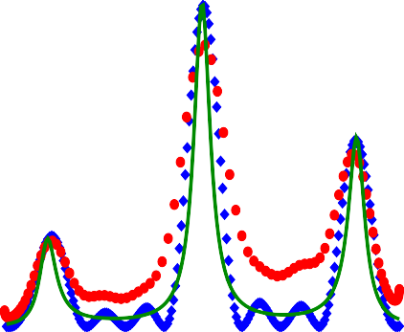
Simulation and Analytical Results
Periodic sequence of (instantaneous) π pulses, with period τ
Good agreement of emission lineshapes
Spectral weight kept at the desired frequency (ω₀ = 0)
_{0.03} τ=0.2, Δ=3.0
8 pulses
Analytics
(E.O.M)
N_{ω}, P(ω)
satellite peaks at ±π/τ ,
±2π/τ , ...
0.02
Analytics
(Master Equation)
peak amplitude grows with time (number of pulses)
0.01
tDMRG
Simulation
satellite peaks suppressed with smaller τ
0
-20 -10
_{ω}0
10 20
H.F.F., A.E. Feiguin, D.D. Awschalom, V. V. Dobrovitski, PRL 116, 033603 (2016)

Slide 31
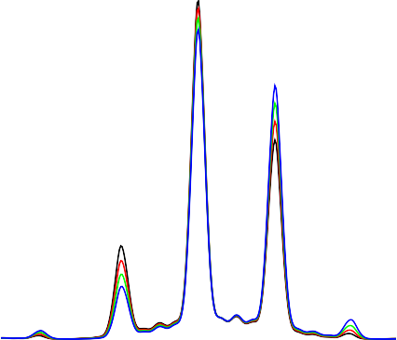
Simulation and Analytical Results
Periodic sequence of (instantaneous) π pulses Little dependence on the environment
Spectral weight kept at the desired frequency (ω₀ = 0)
τ = 0.2, 8 pulses
Δ = 3.0
Δ = 4.0
Δ = 5.0
0.5
Δ = 6.0
0.4
Satellite peaks at ±π/τ ,
±2π/τ , ...
P(ω)
0.3
Peak amplitude grows with time (number of pulses)
0.2
0.1
satellite peaks suppressed with smaller τ
0
_{ω}0
-40
-20
20
40
H.F.F., A.E. Feiguin, D.D. Awschalom, V. V. Dobrovitski, PRL 116, 033603 (2016)

Slide 32
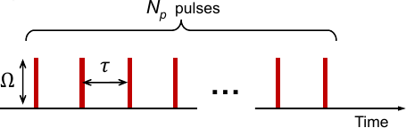
Absorption Spectrum
How does the absorption spectrum change under a pulse sequence?
Weak Field Probe
|es)
ulse drive Period τ
P
ω
^{0.1} Δ = 3.0, τ = 0.2
|gs)
0.05
Time
Absorption
0
▶ Negative and Positive spectral weights
▶ Peaks at ±nπ/τ
▶ Similarity with CW
System not driven on resonance.
-0.05
Time
-0.1
-π/τ
+π/τ
-40 -20
0 20
40
ω
H. F. F and V. V. Dobrovitski, Phys. Rev. B 95, 214301 (2017).

Slide 33


External Protocols to Mitigate the Effects of Spectral Diffusion
HOM with pulse-driven quantum emitters:
Two-Level System coupled to a bosonic bath + control protocol Rotating Frame, Rotating-Wave Approximation:
X X
∆ 2
Ω (t)
†
†
x
H = ω a a +
σ − i g a σ − a σ +
(σ + σ )
k _{k} k
z k _{k} − k +
2
+ −
k
k
∆1
E1
G ⁽²⁾(t, θ) = ⟨a†(t)a†(t + θ)a4(t + θ)a3(t)⟩
34 3 4
1
₃ D1
50:50
T
Emitters
Detectors
g ⁽²⁾(θ) = lim G ⁽²⁾(t, θ)dt
34 34
B.S.
T →∞ ₀
∆2
2
4 D
Master equation + Quantum Regression Theorem
E2
2
E2
Photon Indistinguishability ⇒ “HOM dip in”
g ⁽²⁾(θ)
E1
E1
E
34
2

Slide 34
Inhomogeneous Broadening - Refocusing With External Pulses
Periodic pulse sequence
∆2 ^{∆3}
|e)
∆1 ^{∆4}
|g)
ω0
Ensemble of quantum emitters
Emitter 1 Emitter 2 Emitter 3 Emitter 4
∆1
∆2
∆3
∆4
^{ω0 ω0 ω0 ω}0
ρ(ω)
^{0.4} τ = 4 ns, B = 2π x 400 MHz, Δ = 2π x 120 MHz
x 0
8 pulses
ω
Ensemble with Gaussian distribution.
0.3
No control
Periodic sequence of π
pulses.
P(ω)
0.2
Pulse control
0.1
-⁰320 -160 0
160
320
ω ( x 2π MHz)
HFF, Phys. Rev. A 107, 023719 (2023)

Slide 35

Correlated Systems, the Scientific Difficulties:
▶ Diagrammatic perturbative treatments inaccurate.
Systems are strongly correlated (Hubbard with U ≳ J)
▶ Exact Numerical methods constrained by poor scaling (exponential scaling of computer resources needed)
Exact Diagonalization (ED)
Quantum Monte Carlo (QMC)
▶ Embedding schemes:
Dynamical Mean Field Theory Dynamical Cluster Approximation
Λ(t)
U
Two length scales:
Short: Exact, ED or QMC
Long: Mean-field

