Slide 1


Geometric Quantum Speed Limits in Open Quantum Systems
Frederico Brito
Q4i - 6th Annual Quantum for International Workshop. Rome-NY. 26/Jun/2024

Slide 2

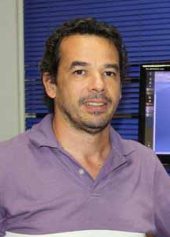


Diego Paiva Pires (Universidade Federal do Maranhão - Brazil)
Eduardo R. deAzevedo (Universidade de São Paulo - Brazil)
Diogo O. Soares-Pinto (Universidade de São Paulo - Brazil)
Jefferson G. Filgueiras (Universidade Federal Fluminense - Brazil)

Slide 3
Agenda
What?
Why?
How?
Our findings

Slide 4
What?
By controlling the system-environment coupling, we experimentally evaluated geometric Quantum Speed Limits for paradigmatic metrics.
Key points:
The open system quantum dynamic is due to a structured environment.
Markovian and non-Markovian regimes could be exploited.
We could derive analytical expressions for our figure of merit in terms of expectation values of observables.

Slide 5


Why?
QSL is related to the distinguishability of quantum states and a fundamental lower bound for the time evolution of quantum systems.
Key points:
The modern view relates QSL to Information geometry.
        Quantum Fisher information:
        Wigner-Yanase skew Information:

Slide 6




The origin of the QSL
What is the minimum $τ$ so $⟨ψ(0)|ψ(τ)⟩$?
Two incompatible lower bounds are found: Which is the tightest?
        Mandelstam and Tamm (1945):
        Margolus and Levitin (1998):
Solution:
Levitin-Toffoli (2009)

Slide 7
Today
In addition to setting a lower bound on how fast the evolution can be (quantum computing), several works have found applications of QSL in quantum many-body systems, quantum thermodynamics, and non-equilibrium quantum dynamics.

Slide 8
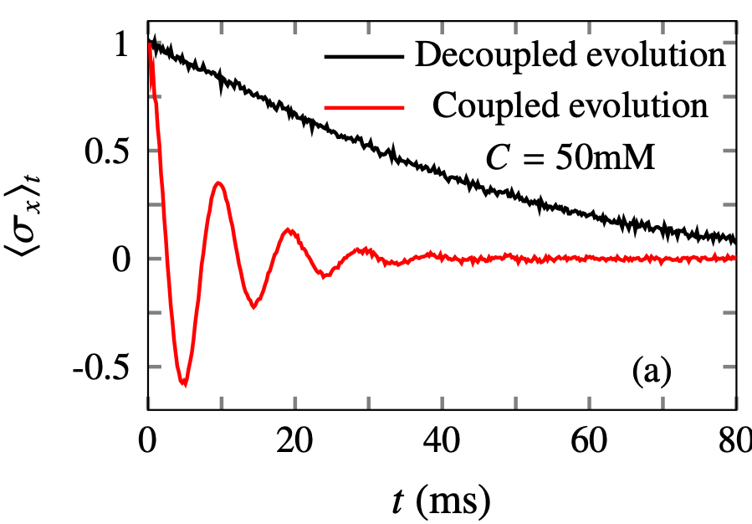

How?
We performed NMR experiments by diluting the paramagnetic salt iron(III) acetylacetonate (Fe(acac)3) to chloroform solutions (CHCl3).
The chloroform encodes an interacting two-qubit system $\left(H=(πJ/2)σ_{z}^{H}⊗σ_{z}^{C}\right)$ using the ¹³C and ¹H nuclei.
Using a decoupling technique, one can assess the single qubit evolution, characterizing their dissipative processes.

Slide 9
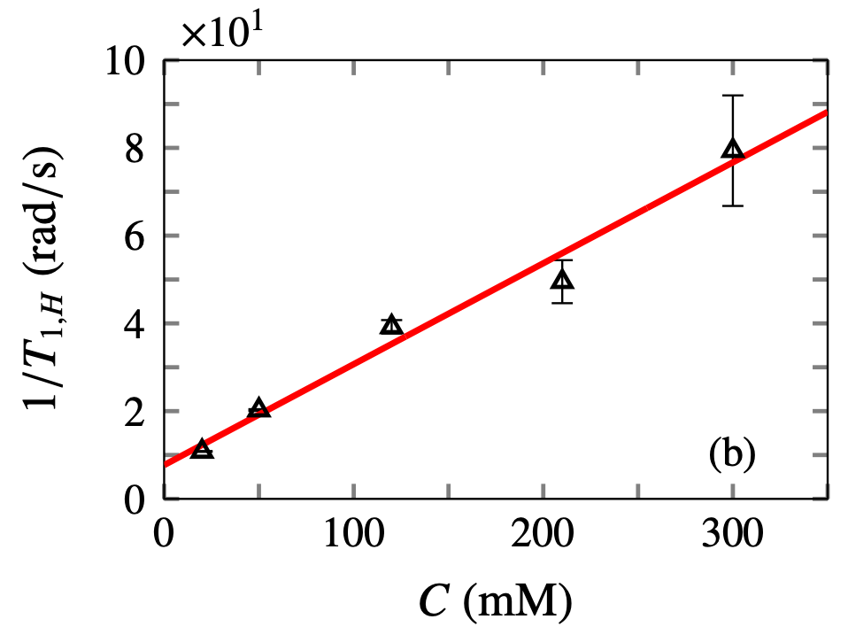
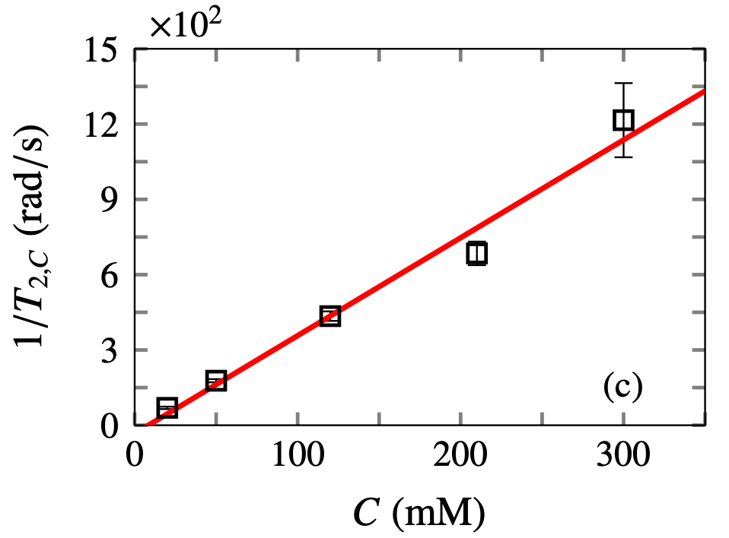
How?
Dissipative channels for single qubits:
Phase damping for ¹³C and bit-phase flip for ¹H.
By increasing the paramagnetic salt concentration, one can control the qubit-environment coupling.

Slide 10
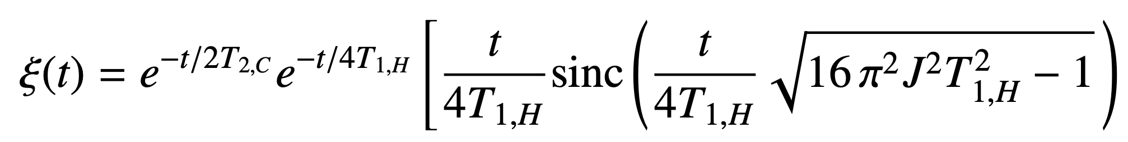
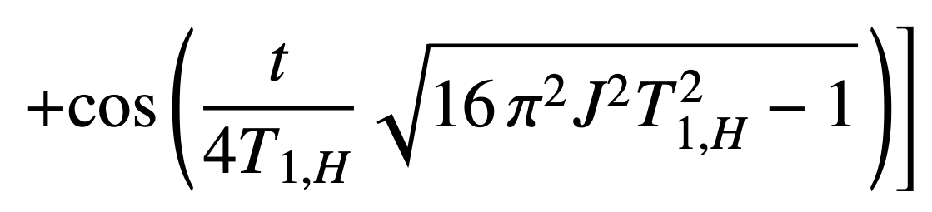
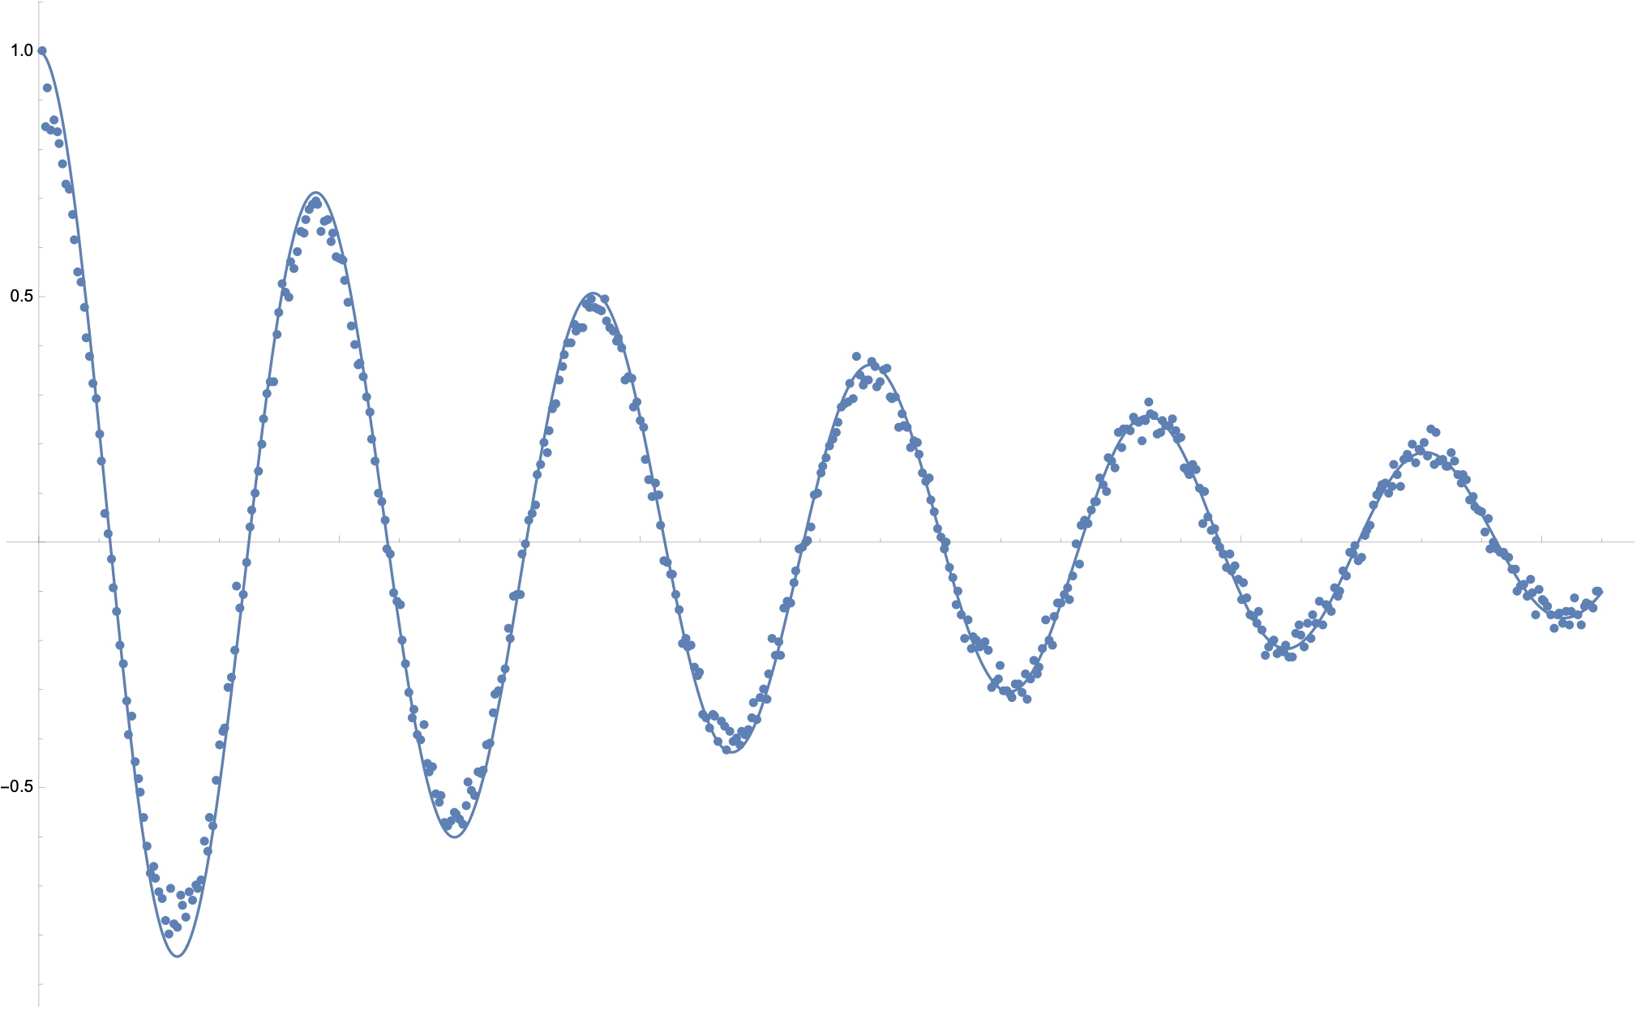
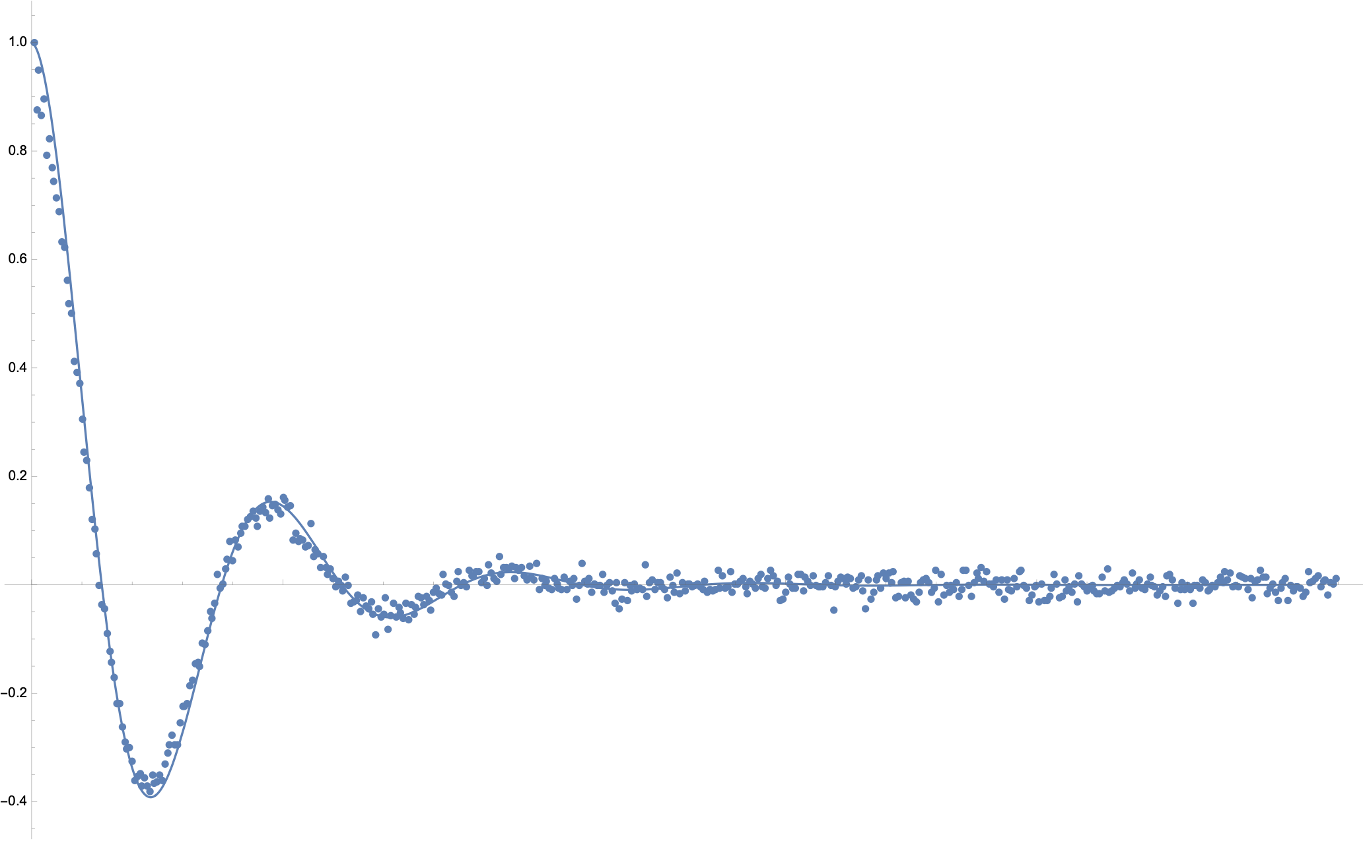
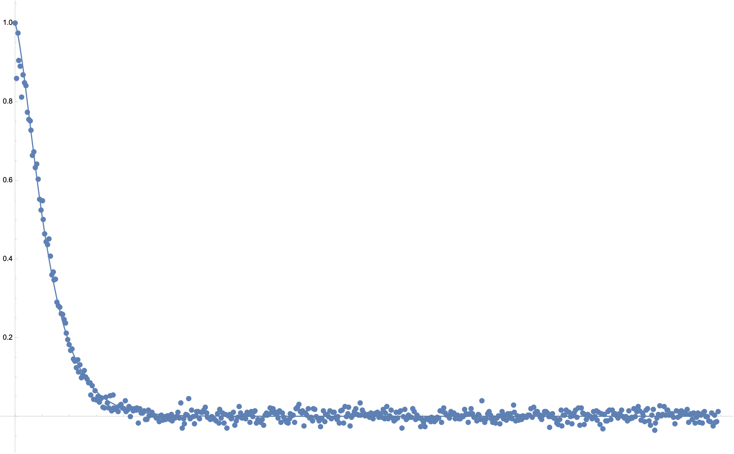

Our findings
The reduced ¹³C dissipative dynamics due to the structured environment (paramagnetic salt + ¹H) can be determined analytically, giving $⟨σ_{x}⟩_{t}=ξ(t)⟨σ_{x}⟩_{0}$
Non-Markovian to Markovian dynamics (salt concentration increases)

Slide 11
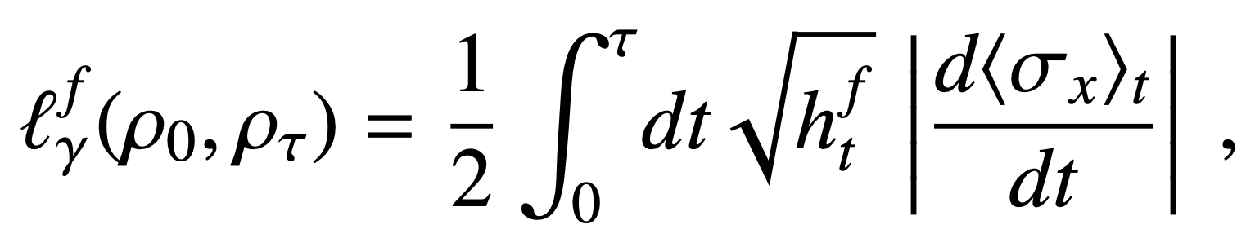
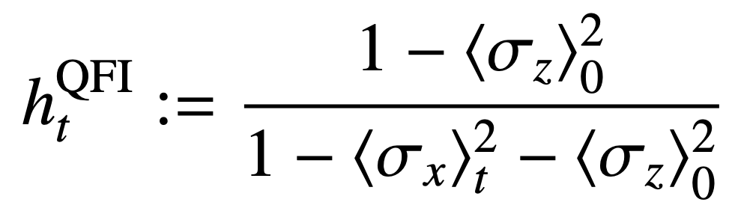
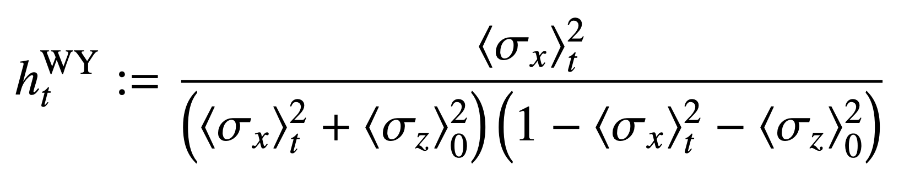
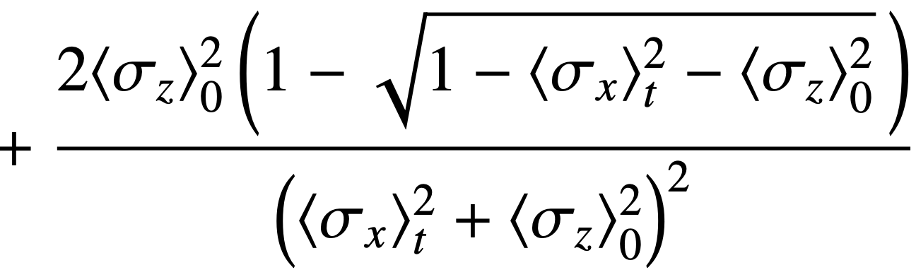

Our findings
The path length of the state $ρ_{t}$ can be written as:
Quantum Fisher:
Wigner-Yanase:

Slide 12
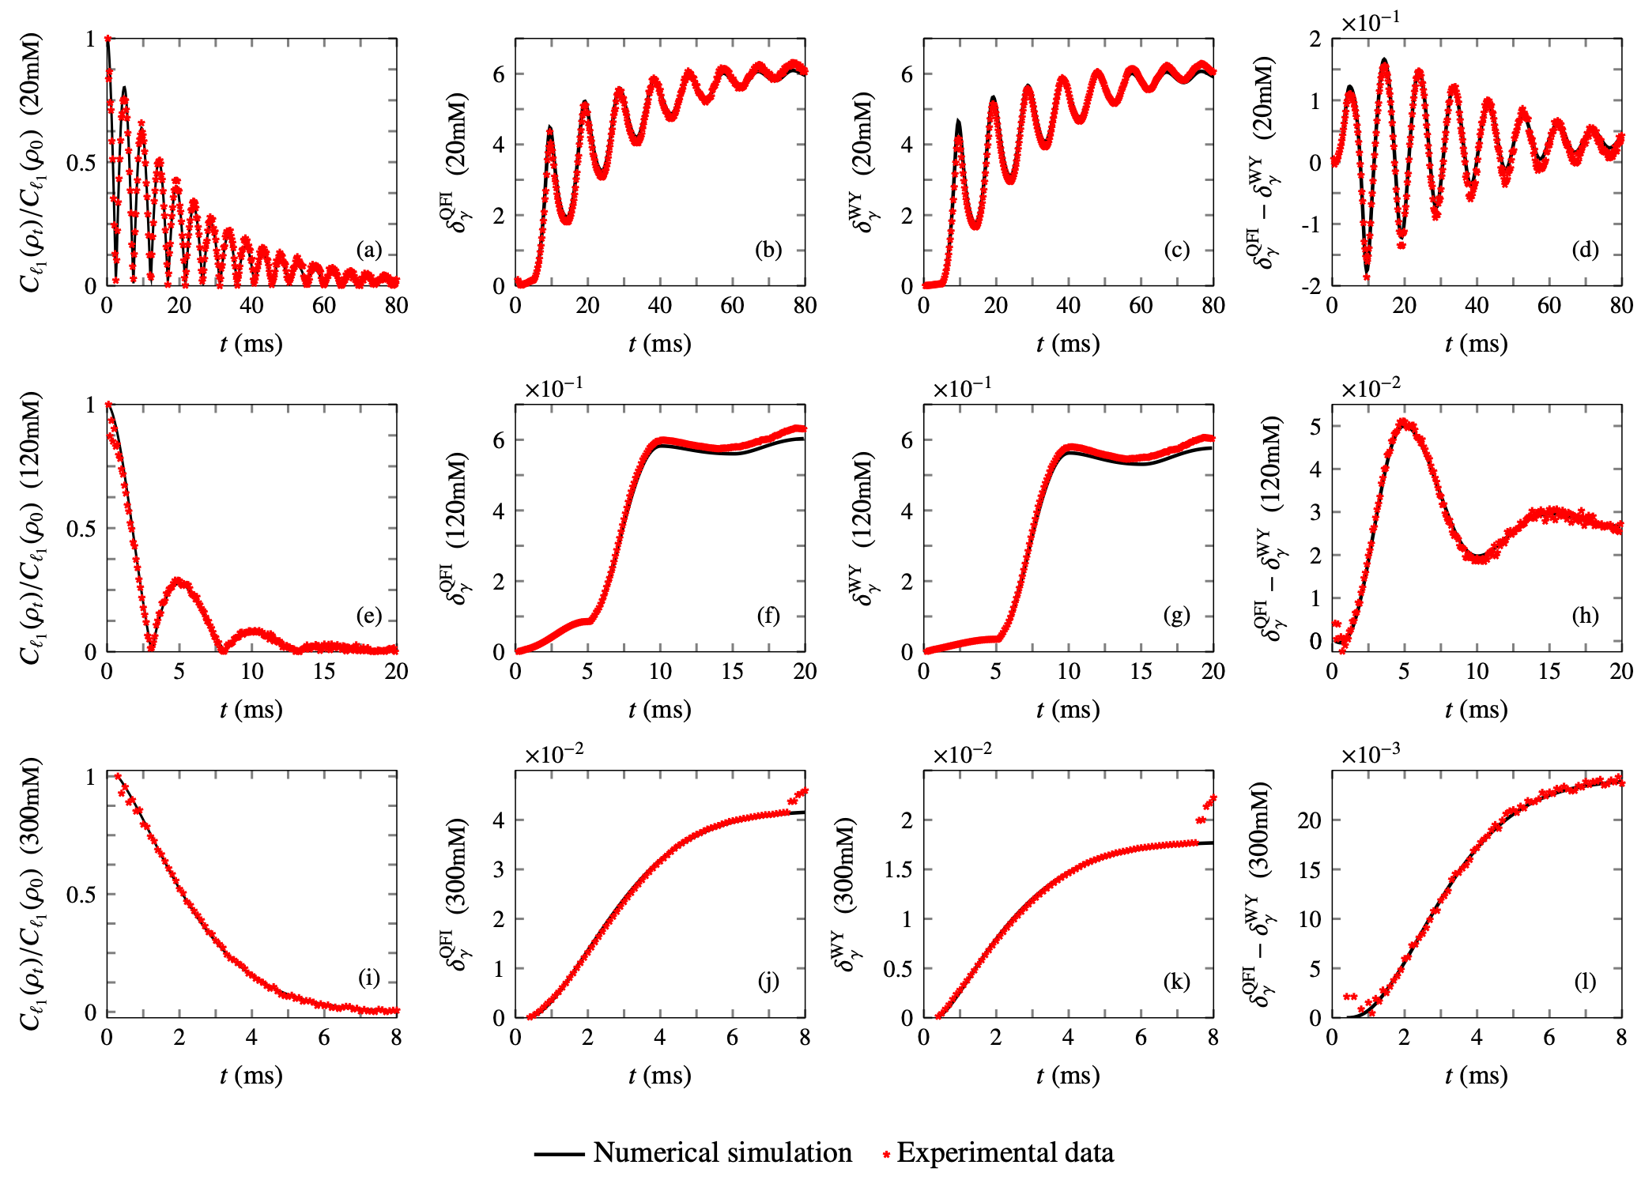
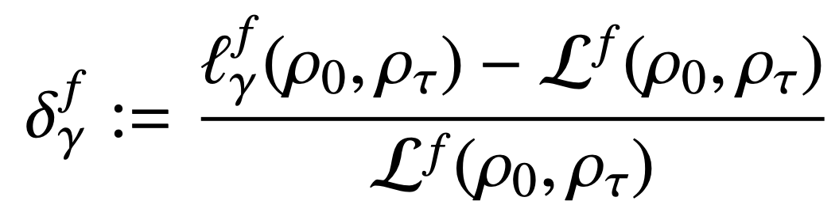
Our findings
Relative deviations:
Crossovers
Between
FI and WY
Bounds
non-Markovian to Markovian dynamics
Commun Phys 7, 142 (2024)

Slide 13
Conclusions
As for our physical system, we found that the tightness of the QSL bound was related to the non-dissipative character of the system evolution, showing crossovers between the tightness of QFI and WY.
Such results suggest that neither QFI nor WY metrics can be seen as fundamental, even when considering the dynamics of the same open quantum system.
Commun Phys 7, 142 (2024)

