Slide 1



AFRL QUANTUM INFORMATION SCIENCE
AI R F O RCE RESEARCH L ABO RA T O R Y J UNE 2 0 2 4
Dr. Kathy-Anne Soderberg
Senior Scientist for Quantum Science and Technology Air Force Research Laboratory

Slide 2
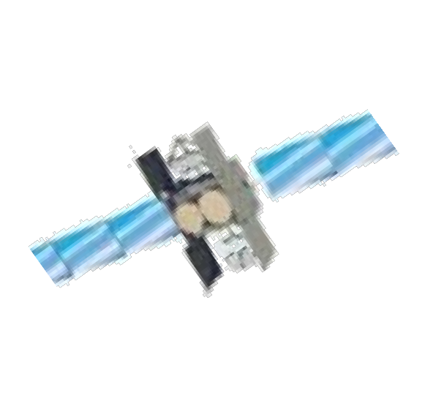
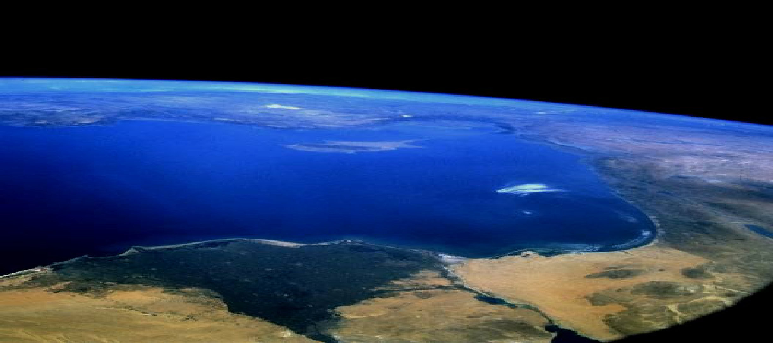
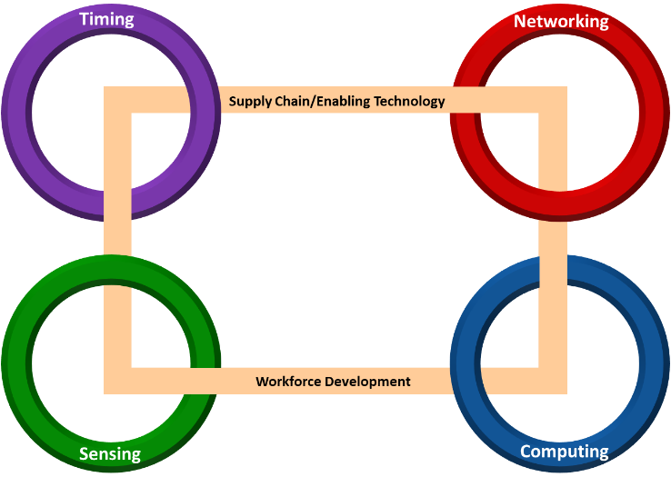

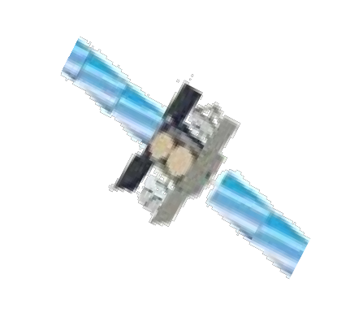




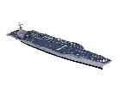


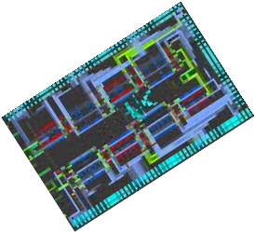
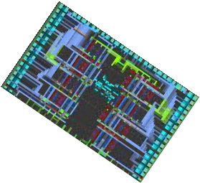
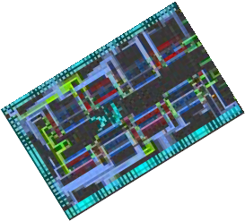

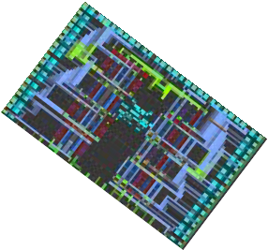

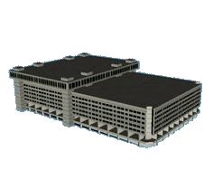

Quantum – Enabled Department of the Air Force (DAF) Capabilities
Entangled Clock Network with Quantum Repeaters
Secure Communication
Tanker or Bomber
Time Transfer
- Complete Data Fusion Possible
Long Duration Unaided Inertial Navigation
Low Probability of Intercept Communications
Target
Carrier Strike Group
Bunker/Tunnel Detection with Advanced Sensors
Rapid Actionable Information with Quantum Computation of Data

Slide 3
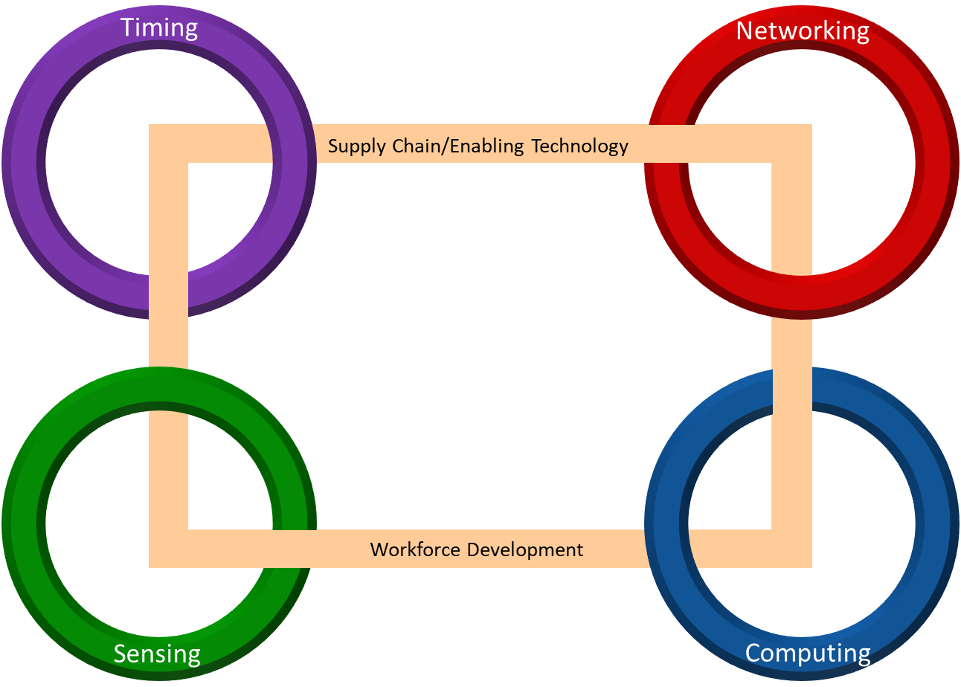


Quantum Technologies and DAF Needs
Nearer Term
Requires less quantum resources
Longer Term
Requires more quantum resources
5-10 years
1-3 years
Self- Sustained PNT
^{Self-} Distributed
Sustained _{Computing}
PNT
Distributed Computing
2-5 years
10+ years

Slide 4


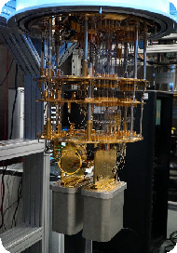
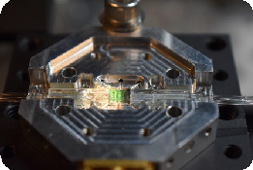
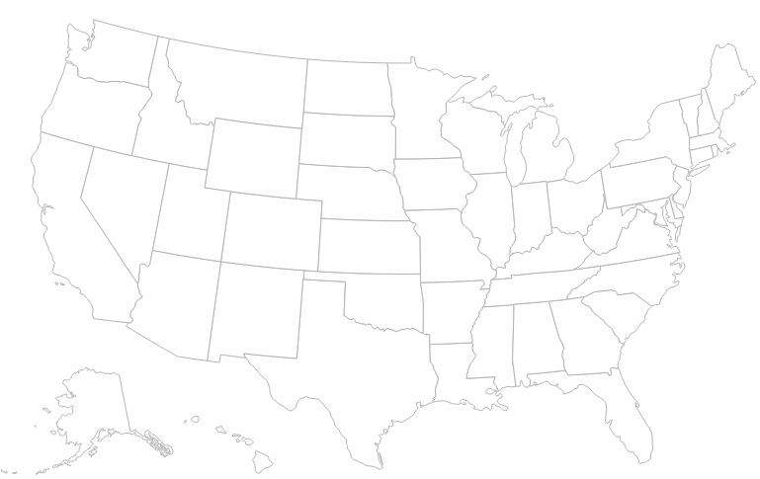
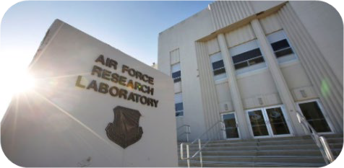
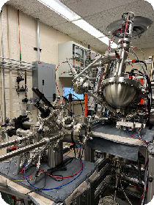
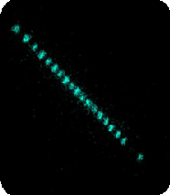
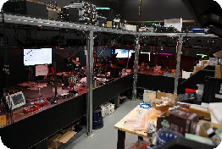
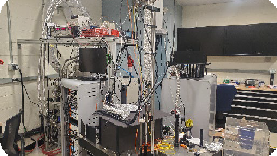

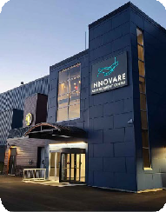

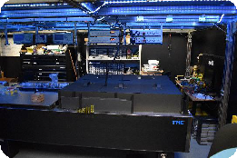






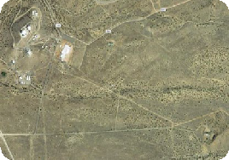
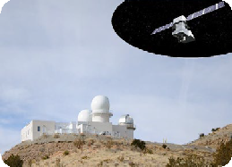



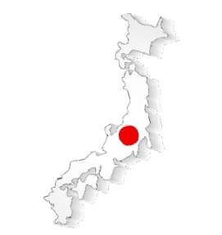
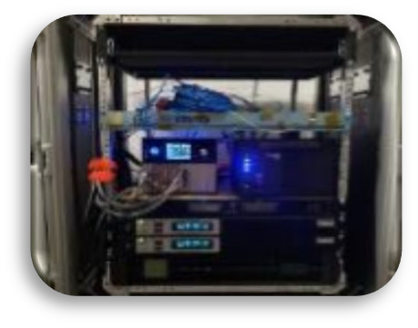


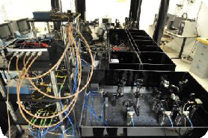
Quantum Information Science around AFRL
AFRL INFORMATION DIRECTORATE
Rome, NY
AFRL HEADQUARTERS
Wright Patterson AFB, OH
RD (Directed Energy): Satellite-based Quantum Networking (DeLange, Lafler, Lanning; NM)
RI (Information): Quantum Computing, Communication, and Networking (Hucul, LaHaye, Sheridan, A.M. Smith, Z. Smith, Wessing; NY)
RY (Sensors): Quantum emitters, Device fabrication (Hendrickson, Usechak; OH)
RV (Space Vehicles): Position, Navigation, Timing (Elgin, Gregoire, Kasch, Kryzweski, Metcalf, Squires, Olson; NM)
RX (Materials and Manufacturing): Solid-State Quantum Defects, Materials, and Supply Chain (Bedford, Bissell, Dass, Pachter, Slocum; OH)
AFOSR: 6.1 Basic Research funding in QIS (Metcalfe, Tabakov; DC, Lyke SOARD; Richards AOARD; Dudley EOARD)
Quantum Senior Scientist (ST): Soderberg; NY Quantum Senior Advisor for Strategic Partnerships: Hayduk; NY
AIR FORCE OFFICE OF SCIENTIFIC RESEARCH (AFOSR)
Arlington, VA
AFRL DIRECTED ENERGY & SPACE VEHICLES
Kirtland AFB, NM
Receiver
RDSS
INTERNATIONAL SITES:
Transmitter
UNITED KINGDOM
BRAZIL AUSTRALIA
JAPAN
CHILE

Slide 5


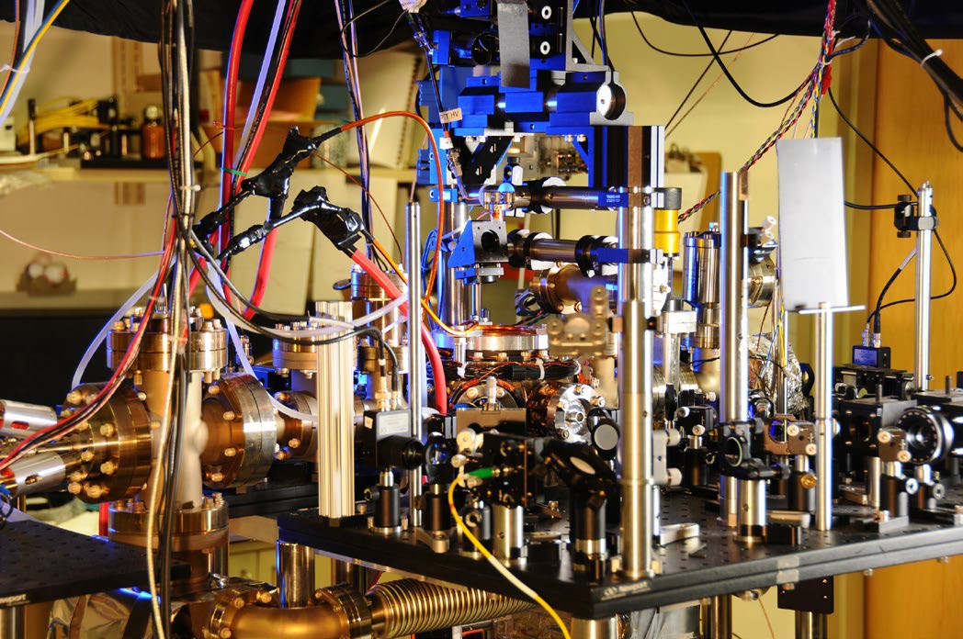
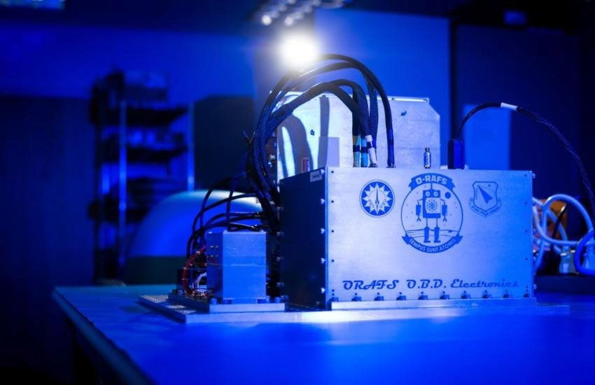

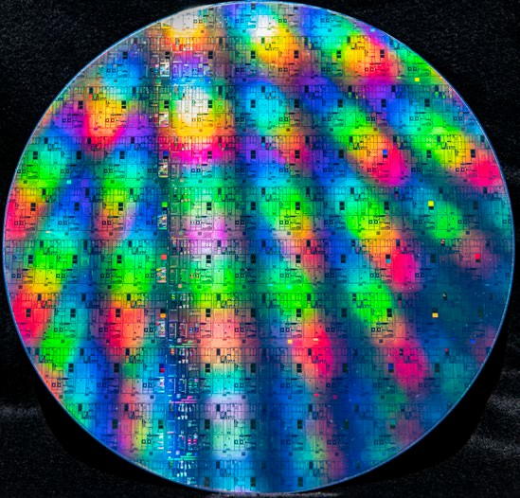
Across the spectrum of fundamental to applied research
J.J. at the English-language Wikipedia, CC BY-SA
3.0 <http://creativecommons.org/licenses/by- sa/3.0/>, via Wikimedia Commons
Low-SWaP cold atom optical atomic clock
Towards portable atomic clocks…
Cold atom
Cold atom optical atomic clock
9”
AFRL Optical Rubidium Atomic Frequency Standard
https://www.nist.gov/image/ytterbiumlatticeatomicclockjpg
Understanding atomic physics…
…to creating research grade atomic clocks…
…to developing portable atomic clocks…
…to exploring the future…

Slide 6

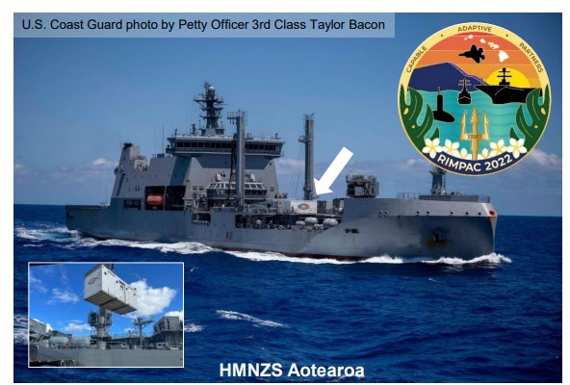
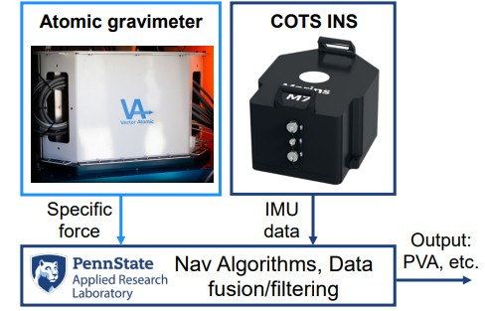


Demonstration of Quantum Sensors, Quantum Clocks and Critical Components at Rim of the Pacific (RIMPAC) 2022 Exercises
Among the first US field tests of advanced optical atomic clocks, cold-atom technology, quantum gravimeters, optical frequency combs, and other quantum-supporting technologies.
Image of the HMNZS Aotearoa while underway at RIMPAC. The ONR custom shipping container used to support the various experiments is visible on the deck.
Air Force Research Laboratory’s Optical Rubidium Atomic Frequency Standard, or ORAFS, is an advanced optical clock design built on existing vapor cell and laser technologies.
Block diagram and images of the atomic gravimeter and commercial off-the-shelf INS system used during the RIMPAC event.

Slide 7
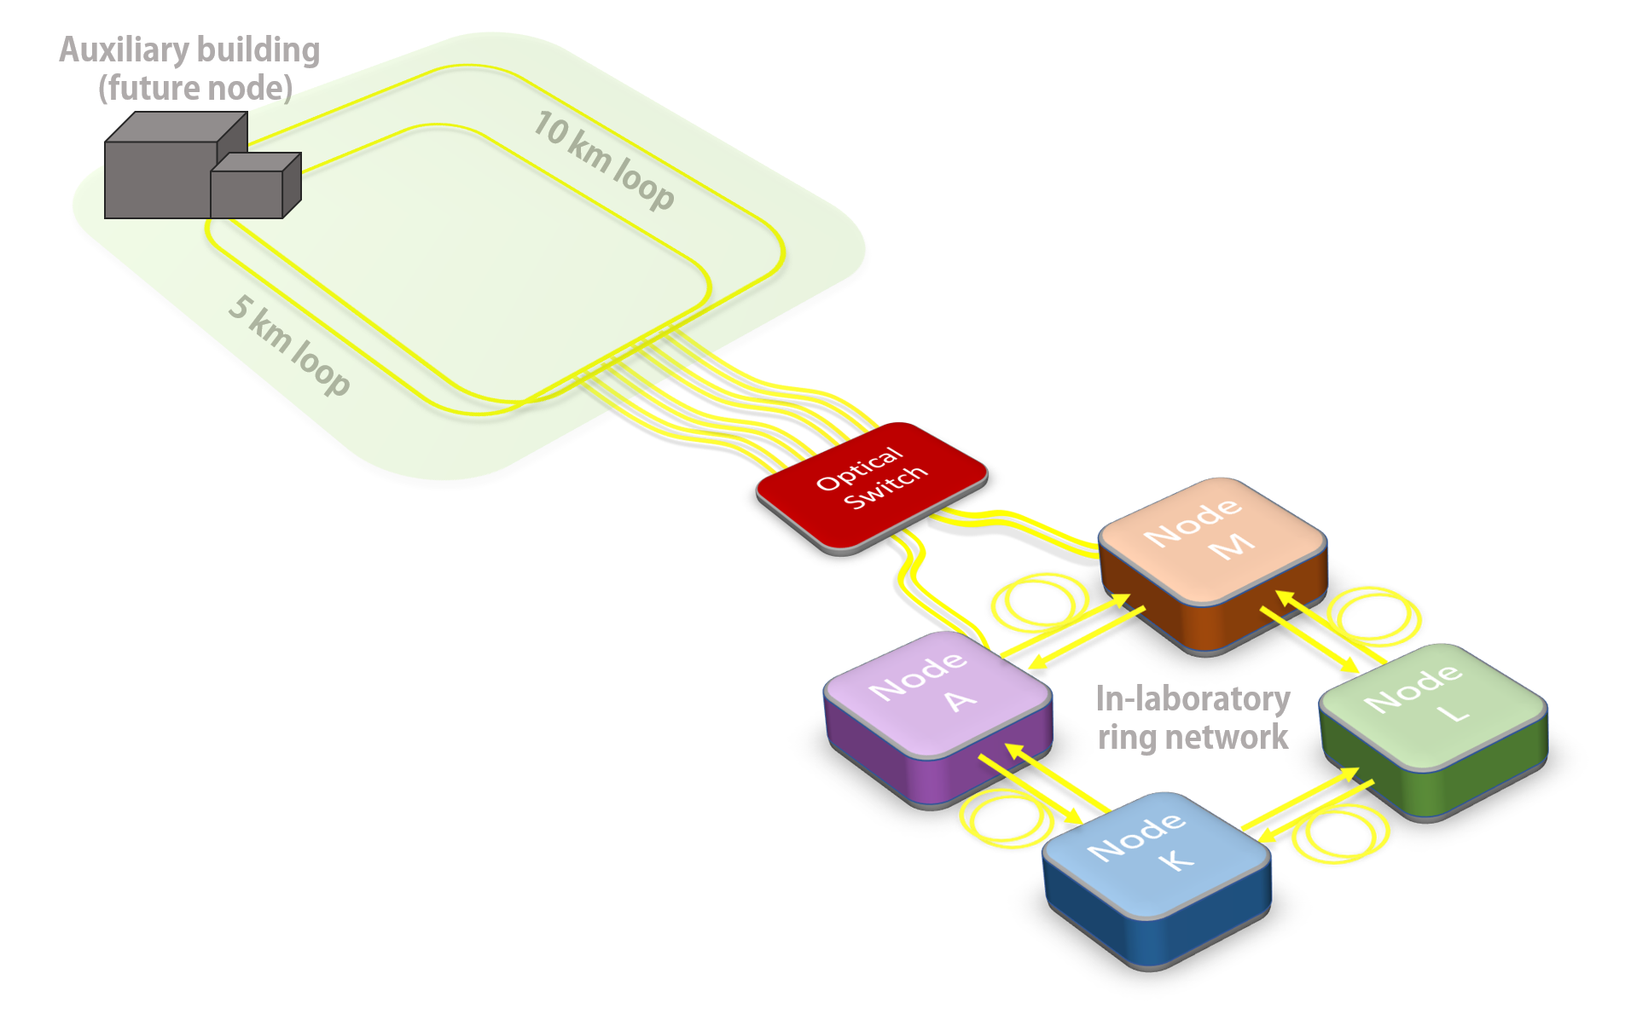
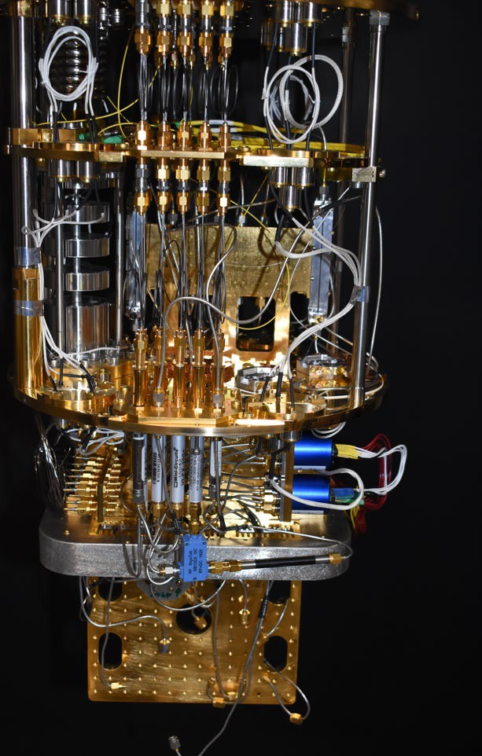

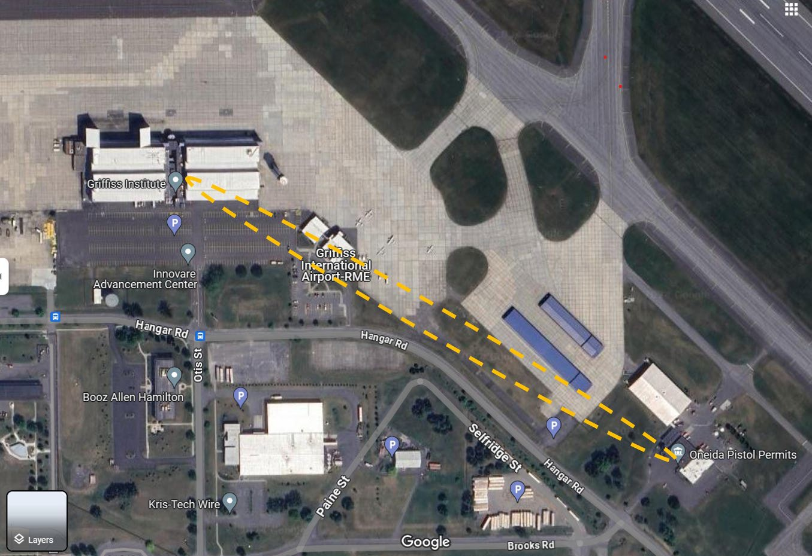
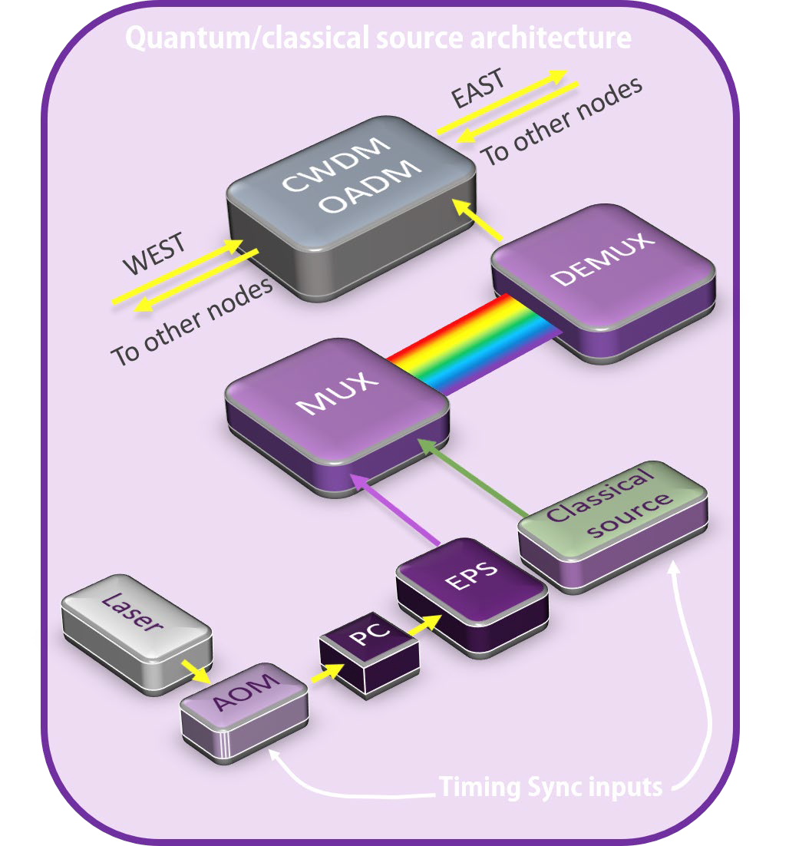
AFRL Quantum Networking Distributed Testbed: Classical and Quantum Interfaces
Superconducting qubit network node
Trapped Ion Node
Classical/quantum channels
Deployed fiber loop
Innovare

Slide 8
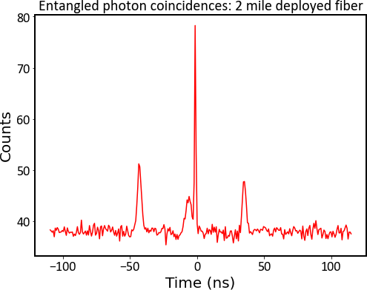
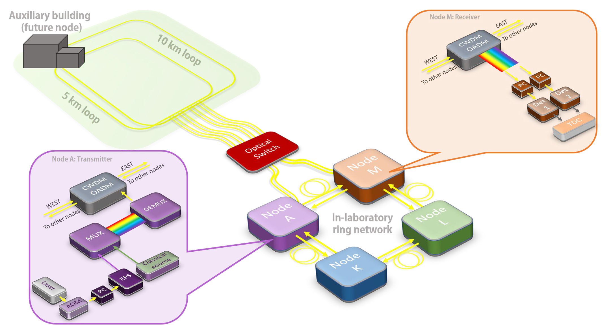
Entangled photons sent through deployed fiber
Quantum photonic integrated circuit (QPIC) entangled photon sourced designed by RITQ and fabricated by AIM Photonics
Entangled photon output routed through indoor ring network and sent through 5 km outdoor loop
Central peak
From scattering in fiber
Cross-correlations
Polarization and frequency-entangled photons (correlated pair) at 1530 nm and 1570 nm
Coincidence peak demonstrates the quantum correlation between the entangled photon pair survives transport through the network

Slide 9





Connecting with AFRL: Non-Traditional Pathways to Partner and Engage
K-12 STEM, INTERNSHIPS, VISITING FACULTY
SMALL BUSINESS
AGREEMENTS
INNOVATION FACILITIES
K-12 STEM Camps and Activities
Internships
Visiting Faculty Program
Information Institute
Small Business Innovation Research (SBIR)
Small Business Technology Transfer (STTR)
Cooperative Research and Development
Information Transfer
Material Transfer
Educational Partnership
Patent License
Commercial Test
Innovare Advancement Center
Quantum Labs
Electronics Labs
Collaboration Workspaces
“Accelerate Innovation and Embrace the Power of Collective Learning.” – AFRL Commanders Intent
See Q4I talks on Day 3 (27 Jun) !
For more info visit innovare.org and afresearchlab.com

Slide 10
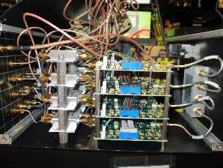
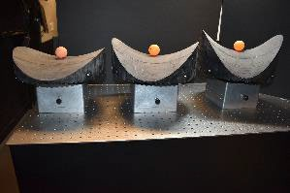
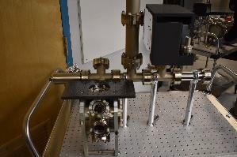
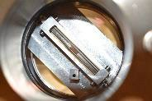
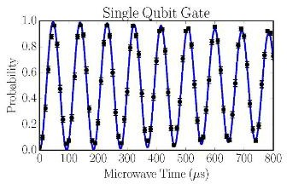
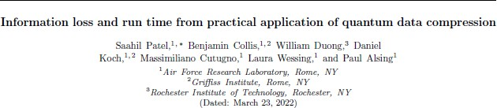
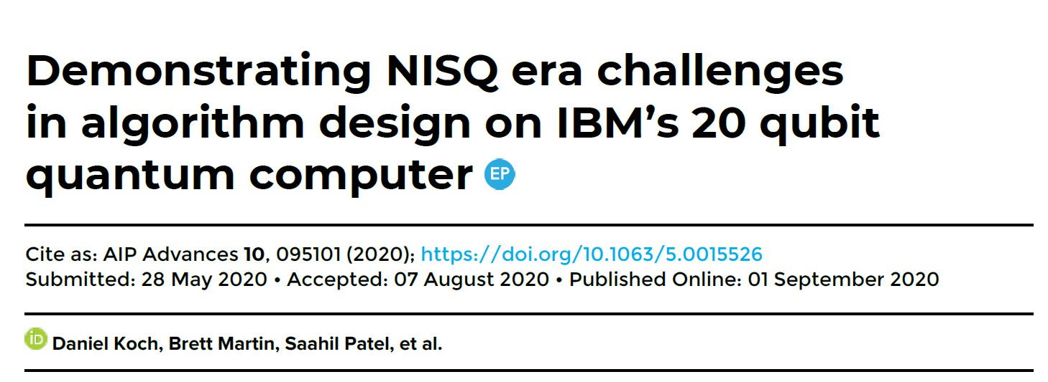
Connecting with AFRL: Some examples of what our students and interns work on
Design, build, and test electronics
Design and build vacuum chamber; operate experiments
Design, build, and test lab demos
Summer (undergrad) student (2-3 months)
Coop (undergrad) student (6 months)
Returning (almost graduate) student (1 year)
Run experiments
Investigate quantum algorithms
Summer (undergrad) students (2- 3 months) plus continuing work during school year and/or joining our team for an additional year
Coop (undergrad) student (6 months)
See Q4I talks on Day 3 (27 Jun) !
Approved for Public Release; [Case Number AFRL-2024-3240]; Distribution Unlimited
10

Slide 11






QUESTIONS?
Approved for Public Release; [Case Number AFRL-2024-3240]; Distribution Unlimited
11
Approved for Public Release; [Case Number AFRL-2024-3240]; Distribution Unlimited

