Slide 1

Coherent control of molecular collisions in and beyond the ultracold regime
A. Devolder, T. Tscherbul AND P. Brumer

Slide 2
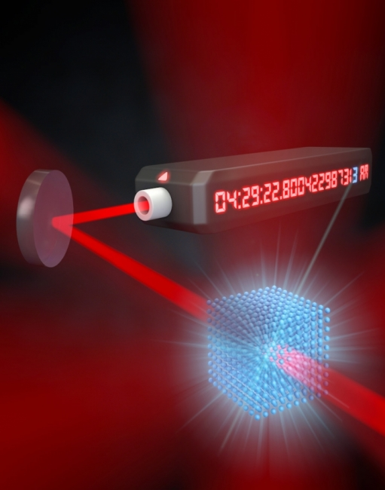
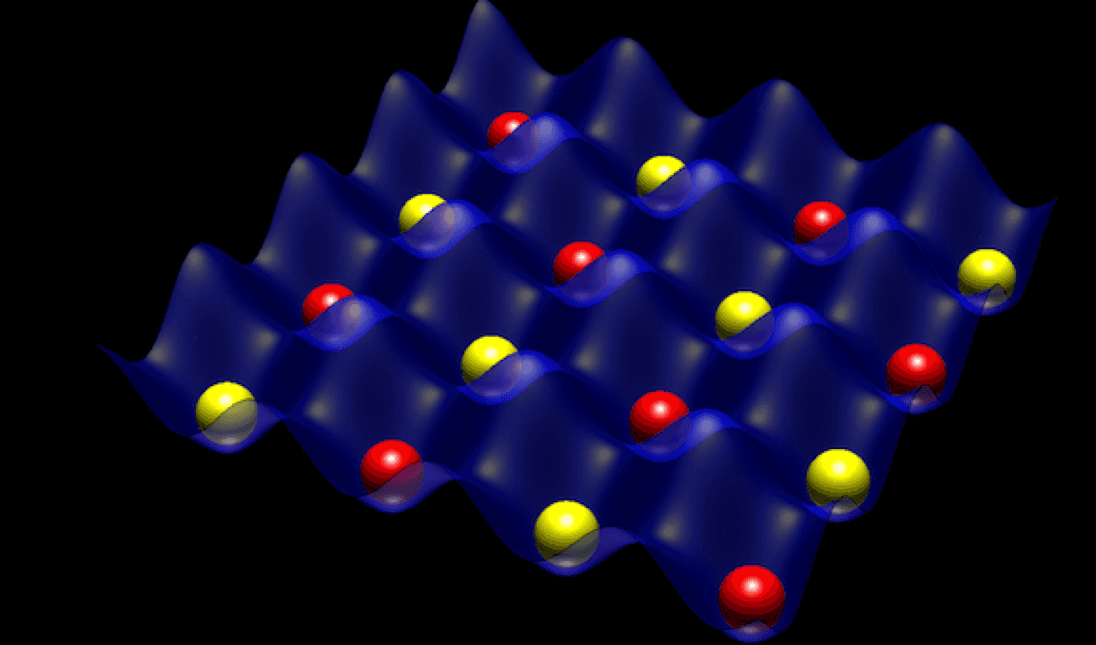
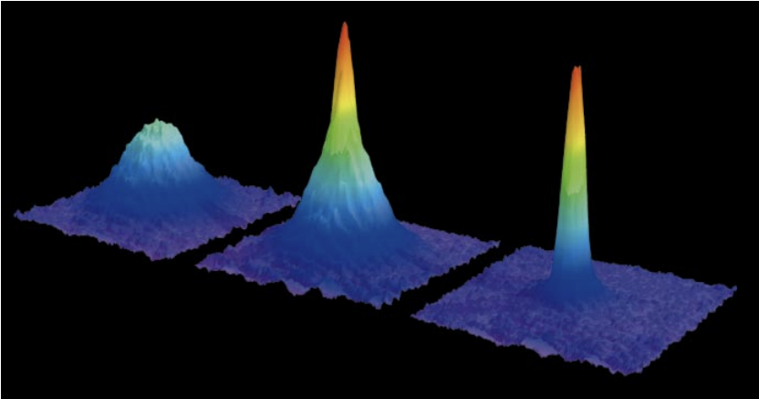
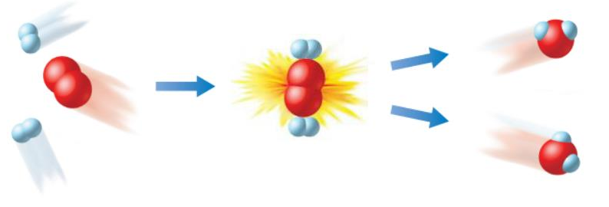

Why controlling collisions?
Suppressing collisional decoherence for quantum computing/simulation
Suppressing errors in precision measurement
Figure from T. Porto “Cold Atoms in Optical Lattices”
Figure from S.L. Campbell , Science, 358, 6359 (2017)
Improving the cooling of atoms/ions/molecules
Optimizing the reaction yields
Figure from W. Keterlee, RMP,, 562, 74, 1131-1151 (2002)
Figure from Wong Hsiung “Rate of reaction”

Slide 3
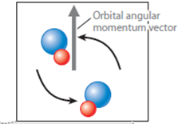
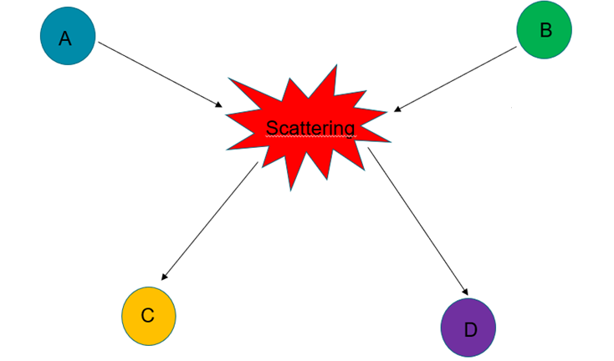
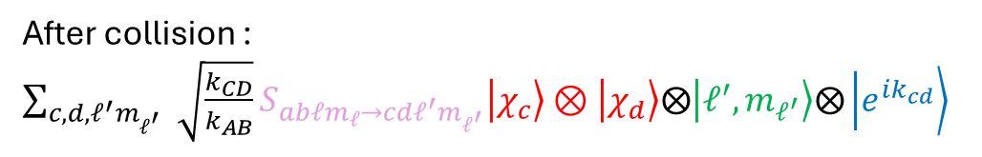
Collisions in quantum framework
Internal states of colliding particles ( electronic, vibrational, rotational, spin states etc …)
relative rotation of colliding particles (initial partial wave)
Before collision : $\left.\left|χ_{a}\right.\right\rangle ⊗\left.\left|χ_{b}\right.\right\rangle ⨂\left.\left|ℓ,m_{ℓ}\right.\right\rangle ⨂\left.\left|e^{−ik_{AB}}\right.\right\rangle$
Ingoing wave
Figure from Yu Liu et al. Annu. Rev. Phys. Chem, 73, 73-96 (2022)
S-matrix: transition amplitude
S-matrix is unitary
After collision : $\sum_{c,d,ℓ^{′}m_{ℓ_{}^{′}}}{\sqrt{\frac{k_{CD}}{k_{AB}}}S_{abℓm_{ℓ}→cdℓ^{′}m_{ℓ^{′}}}\left.\left|χ_{c}\right.\right\rangle ⊗\left.\left|χ_{d}\right.\right\rangle ⨂\left.\left|ℓ^{′},m_{ℓ^{′}}\right.\right\rangle ⨂\left.\left|e^{ik_{cd}}\right.\right\rangle }$
Outgoing wave
Internal states of scattered particles
relative rotation of scattered particles (final partial wave)

Slide 4
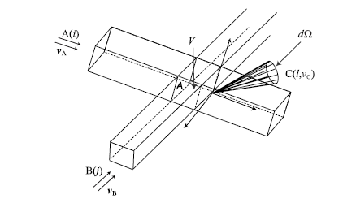
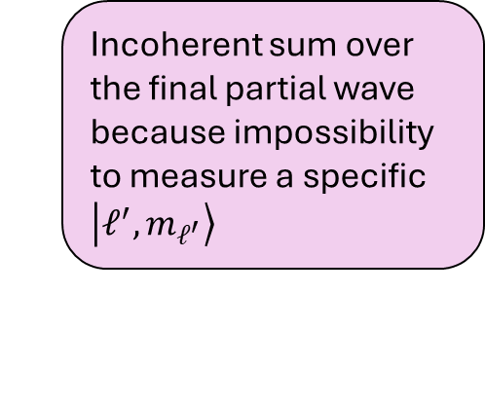
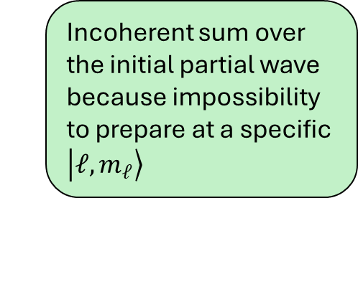
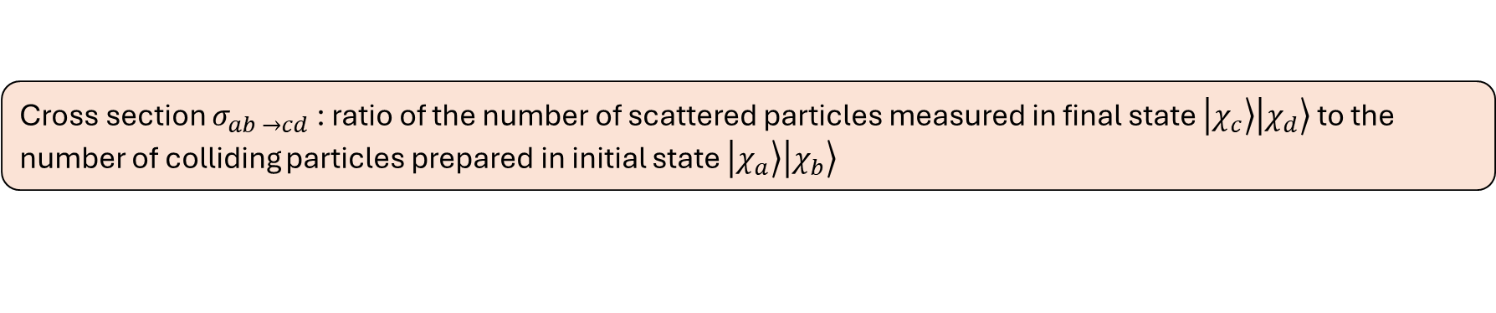
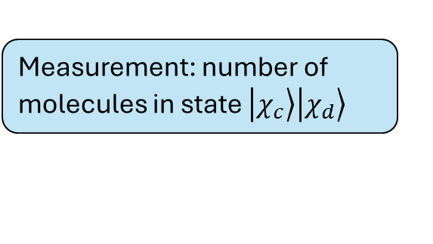

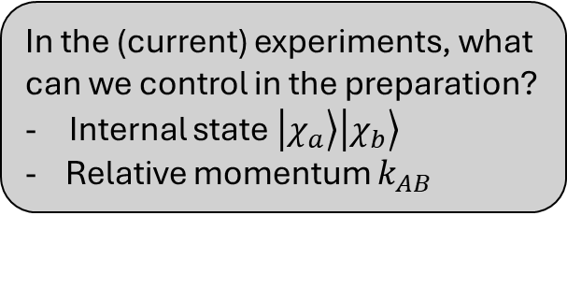
Main observable: Cross section
In the (current) experiments, what can we control in the preparation?
Internal state $\left.\left|χ_{a}\right.\right\rangle \left.\left|χ_{b}\right.\right\rangle$
- Relative momentum $k_{AB}$
Measurement: number of molecules in state $\left.\left|χ_{c}\right.\right\rangle \left.\left|χ_{d}\right.\right\rangle$
Figure from N. E. Henriksen and F. Y. Hansen “Theories of molecular reaction dynamics”
Cross section $σ_{ab →cd}$: ratio of the number of scattered particles measured in final state $\left.\left|χ_{c}\right.\right\rangle \left.\left|χ_{d}\right.\right\rangle$ to the number of colliding particles prepared in initial state $\left.\left|χ_{a}\right.\right\rangle \left.\left|χ_{b}\right.\right\rangle$
$$σ_{ab →cd}=\frac{π}{k_{ab}^{2}}\sum_{ℓ,m_{ℓ}}{\sum_{ℓ^{′},m_{ℓ}^{′} }{{\left|T_{abℓm_{ℓ}→cdℓ^{′}m_{ℓ}^{′}}\right|}^{2}}}$$
$$T_{abℓm_{ℓ}→cdℓ^{′}m_{ℓ}^{′}}=δ_{abℓm_{ℓ}→cdℓ^{′}m_{ℓ}^{′}}−S_{abℓm_{ℓ}→cdℓ^{′}m_{ℓ}^{′}}$$
Incoherent sum over the initial partial wave because impossibility to prepare at a specific $\left.\left|ℓ,m_{ℓ}\right.\right\rangle$
Incoherent sum over the final partial wave because impossibility to measure a specific $\left.\left|ℓ^{′},m_{ℓ^{′}}\right.\right\rangle$

Slide 5
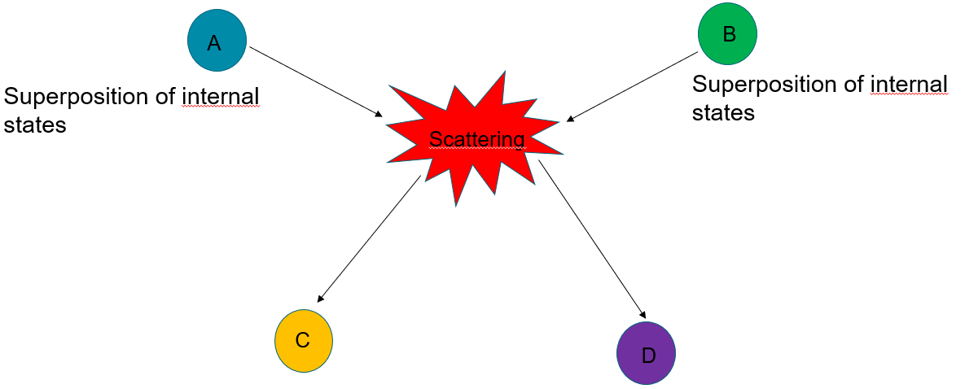
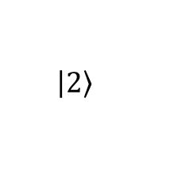
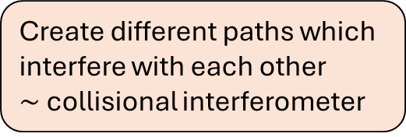
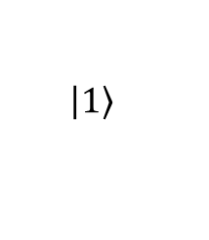

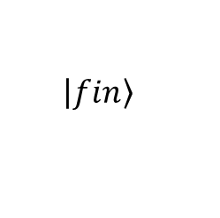

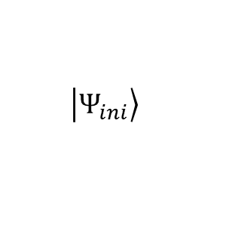


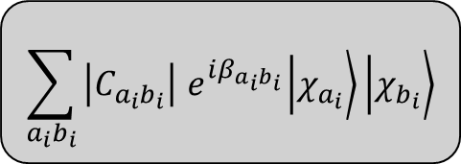
Coherent control of collisions
$$\sum_{a_{i}b_{i}}{\left.\left|C_{a_{i}b_{i}}\right|{ e}^{iβ_{a_{i}b_{i}}}\left|χ_{a_{i}}\right.\right\rangle \left.\left|χ_{b_{i}}\right.\right\rangle }$$
$$\left.\left|1\right.\right\rangle$$
$$\left|c_{1}\right|$$
$$T_{1→fin}$$
$$\left.\left|Ψ_{ini}\right.\right\rangle$$
$$\left.\left|fin\right.\right\rangle$$
$$\left|c_{2}\right|e^{iβ}$$
$$T_{2→fin}$$
$$\left.\left|2\right.\right\rangle$$
Create different paths which interfere with each other
$\sim$collisional interferometer
Direct term
Interference term
$$σ_{sup →cd}=\frac{π}{k_{}^{2}}\sum_{ℓ,m_{ℓ}}{\sum_{ℓ^{′},m_{ℓ}^{′} }{\left(\sum_{a_{i}b_{i}}{{\left|C_{a_{i}b_{i}}\right|}^{2}{\left|T_{a_{i}b_{i}ℓm_{ℓ}→cdℓ^{′}m_{ℓ}^{′}}\right|}^{2}}+\sum_{a_{i}b_{i}}{\sum_{a_{j}b_{j}}{\left|C_{a_{i}b_{i}}\right|\left|C_{a_{j}b_{j}}\right|e^{i\left(β_{a_{i}b_{i}}−β_{a_{j}b_{j}}\right)}T_{a_{i}b_{i}ℓm_{ℓ}→cd ℓ^{′}m_{ℓ}^{′}}^{∗}T_{a_{j}b_{j}ℓm_{ℓ}→cd ℓ^{′}m_{ℓ}^{′}}}}\right)}}$$
Controlled by tuning the relative phases

Slide 6




Type of superpositions
Interference if :
Same internal energy $→$ Superposition of degenerate magnetic sublevels (m-superposition)
Same internal projection
$$\left.\left|ψ_{A}\right.\right\rangle =\frac{1}{\sqrt{2}}\left(\cos{η}\left.\left|m_{1}^{A}\right.\right\rangle +\sin{η}e^{iβ}\left.\left|m_{2}^{A}\right.\right\rangle \right)$$
$$\left.\left|ψ_{B}\right.\right\rangle =\frac{1}{\sqrt{2}}\left(\sin{η}\left.\left|m_{1}^{B}\right.\right\rangle +\cos{η}\left.\left|m_{2}^{B}\right.\right\rangle \right)$$
$$\left.\left|Ψ_{nent}\right.\right\rangle =\left|\left.ψ_{A}\right\rangle ⨂\left.\left|ψ_{B}\right.\right\rangle =\frac{1}{2}\right.\left(\cos{η}\sin{η}\left.\left|m_{1}^{A},m_{1}^{B}\right.\right\rangle +\cos^{2}η\left.\left|m_{1}^{A},m_{2}^{B}\right.\right\rangle +\sin^{2}ηe^{iβ}\left.\left|m_{2}^{A},m_{1}^{B}\right.\right\rangle +\cos{η}\sin{η}\left.\left|m_{2}^{A},m_{2}^{B}\right.\right\rangle \right)$$
Interference
$$m_{1}^{A}+m_{2}^{B}=m_{2}^{A}+m_{1}^{B}$$
Example with spin-half particles:
$$\left.\left|Ψ_{nent}\right.\right\rangle =\left|\left.ψ_{A}\right\rangle ⨂\left.\left|ψ_{B}\right.\right\rangle =\frac{1}{2}\right.\left(\cos{η}\sin{η}\left.\left|↑,↑ \right.\right\rangle +\cos^{2}η\left.\left|↑,↓ \right.\right\rangle +\sin^{2}ηe^{iβ}\left.\left|↓,↑ \right.\right\rangle +\cos{η}\sin{η}\left.\left|↓,↓\right.\right\rangle \right)$$

Slide 7
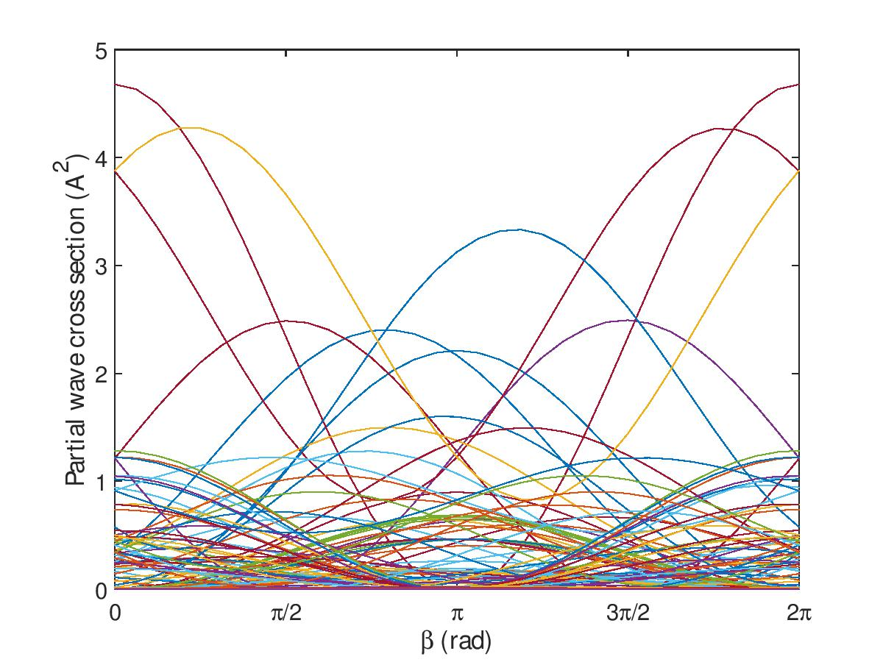
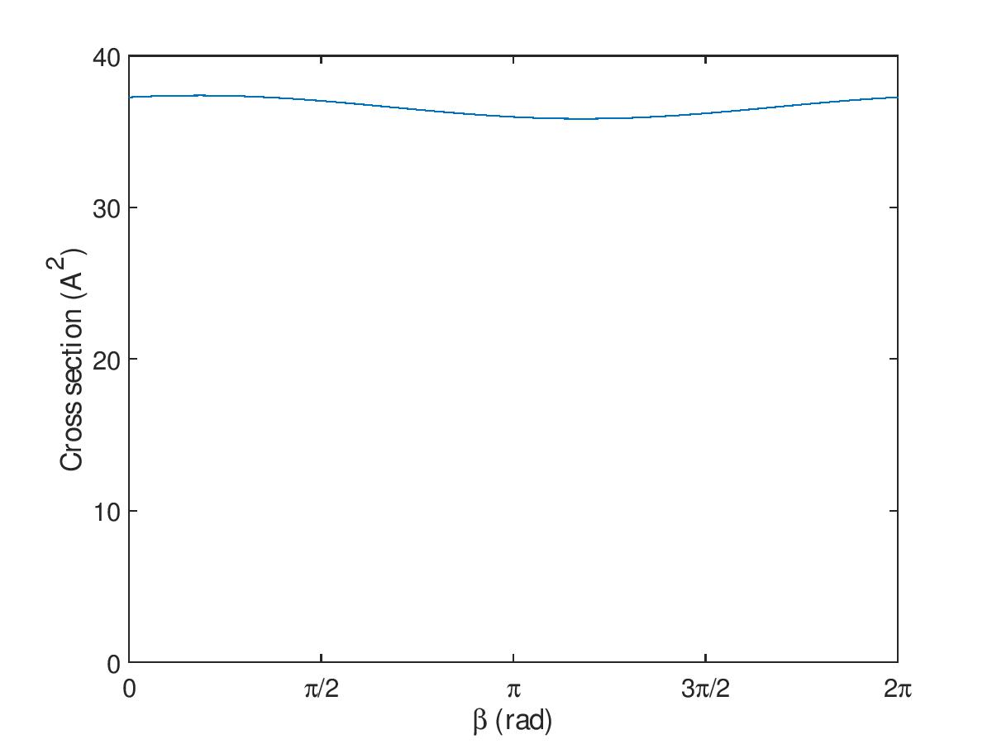
Partial wave expansion challenge
$$σ_{sup →cd}=\frac{π}{k_{ab}^{2}}\sum_{ℓ,m_{ℓ}}{\sum_{ℓ^{′},m_{ℓ}^{′} }{{\left|\sum_{i}{\cos^{2}ηT_{m_{1}^{A}m_{2}^{B}ℓm_{ℓ}→cd ℓ^{′}m_{ℓ}^{′}}+\sin^{2}η}e^{iβ}T_{m_{2}^{A}m_{1}^{B}ℓm_{ℓ}→cd ℓ^{′}m_{ℓ}^{′}}\right|}^{2}+σ_{sat}}}$$
Different control between partial waves → Cancellation of interference terms
Example with 50 partial waves (Rb-Rb scattering at 1K):
How to solve it?

Slide 8
Strategies
3 Strategies :
Ultracold regime
Resonance
Phase-locking mechanism

Slide 9
Strategies
3 Strategies :
Ultracold regime
Resonance
Phase-locking mechanism

Slide 10
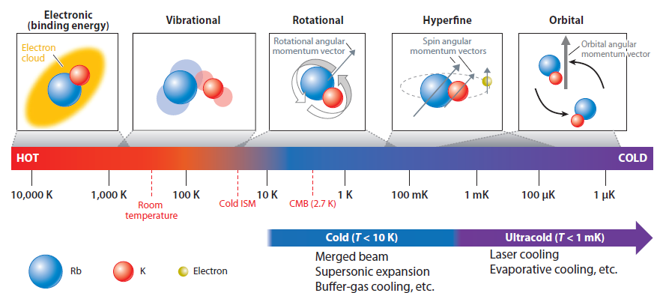
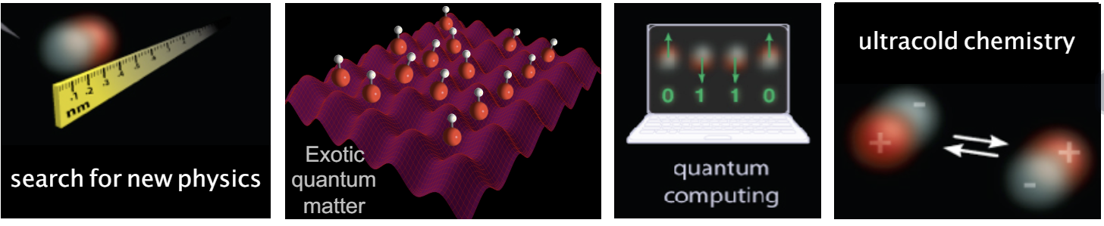
Ultracold regime
Why so cold ?
Enhanced quantum behaviour at these temperature
Better control on all degrees of freedom
Increasing precision of measurements
Figure from Yu Liu et al. Annu. Rev. Phys. Chem, 73, 73-96 (2022)
Application:
Figure from K.K. Ni “Ultracold Molecules for physics and chemistry”

Slide 11
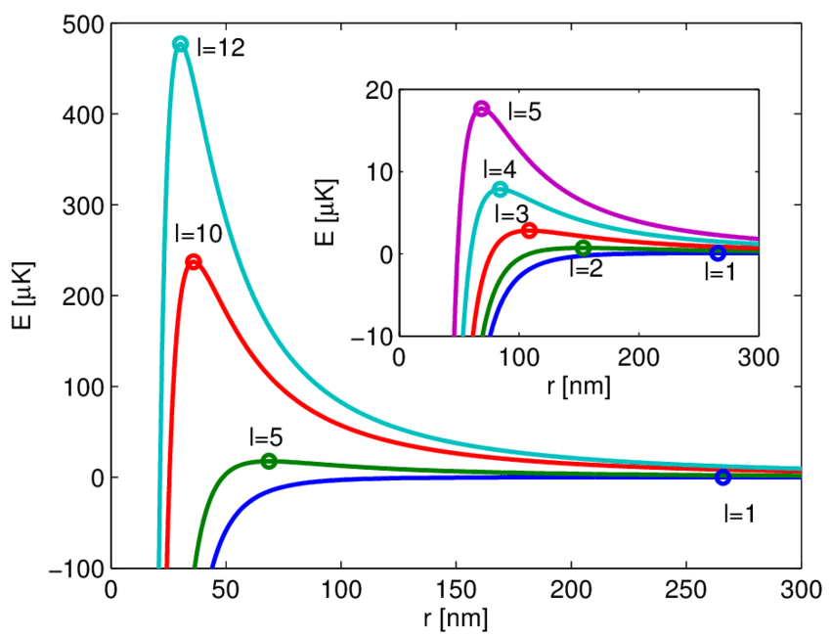
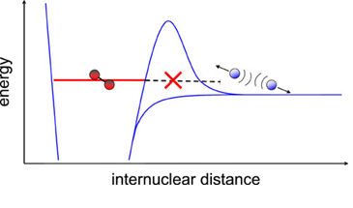
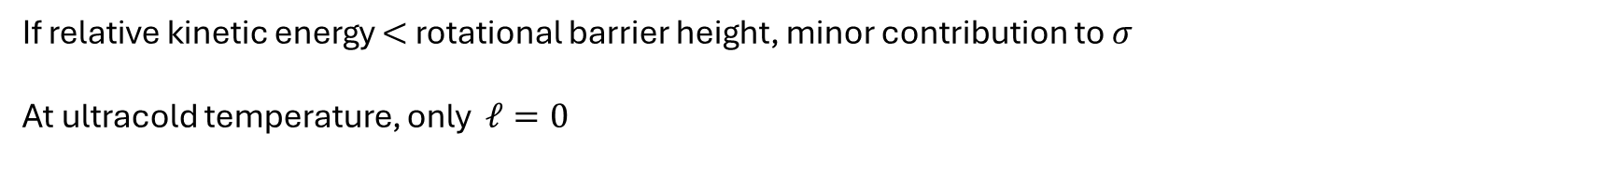
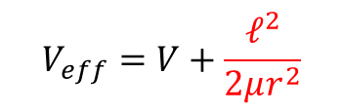
Partial waves and ultracold temperature
Figure from R. Krems “Molecules in Electromagnetic fields”
Figure from Z. Meir’s thesis “Dynamics of a single, ground-state cooled and trapped ion colliding with ultracold atoms: A micromotion tale”
$$V_{eff}=V+\frac{ℓ^{2}}{2μr^{2}}$$
If relative kinetic energy $<$ rotational barrier height, minor contribution to $σ$
At ultracold temperature, only $ℓ=0$

Slide 12
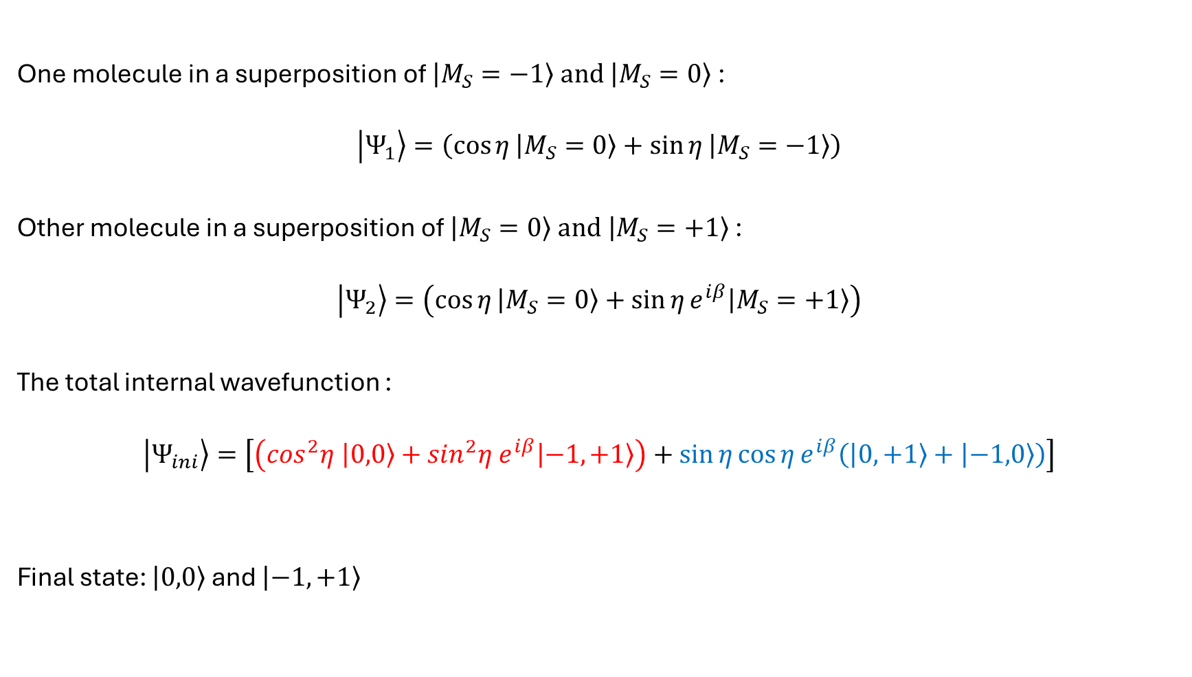

Example : $O_{2}−O_{2}$ scattering
One molecule in a superposition of $\left.\left|M_{S}=−1\right.\right\rangle and \left.\left|M_{S}=0\right.\right\rangle$:
$$\left.\left|Ψ_{1}\right.\right\rangle =\left(\cos{η}\left.\left|M_{S}=0\right.\right\rangle +\sin{η}\left.\left|M_{S}=−1\right.\right\rangle \right)$$
Other molecule in a superposition of $\left.\left|M_{S}=0\right.\right\rangle and \left.\left|M_{S}=+1\right.\right\rangle$ :
$$\left.\left|Ψ_{2}\right.\right\rangle =\left(\cos{η}\left.\left|M_{S}=0\right.\right\rangle +\sin{η}e^{iβ}\left.\left|M_{S}=+1\right.\right\rangle \right)$$
The total internal wavefunction :
$$\left.\left|Ψ_{ini}\right.\right\rangle =\left[\left(\cos^{2}η \left.\left|0,0\right.\right\rangle +\sin^{2}η e^{iβ}\left.\left|−1,+1\right.\right\rangle \right)+\sin{η}\cos{η}e^{iβ}\left(\left.\left|0,+1\right.\right\rangle +\left.\left|−1,0\right.\right\rangle \right)\right]$$
Final state: $\left.\left|0,0\right.\right\rangle$ and $\left.\left|−1,+1\right.\right\rangle$
Control part
Satellite terms
Devolder A. et al. PRL, 126, 153403 (2021)

Slide 13
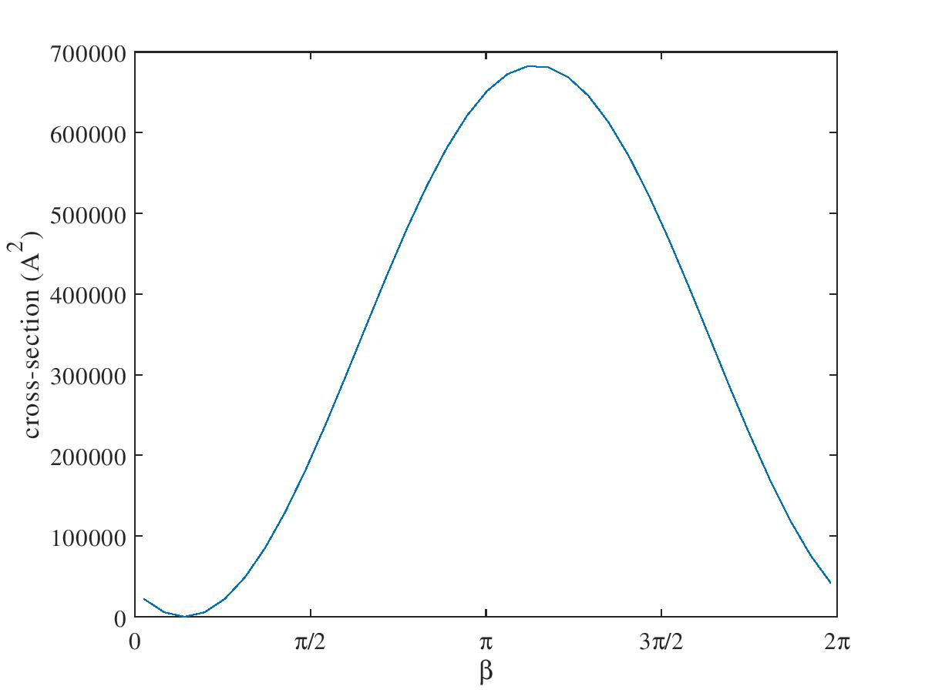
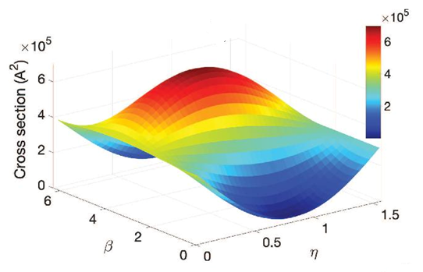
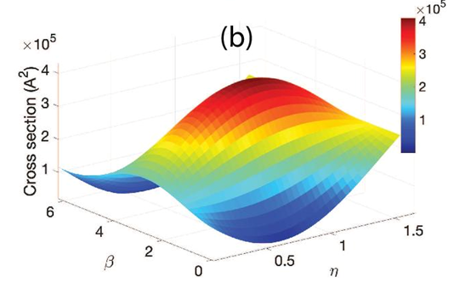
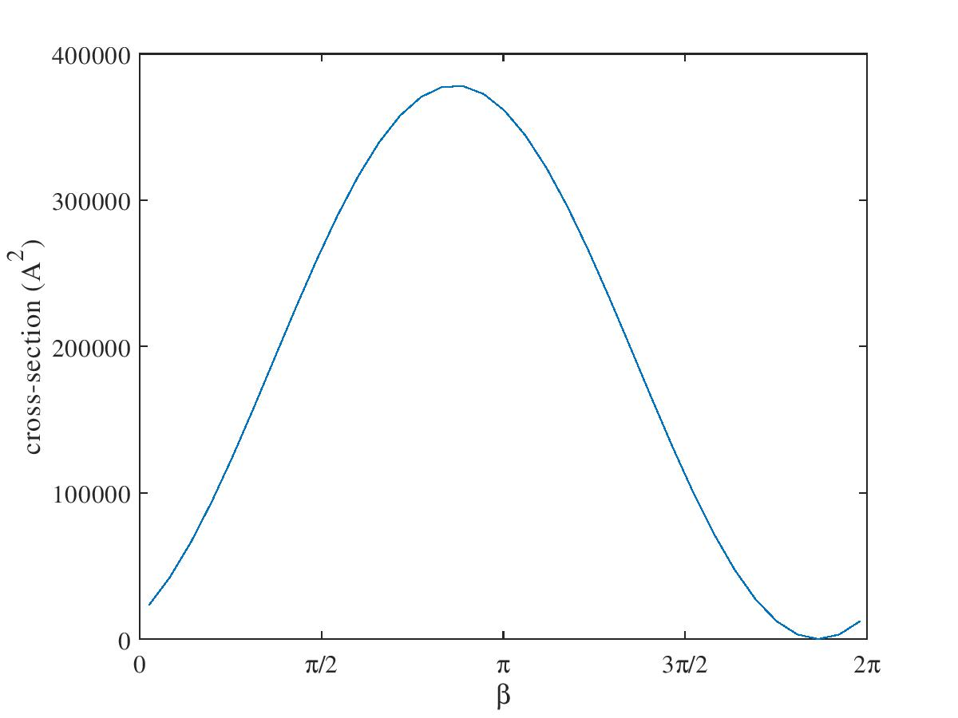








Complete destructive interference of cross-sections
$$σ_{max}=682392 Å^{2}$$
$σ_{sup→00}$
$$× {10}^{9}$$
$$σ_{min}=0.0002 Å^{2}$$
Complete destructive interference
$$σ_{max}=377977 Å^{2}$$
$σ_{sup→−1+1}$
$$× {10}^{9}$$
$$σ_{min}=0.0001 Å^{2}$$
Devolder A. et al. PRL, 126, 153403 (2021)

Slide 14
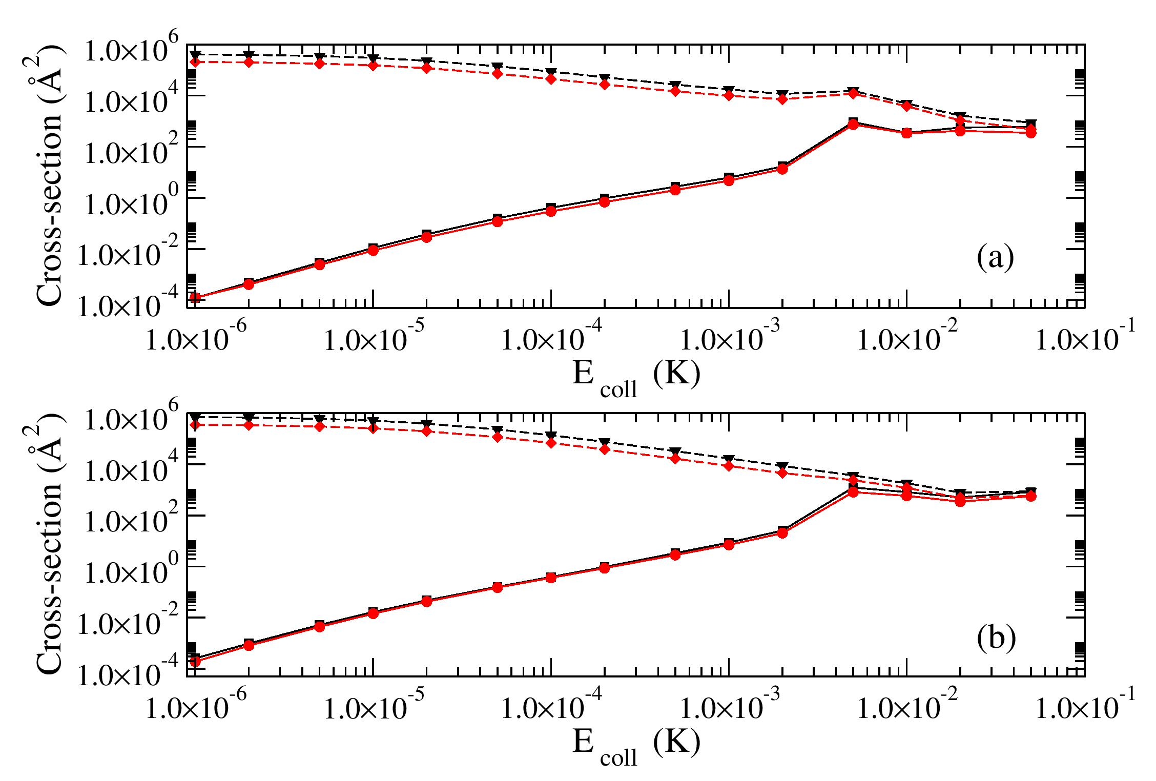


Complete destructive interference of cross-sections
$σ_{sup→00}$
9 orders of magnitude
$σ_{sup→−1+1}$
Ultracold regime
Devolder A. et al. PRL, 126, 153403 (2021)

Slide 15
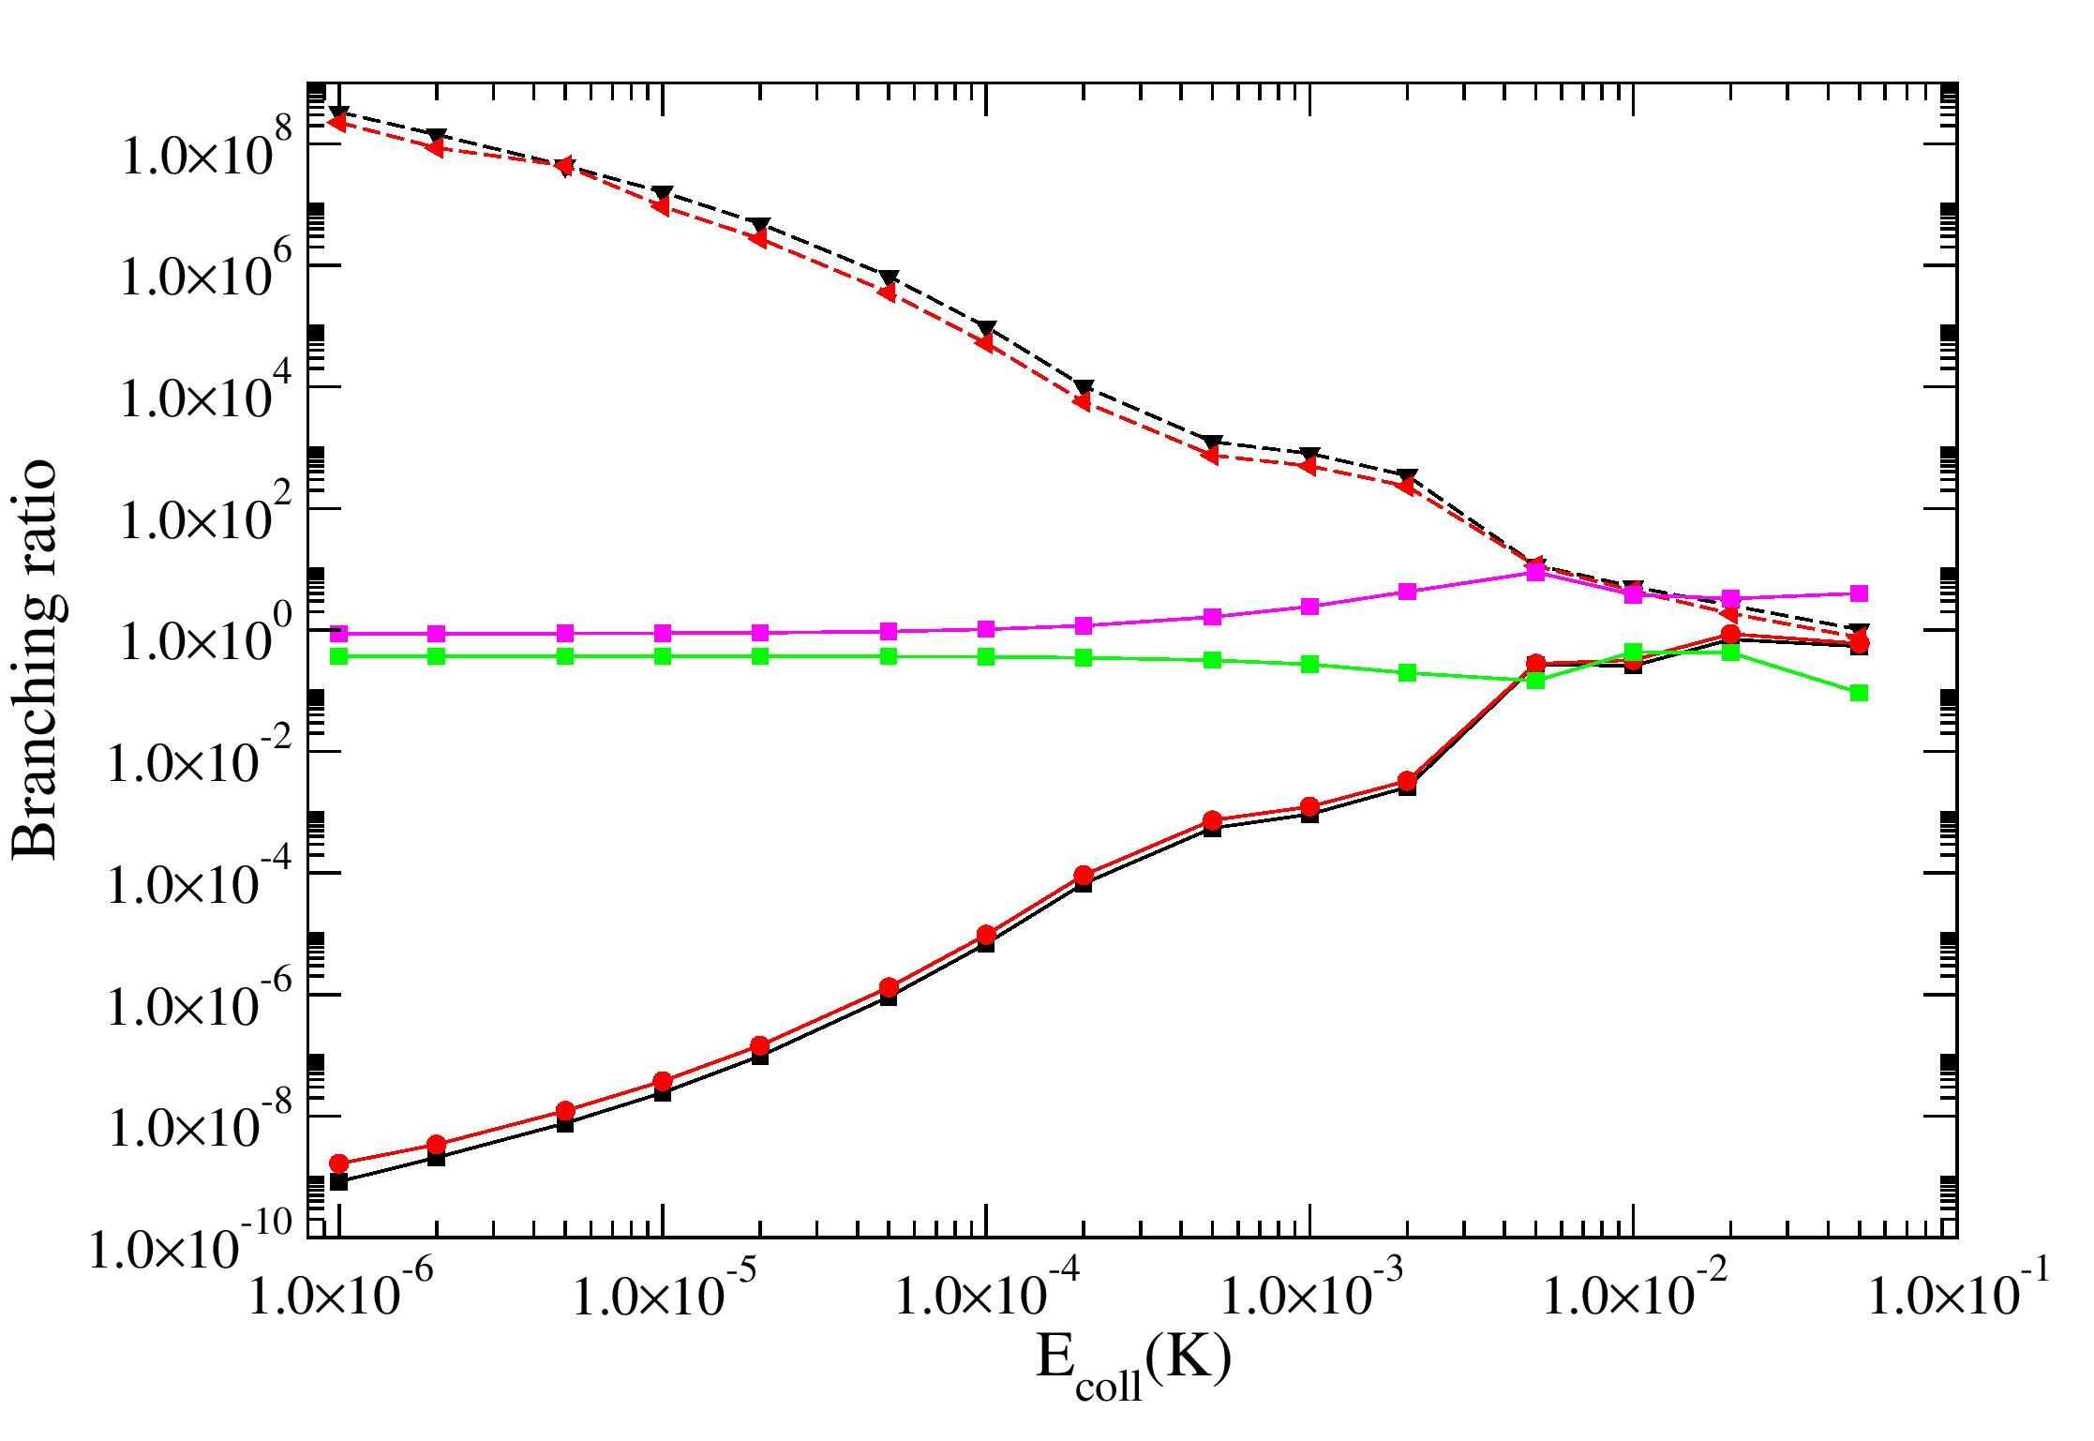
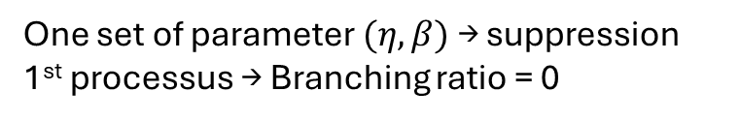
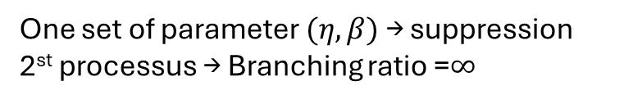
Complete control of branching ratio
One set of parameter $(η,β)$ → suppression 2st processus → Branching ratio =$∞$
17 orders of magnitude
Complete control of branching ratio
One set of parameter $(η,β)$ → suppression 1st processus → Branching ratio = 0
$⇒$ Ultracold regime is ideal for coherent control
Devolder A. et al. PRL, 126, 153403 (2021)

Slide 16
Strategies
3 Strategies :
Ultracold regime
Resonance
Phase-locking mechanism

Slide 17
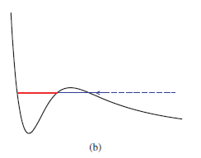

Shape resonance
Figure from Z. Meir’s thesis “Dynamics of a single, ground-state cooled and trapped ion colliding with ultracold atoms: A micromotion tale”
Figure from R. Krems “Molecules in Electromagnetic fields”
Quasi-bound state occurring due to the presence of the centrifugal barrier
One predominant partial wave $→$ ideal for coherent control
Devolder A. et al. J. Phys. Chem. Lett., 14, 8, 2171-2177 (2023)

Slide 18
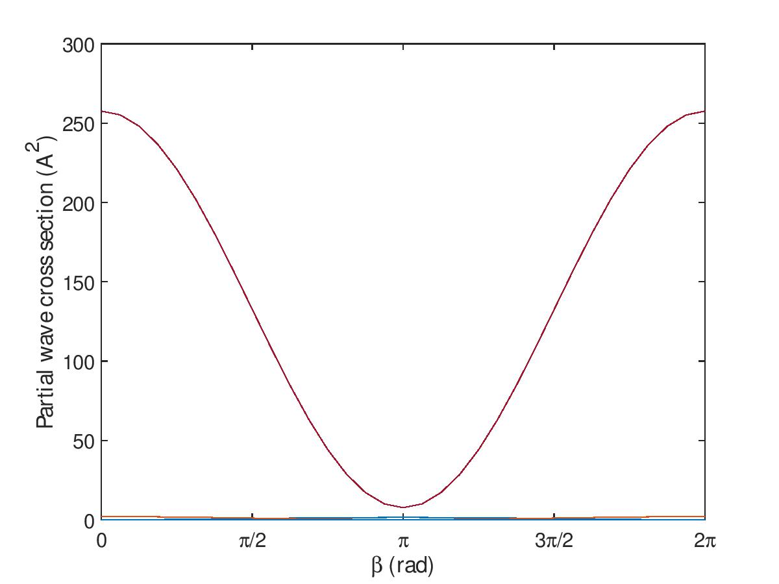
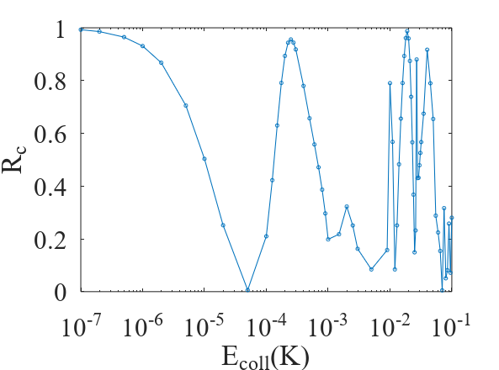
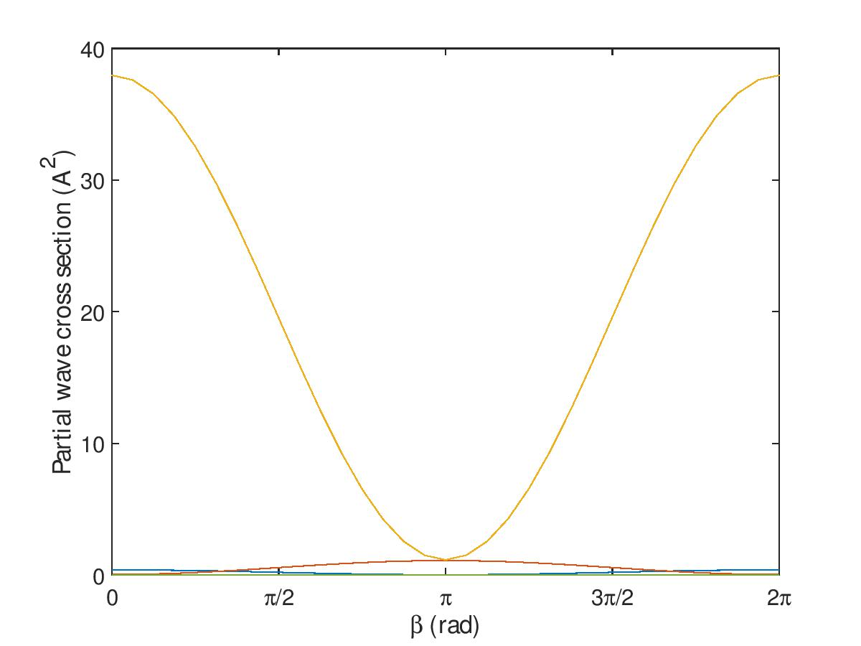
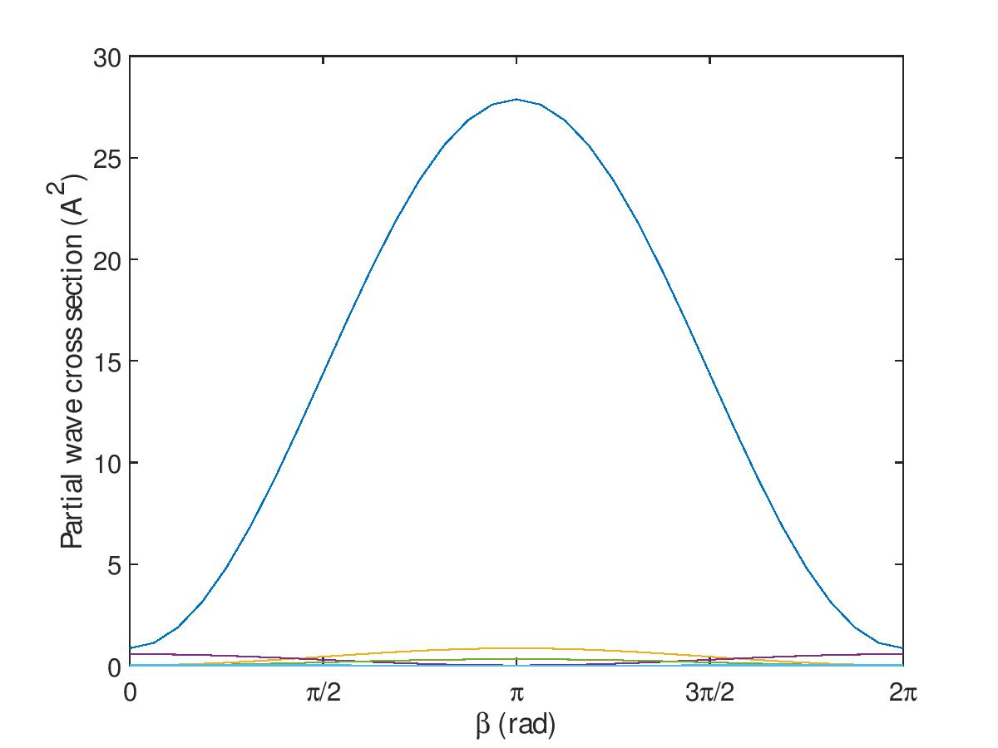
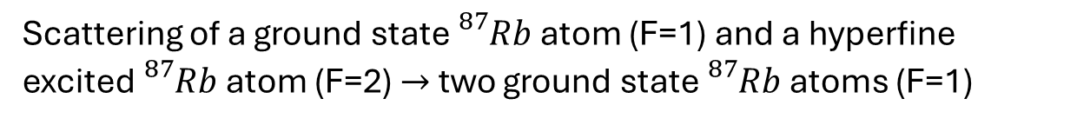

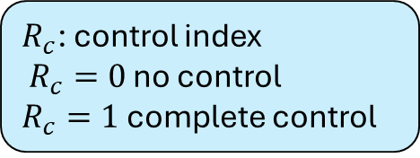


Coherent control around shape resonance
Scattering of a ground state ${}_{}^{87}{Rb}$ atom (F=1) and a hyperfine excited ${}_{}^{87}{Rb}$ atom (F=2) $→$ two ground state ${}_{}^{87}{Rb}$ atoms (F=1)
x30
Shape resonance $ℓ$=6
x25
Shape resonance $ℓ$=2
x30
$R_{c}$: control index
$R_{c}=0$ no control
$R_{c}=1$ complete control
Devolder A. et al. J. Phys. Chem. Lett., 14, 8, 2171-2177 (2023)
Shape resonance $ℓ$=7

Slide 19
Strategies
3 Strategies :
Ultracold regime
Resonance
Phase-locking mechanism

Slide 20
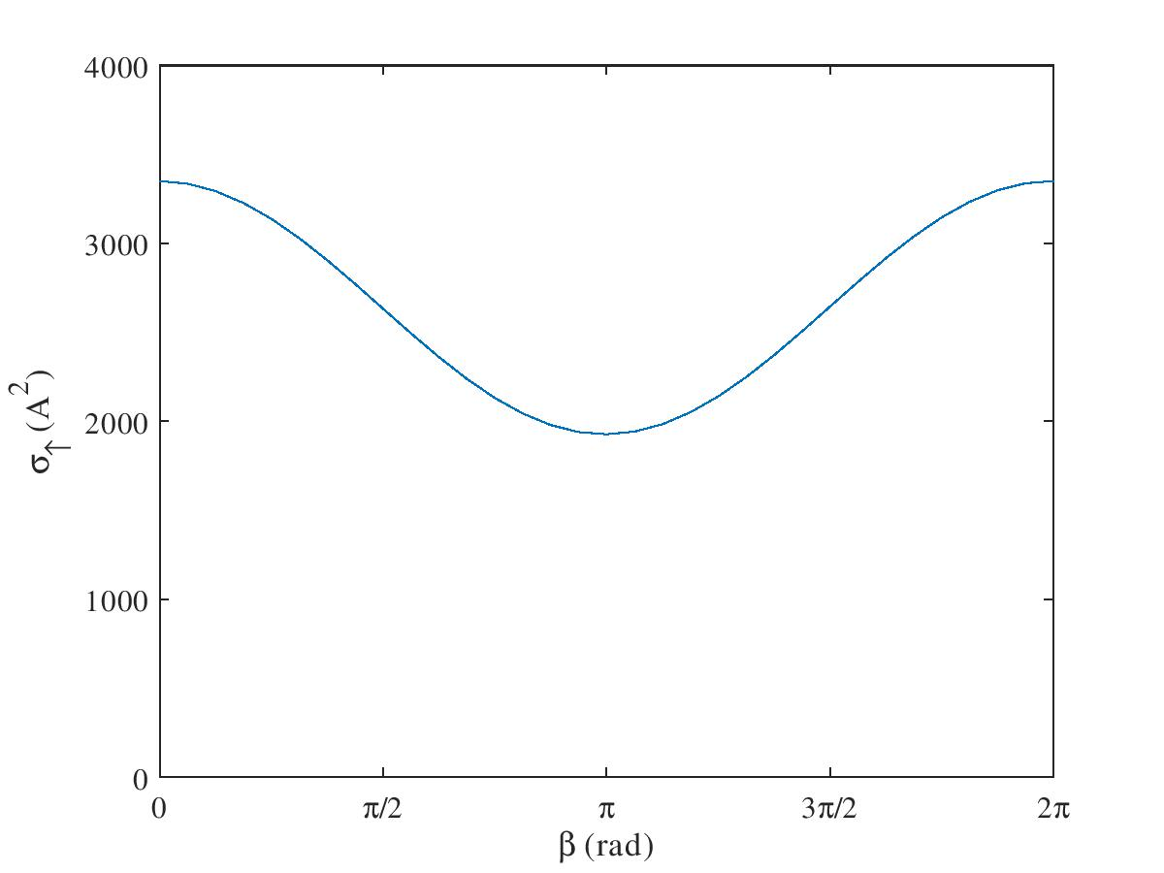
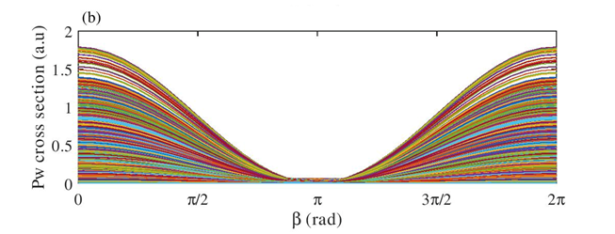
Partial wave phase locking mechanism
Phase locking of partial wave contributions: synchronization of the control of every partial waves
Partial wave phase-locking discovered in spin-exchange and spin-relaxation in atom-ion collisions (T. Sikorsky et al. PRL 173402 (2018) and R. Côté PRL 173401 (2018) )
Collisions between ${}_{}^{87}{Rb}$ atom (F=2) and a ground state ${{}_{}^{88}{Sr}}^{+}$iom (S=1/2) :
x2
E=50 mK
80 partial waves and 5000 contributions !
A. Devolder et al. PRR 5, L042025 (2023)

Slide 21
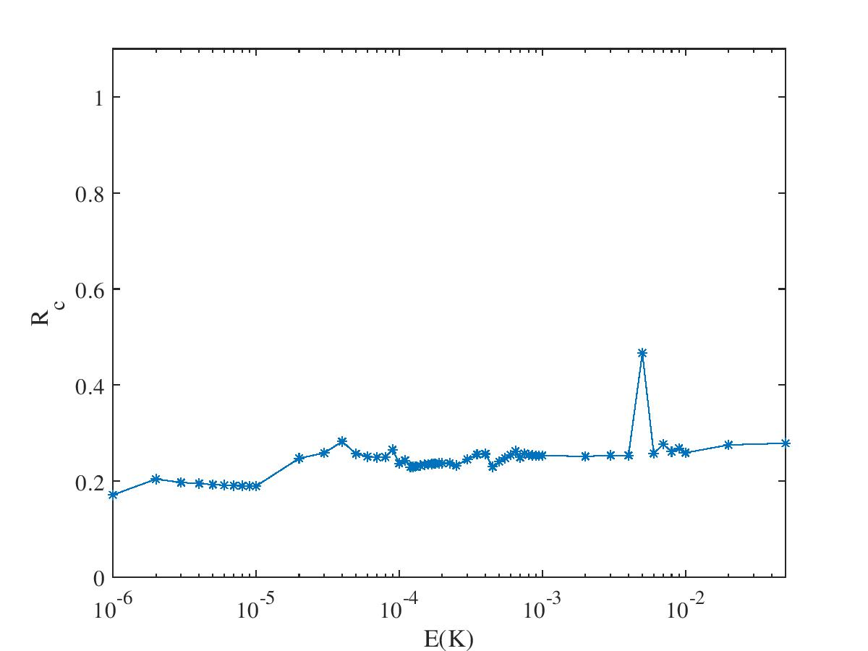

Robust coherent control beyond ultracold regime
Why not perfect control?
Due to the satellite contributions !
Satellite contribution
Solution: entangled superpositions
$$\left.\left|Ψ_{ent}\right.\right\rangle =\frac{1}{\sqrt{2}}\left(\left.\left|m_{1}^{A},m_{2}^{B}\right.\right\rangle +e^{iβ}\left.\left|m_{2}^{A},m_{1}^{B}\right.\right\rangle \right)$$
Control robust against the increase of collisional energies
No more satellite terms!
A. Devolder et al. PRR 5, L042025 (2023)

Slide 22
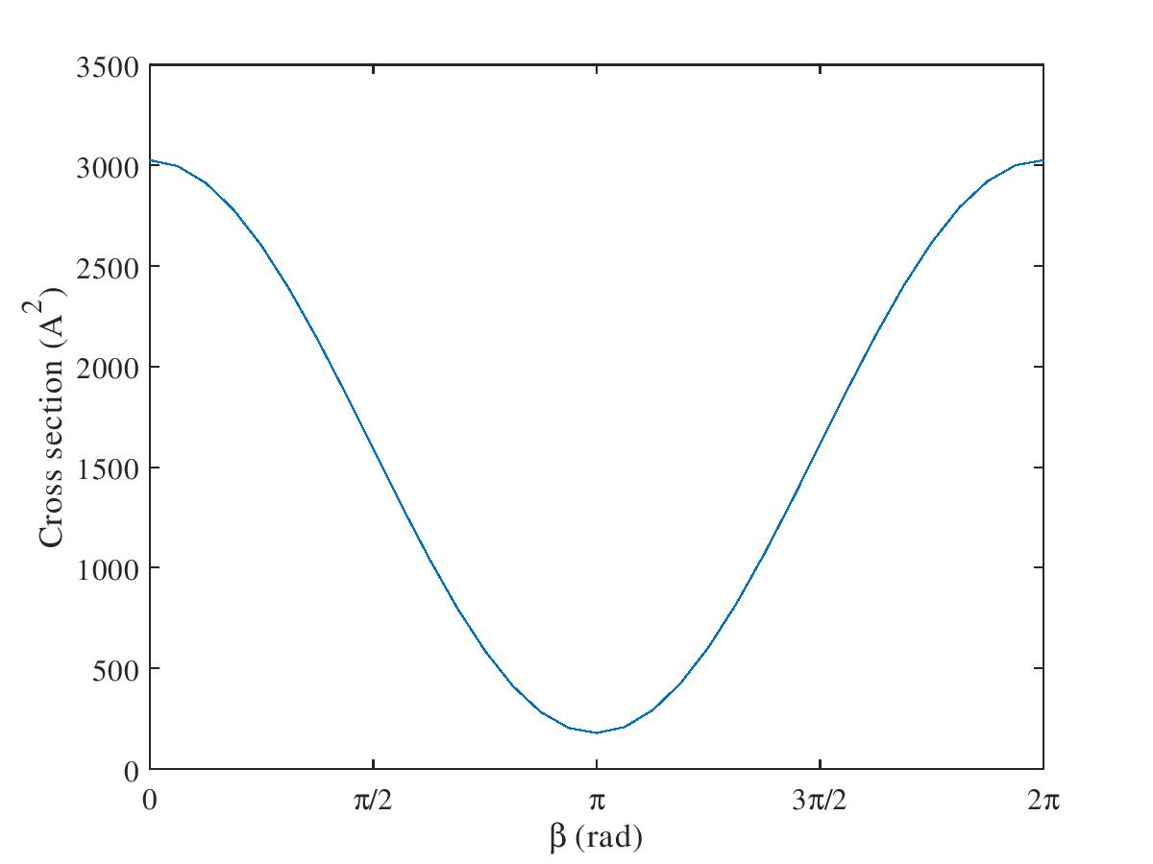
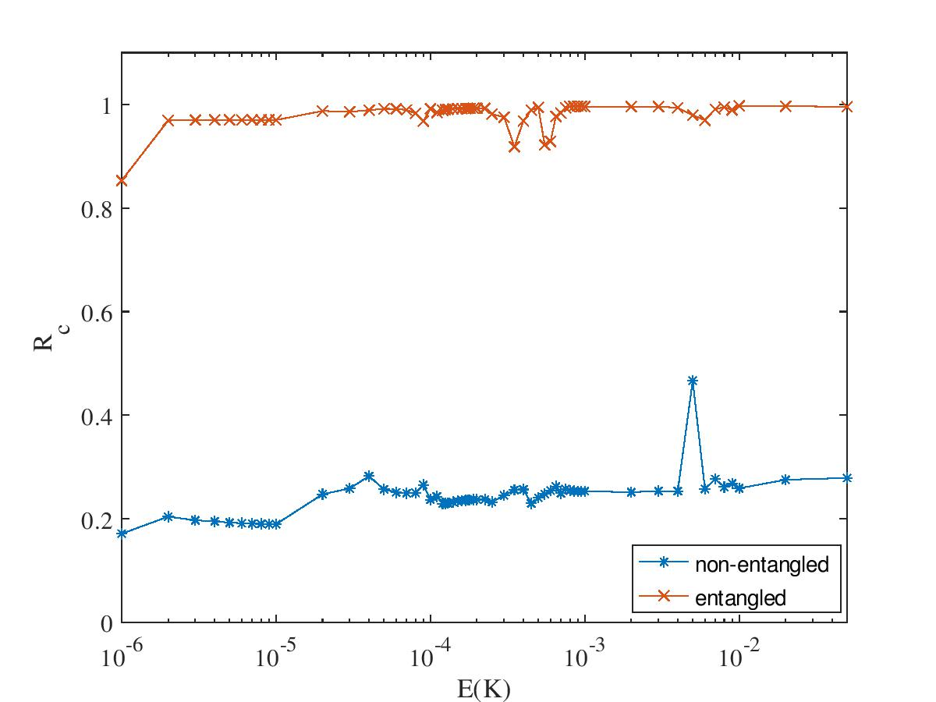
Coherent control with entangled superposition
E=50 mK
Complete control at any collisional energy
x20
Destructive interference
A. Devolder et al. PRR 5, L042025 (2023)

Slide 23

Conclusions
Preparation of initial superposition open the ways of control of molecular collisions via quantum interference
Challenge from the partial wave expansion
Resolved if:
- One dominant partial wave $ℓ,m_{ℓ}{,ℓ}^{′},m_{ℓ}^{′}$ (ultracold regime and shape resonance)
- Synchronized control for every partial waves $ℓ,m_{ℓ}{,ℓ}^{′},m_{ℓ}^{′}$ (Partial wave phase locking mechanism)
Enhancement of the control with entangled superposition

Slide 24



Thank you for your attention

Slide 25

Example: Rb-Rb scattering
Scattering of a ground state ${}_{}^{87}{Rb}$ atom (F=1) and a hyperfine excited ${}_{}^{87}{Rb}$ atom (F=2) $→$ two ground state ${}_{}^{87}{Rb}$ atoms (F=1)
Initial superposition : $\left(\left.\left|F=1,M=1\right.\right\rangle +\left.\left|F=1,M=0\right.\right\rangle \right) ⨂\left(\left.\left|F=2,M=−2\right.\right\rangle +\left.\left|F=2,M=−1\right.\right\rangle \right)$
interference between $\left.\left|F=1,M=1\right.\right\rangle$ $\left.\left|F=2,M=−2\right.\right\rangle$ and $\left.\left|F=1,M=0\right.\right\rangle$ $\left.\left|F=2,M=−1\right.\right\rangle$
Final state: $\left.\left|F=1,M=−1\right.\right\rangle \left.\left|F=1,M=0\right.\right\rangle$

Slide 26


Detecting partial wave phase-locking mechanism
Coherent control: perfect tool to investigate the partial wave phase-locking mechanism
Entangled superposition
Non-entangled superposition
Measuring satellite terms $σ_{m_{1}^{A};m_{1}^{B}}$ and $σ_{m_{2}^{A};m_{2}^{B}}$
Preparation of $\left.\left|Ψ_{nent}\right.\right\rangle$
Measuring cross section $σ_{nent}\left(η,β\right)$ from $\left.\left|Ψ_{nent}\right.\right\rangle$ as function of $η$ and $β$
Extract $σ_{int}\left(η,β\right)=σ_{nent}\left(η,β\right)−\cos^{2}η \sin^{2}η\left(σ_{m_{1}^{A};m_{1}^{B}}+σ_{m_{2}^{A};m_{2}^{B}}\right)$
Extract control index $R_{c,int}$ from $σ_{int}\left(η,β\right)$
Redo 1-5 for different collisional energies
If $R_{c,int}$ is robust against the increase of collisional energy $⇒$ presence of partial wave phase-locking mechanism
Preparation of $\left.\left|Ψ_{ent}\right.\right\rangle$
Measuring cross section $σ_{ent}\left(η,β\right)$ from $\left.\left|Ψ_{ent}\right.\right\rangle$ as function of $η$ and $β$
Extracting control index $R_{c}$
Redo 1-3 for different collisional energies
If $R_{c}$ is robust against the increase of collisional energy $⇒$ presence of partial wave phase-locking mechanism
A. Devolder et al. PRR 5, L042025 (2023)

Slide 27



Example : $O_{2}−O_{2}$ scattering
Transition between spin states of $O_{2}$ ($S=1,M_{S}=−1,0,1)$ in the rovibrational ground state
Spin exchange important process for cooling and spinor Bose condensate
Transitions which conserve the projection $\left.\left|0\right.,0\right\rangle ↔\left.\left|−1\right.,+1\right\rangle$ can be used for quantum information and computation

Slide 28


Isolated versus overlapping resonances
Isolated resonances
Overlapping resonances
Complete control
Loss of control when resonances overlap
Devolder A. et al. J. Phys. Chem. Lett., 14, 8, 2171-2177 (2023)

Slide 29


Distribution of $β_{min}$ and partial wave phase-locking mechanism
$$σ_{sup →cd}=\frac{π}{k_{ab}^{2}}\sum_{ℓ,m_{ℓ}}{\sum_{ℓ^{′},m_{ℓ}^{′} }{{\left|\sum_{i}{\cos^{2}ηT_{m_{1}^{A}m_{2}^{B}ℓm_{ℓ}→cd ℓ^{′}m_{ℓ}^{′}}+\sin^{2}η}e^{iβ}T_{m_{2}^{A}m_{1}^{B}ℓm_{ℓ}→cd ℓ^{′}m_{ℓ}^{′}}\right|}^{2}+σ_{sat}}}$$
Minimal when $β$ equals the phase difference of the T-matrix elements :
$$β_{min}^{ℓ,m_{ℓ},ℓ^{′}m_{ℓ^{′}}}=arg\left(T_{m_{1}^{A}m_{2}^{B}ℓm_{ℓ}→cd ℓ^{′}m_{ℓ}^{′}}\right)−arg\left(T_{m_{2}^{A}m_{1}^{B}ℓm_{ℓ}→cd ℓ^{′}m_{ℓ}^{′}}\right)$$
Extent of control depends strongly on the distribution of $β_{min}$
Phase locking of partial wave contributions: clustering of $β_{min}$ around one value
Partial wave phase-locking discovered in spin-exchange and spin-relaxation in atom-ion collisions (T. Sikorsky et al. PRL 173402 (2018) and R. Côté PRL 173401 (2018) )
A. Devolder et al. PRR 5, L042025 (2023)

Slide 30






Partial wave phase locking mechanism
Initial state: hyperfine-excited ${}_{}^{87}{Rb}$ atom (F=2) and a ground state ${{}_{}^{88}{Sr}}^{+}$iom (S=1/2)
$$\left|\left.ψ_{Rb}\right\rangle \right.=\frac{1}{\sqrt{2}}\left(\left.\left|2,−1\right.\right\rangle +\left.\left|2,0\right.\right\rangle \right)$$
$$\left|\left.ψ_{{Sr}^{+}}\right\rangle \right.=\frac{1}{\sqrt{2}}\left(\left.\left|1/2,−1/2\right.\right\rangle +e^{iβ}\left.\left|1/2,1/2\right.\right\rangle \right)$$
Final state:
$${\left.\left|1,0\right.\right\rangle }_{Rb}{\left.\left|1/2,1/2\right.\right\rangle }_{{Sr}^{+}}$$
Partial wave cross section
$β_{min}$ distribution
cross section
x2
E=50 mK
80 partial waves and 5000 contributions !
A. Devolder et al. PRR 5, L042025 (2023)

